Slide 1
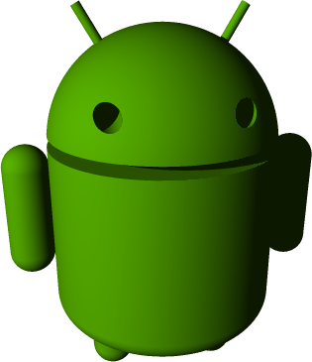
Technology Overview
Ronald L. Ramos
IT Specialist
Smart
TSD-IQM-P&OE

Slide 2
Download presentations here:
http://mobiledev.ronaldramos.info/schooltalks/

Slide 3
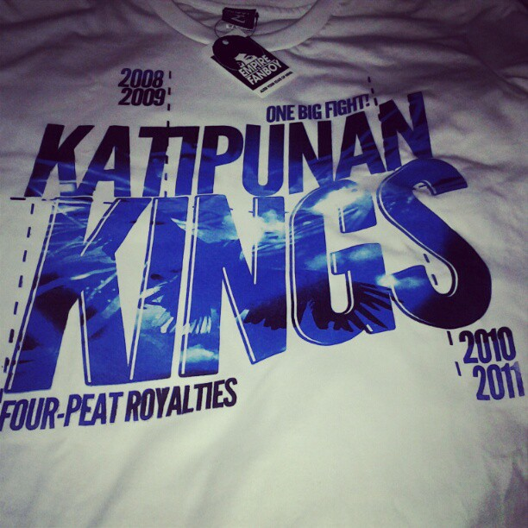
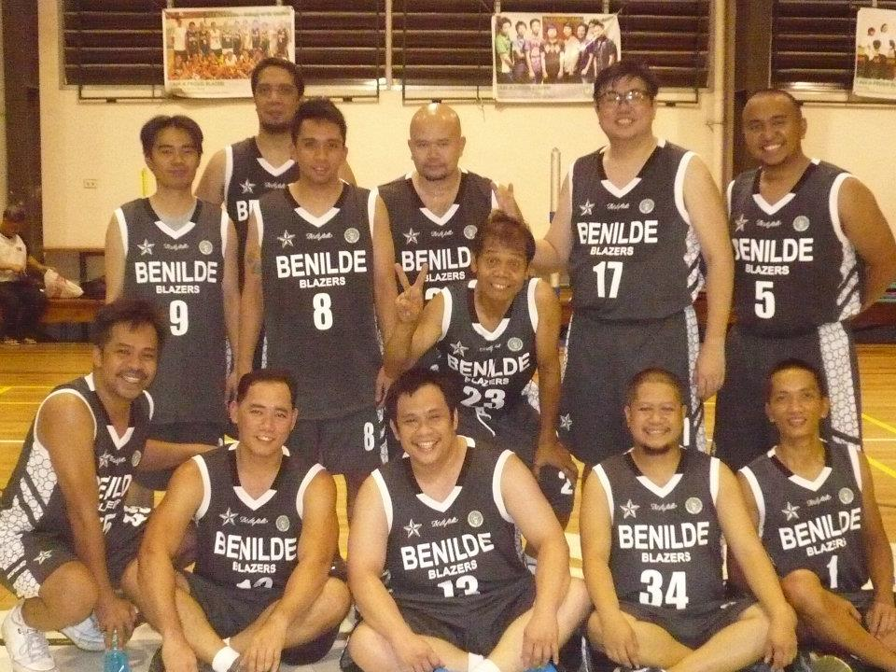
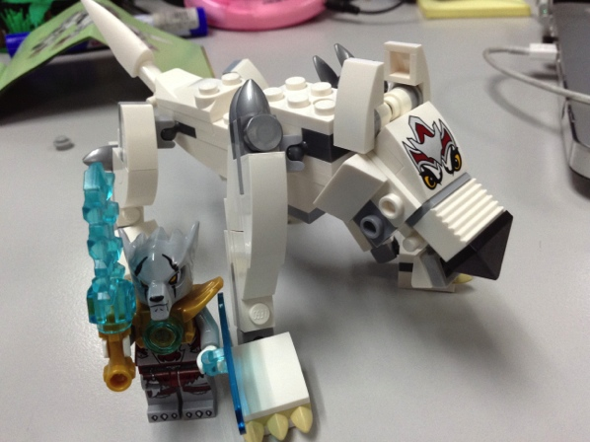
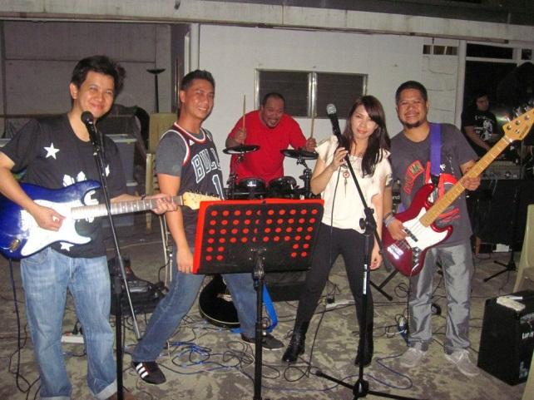
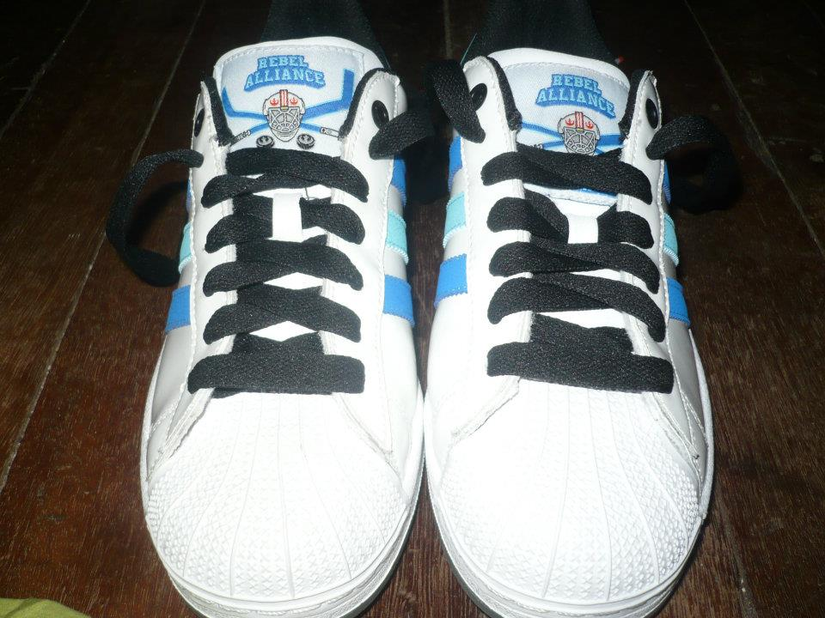
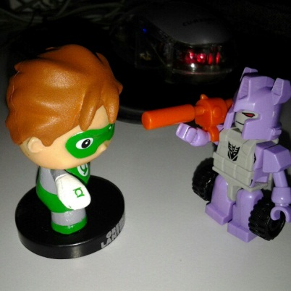
About me briefly
Ronald L. Ramos

Slide 4
Description
This talk aims to present an overview of technologies that are in the horizon for the telecommunications industry.

Slide 5
Topics
Convergence/Smart’s Changing Landscape
LTE
The Internet of Things
Big Data
Android

Slide 6
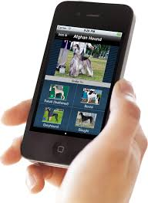
2013 was the first year that Americans spent more time online on mobile devices than on computers
Notes:
http://pando.com/2014/03/05/how-the-rise-of-mobile-apps-will-help-apple-google-and-facebook-kill-the-internet-as-we-know-it/

Slide 7
In the middle of 2010, what time we were on mobile was split 60-40 between the mobile web and apps. This became an even split by the end of 2010. Then apps pulled ahead in early in 2011.

Slide 8
Why do we need more Bandwidth?

Slide 9
Convergence
Telecommunications convergence, network convergence or simply convergence are broad terms used to describe emerging telecommunications technologies, and network architecture used to migrate multiple communications services into a single network.
Specifically this involves the converging of previously distinct media such as telephony and data communications into common interfaces on single devices
Convergence services, such as VoIP, IPTV, Mobile TV, etc., will replace the old technologies and is a threat to the current service providers. IP-based convergence is inevitable and will result in new service and new demand in the market
Notes:
Play video
1 - Did_You_Know_4.0.mp4
2 - Productivity_Future_Vision_2011.mp4
Text Source: http://en.wikipedia.org/wiki/Technological_convergence
Video Source: http://www.youtube.com/watch?v=6ILQrUrEWe8
Presenter notes:
Highlight some of the statistics found in the video.
We live in exponential times
A lot of folks are on the Internet

Slide 10
LTE Overview

Slide 11
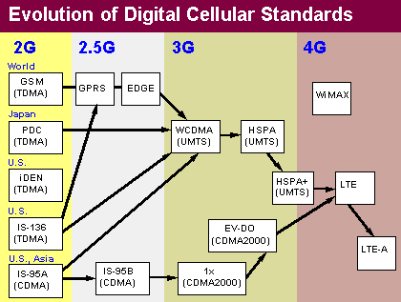
Cellular Generations
The "G" stands for a generation of mobile technology, installed in phones and on cellular networks.
Each "G" generally requires you to get a new phone, and for networks to make expensive upgrades. The first two were analog cell phones (1G) and digital phones (2G).
We are currently in the fourth generation (4G).
Notes:
http://www.pcmag.com/encyclopedia/term/55406/cellular-generations
Play video: 4 - 3G_vs._4G_Wireless_-_What_is_the_Difference.mp4

Slide 12
Cellular Generations (Expanded)
4G – LTE Starting in the 2011 time frame, GSM and CDMA carriers embraced LTE, which offers higher speeds than 3G networks. LTE embodies the design goals of the IP Multimedia Subsystem (IMS), which integrates all communications using the IP protocol (voice, video, e-mail, Web, messaging, etc.). See LTE and IP Multimedia Subsystem.
4G – WiMAX Sprint was the first carrier to offer a 4G cellular network in the U.S. Using the WiMAX technology, 4G service was rolled out to major cities in 2009, providing faster downloads than Sprint's 3G service. See WiMAX.
4G - HSPA+ In late 2010, the ITU officially designated HSPA+ as a 4G technology, having previously defined it as 3G. See HSPA.
3G - WCDMA/HSDPA and CDMA2000 Launched after the turn of the century, the third generation features faster access to the Internet with downstream speeds up to 1 Mbps and more depending on the 3G version. The predominant 3G technologies on the GSM side are WCDMA and HSDPA with CDMA2000 on the CDMA side (see WCDMA, HSPA and CDMA2000). 3G also embraces worldwide roaming for global travelers (see GAN).
2G/2.5G - GSM/CDMA, GPRS/EDGE/IS95-B The second generation refers to the digital voice systems of the 1990s, replacing analog phones and based on the TDMA and CDMA air interfaces. First deployed in Europe, GSM became the predominant TDMA-based cellular system worldwide. Data networks (GPRS, EDGE, IS-95B) were added and commonly called 2.5G technologies, enabling Internet access and e-mail with slow downstream speeds up to approximately 200 Kbps. See GSM, CDMA, GPRS, EDGE and IS-95.
1G - Analog Voice Introduced in the late 1970s, the first cellular systems were analog voice. Years later, some 1G cellphones occasionally provided wireless data service to a laptop by connecting them to the laptop's dial-up modem, but hookups were precarious, and when it worked, the data transfer rate was minuscule. See AMPS, TACS and NMT.
Notes:
Use this extra slide if anyone asks about the actual generations

Slide 13
Long Term Evolution
Long Term Evolution is the latest high-speed cellular data transmission network. LTE is a 4G technology, surpassing the speeds of the widely used 3G networks. Apple aficionados eagerly awaited the iPhone 5 because it was the first iPhone to support LTE.
Available for the two major cellphone systems worldwide (GSM and CDMA), LTE is envisioned to provide global interoperability. However, LTE operates in more than three dozen frequency bands, making it difficult to build a phone that can tune in that many channels.
Approved in 2008 with download speeds up to 173 Mbps, LTE uses a different air interface and packet structure than 3G. See cellular generations and 3G.
LTE - From 3G to 4G Officially
The ITU previously designated LTE-Advanced (LTE-A) as the true 4G evolution. However, in late 2010, it widened its definition to include regular LTE, along with WiMAX and HSPA+, as bona fide 4G technologies since they are faster than 3G.
Notes:
Play Video:
5 - The_simple_truth_about_LTE.mp4

Slide 14
From 3G to 4G
The ITU previously designated LTE-Advanced (LTE-A) as the true 4G evolution. However, in late 2010, it widened its definition to include regular LTE, along with WiMAX and HSPA+, as bona fide 4G technologies since they are faster than 3G.
Notes:
That is why before there was some protests among local carriers as some companies started claiming their HSPA+ and WiMAX networks as 4G. When the ITU changed the standards the debate became irrelevant.

Slide 15
3G Versus 4G | 3G | 4G
Data Throughput: | Up to 3.1Mbps with an average speed range between 0.5 to 1.5 Mbps | Practically speaking, 2 to 12 Mbps (Telstra in Australia claims up to 40 Mbps) but potential estimated at a range of 100 to 300 Mbps.
Peak Upload Rate: | 5 Mbps | 500 Mbps
Peak Download Rate: | 100 Mbps | 1 Gbps
Switching Technique: | packet switching | packet switching, message switching
Network Architecture: | Wide Area Cell Based | Integration of wireless LAN and Wide area.
Services And Applications: | CDMA 2000, UMTS, EDGE etc | Wimax2 and LTE-Advance
Forward error correction (FEC): | 3G uses Turbo codes for error correction. | Concatenated codes are used for error corrections in 4G.
Frequency Band: | 1.8 – 2.5GHz | 2 – 8GHz
Notes:
http://www.diffen.com/difference/3G_vs_4G
Play video:
6 - 4G_vs._3G_Explaining_the_difference.mp4
7 - LTE_-_How_Broadband_LTE_Works.mp4

Slide 16
Smart LTE
Notes:
http://www.youtube.com/watch?v=rjgVzxHMYX8
Videos:
Smart LTE 4G Live Demo at Launch in Resorts World Manila (2012) –
8 - Smart_LTE_4G_Live_Demo_at_Launch_in_Resorts_World_Manila.mp4
Experiencing Smart LTE in Boracay (2011) –
9 - Experiencing_Smart_LTE_in_Boracay.mp4

Slide 17
Smart’s Changing Landscape
Notes:
Show video: 01 - Did_You_Know_Shift_Happens_Version_6_2012

Slide 18
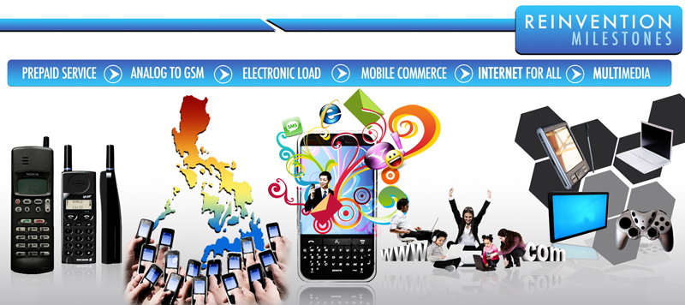
Smart’s History

Slide 19
The Internet of Things
Notes:
Run ibm video
http://www.internet-of-things.eu/

Slide 20
Internet of Things
Equipping all objects in the world with minuscule identifying devices could be transformative of daily life. For instance, business may no longer run out of stock or generate waste products, as involved parties would know which products are required and consumed.
We have a clear vision – to create a world where every object - from jumbo jets to sewing needles – is linked to the Internet.
According to ABI Research more than 30 billion devices will be wirelessly connected to the Internet of Things (Internet of Everything) by 2020.
Notes:
Play Video:
3 - The_Internet_of_Things.mp4
Presenter’s notes:
Discuss on how devices will play a bigger and bigger role in our world. Aside from devices every we are getting more connected with each other via the Internet.

Slide 21
McKinsey Quarterly
“More objects are becoming embedded with sensors and gaining the ability to communicate. The resulting information networks promise to create new business models, improve business processes, and reduce costs and risks.”
Notes:
McKinsey & Company is the trusted advisor and counselor to many of the world's most influential businesses and institutions.
http://www.mckinseyquarterly.com/The_Internet_of_Things_2538
In most organizations, information travels along familiar routes. Proprietary information is lodged in databases and analyzed in reports and then rises up the management chain. Information also originates externally—gathered from public sources, harvested from the Internet, or purchased from information suppliers.
But the predictable pathways of information are changing: the physical world itself is becoming a type of information system. In what’s called the Internet of Things, sensors and actuators embedded in physical objects—from roadways to pacemakers—are linked through wired and wireless networks, often using the same Internet Protocol (IP) that connects the Internet. These networks churn out huge volumes of data that flow to computers for analysis. When objects can both sense the environment and communicate, they become tools for understanding complexity and responding to it swiftly. What’s revolutionary in all this is that these physical information systems are now beginning to be deployed, and some of them even work largely without human intervention.
Pill-shaped microcameras already traverse the human digestive tract and send back thousands of images to pinpoint sources of illness. Precision farming equipment with wireless links to data collected from remote satellites and ground sensors can take into account crop conditions and adjust the way each individual part of a field is farmed—for instance, by spreading extra fertilizer on areas that need more nutrients. Billboards in Japan peer back at passersby, assessing how they fit consumer profiles, and instantly change displayed messages based on those assessments.

Slide 22
An example
Notes:
http://interactivemultimediatechnology.blogspot.com/2009/05/interacting-with-internet-of-things.html
Pachube: "A web service that enables people to tag and share real time sensor data from objects, devices and spaces around the world, facilitating interaction between remote e
http://community.pachube.com/

Slide 23
Cisco’s view
Notes:
http://blogs.cisco.com/news/the-internet-of-things-infographic/
When we think of being connected to the Internet, our minds immediately shift to our computers, phones, and most recently tablets. This week at Cisco live, I shared that in 2008, the number of devices connected to the Internet exceeded the number of people on Earth.
That’s right. There are more devices tapping into the Internet than people on Earth to use them. How is this possible?

Slide 24
Big Data

Slide 25
What is big data?
Every day, we create 2.5 quintillion bytes of data — so much that 90% of the data in the world today has been created in the last two years alone.
This data comes from everywhere: sensors used to gather climate information, posts to social media sites, digital pictures and videos, purchase transaction records, and cell phone GPS signals to name a few. This data is big data.
Notes:
Big Data is data that is too large, complex and dynamic for any conventional data tools to capture, store, manage and analyze. The right use of Big Data allows analysts to spot trends and gives niche insights that help create value and innovation much faster than conventional methods.
http://visual.ly/big-data

Slide 26
Four Dimensions of Big Data
Volume – high data traffic
Velocity – data is used the moment it streams in
Variety – it is any type of data
Veracity – how can your data be trusted
Notes:
Volume: Enterprises are awash with ever-growing data of all types, easily amassing terabytes—even petabytes—of information.
Turn 12 terabytes of Tweets created each day into improved product sentiment analysis
Convert 350 billion annual meter readings to better predict power consumption
Velocity: Sometimes 2 minutes is too late. For time-sensitive processes such as catching fraud, big data must be used as it streams into your enterprise in order to maximize its value.
Scrutinize 5 million trade events created each day to identify potential fraud
Analyze 500 million daily call detail records in real-time to predict customer churn faster
Variety: Big data is any type of data - structured and unstructured data such as text, sensor data, audio, video, click streams, log files and more. New insights are found when analyzing these data types together.
Monitor 100’s of live video feeds from surveillance cameras to target points of interest
Exploit the 80% data growth in images, video and documents to improve customer satisfaction
Veracity: 1 in 3 business leaders don’t trust the information they use to make decisions. How can you act upon information if you don’t trust it? Establishing trust in big data presents a huge challenge as the variety and number of sources grows.

Slide 27
Big data = Big Return on Investment (ROI)
Healthcare: 20% decrease in patient mortality by analyzing streaming patient data
Telco: 92% decrease in processing time by analyzing networking and call data
Utilities: 99% improved accuracy in placing power generation resources by analyzing 2.8 petabytes of untapped data
Notes:
While there is a lot of buzz about big data in the market, it isn’t hype. Plenty of customers are seeing tangible ROI using IBM solutions to address their big data challenges

Slide 28
Big data is more than simply a matter of size; it is an opportunity to find insights in new and emerging types of data and content, to make your business more agile, and to answer questions that were previously considered beyond your reach.

Slide 29
Uses of Big Data
Financial Services
Risk and fraud management
Customer analytics
Transportation
Logistics optimization
Traffic congestion
Healthcare/Life Sciences
Medical record text analytics
Genomic analytics
Telecommunications
Call detail record processing
Customer profile monetization
Energy and Utilities
Smart meter analytics
Asset management
Digital Media
Real-time ad targeting
Website analysis
Retail
Omni-channel marketing
Click-stream analysis
Law Enforcement
Real-time multimodal surveillance
Cyber security detection

Slide 30
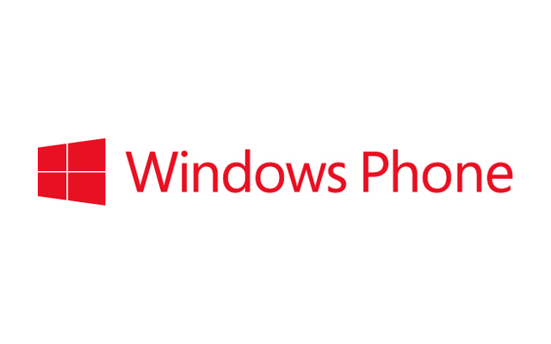
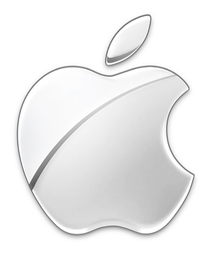
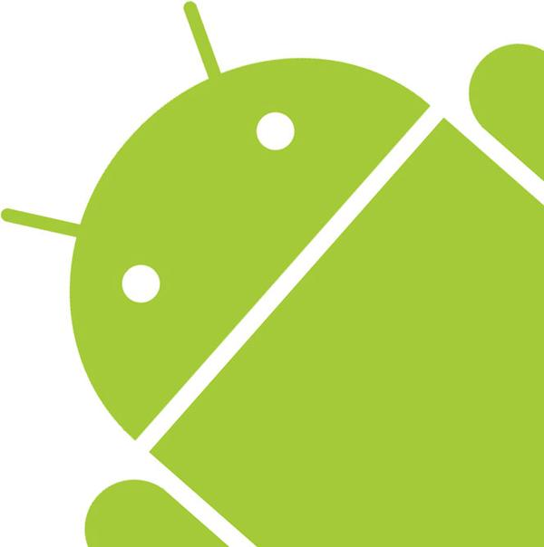
Smart Phones
Notes:
Show video: 03 - Introducing_Android

Slide 31
Android
The version history of the Android mobile operating system began with the release of the Android beta in November 2007. The first commercial version, Android 1.0, was released in September 2008.
Android is under ongoing development by Google and the Open Handset Alliance, and has seen a number of updates to its base operating system since its original release. These updates typically fix bugs and add new features.
Since April 2009, Android versions have been developed under a codename and released in alphabetical order: Cupcake, Donut, Eclair, Froyo, Gingerbread, Honeycomb, Ice Cream Sandwich (ICS), and Jelly Bean. As of 2013, over 500 million active devices use the Android OS worldwide. The most recent major Android update was Jelly Bean 4.2, which was released on commercial devices in November 2012.

Slide 32
Open Handset Alliance
The Open Handset Alliance (OHA) is a consortium of 84 firms to develop open standards for mobile devices. Member firms include Google, HTC, Sony, Dell, Intel, Motorola, Qualcomm, Texas Instruments, Samsung Electronics, LG Electronics, T-Mobile, Sprint Nextel, Nvidia, and Wind River Systems.
The OHA was established on 6 November 2007, led by Google with 34 members including mobile handset makers, application developers, some mobile carriers and chip makers.[3] Android, the flagship software of the alliance, is based on an open source license and competes against mobile platforms from Apple, Microsoft, Nokia (Symbian), HP (formerly Palm), and Samsung Electronics (bada).
Members of OHA are not allowed to produce phones that run incompatible versions of Android.

Slide 33
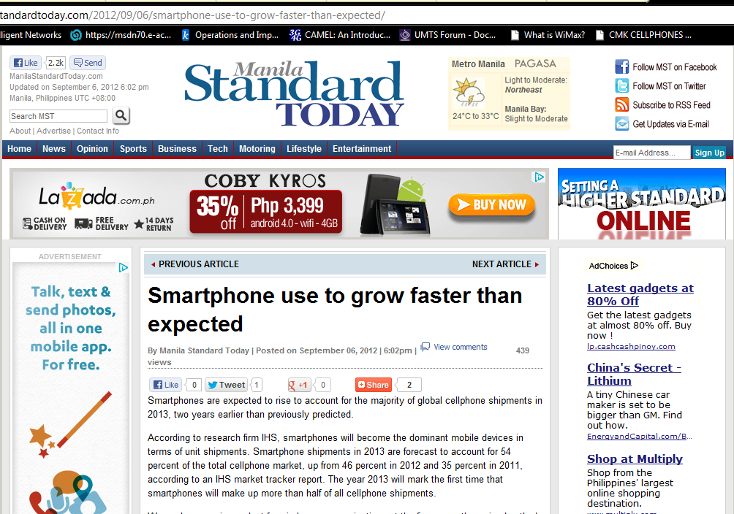
Notes:
WE focus on ANDROIDs…. For a variety of reasons, it is more adaptable to prepaid markets due to its lower prices and flexibility in accessing the market.

Slide 34
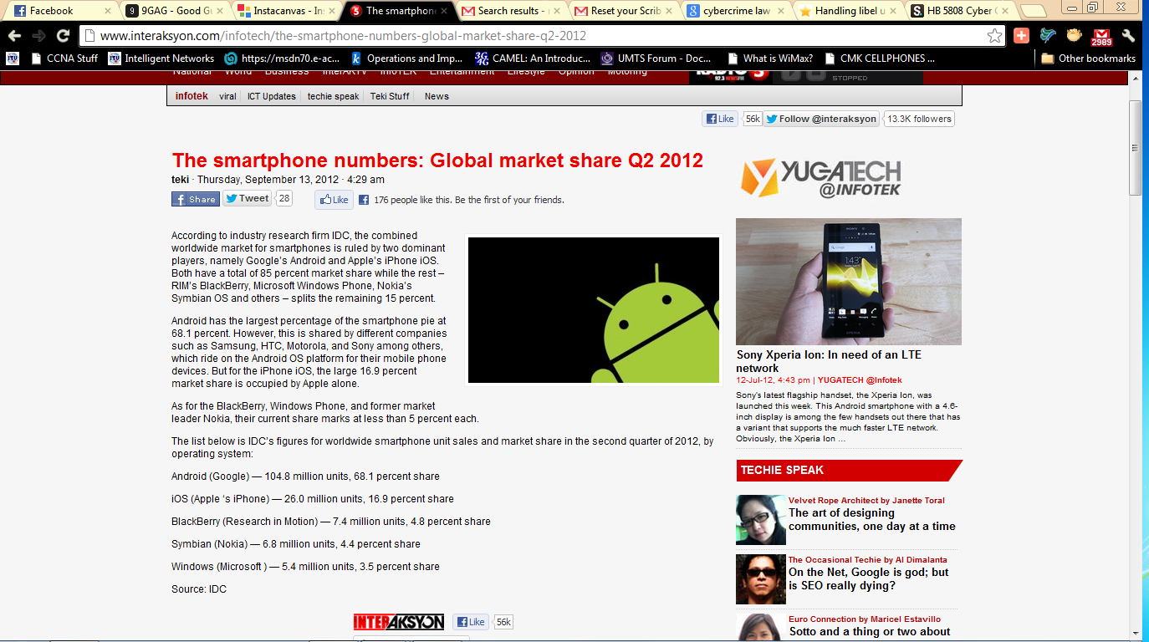
Notes:
If we are to seize the future, we have learn how to create APPs

Slide 35
Top Five Smartphone Vendors, Shipments, and Market Share, 2012 Q3 (Units in Millions)
Vendor | 3Q12 Unit Shipments | 3Q12 Market Share | 3Q11 Unit Shipments | 3Q11 Market Share | Year-over-year Change
Samsung | 56.3 | 31.3% | 28.1 | 22.7% | 100.4%
Apple | 26.9 | 15.0% | 17.1 | 13.8% | 57.3%
Research In Motion | 7.7 | 4.3% | 11.8 | 9.6% | -34.7%
ZTE | 7.5 | 4.2% | 4.1 | 3.3% | 82.9%
HTC | 7.3 | 4.0% | 12.7 | 10.3% | -42.5%
Others | 74.0 | 41.2% | 49.9 | 40.3% | 48.3%
Total | 179.7 | 100.0% | 123.7 | 100.0% | 45.3%
Notes:
http://www.idc.com/getdoc.jsp?containerId=prUS23753512#.URHABL9wrjY

Slide 36
Top Six Smartphone Mobile Operating Systems, Shipments, and Market Share, Q3 2012 (Preliminary) (Units in Millions)
Operating System | 3Q12 Shipment Volumes | 3Q12 Market Share | 3Q11 Shipment Volumes | 3Q11 Market Share | Year-Over-Year Change
Android | 136.0 | 75.0% | 71.0 | 57.5% | 91.5%
iOS | 26.9 | 14.9% | 17.1 | 13.8% | 57.3%
BlackBerry | 7.7 | 4.3% | 11.8 | 9.5% | -34.7%
Symbian | 4.1 | 2.3% | 18.1 | 14.6% | -77.3%
Windows Phone 7/ Windows Mobile | 3.6 | 2.0% | 1.5 | 1.2% | 140.0%
Linux | 2.8 | 1.5% | 4.1 | 3.3% | -31.7%
Others | 0.0 | 0.0% | 0.1 | 0.1% | -100.0%
Totals | 181.1 | 100.0% | 123.7 | 100.0% | 46.4%
Notes:
http://appleinsider.com/articles/12/05/01/samsung_overtakes_apple_to_claim_smartphone_market_share_lead

Slide 37
There are now more Android-enabled phones out there than iPhones. 400,000 new Android devices are activated each day.
Notes:
It has become the platform of choice for most people looking to get a smartphone.

Slide 38
Android Statistics
Data collected during a 14-day period ending on February 4, 2013
Notes:
http://developer.android.com/about/dashboards/index.html

Slide 39
Android Statistics
Version | Codename | API | Distribution
1.6 | Donut | 4 | 0.2%
2.1 | Eclair | 7 | 2.2%
2.2 | Froyo | 8 | 8.1%
2.3 - 2.3.2 | Gingerbread | 9 | 0.2%
2.3.3 - 2.3.7 |  | 10 | 45.4%
3.1 | Honeycomb | 12 | 0.3%
3.2 |  | 13 | 1.0%
4.0.3 - 4.0.4 | Ice Cream Sandwich | 15 | 29.0%
4.1 | Jelly Bean | 16 | 12.2%
4.2 |  | 17 | 1.4%
Data collected during a 14-day period ending on February 4, 2013
Notes:
http://developer.android.com/about/dashboards/index.html

Slide 40
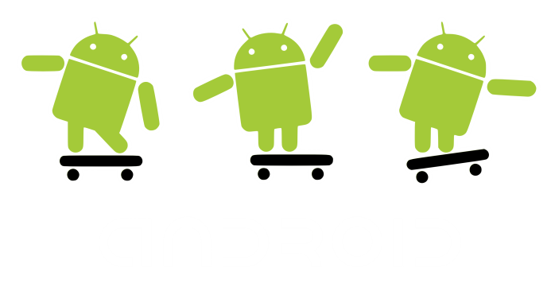
Android for the Masses: Smart’s Netphone
I am also known as the ZTE Blade
Notes:
The “masa” will never spend too much on a cellphone nowadays. Just take a look at the popularity of china phones and brands like Cherry and myPhone. They gravitate towards the cheapest phones with the most features. Smart aims to make Android phones reachable by the masses via the Netphone.
Show video: 04 -SMART Introduces the Red Bend-Enabled Netphone

Slide 41
Smart’s Vision
Android phones for the masses
An appstore where Filipinos can sell their apps
A strong community of Filipino Application Developers

Slide 42
Android is adaptable to PREPAID
Lower handset prices
Flexible Market
It is possible to use prepaid load as payment for apps

Slide 43
App development is not rocket science
Notes:
The greatest apps came from the simplest ideas

Slide 44
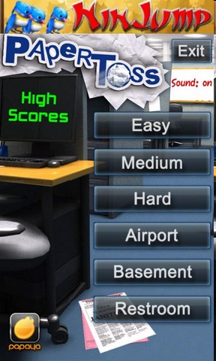
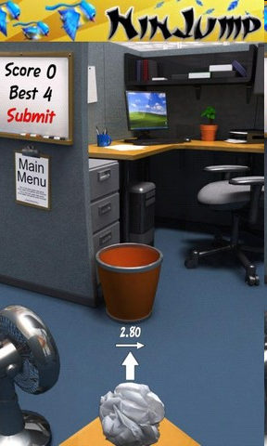
Paper Toss
Notes:
Just physics and graphics.
It wins because it is so, so easy and a great way to pass up time.

Slide 45
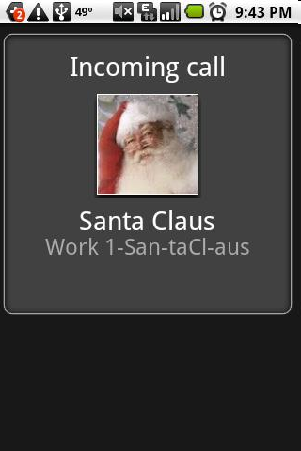
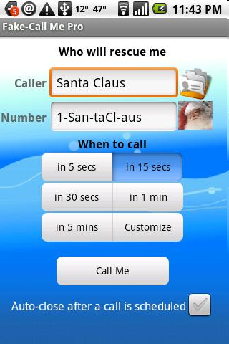
Fake Caller
Notes:
SIMPLE and entertaining. And it does serve a purpose.

Slide 46
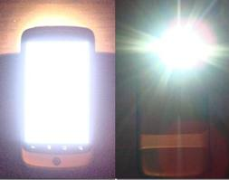
Flashlight
Notes:
SIMPLE and entertaining. And it does serve a purpose.

Slide 47
Mobile development can rival Desktop Applications
Notes:
The greatest apps came from the simplest ideas

Slide 48
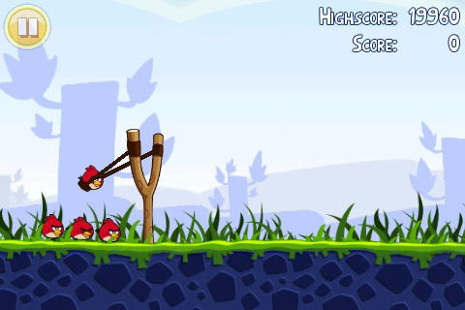
Angry Birds
Notes:
SIMPLE and entertaining. And it does serve a purpose.

Slide 49
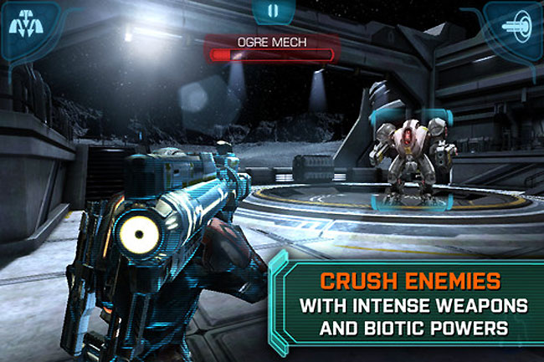
Mass Effect Infiltrator

Slide 50
Smart Dev Net

Slide 51
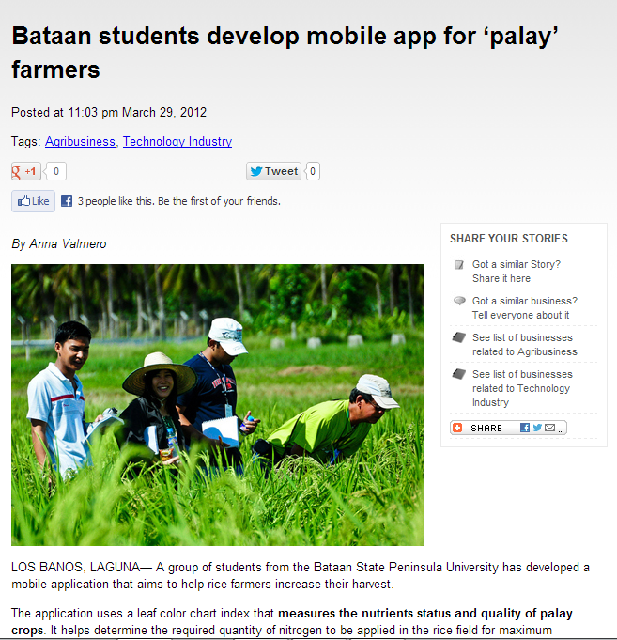
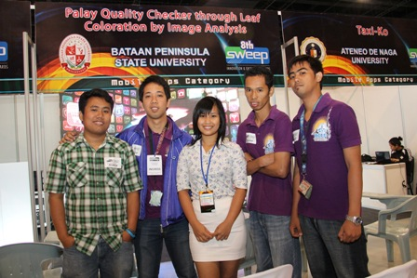
Palay Checker App

Slide 52
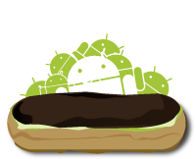
Smart believes that…
Teachers and students can provide a strong App development community
Notes:
Whether its through thesis groups, school orgs or just plain interest in Android development, the academe provides a fertile ground for app development

Slide 53
Smart’s Support
Android Development Training for Teachers
Android Seminars for School Orgs/Events
App Development Competitions
Android Phones for School Partners (Under discussion)

Slide 54
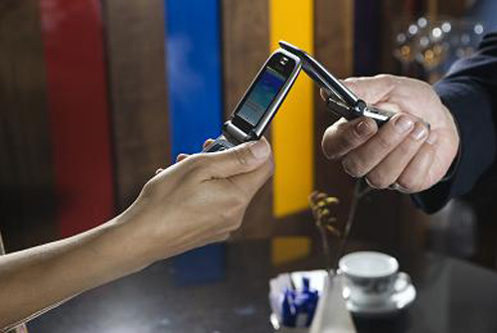
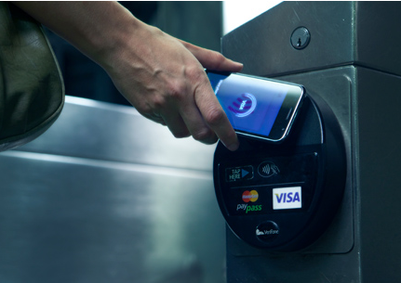
Near Field Communication
Near field communication (NFC) is a set of standards for smartphones and similar devices to establish radio communication with each other by touching them together or bringing them into close proximity, usually no more than a few centimetres.
Present and anticipated applications include contactless transactions, data exchange, and simplified setup of more complex communications such as Wi-Fi. Communication is also possible between an NFC device and an unpowered NFC chip, called a "tag".

Slide 55
Sample NFC Workflow

Slide 56
Smart Careers
Be one of the best!

Slide 57
Smart Careers
Website
Smart.com.ph/careers
Twitter
@workatsmart
Job roles
Electronics Engineer
Application Developer
Testers
Business Analysts
Other technical roles

Slide 58
Some advice…
Get a job you are passionate about (as much as possible)
Money isn’t everything
Never stop learning

Slide 59
Summary

Slide 60
The future will have
Convergence – Our devices will play multiple roles in our lives. The phone is predicted to become the number one channel for internet access
Internet of Things – our devices will be connected to each other and will lead us to better lives.
LTE is the means by which we can get the bandwidth needed to make the first two come true
Big Data - We will use DATA to make all our lives better
Notes:
Show final video after summarizing:
10 - Redefine_the_wireless_experience_with_LTE.mp4

Slide 61
Do you have any questions?

Slide 62
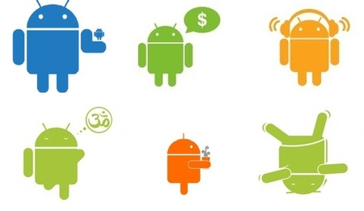
This is the end of the presentation.
Thank you for attending!
For questions or inquiries :
eMail: rlramos@smart.com.ph
Mobile: 09298874076
Office #: 5113175
Facebook: rlramos@gmail.com
Notes:
Show video: 08 - Redefine_the_wireless_experience_with_LTE

