Slide 1

The World of Mobile Apps
Ronald L. Ramos
IT Specialist
Smart

Slide 2
Download presentations here:
http://mobiledev.ronaldramos.info/publictalks/

Slide 3
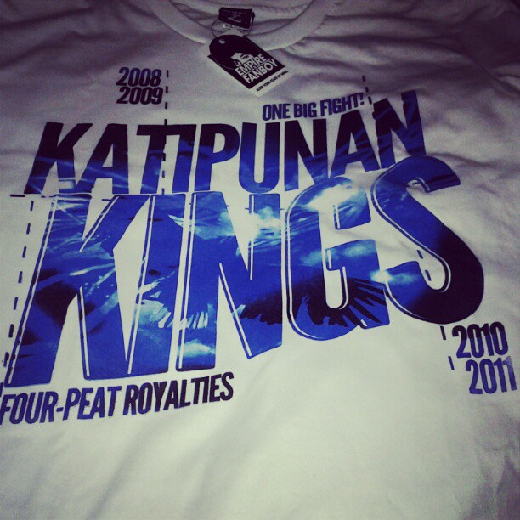

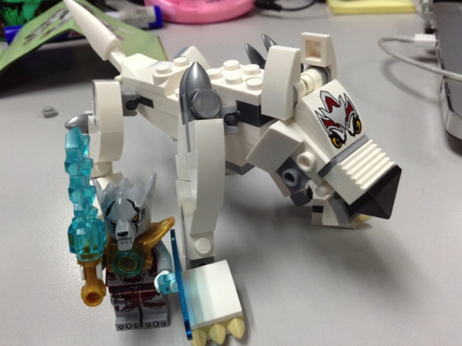



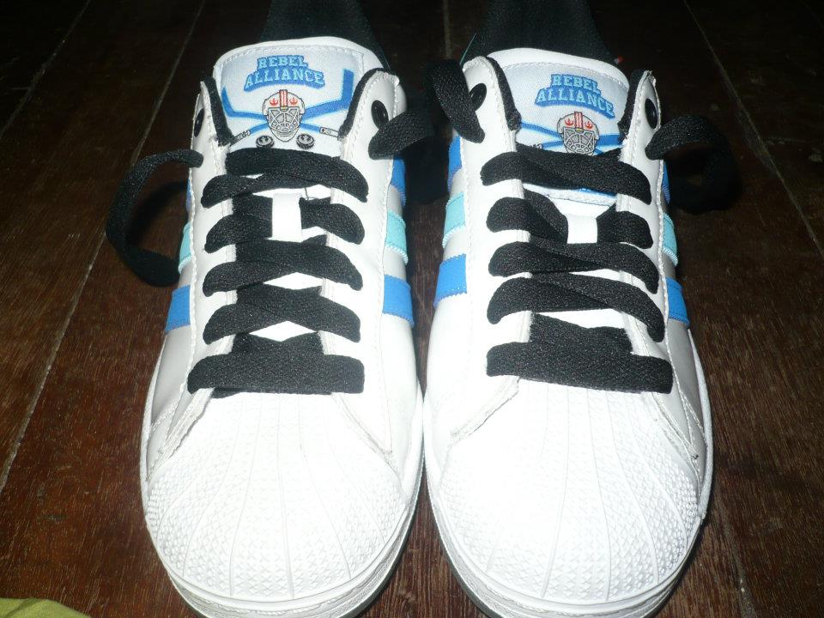
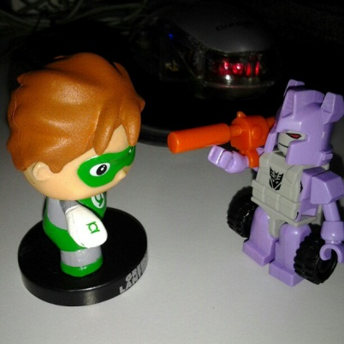
About me briefly
Ronald L. Ramos

Slide 4
Description
This talk aims to present an overview of mobile apps development

Slide 5
What’s up
The Internet of Things
The World of Apps
Mock-Ups (Balsamiq)
InfiniteMonkey
AppInventor

Slide 6
The Internet of Things

Slide 7
What is it?
The Internet of Things (IoT) is a scenario in which objects, animals or people are provided with unique identifiers and the ability to automatically transfer data over a network without requiring human-to-human or human-to-computer interaction.
IoT has evolved from the convergence of wireless technologies, micro-electromechanical systems (MEMS) and the Internet.
Notes:
A thing, in the Internet of Things, can be a person with a heart monitor implant, a farm animal with a biochip transponder, an automobile that has built-in sensors to alert the driver when tire pressure is low -- or any other natural or man-made object that can be assigned an IP address and provided with the ability to transfer data over a network. So far, the Internet of Things has been most closely associated with machine-to-machine (M2M) communication in manufacturing and power, oil and gas utilities. Products built with M2M communication capabilities are often referred to as being smart.
From: http://whatis.techtarget.com/definition/Internet-of-Things

Slide 8
The World of Mobile Apps

Slide 9

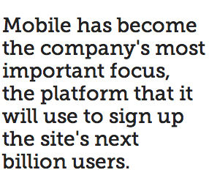
Mark Zuckerberg, Founder, Facebook
Notes:
Mobile has become the company's most important focus, the platform that it will use to sign up the site's next billion users. (And probably the billion after that, too.) Since launching native iOS and Android apps last fall, Facebook has taken a mobile first approach both publicly and internally.
The part of the company that was once a black eye is now the center of attention as Facebook advances on its quest to get the entire world not only onto the Internet, but onto the platform. “If you rewind like two years ago, everyone was, like, ‘mobile is coming, mobile is coming, mobile is coming,'" said Mike Vernal, Facebook's director of engineering. "For Facebook and specifically our developers, for the past year-plus we’ve just been focused on, ‘Ok, it’s just about mobile, how can we help mobile developers?'"
It's no secret that mobile users are important to the company. Of the 699 million daily active users who logged onto the site in June, more than two-thirds did so from a mobile device. Mobile ads (which didn't even exist a year ago) made up 41% of the company's total ad revenue in Q2, more than $655 million. Mobile users spend one in every five minutes online using Facebook; web users spend one in every seven minutes, Zuckerberg said.

Slide 10
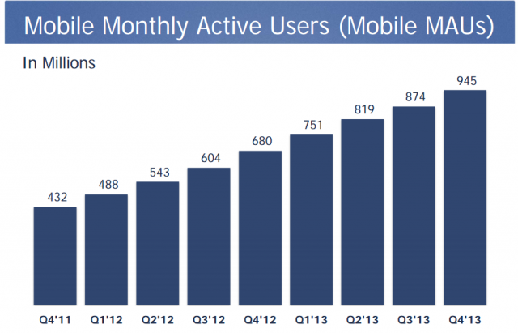
Monthly Active Users - FB
Notes:
Facebook now has 1.23 billion monthly active users, up 16% year-over-year. Even more impressive: Facebook's daily active users increased 22% year-over-year to 757 million.
For the 2013 fiscal year as a whole, Facebook generated $7.87 billion in revenue. That's up 55% from just more than $5 billion in the 2012 fiscal year.
The company's stock doubled in 2013 thanks to renewed confidence in the company's prospects on mobile, as well as optimism for new and existing revenue streams from video ads, Instagram ads and mobile app install ads.
The stock jumped by more than 5% in after hours trading following the earnings report.

Slide 11
Facebook’s about face
Facebook had fewer than 20 people on their core mobile team in early 2012, and changes to the mobile app came every three to six months — compared to the desktop version, which was updated twice per day -- Cory Ondrejka, Facebook's VP of mobile engineering.
When Facebook decided to revamp its mobile approach last summer, Zuckerberg refocused the company, giving each team mobile engineers and developers so that updates and new features could be built with the mobile experience in mind. "[Mark] said, 'You know, we need to think about maybe putting mobile first and being a mobile-first company,'" Facebook Vice President of Business and Marketing Partnerships David Fischer told Fortune's Adam Lashinsky in February (2013). "We realigned the company around, so everybody was responsible for mobile."
Notes:
Article Date: Sept. 2013
With such a major part of the company reliant on mobile, it's interesting to think how little attention was spent on building a great mobile offering even 18 months ago.
Eighteen months ago, Mark Zuckerberg was not happy with Facebook's mobile strategy. The world's largest social network was offering up a weak product — a hybrid app running on HTML5 instead of native apps for iOS and Android — essentially ignoring the platform (mobile) that it now deems most important. A change needed to be made, and Zuckerberg now openly admits it.
"We took a bad bet," the Facebook CEO said during last week's TechCrunch Disrupt conference in San Francisco. "Our legacy as a company was building this big website and focusing on being able to develop for the web. So naturally we tried to look at things and see if we could build an HTML5 system for across these different platforms and we just realized pretty quickly that we weren't going to get the quality level that we needed.
"So we took a year and it was painful and we retooled that.”
When Facebook decided to revamp its mobile approach last summer, Zuckerberg refocused the company, giving each team mobile engineers and developers so that updates and new features could be built with the mobile experience in mind. "[Mark] said, 'You know, we need to think about maybe putting mobile first and being a mobile-first company,'" Facebook Vice President of Business and Marketing Partnerships David Fischer told Fortune's Adam Lashinsky in February. "We realigned the company around, so everybody was responsible for mobile."
Facebook has since put hundreds of engineers through week-long iOS and Android classes on campus, Ondrejka said, and updates to the native apps come each month instead of three to four times a year.

Slide 12
App Development Costs
A study by backend-as-a-service (BaaS) platform provider AnyPresence revealed the majority of companies, 54 percent, are spending between $25,000 and $100,000 on each mobile apps they develop, whether it be for customer or employee use.
Additionally, another quarter are investing more than $100,000 into each app.
Notes:
http://www.businessnewsdaily.com/4773-cost-to-build-a-mobile-app.html
"The high cost of development among respondents reflects the inherent complexity of enterprise apps," said Richard Mendis, AnyPresence chief marketing officer and co-founder. "Whether the app is targeted at employees, partner, or customers, enterprise mobile applications can have sophisticated integration, security and performance needs that often make them more complex to develop, test and maintain than the typical consumer app."

Slide 13
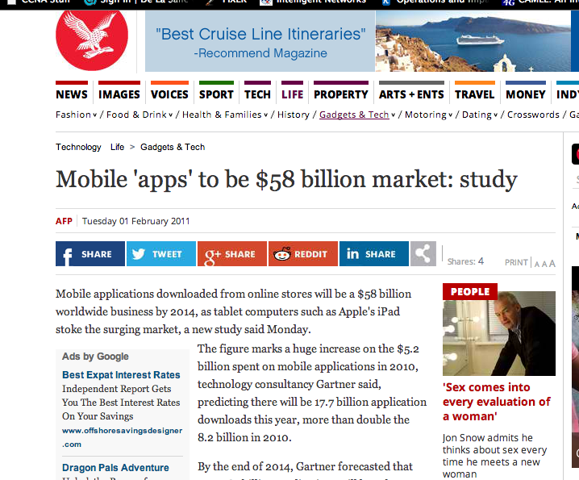
In 2011

Slide 14
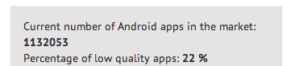

Google Play Store stats
Notes:
As of Feb 13, 2014
http://www.appbrain.com/stats/free-and-paid-android-applications

Slide 15
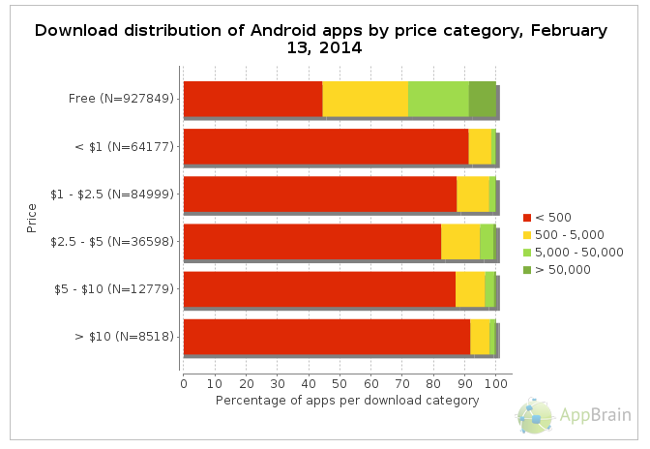
Download numbers per price

Slide 16
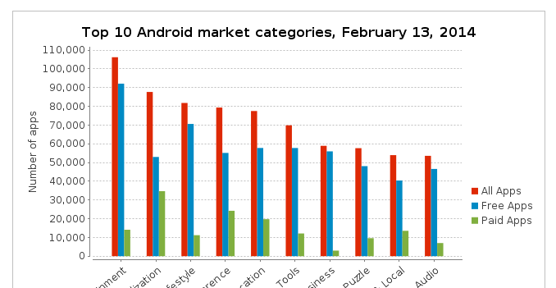

Slide 17
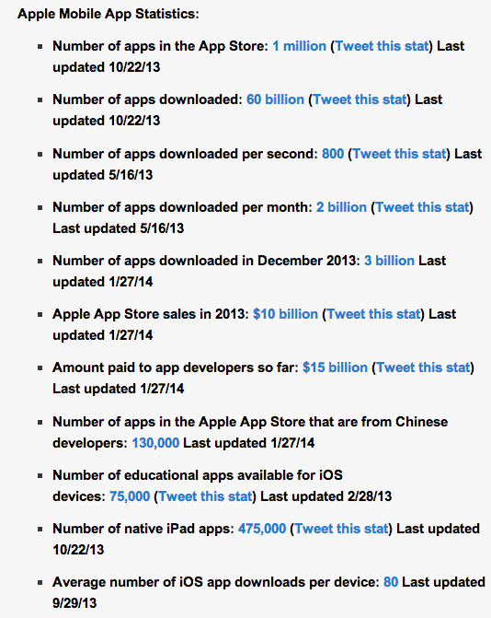
Notes:
http://expandedramblings.com/index.php/by-the-numbers-amazing-apple-stats/2/#.UxfNo-eSx4E
Jan 2014

Slide 18
Native Apps versus Web apps

Slide 19
What they are
Native Apps
Web Apps
an app developed essentially for one particular mobile device and is installed directly onto the device itself.
Users of native apps usually download them via app stores online or the app marketplace, such as the Apple App Store, the Google Play store and so on.
An example of a native app is the Camera+ app for Apple’s iOS devices.
basically Internet-enabled apps that are accessible via the mobile device’s Web browser. They need not be downloaded onto the user’s mobile device in order to be accessed. The Safari browser is a good example of a mobile Web app.

Slide 20
User Interface
From the point of the mobile device user, some native and Web apps look and work much the same way, with very little difference between them.

Slide 21
Accessibility
Native Apps
Web Apps
A native app is totally compatible with the device’s hardware and native features, such as accelerometer, camera and so on. Web apps, on the other hand, can access only a limited amount of a device’s native features.
While a native app works as a standalone entity, the problem is that the user has to keep downloading updates.
A Web app, on the other hand updates itself without the need for user intervention. However, it necessarily needs to be accessed via a mobile device’s browser.

Slide 22
Efficiency
Native Apps
Web Apps
Native apps are more expensive to develop.
However, they are faster and more efficient, as they work in tandem with the mobile device they are developed for.
Also, they are assured of quality, as users can access them only via app stores online.
Web apps may result in higher costs of maintenance across multiple mobile platforms.
There is no specific regulatory authority to control quality standards of these apps.
The Apple App Store, though, features a listing of Apple’s Web apps.

Slide 23
App Monetization
Native Apps
Web Apps
App monetization with native apps can be tricky, since certain mobile device manufacturers may lay restrictions on integrating services with certain mobile ad platforms and networks.
Web apps enable you to monetize apps by way of advertisements, charging membership fees and so on
However, while the app store takes care of your revenue and commissions in the case of native app, you need to setup your own payment system in case of a Web app.

Slide 24
Development
Native Apps
Web Apps
Each mobile platform that the native app is developed for, stipulates its own unique development process. In the case of Web apps running on a mobile device’s Web browser, the problem that arises is that each of these mobile devices have unique features and come with their unique problems as well.
Every mobile platform uses a different native programming language. While iOS uses Objective-C, Android uses Java, Windows Mobile uses C++ and so on. Web apps, on the other hand, use languages such as JavaScript, HTML 5, CSS3 or other Web application frameworks as per the developer’s preferences.
Each mobile platform offers the developer its own standardized SDK, development tools and other user interface elements, which they can use to develop their native app with relative ease.
In the case of Web apps, though, there is no such standardization and the developer has no access to SDKs or tools of any sort.

Slide 25
Setup and Costs
Apple
Android
Item | Description | Cost
Computer | Macbook or Mac Desktop | From 56K Pesos and up
SDK | Xcode | Free
Developer Account | Renewed yearly; | $99
Testing | Any iOS Device (iPhone, iPad) | Comes with the $99 developer account
Distribution | Via apple App Store | Comes with the $99 developer account
Item | Description | Cost
Computer | Any Windows, Mac or Linux based
SDK | Eclipse | Free
Developer Account | Lifetime | Free
Testing on Device | Any Android device | Free
Distribution | Via Google Play Store | Free

Slide 26
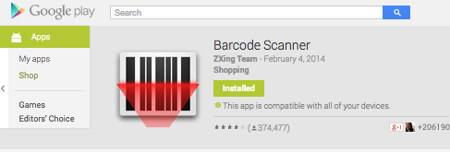
Before we start…
Download and install a barcode reader app for your Android Device:

Slide 27
Mock-Ups
I have an idea but I can’t put it into words

Slide 28
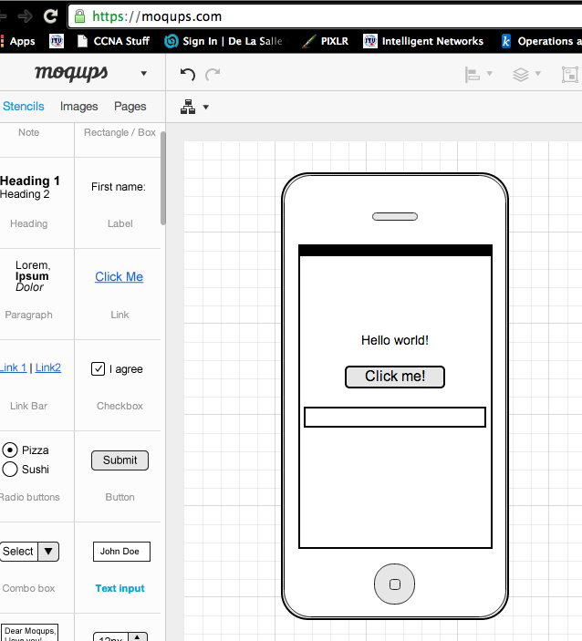
Moqups.com
Wireframing is a technique that enables non-technical people to express

Slide 29
Mobile App Generators
I just want to quickly make an app!

Slide 30
Want to build an app?
Do-it-yourself (DIY) app builders let businesses craft their own apps with no technical skills required.
Technologies:
  HTML5
  CSS3
  Javascript
Notes:
http://www.businessnewsdaily.com/4901-best-app-makers-creators.html
While developing a robust app from scratch can cost tens or even hundreds of thousands of dollars, DIY app-making platforms enable budget-conscious businesses to build functional mobile apps at a fraction of the cost.

Slide 31
Some app generators
http://appsgeyser.com
http://www.infinitemonkeys.mobi/
http://appypie.com
http://appery.io/
https://mainstreet-apps.com/
http://www.appsbar.com/

Slide 32
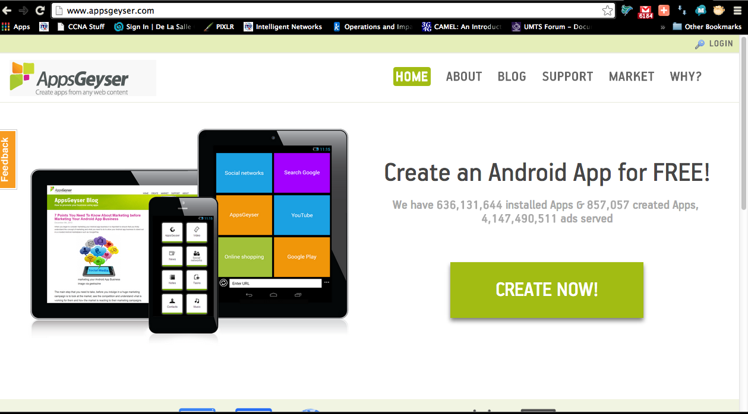
Make your own app now!
http://appsgeyser.com/

Slide 33
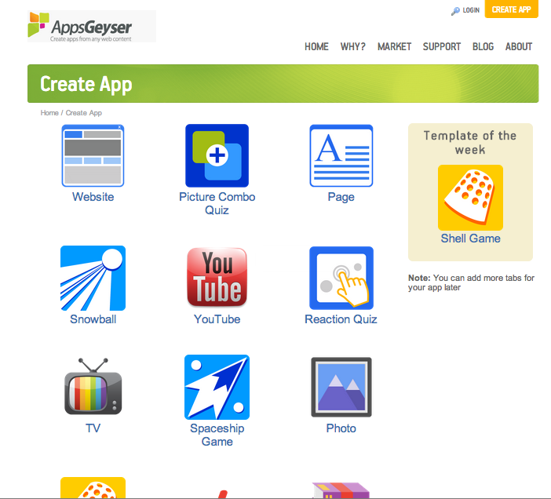
Pick a template!

Slide 34
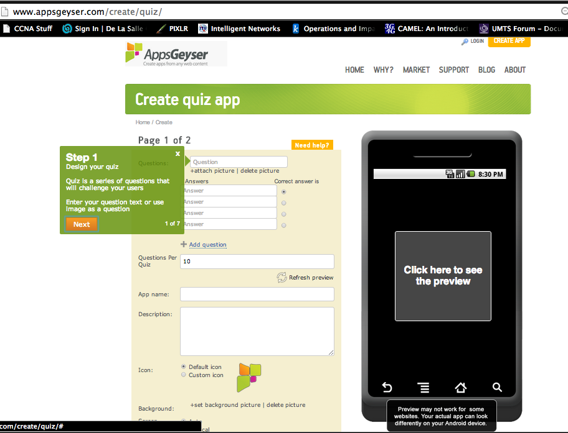
Fill in the details!

Slide 35
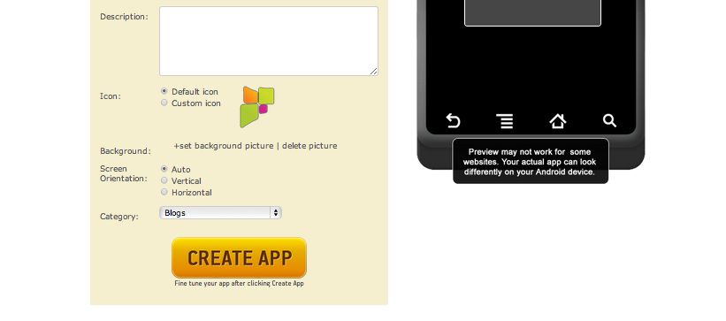
Click on create app!

Slide 36
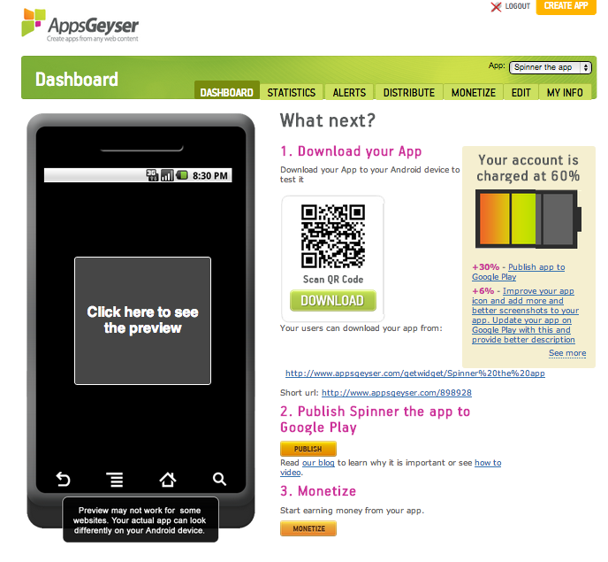
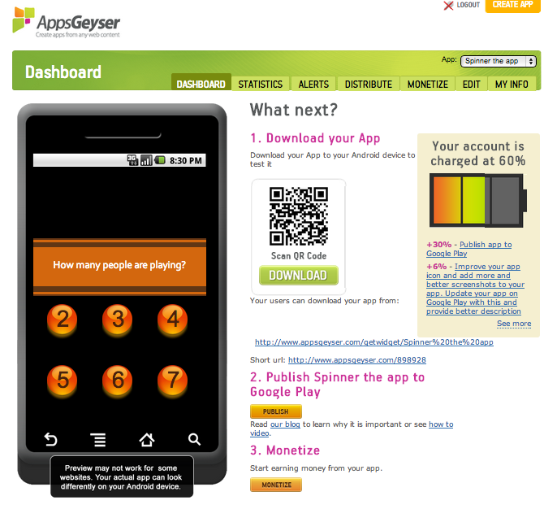
Preview your app!

Slide 37
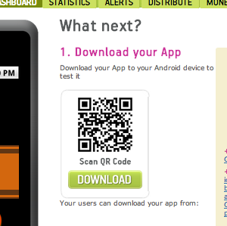
Install your app to your device!
Notes:
Scan the QR code to get the download link for your application.

Slide 38
Remember
Most DIY app generators create limited functionality like content generator/link summary apps.

Slide 39
Something More Complicated
MIT’s App Inventor

Slide 40
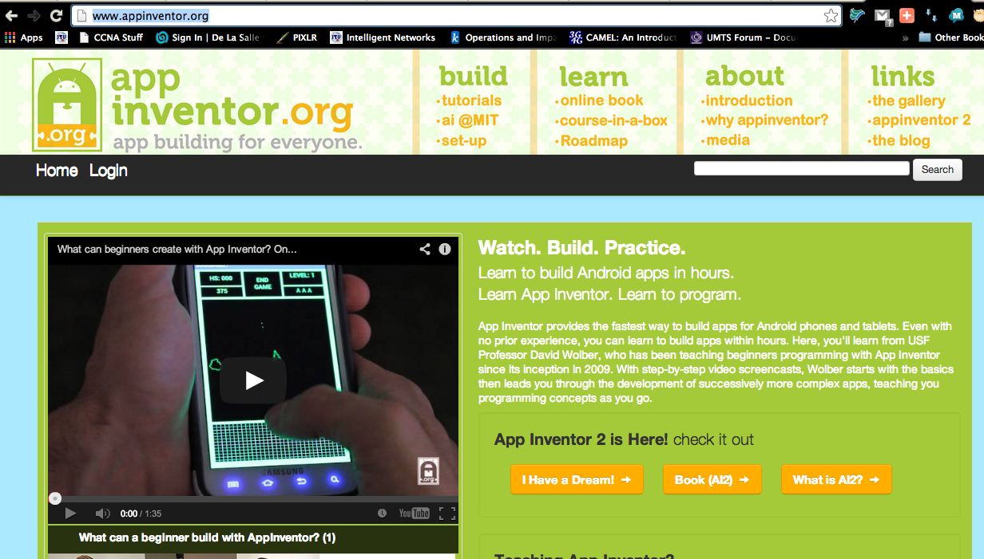
Demo! MIT’s App Inventor
http://ai2.appinventor.mit.edu/

Slide 41
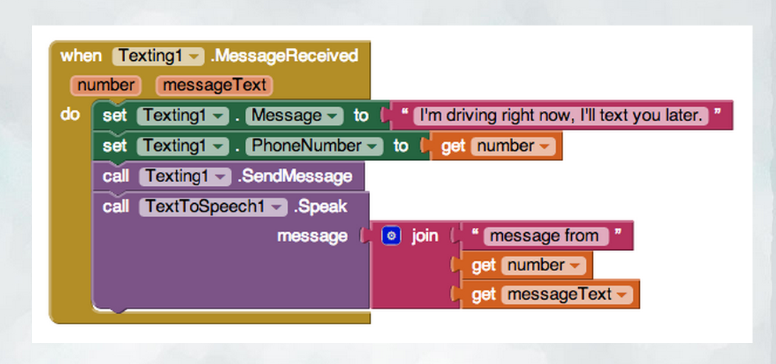
Can you tell what’s supposed to happen?
Notes:
http://www.appinventor.org/

Slide 42
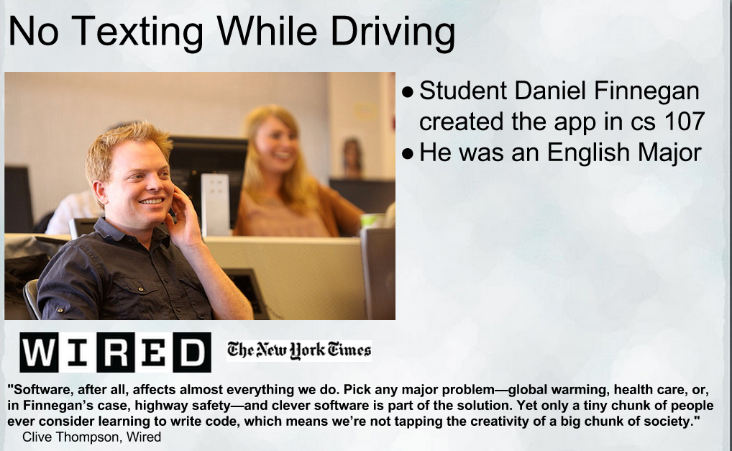

Slide 43
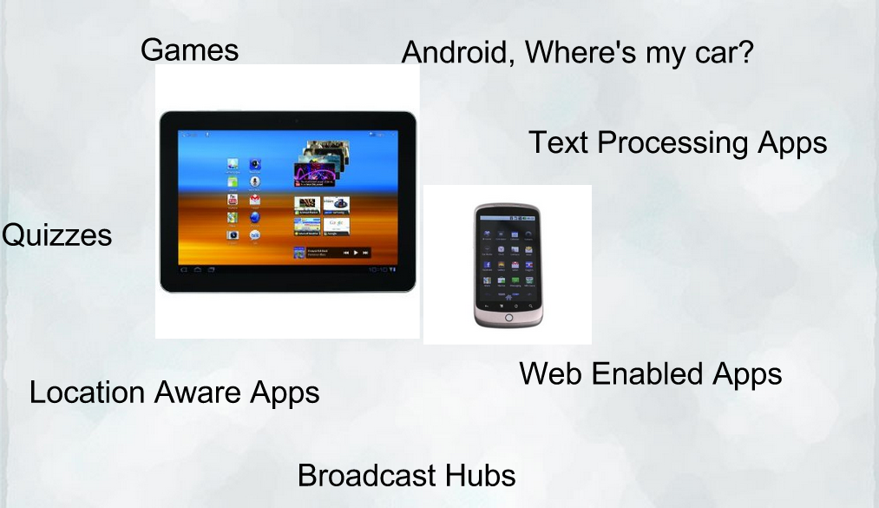
What’s possible!

Slide 44
Native Apps Development

Slide 45
Platforms
Android
  Android SDK
  Java
  Android Development Tools
iOS
  iOS SDK
  Objective-C
  xCode Development Tool
Windows Phone
  Windows Phone SDK
  C++/C#

Slide 46
Summary

Slide 47
Do you have any questions?

Slide 48
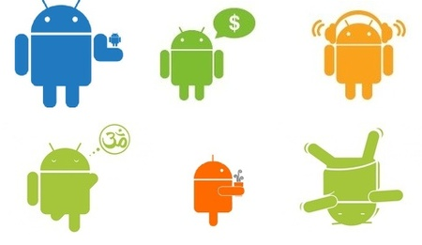
This is the end of the presentation.
Thank you for attending!
For questions or inquiries :
  eMail: rlramos@smart.com.ph
  Mobile: 09298874076
  Office #: 5113175
  Facebook: rlramos@gmail.com
Notes:
Show video: 08 - Redefine_the_wireless_experience_with_LTE

