Slide 1
iOS Advance Topics Day 3
A Quick Overview of SpriteKit
Ronald L. Ramos

Slide 2
Sprite Kit!

Slide 3
What is Sprite Kit?
Sprite Kit is a new framework for making 2D games that comes built-in to iOS 7.
It has sprite support, support for cool special effects like videos, filters, and masking, an integrated physics library, and a lot more.

Slide 4
Sprite Kit Pros
It’s built right into iOS, so there is no need to download extra libraries or have external dependencies. It’s also written by Apple, so you can be sure that it will be well supported and updated moving forward.
It has built-in tool support for texture atlases and particles.
It lets you do some things that would be very difficult if not impossible to do in other frameworks, like treating videos as sprites or applying cool image effects and masks.
Notes:
Sprite Kit isn’t the only option for you to make 2D games on iOS, and it has several pros and cons you should be aware of.

Slide 5
Sprite Kit Cons
If you use SpriteKit, you’re locked into the iOS ecosystem. You never know if you have a hit game that you might want to port to Android!
Sprite Kit is still in the early stages and this time doesn’t have as many useful features as some of the other frameworks, like Cocos2D in particular. It has no ability to write custom OpenGL code.

Slide 6
Which 2D framework to use?
Beginner, or solely focused on iOS: Use Sprite Kit – it’s built in, easy to learn, and will get the job done.
Need to write your own OpenGL code: Stick with Cocos2D or another option for now, as Sprite Kit does not currently support this.
Want to be cross-platform: Choose Cocos2D-X or Unity.
  Cocos2D-X is nice because it’s “down to the wire”, built for 2D games, and you can do just about anything you want with it.
  Unity is nice because it gives you more flexibility (i.e. you can add some 3D aspects into your game if you want), however you have to go through a few more hoops to make 2D games.

Slide 7
Hello World!
Sprite Kit Style!

Slide 8
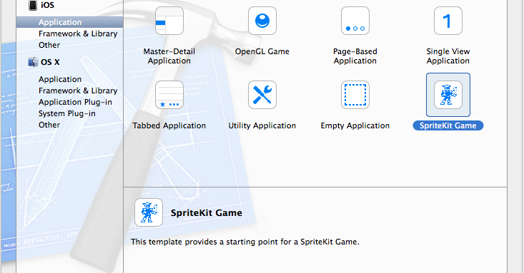
Create a New Project

Slide 9
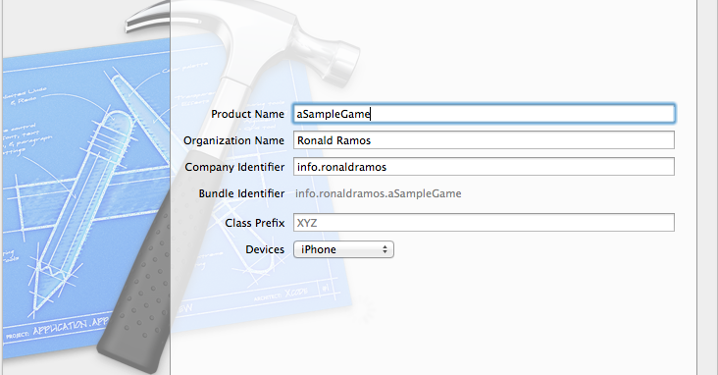
Fill in name

Slide 10
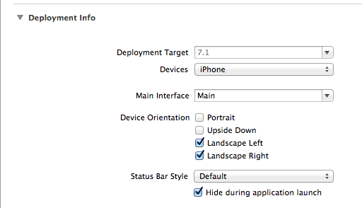
Set Configuration

Slide 11
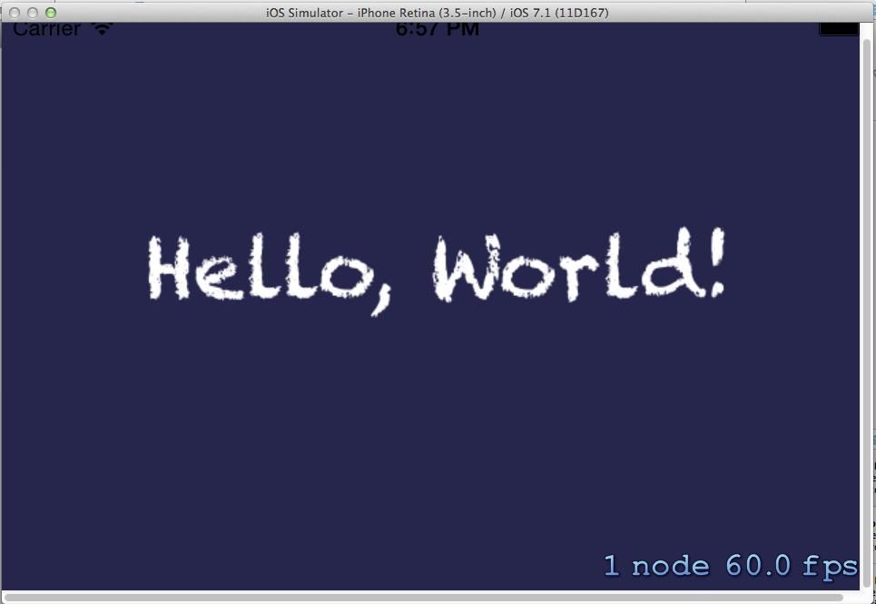
Running the App

Slide 12
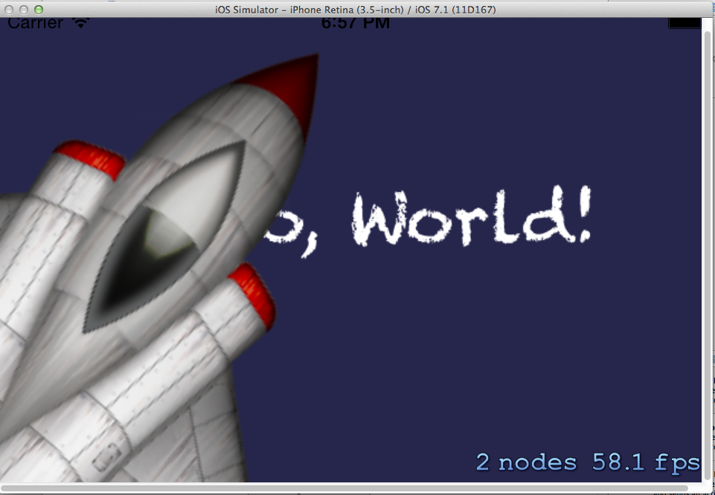
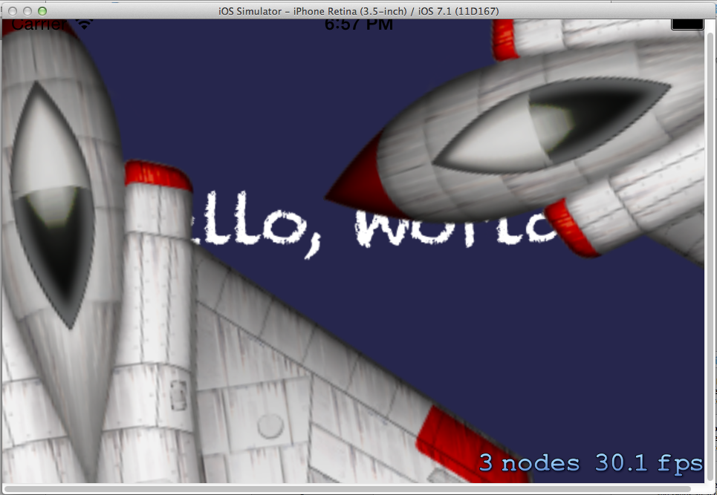
Working Code!

Slide 13
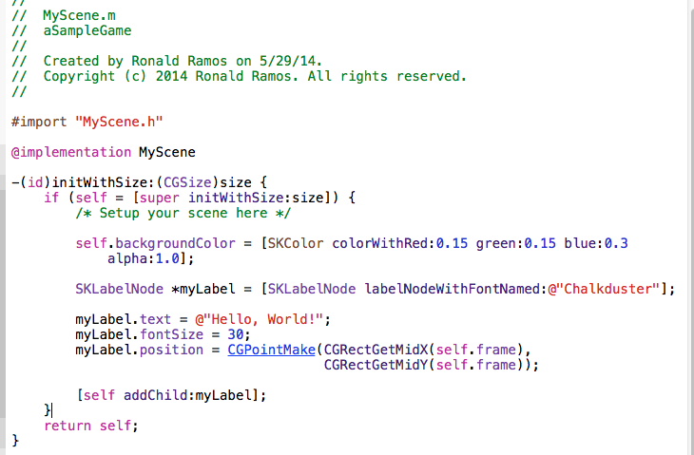
MyScene.m

Slide 14
Modifying the Project

Slide 15
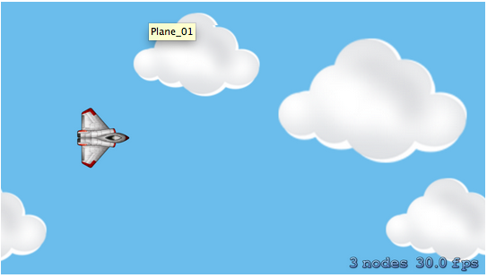
The Goal

Slide 16
SpriteKit Physics and Collision Detection
SpriteKit comes with a physics engine built-in, which helps simulate realistic movements and collision detection.
We are going to use SpriteKit's physics engine to move our spaceship and detect collisions between spaceship and missile.
We will build our game in the following steps:
  Adding the main character of the game (spaceship) on the screen
  Adding scrolling background

Slide 17

Import Graphic Assets
Spaceship is already in the project
Background needs to get imported
Download graphics here:
http://mobiledev.ronaldramos.info/presentations/iOSAdvanced/

Slide 18
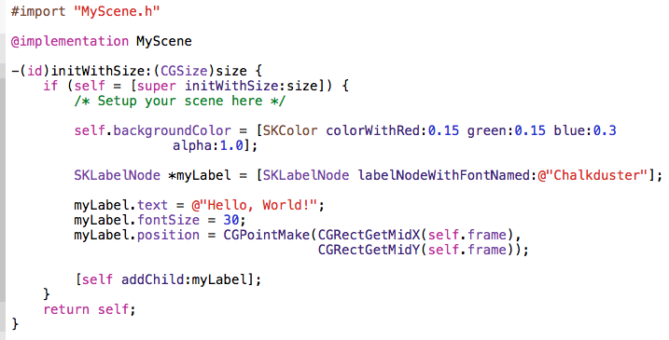
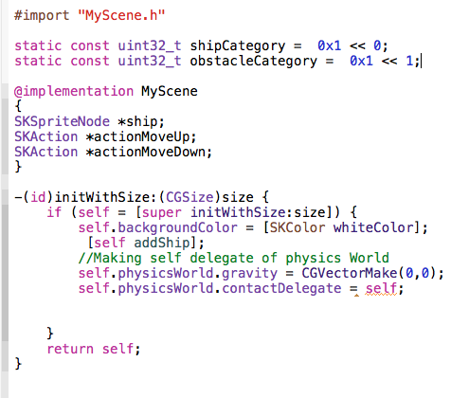
Modify MyScene.m
Original
Modified
Notes:
Run the app after modifications
Partial code for MyScene.m
#import "MyScene.h"
static const uint32_t shipCategory = 0x1 << 0;
static const uint32_t obstacleCategory = 0x1 << 1;
@implementation MyScene
{
SKSpriteNode *ship;
SKAction *actionMoveUp;
SKAction *actionMoveDown;
}
-(id)initWithSize:(CGSize)size {
if (self = [super initWithSize:size]) {
self.backgroundColor = [SKColor whiteColor];
[self addShip];
//Making self delegate of physics World
self.physicsWorld.gravity = CGVectorMake(0,0);
self.physicsWorld.contactDelegate = self;
}
return self;
}

Slide 19
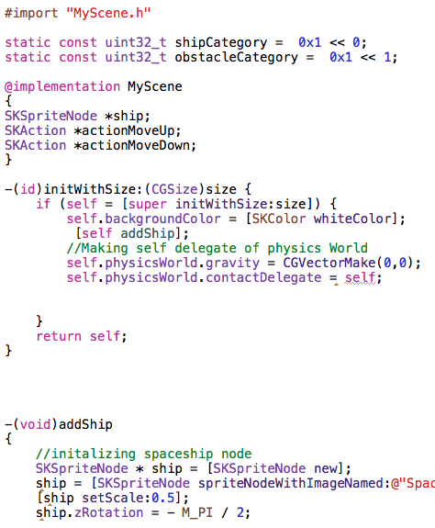
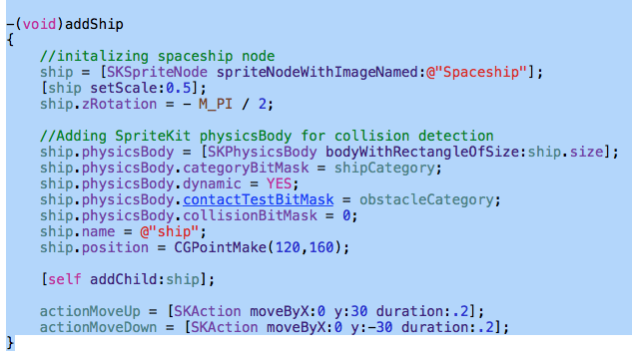
addShip method
addShip method
Put it after initWithSize
Notes:
-(void)addShip
{
//initalizing spaceship node
ship = [SKSpriteNode spriteNodeWithImageNamed:@"Spaceship"];
[ship setScale:0.5];
ship.zRotation = - M_PI / 2;
//Adding SpriteKit physicsBody for collision detection
ship.physicsBody = [SKPhysicsBody bodyWithRectangleOfSize:ship.size];
ship.physicsBody.categoryBitMask = shipCategory;
ship.physicsBody.dynamic = YES;
ship.physicsBody.contactTestBitMask = obstacleCategory;
ship.physicsBody.collisionBitMask = 0;
ship.name = @"ship";
ship.position = CGPointMake(120,160);
[self addChild:ship];
actionMoveUp = [SKAction moveByX:0 y:30 duration:.2];
actionMoveDown = [SKAction moveByX:0 y:-30 duration:.2];
}

Slide 20
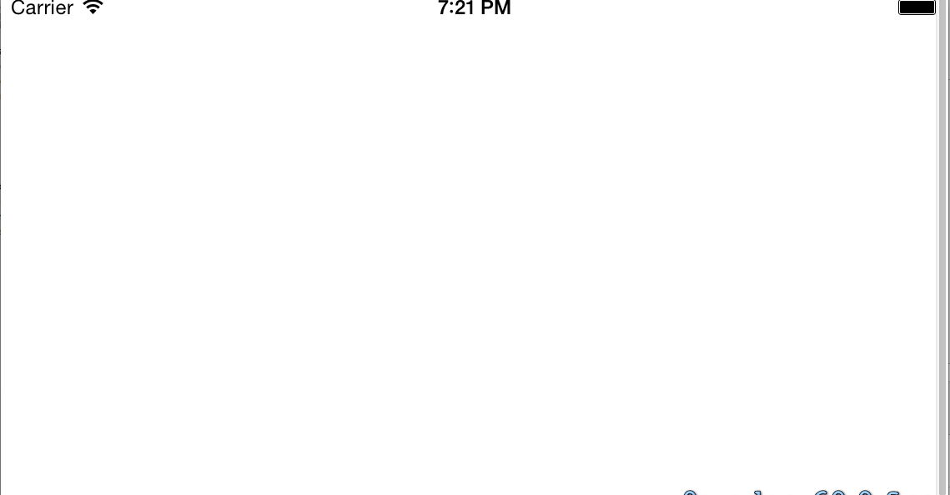
Running the App
Notes:
If you run the project now, it wont show the spaceship where we want it be on the screen.

Slide 21
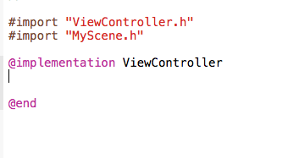
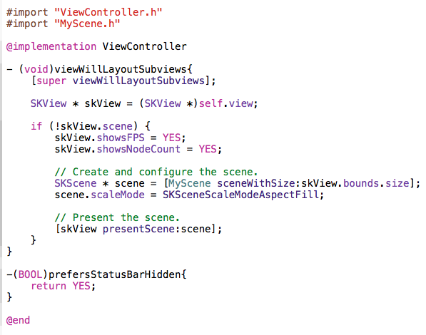
Modify ViewController.m
Delete everything in between ViewController.m
New code
Notes:
Code: ViewController.m
#import "ViewController.h"
#import "MyScene.h"
@implementation ViewController
- (void)viewWillLayoutSubviews{
[super viewWillLayoutSubviews];
SKView * skView = (SKView *)self.view;
if (!skView.scene) {
skView.showsFPS = YES;
skView.showsNodeCount = YES;
// Create and configure the scene.
SKScene * scene = [MyScene sceneWithSize:skView.bounds.size];
scene.scaleMode = SKSceneScaleModeAspectFill;
// Present the scene.
[skView presentScene:scene];
}
}
-(BOOL)prefersStatusBarHidden{
return YES;
}
@end

Slide 22
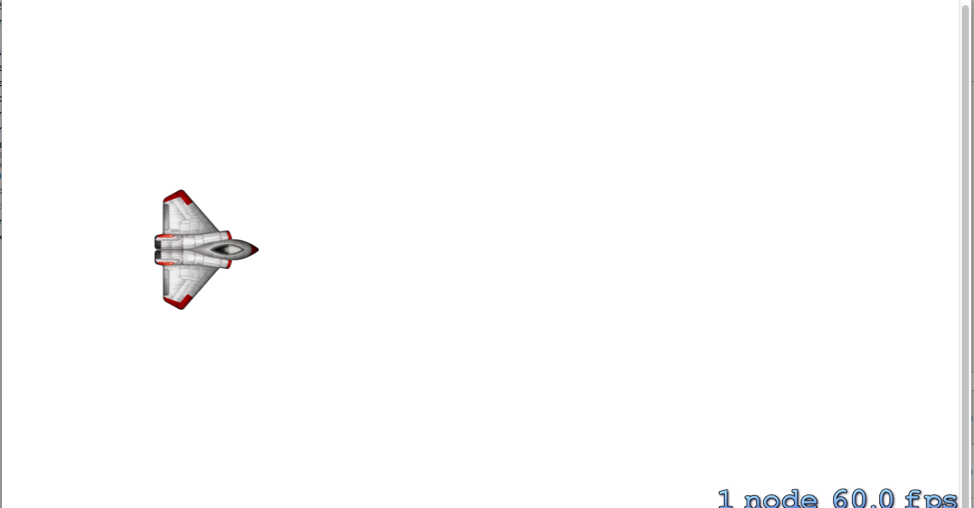
Run the App
Notes:
We are now creating the scene from viewWillLayoutSubviews method instead of viewDidLoad. When viewDidLoad is called it is not aware of the layout of changes, hence it will not set the bounds of the scene correctly

Slide 23
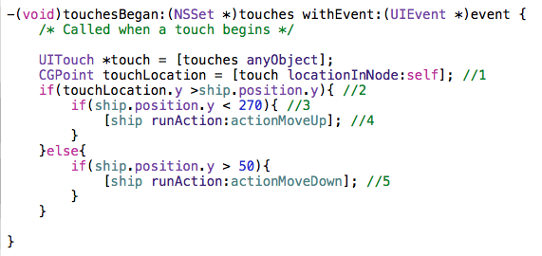
Moving the Ship
Notes:
The logic implemented in the method “touchesBegan” will:
Will track the location of the touch on the screen
If the location is higher than the ship's, we want to move the ship up
Setting offset from the edge so the ship completely stays in bounds of the scene
Calling actionMoveUp to move the ship up by 30 points
Calling actionMoveDown when touch location is below ship current location
Code:
- (void)touchesBegan:(NSSet *)touches withEvent:(UIEvent *)event {
UITouch *touch = [touches anyObject];
CGPoint touchLocation = [touch locationInNode:self.scene]; //1
if(touchLocation.y >ship.position.y){ //2
if(ship.position.y < 270){ //3
[ship runAction:actionMoveUp]; //4
}
}else{
if(ship.position.y > 50){
[ship runAction:actionMoveDown]; //5
}
}
}

Slide 24
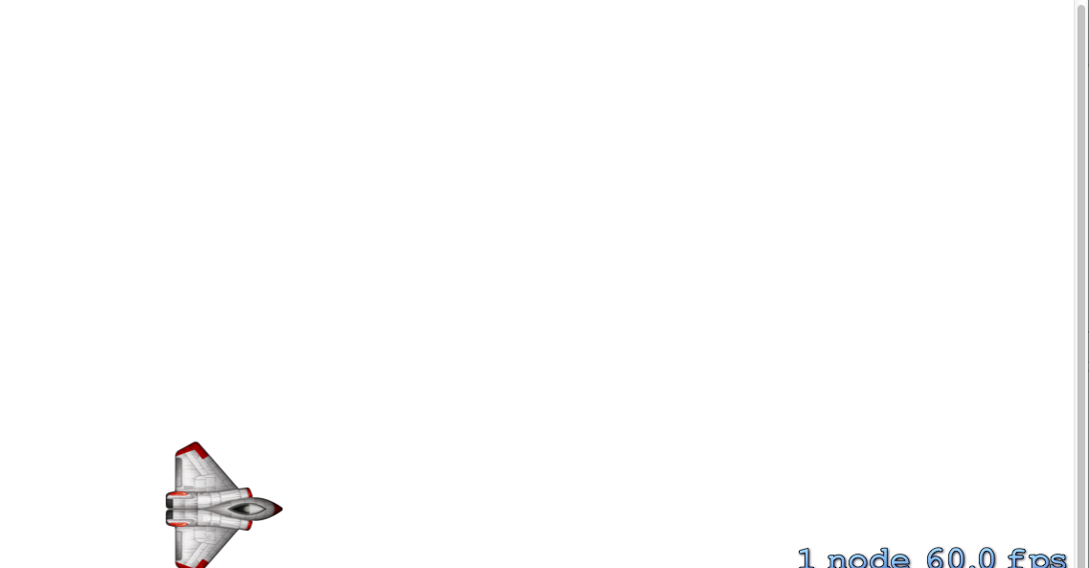
Run the App

Slide 25
The Scrolling Background
Notes:
To make an endlessly scrolling background, make two background images instead of one and lay them side-by-side. Then, as you scroll both images from right to left, once one of the images goes off-screen, you simply put it back to the right.

Slide 26
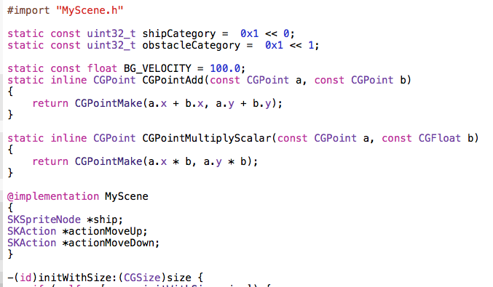
Declare Constants (MyScene.m)
Notes:
Code:
#import "MyScene.h"
static const uint32_t shipCategory = 0x1 << 0;
static const uint32_t obstacleCategory = 0x1 << 1;
static const float BG_VELOCITY = 100.0;
static inline CGPoint CGPointAdd(const CGPoint a, const CGPoint b)
{
return CGPointMake(a.x + b.x, a.y + b.y);
}
static inline CGPoint CGPointMultiplyScalar(const CGPoint a, const CGFloat b)
{
return CGPointMake(a.x * b, a.y * b);
}
@implementation MyScene
{
SKSpriteNode *ship;
SKAction *actionMoveUp;
SKAction *actionMoveDown;
}
-(id)initWithSize:(CGSize)size {
if (self = [super initWithSize:size]) {
self.backgroundColor = [SKColor whiteColor];
[self addShip];
//Making self delegate of physics World
self.physicsWorld.gravity = CGVectorMake(0,0);
self.physicsWorld.contactDelegate = self;
}
return self;
}

Slide 27

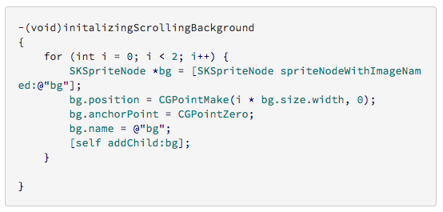
Initialize the background
Initialize method
Modify initWithSize
Notes:
Code:
-(void)initalizingScrollingBackground
{
for (int i = 0; i < 2; i++) {
SKSpriteNode *bg = [SKSpriteNode spriteNodeWithImageNamed:@"bg"];
bg.position = CGPointMake(i * bg.size.width, 0);
bg.anchorPoint = CGPointZero;
bg.name = @"bg";
[self addChild:bg];
}
}

Slide 28
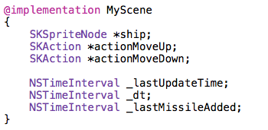
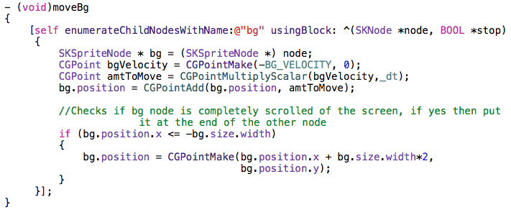
Making the BG Move
Declare constants for timing
moveBG method
Notes:
Code:
- (void)moveBg
{
[self enumerateChildNodesWithName:@"bg" usingBlock: ^(SKNode *node, BOOL *stop)
{
SKSpriteNode * bg = (SKSpriteNode *) node;
CGPoint bgVelocity = CGPointMake(-BG_VELOCITY, 0);
CGPoint amtToMove = CGPointMultiplyScalar(bgVelocity,_dt);
bg.position = CGPointAdd(bg.position, amtToMove);
//Checks if bg node is completely scrolled of the screen, if yes then put it at the end of the other node
if (bg.position.x <= -bg.size.width)
{
bg.position = CGPointMake(bg.position.x + bg.size.width*2,
bg.position.y);
}
}];
}

Slide 29
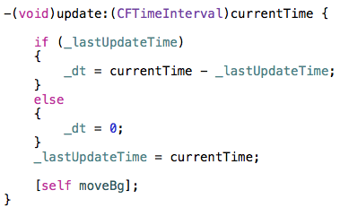
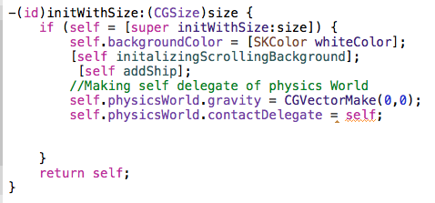
Make the BG Move
Update method
Updated initWithSize
Notes:
Code:
-(void)update:(CFTimeInterval)currentTime {
if (_lastUpdateTime)
{
_dt = currentTime - _lastUpdateTime;
}
else
{
_dt = 0;
}
_lastUpdateTime = currentTime;
[self moveBg];
}
Code:
-(id)initWithSize:(CGSize)size {
if (self = [super initWithSize:size]) {
self.backgroundColor = [SKColor whiteColor];
[self initalizingScrollingBackground];
[self addShip];
//Making self delegate of physics World
self.physicsWorld.gravity = CGVectorMake(0,0);
self.physicsWorld.contactDelegate = self;
}
return self;
}

Slide 30
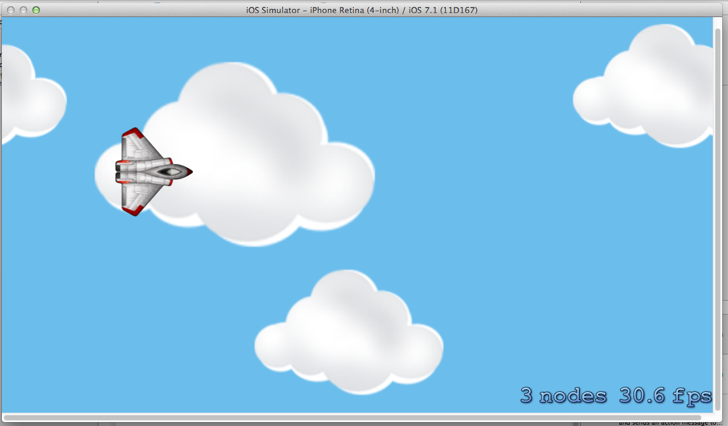
Run the App

Slide 31
End of the Presentation

