Slide 1
iOS Advanced – Day 2
Ronald L. Ramos

Slide 2
Viewing Data

Slide 3
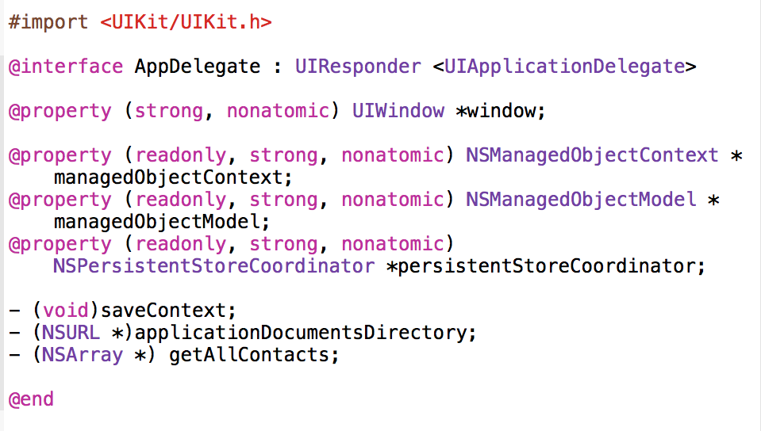
Modify AppDelegate.h
Notes:
Use the sample from Day 1

Slide 4
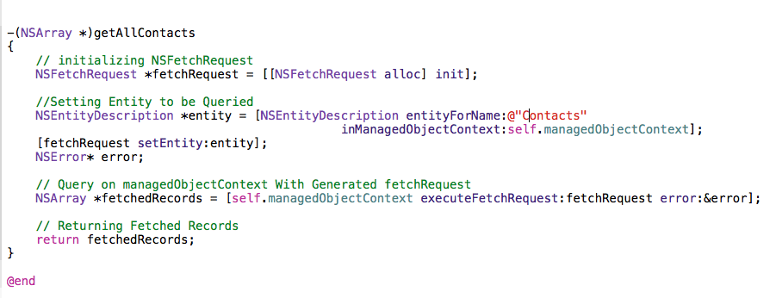
Modify AppDelegate.m
Notes:
Code added at the end:
-(NSArray *)getAllContacts
{
// initializing NSFetchRequest
NSFetchRequest *fetchRequest = [[NSFetchRequest alloc] init];
//Setting Entity to be Queried
NSEntityDescription *entity = [NSEntityDescription entityForName:@"Contacts"
inManagedObjectContext:self.managedObjectContext];
[fetchRequest setEntity:entity];
NSError* error;
// Query on managedObjectContext With Generated fetchRequest
NSArray *fetchedRecords = [self.managedObjectContext executeFetchRequest:fetchRequest error:&error];
// Returning Fetched Records
return fetchedRecords;
}
@end

Slide 5
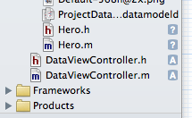
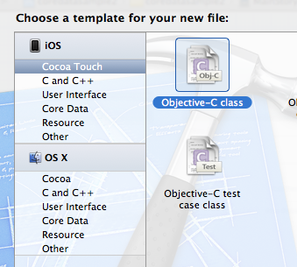
Add A Custom Controller Class

Slide 6
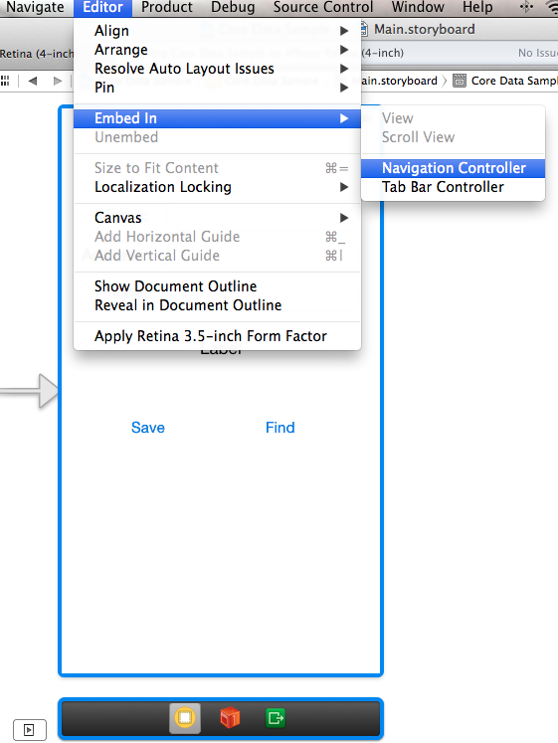
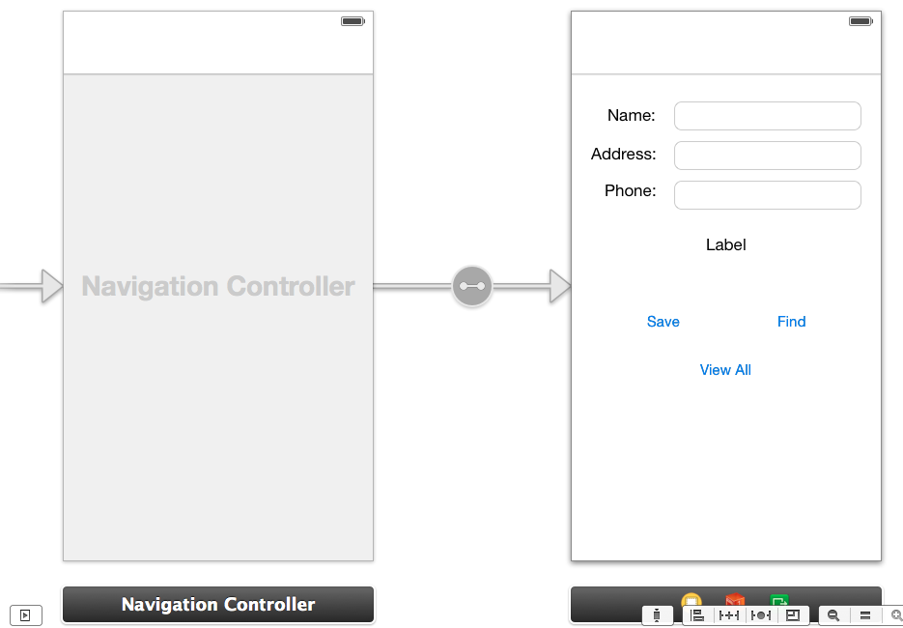
Embed the Existing ViewController in a Navcontroller

Slide 7
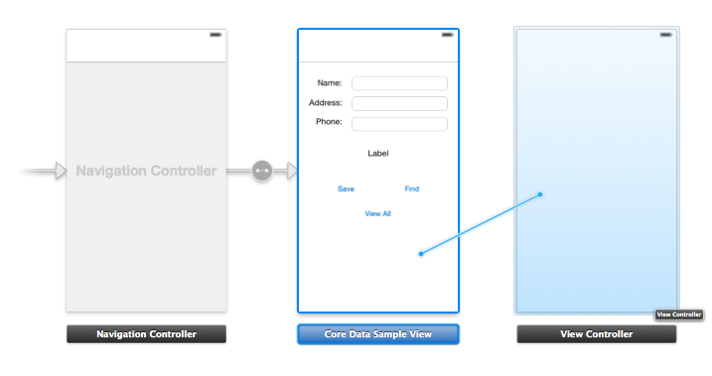
Add a Table ViewController
Notes:
Then control-drag the original Viewcontroller to create a push segue

Slide 8
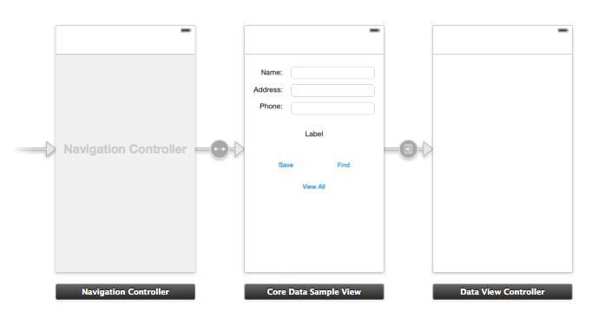
Modify the StoryBoard
Embed in a navigation controller
Add a second controller with a
Table view control
Notes:
Embed the first view controller in a navigation bar control
Then add a button to the first view controller
Add a second ViewController to the storyboard and associate it to your custom ViewController class
Add a push segue from the button to the second Viewcontroller

Slide 9
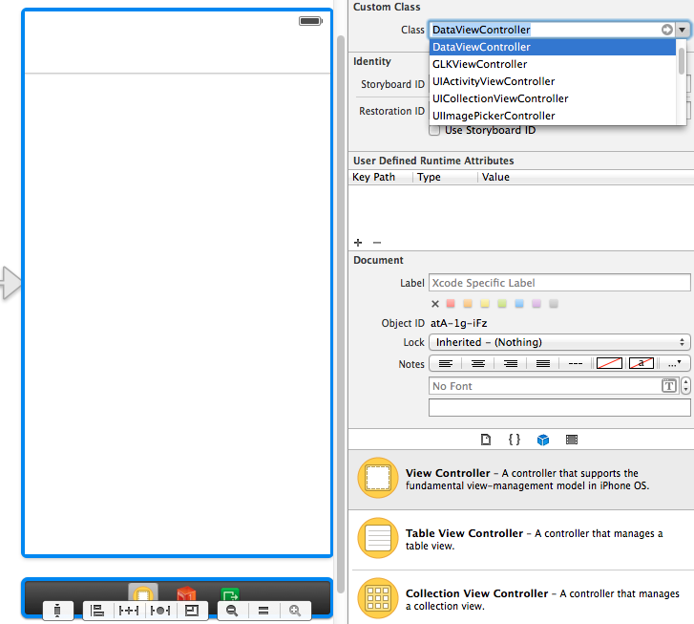
Associate Custom Class with Second View Controller

Slide 10
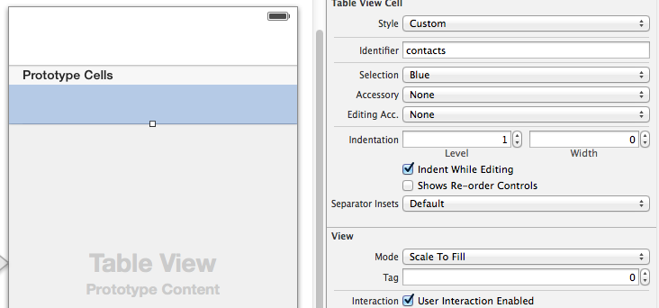
Add a Table View and Give an identifier to your prototype cell
Notes:
Identifier should be “contacts”

Slide 11
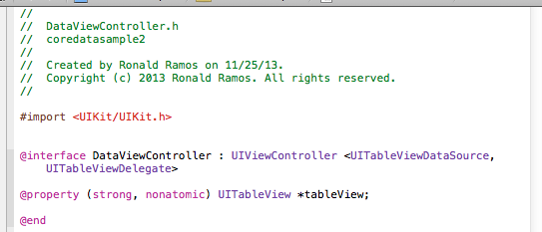
Modify DataViewController.h
Notes:
DataViewController.h is your custom class
Code:
//
// DataViewController.h
// coredatasample2
//
// Created by Ronald Ramos on 11/25/13.
// Copyright (c) 2013 Ronald Ramos. All rights reserved.
//
#import <UIKit/UIKit.h>
@interface DataViewController : UIViewController <UITableViewDataSource, UITableViewDelegate>
@property (strong, nonatomic) UITableView *tableView;
@end

Slide 12
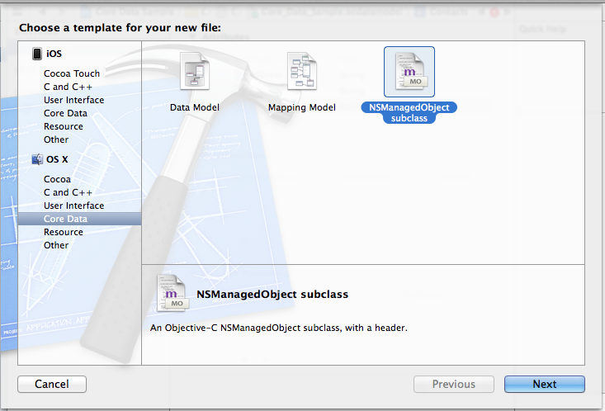
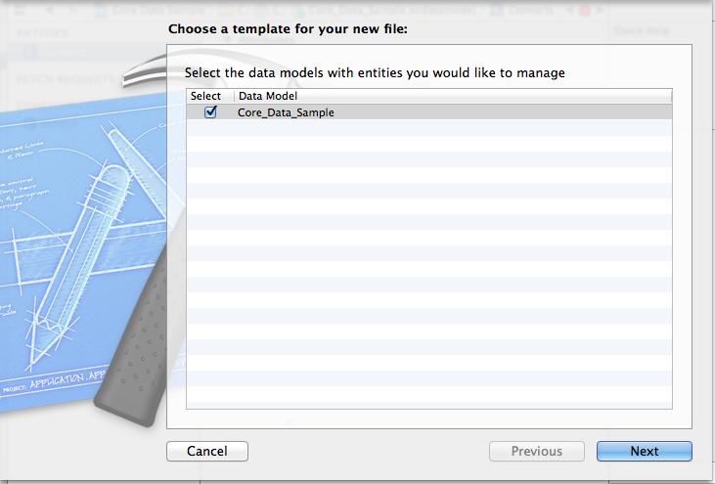
Add managedobject
Notes:
Click on next until Contacts.h and Contacts.m are created

Slide 13
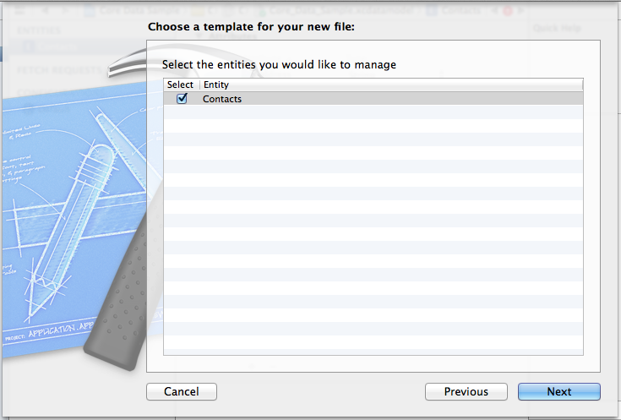

Add managed objects
Notes:
Click on next until Contacts.h and Contacts.m are created

Slide 14
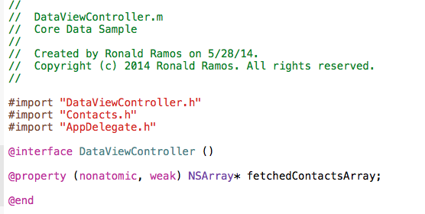
Modify DataViewController.m: Imports and declaration
Notes:
Add the import:
#import "DataViewController.h"
#import "Contacts.h"
#import "AppDelegate.h”
Add this declaration in the interface section:
@property (nonatomic, weak) NSArray* fetchedContactsArray;

Slide 15
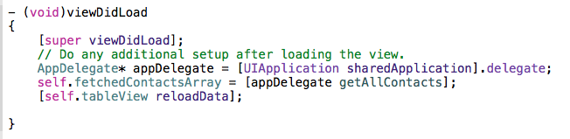
Modify DataViewController.m: ViewDidLoad
Notes:
Modify viewDidLoad:
- (void)viewDidLoad
{
[super viewDidLoad];
// Do any additional setup after loading the view.
AppDelegate* appDelegate = [UIApplication sharedApplication].delegate;
self.fetchedContactsArray = [appDelegate getAllContacts];
[self.tableView reloadData];
}

Slide 16
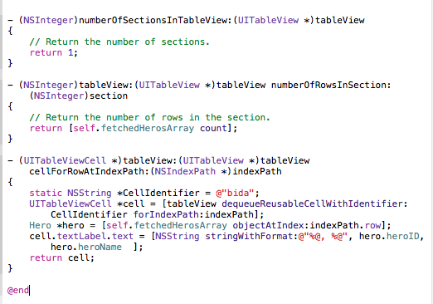
Modify DataViewController.m: Table methods
Notes:
Complete Code:
//
// DataViewController.m
// Core Data Sample
//
// Created by Ronald Ramos on 5/28/14.
// Copyright (c) 2014 Ronald Ramos. All rights reserved.
//
#import "DataViewController.h"
#import "Contacts.h"
#import "AppDelegate.h"
@interface DataViewController ()
@property (nonatomic, weak) NSArray* fetchedContactsArray;
@end
@implementation DataViewController
- (id)initWithNibName:(NSString *)nibNameOrNil bundle:(NSBundle *)nibBundleOrNil
{
self = [super initWithNibName:nibNameOrNil bundle:nibBundleOrNil];
if (self) {
// Custom initialization
}
return self;
}
- (void)viewDidLoad
{
[super viewDidLoad];
// Do any additional setup after loading the view.
AppDelegate* appDelegate = [UIApplication sharedApplication].delegate;
self.fetchedContactsArray = [appDelegate getAllContacts];
[self.tableView reloadData];
}
- (void)didReceiveMemoryWarning
{
[super didReceiveMemoryWarning];
// Dispose of any resources that can be recreated.
}
/*
#pragma mark - Navigation
// In a storyboard-based application, you will often want to do a little preparation before navigation
- (void)prepareForSegue:(UIStoryboardSegue *)segue sender:(id)sender
{
// Get the new view controller using [segue destinationViewController].
// Pass the selected object to the new view controller.
}
*/
- (NSInteger)numberOfSectionsInTableView:(UITableView *)tableView
{
// Return the number of sections.
return 1;
}
- (NSInteger)tableView:(UITableView *)tableView numberOfRowsInSection:(NSInteger)section
{
// Return the number of rows in the section.
return [self.fetchedContactsArray count];
}
- (UITableViewCell *)tableView:(UITableView *)tableView cellForRowAtIndexPath:(NSIndexPath *)indexPath
{
static NSString *CellIdentifier = @"person";
UITableViewCell *cell = [tableView dequeueReusableCellWithIdentifier:CellIdentifier forIndexPath:indexPath];
Contacts *contact = [self.fetchedContactsArray objectAtIndex:indexPath.row];
cell.textLabel.text = [NSString stringWithFormat:@"%@", contact.name];
return cell;
}
@end

Slide 17
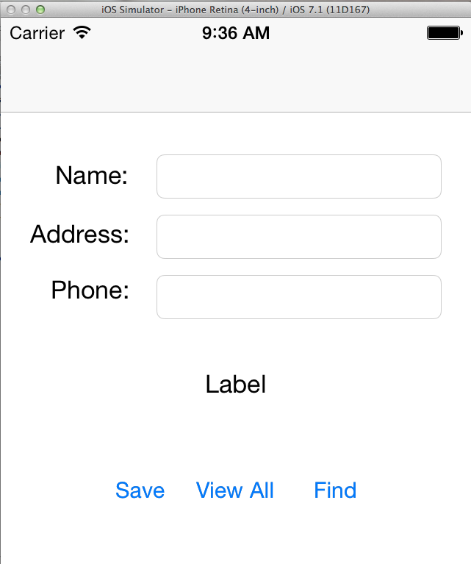
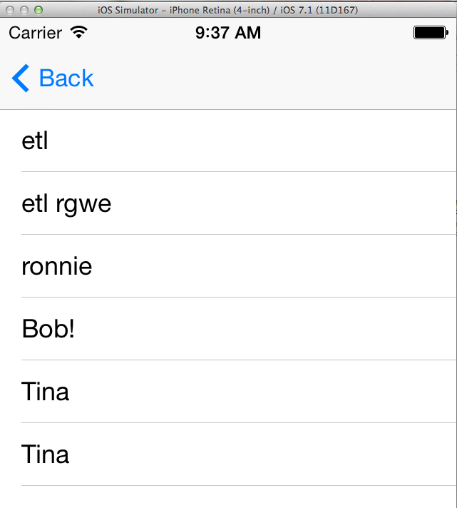
Run the App

Slide 18
End of Presentation

