Slide 1
Advanced iOS Topics
Core Data

Slide 2
A copy of this presentation can be found at:
http://mobiledev.ronaldramos.info/presentations/iOSAdvanced/

Slide 3
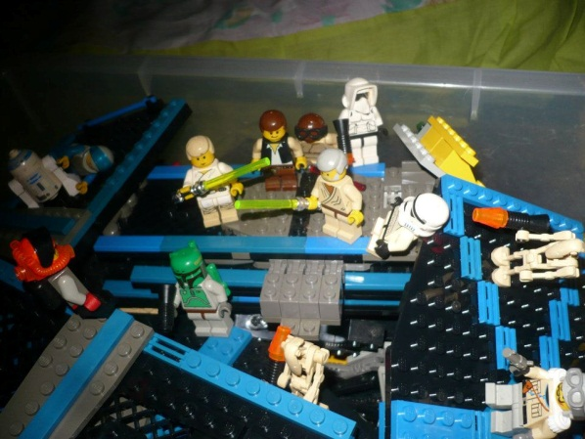
Hello I’m Ronald L. Ramos

Slide 4
Ronald L. Ramos
Mobile: 09298874076
FB: rlramos@gmail.com
Office e-Mail: rlramos@smart.com.ph
Blog: http://brickstories.blogspot.com

Slide 5
Introduce Yourself
Name and nickname
What do you remember about iOS development?

Slide 6
The Core Data Stack

Slide 7
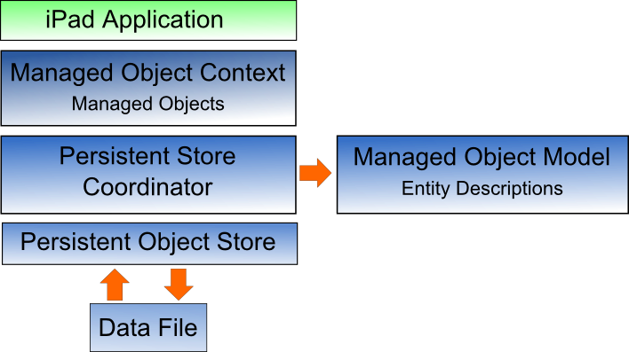
The Core Data Stack
Core Data consists of a number of framework objects that integrate to provide the data storage functionality.
Notes:
the iOS based application sits on top of the stack and interacts with the managed data objects handled by the managed object context. Of particular significance in this diagram is the fact that although the lower levels in the stack perform a considerable amount of the work involved in providing Core Data functionality, the application code does not interact with them directly.

Slide 8
Managed Objects
Managed objects are the objects that are created by your application code to store data.
A managed object may be thought of as a row or a record in a relational database table.
For each new record to be added, a new managed object must be created to store the data. Similarly, retrieved data will be returned in the form of managed objects, one for each record matching the defined retrieval criteria.
Managed objects are actually instances of the NSManagedObject class, or a subclass thereof.
These objects are contained and maintained by the managed object context.
Notes:
Managed Objects

Slide 9
Managed Object Context
Core Data based applications never interact directly with the persistent store. Instead, the application code interacts with the managed objects contained in the managed object context layer of the Core Data stack.
The context maintains the status of the objects in relation to the underlying data store and manages the relationships between managed objects defined by the managed object model.
All interactions with the underlying database are held temporarily within the context until the context is instructed to save the changes, at which point the changes are passed down through the Core Data stack and written to the persistent store.

Slide 10
Managed Object Model
So far we have focused on the management of data objects but have not yet looked at how the data models are defined. This is the task of the Managed Object Model which defines a concept referred to as entities.
Much as a class description defines a blueprint for an object instance, entities define the data model for managed objects. In essence, an entity is analogous to the schema that defines a table in a relational database.
Notes:
As such, each entity has a set of attributes associated with it that define the data to be stored in managed objects derived from that entity. For example, a Contacts entity might contain name, address and phone number attributes.
In addition to attributes, entities can also contain relationships, fetched properties and fetch requests:
Relationships – In the context of Core Data, relationships are the same as those in other relational database systems in that they refer to how one data object relates to another. Core Data relationships can be one-to-one, one-to-many or many-to-many.
Fetched property – This provides an alternative to defining relationships. Fetched properties allow properties of one data object to be accessed from another data object as though a relationship had been defined between those entities. Fetched properties lack the flexibility of relationships and are referred to by Apple’s Core Data documentation as “weak, one way relationships” best suited to “loosely coupled relationships”.
Fetch request – A predefined query that can be referenced to retrieve data objects based on defined predicates. For example, a fetch request can be configured into an entity to retrieve all contact objects where the name field matches “John Smith”.

Slide 11
Persistent Store Coordinator
The persistent store coordinator is responsible for coordinating access to multiple persistent object stores.
As an iOS developer you will never directly interact with the persistence store coordinator and, in fact, will very rarely need to develop an application that requires more than one persistent object store.
When multiple stores are required, the coordinator presents these stores to the upper layers of the Core Data stack as a single store.

Slide 12
Persistent Object Store
The term persistent object store refers to the underlying storage environment in which data are stored when using Core Data. Core Data supports three disk-based and one memory-based persistent store. Disk based options consist of SQLite, XML and binary.
By default, the iOS SDK will use SQLite as the persistent store.
Notes:
. In practice, the type of store being used is transparent to you as the developer. Regardless of your choice of persistent store, your code will make the same calls to the same Core Data APIs to manage the data objects required by your application.

Slide 13
A Project using Core Data

Slide 14
Creating the Project
Notes:
As is often the case, we can rely on Xcode to do much of the preparatory work for us when developing an iOS application that will use Core Data. Currently, however, only the Master-Detail Application, Utility Application and Empty Application project templates offer the option to automatically include support for Core Data.
To create the example application project, launch Xcode and select the option to create a new project. In the new project window, select the Empty Application option. In the next screen make sure that the Devices menu is set to iPhone. In the Product Name and Class Prefix fields enter CoreData, enable the Use Core Data checkbox and click Next to select a location to store the project files. Xcode will create the new project and display the main project window

Slide 15
Creating the Project – Entity Description
Notes:
In addition to the usual files that are present when creating a new project, this time an additional file named CoreData.xcdatamodeld is also created. This is the file where the entity descriptions for our data model are going to be stored.
The entity description defines the model for our data, much in the way a schema defines the model of a database table.

Slide 16
The Entity Description

Slide 17
Creating the Entity Description
Notes:
To create the entity for the Core Data application, select the CoreData.xcdatamodeld file to load the entity editor.
To create a new entity, click on the Add Entity button located in the bottom panel. Double click on the new Entity item that appears beneath the Entities heading and change entity name to Contacts. With the entity created, the next step is to add some attributes that represent the data that is to be stored. To do so, click on the Add Attribute button. In the Attribute pane, name the attribute name and set the Type to String. Repeat these steps to add two other String attributes named address and phone respectively.

Slide 18
Creating the Entity Description
Notes:
Double click on the new Entity item that appears beneath the Entities heading and change entity name to Contacts. With the entity created, the next step is to add some attributes that represent the data that is to be stored. To do so, click on the Add Attribute button. In the Attribute pane, name the attribute name and set the Type to String. Repeat these steps to add two other String attributes named address and phone respectively.
The entity is now defined and it is time to start writing code.

Slide 19
The Storyboard
Notes:
In order to automatically add Core Data support to our application we had to choose the Empty Application project template option when we started Xcode. As such, we now need to create our own storyboard file and view controller class.

Slide 20
Adding the Storyboard
Notes:
To add a storyboard file, select the File -> New File… menu option and, in the resulting dialog, select the User Interface category from beneath iOS in the left hand panel. In the main panel, select the Storyboard option and click on Next. On the subsequent screen make sure iPhone is selected from the Device Family menu before clicking on Next.

Slide 21
Adding the Storyboard
Notes:
Name the storyboard Main, select a location in the project for the new file then click on Create.

Slide 22
Modifying the App to use Main storyboard
Notes:
With the new Storyboard file added to the project, some additional changes are required so that it is used within the application. First, select the CoreData entry at the top of the project navigator panel to display the General settings screen. In the Deployment Info section, locate the Main Interface property and select the newly created Main storyboard file from the corresponding menu.

Slide 23
Modifying the App to use Main storyboard
Notes:
Next, edit the AppDelegate.m file and modify the didFinishLaunchingWithOptions method so that it simply returns YES instead of creating a window for the application (since we are now using a storyboard file for the user interface this is no longer needed):

Slide 24
The View Controller
Notes:
With a storyboard file added and configured into the application, we now need to create a view controller.

Slide 25
Notes:
Within the Xcode project navigator panel, Ctrl-click on the CoreData folder entry. From the popup menu, select New File.... In the new file panel, select the iOS Cocoa Touch category followed by the Objective-C class icon and click Next. On the following options screen, make sure the Subclass of menu is set to UIViewController and name the class CoreDataSampleViewController. Also, make sure the Targeted for iPad and With XIB for user interface options are off. Click Next and select a location for the new class files before clicking on Create.

Slide 26
Notes:
Add a UIViewController instance to the storyboard and to associate it with our newly created view controller class. Select the Main.storyboard file and drag and drop a View Controller instance from the Object Library panel onto the storyboard design canvas.

Slide 27
Notes:
Select this new view controller so that it is highlighted in blue, display the Identity Inspector panel and change the Class setting from UIViewController to our new CoreDataViewController class.
The new storyboard file and view controller are now ready.

Slide 28
The User Interface

Slide 29
Create the User Interface
Notes:
Before proceeding, stretch the status label (located above the two buttons) so that it covers most of the width of the view and change the text alignment in the Attributes Inspector so that it is centered. Finally, edit the label and remove the word “Label” so that it is blank.
Select the top most text field object in the view canvas, display the Assistant Editor panel and verify that the editor is displaying the contents of the ViewController.h file.
Ctrl-click on the text field object again and drag to a position just below the @interface line in the Assistant Editor. Release the line and in the resulting connection dialog establish an outlet connection named name. Repeat the above steps to establish outlet connections for the remaining text fields and the label object to properties named address, phone and status respectively.
Ctrl-click on the Save button object and drag the line to the area immediately beneath the newly created outlet in the Assistant Editor panel. Release the line and, within the resulting connection dialog, establish an Action method on the Touch Up Inside event configured to call a method named saveData. Repeat this step to create an action connection from the Find button to a method named findData

Slide 30
CoreDataSampleViewController.h
Notes:
Modify the file to import the CoreDataAppDelegate.h file which will be required by code added to the view controller later in the chapter:

Slide 31
Using Persistent Storage
Notes:
When the application is launched it will need to check whether the database file already exists and, if not, create both the database file and a table within the database in which to store the contact information entered by the user.

Slide 32
Saving Data to Persistent Storage
Notes:
Saving Data to the Persistent Store using Core Data
When the user touches the Save button the saveData method is called. It is within this method, therefore, that we must implement the code to obtain the managed object context and create and store managed objects containing the data entered by the user. Select the CoreDataViewController.m file, scroll down to the template saveData method and implement the code as follows:
CODE:
- (IBAction)saveData:(id)sender {
AppDelegate *appDelegate =
[[UIApplication sharedApplication] delegate];
NSManagedObjectContext *context =
[appDelegate managedObjectContext];
NSManagedObject *newContact;
newContact = [NSEntityDescription
insertNewObjectForEntityForName:@"Contacts"
inManagedObjectContext:context];
[newContact setValue: _name.text forKey:@"name"];
[newContact setValue: _address.text forKey:@"address"];
[newContact setValue: _phone.text forKey:@"phone"];
_name.text = @"";
_address.text = @"";
_phone.text = @"";
NSError *error;
[context save:&error];
_status.text = @"Contact saved";
}
The above code identifies the application delegate instance and uses that object to identify the managed object context. This context is then used to create a new managed object using the Contacts entity description. The setValue method of the managed object is then called to set the name, address and phone attribute values of the managed object (which in turn are read from the text field user interface components). Finally, the context is instructed to save the changes to the persistent store with a call to the context’s save method.

Slide 33
Retrieve Data from Persistent Storage
Notes:
In order to allow the user to search for a contact it is now necessary to implement the findContact action method. As with the save method, this method will need to identify the application delegate and managed object context. It will then need to obtain the entity description for the Contacts entity and then create a predicate to ensure that only objects with the name specified by the user are retrieved from the store. Matching objects are placed in an array from which the attributes for the first match are retrieved using the valueForKey method and displayed to the user. A full count of the matches is displayed in the status field.
The code to perform these tasks is as follows:
- (IBAction)findData:(id)sender {
AppDelegate *appDelegate =
[[UIApplication sharedApplication] delegate];
NSManagedObjectContext *context =
[appDelegate managedObjectContext];
NSEntityDescription *entityDesc =
[NSEntityDescription entityForName:@"Contacts"
inManagedObjectContext:context];
NSFetchRequest *request = [[NSFetchRequest alloc] init];
[request setEntity:entityDesc];
NSPredicate *pred =
[NSPredicate predicateWithFormat:@"(name = %@)",
_name.text];
[request setPredicate:pred];
NSManagedObject *matches = nil;
NSError *error;
NSArray *objects = [context executeFetchRequest:request
error:&error];
if ([objects count] == 0) {
_status.text = @"No matches";
} else {
matches = objects[0];
_address.text = [matches valueForKey:@"address"];
_phone.text = [matches valueForKey:@"phone"];
_status.text = [NSString stringWithFormat:
@"%lu matches found", (unsigned long)[objects count]];
}
}

Slide 34
Running the App

Slide 35
Find Data
Save Data

