Slide 1

Android Development Boot Camp 2015
Ronald L. Ramos

Slide 2
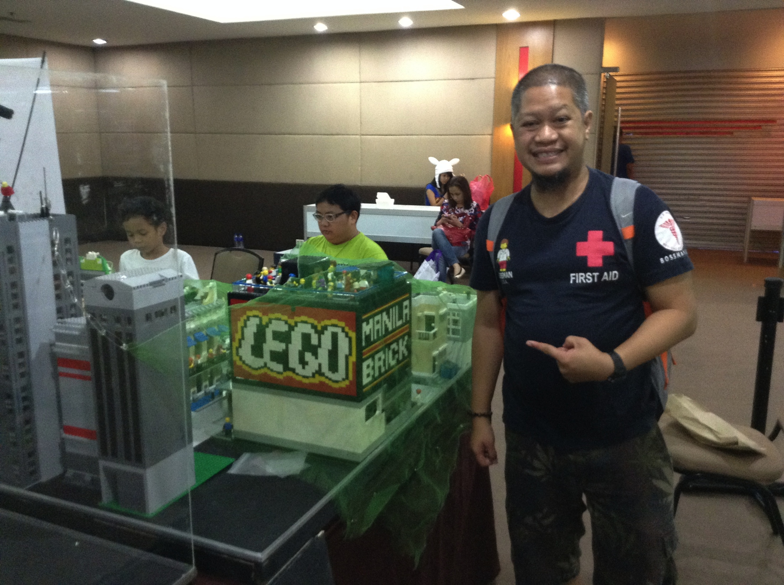

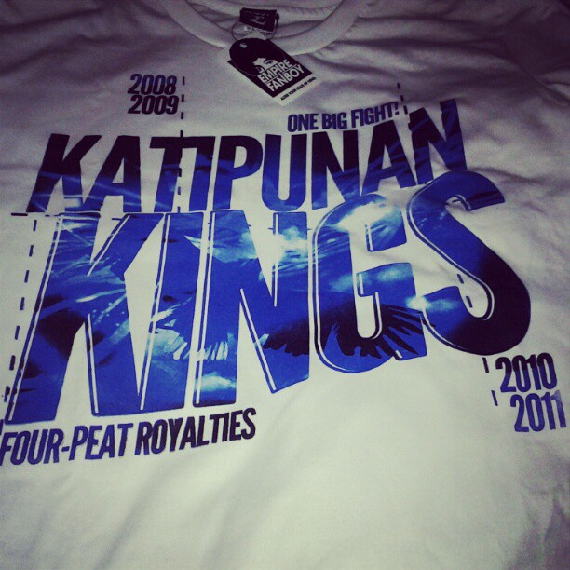

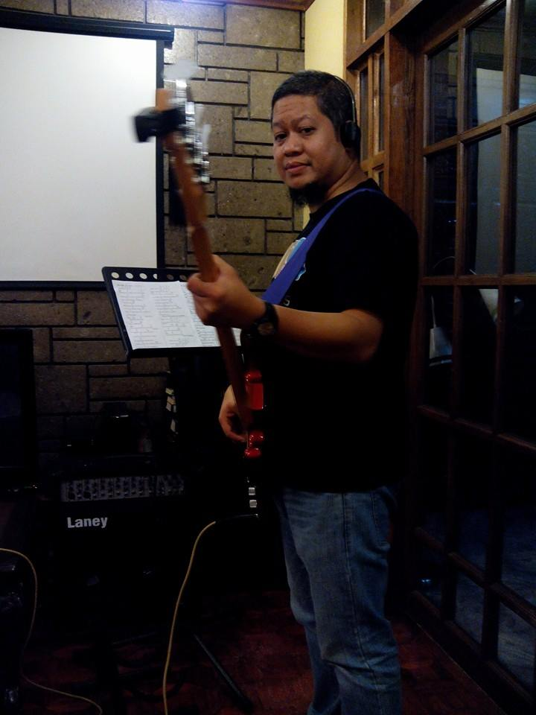
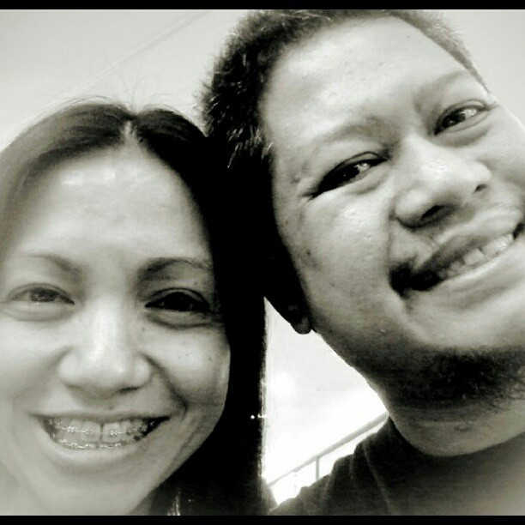
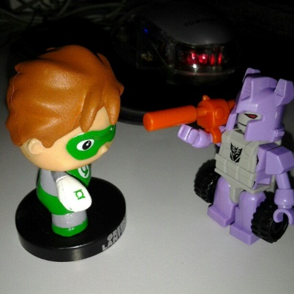
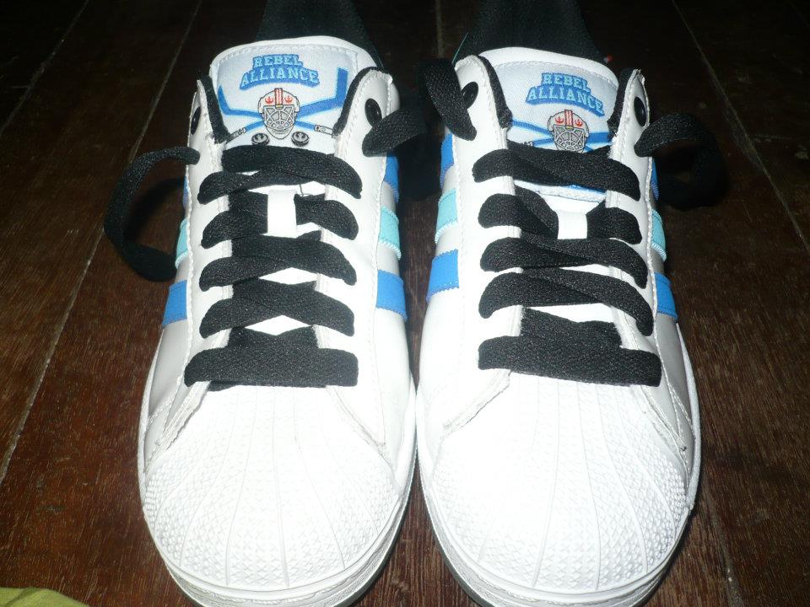
Ronald L. Ramos

Slide 3
Ronald L. Ramos
rlramos@gmail.com
09298874076/ 5113175
Twitter: @taleweaver
Facebook: rlramos@gmail.com
Blog: http://brickstories.blogspot.com

Slide 4
Presentations
Get the presentation here:
http://mobiledev.ronaldramos.info/pjlandroidbootcamp2015/

Slide 5
Introduce yourself
Name/Nickname
Team
Programming experience
Expectations for the training
Smartphone user? What’s your smartphone?
Favorite tv show? Why?

Slide 6
Objectives
Get an overview of Mobile Application development
Know the basic skills needed to create a simple app.
Create a simple application

Slide 7
The Internet of Things
Notes:
Run ibm video
http://www.internet-of-things.eu/

Slide 8
What is it?
“Imagine a world where everything can be both analogue and digitally approached - reformulates our relationship with objects – things- as well as the objects themselves. Any object that carries an RFID tag relates not only to you, but also through being read by a RFID reader nearby, to other objects, relations or values in a database. In this world, you are no longer alone, anywhere.”
Notes:
http://www.theinternetofthings.eu/what-is-the-internet-of-things
Currently we can discern two main blocks of thought on IoT. The first is a reactive framework of ideas and thought that sees IoT as a layer of digital connectivity on top of existing infrastructure and things. This position sees IoT as a manageable set of convergent developments on infrastructure, services, applications and governance tools. It is assumed that, as in the transition from mainframe to Internet some business will fail and new ones will emerge, this will happen within the current governance, currency end business models.
The second is a proactive framework of ideas and thought that sees IoT as a severely disruptive convergence that is unmanageable with current tools, as it will change the notion of what data and what noise is from the supply chain on to 'apps'.

Slide 9
McKinsey Quarterly
“More objects are becoming embedded with sensors and gaining the ability to communicate. The resulting information networks promise to create new business models, improve business processes, and reduce costs and risks.”
Notes:
McKinsey & Company is the trusted advisor and counselor to many of the world's most influential businesses and institutions.
http://www.mckinseyquarterly.com/The_Internet_of_Things_2538
In most organizations, information travels along familiar routes. Proprietary information is lodged in databases and analyzed in reports and then rises up the management chain. Information also originates externally—gathered from public sources, harvested from the Internet, or purchased from information suppliers.
But the predictable pathways of information are changing: the physical world itself is becoming a type of information system. In what’s called the Internet of Things, sensors and actuators embedded in physical objects—from roadways to pacemakers—are linked through wired and wireless networks, often using the same Internet Protocol (IP) that connects the Internet. These networks churn out huge volumes of data that flow to computers for analysis. When objects can both sense the environment and communicate, they become tools for understanding complexity and responding to it swiftly. What’s revolutionary in all this is that these physical information systems are now beginning to be deployed, and some of them even work largely without human intervention.
Pill-shaped microcameras already traverse the human digestive tract and send back thousands of images to pinpoint sources of illness. Precision farming equipment with wireless links to data collected from remote satellites and ground sensors can take into account crop conditions and adjust the way each individual part of a field is farmed—for instance, by spreading extra fertilizer on areas that need more nutrients. Billboards in Japan peer back at passersby, assessing how they fit consumer profiles, and instantly change displayed messages based on those assessments.

Slide 10
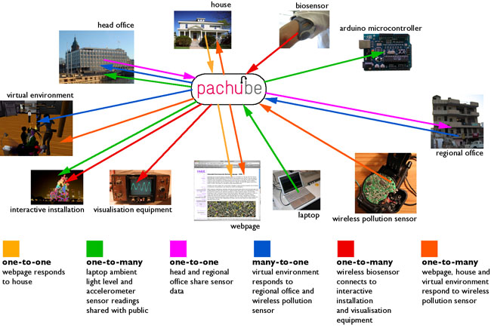
An example
Notes:
http://interactivemultimediatechnology.blogspot.com/2009/05/interacting-with-internet-of-things.html
Pachube: "A web service that enables people to tag and share real time sensor data from objects, devices and spaces around the world, facilitating interaction between remote e
http://community.pachube.com/

Slide 11
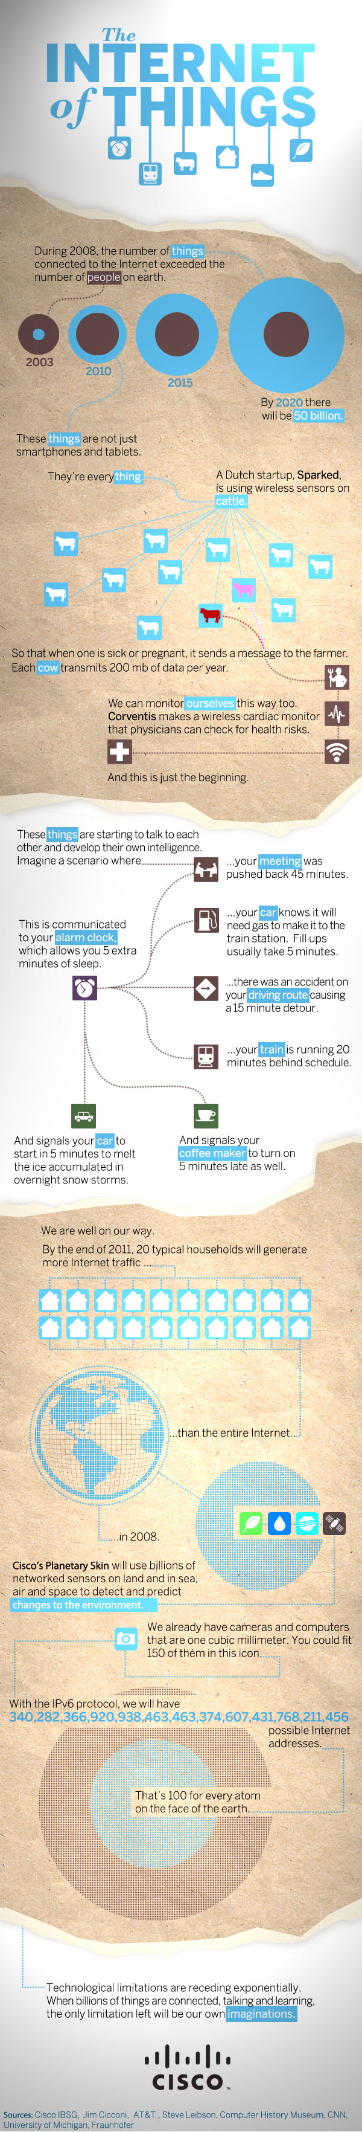
Cisco’s view
Notes:
http://blogs.cisco.com/news/the-internet-of-things-infographic/
When we think of being connected to the Internet, our minds immediately shift to our computers, phones, and most recently tablets. This week at Cisco live, I shared that in 2008, the number of devices connected to the Internet exceeded the number of people on Earth.
That’s right. There are more devices tapping into the Internet than people on Earth to use them. How is this possible?

Slide 12
Introduction to Android

Slide 13
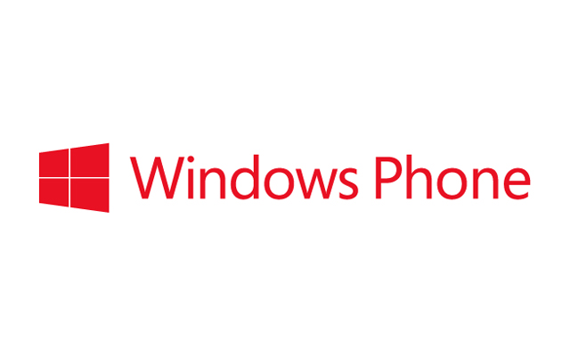


Smart Phones
Notes:
Show video: 03 - Introducing_Android

Slide 14
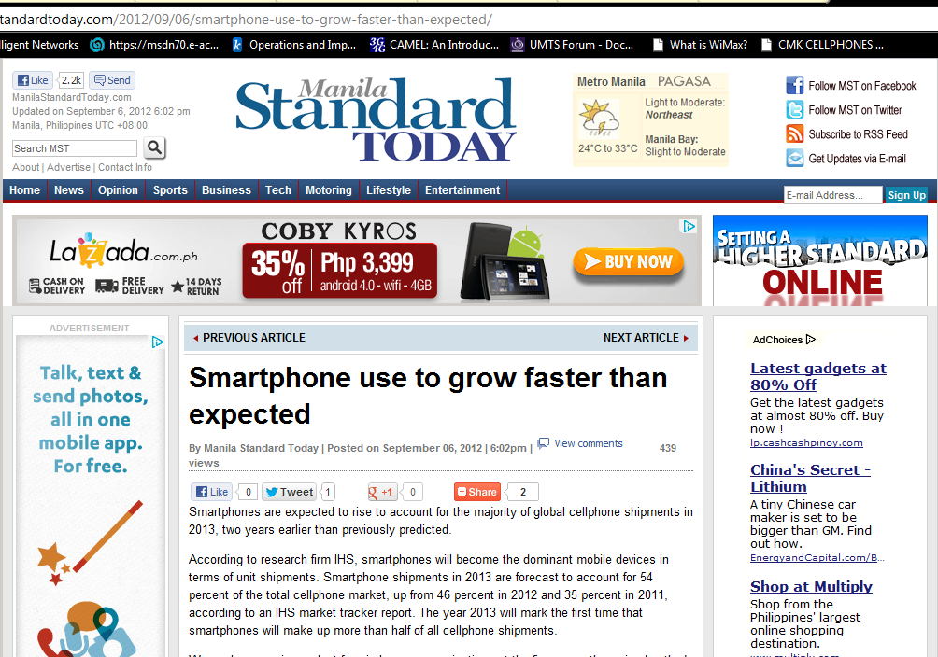
Notes:
WE focus on ANDROIDs…. For a variety of reasons, it is more adaptable to prepaid markets due to its lower prices and flexibility in accessing the market.

Slide 15
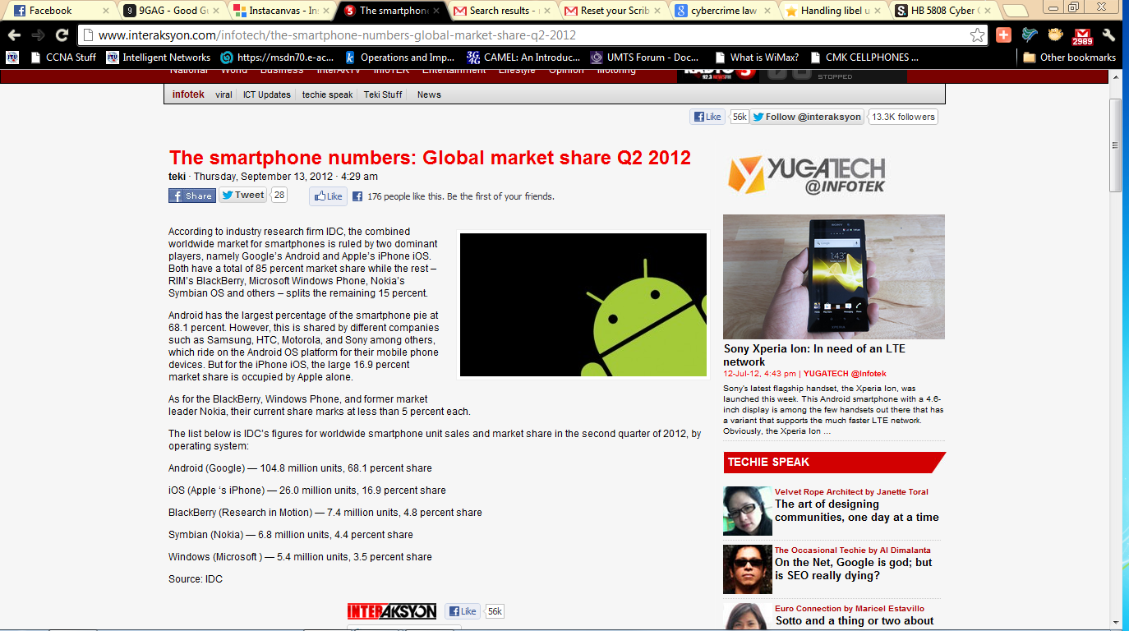
Notes:
If we are to seize the future, we have learn how to create APPs

Slide 16

There are now more Android-enabled phones out there than iPhones. 400,000 new Android devices are activated each day.
Notes:
It has become the platform of choice for most people looking to get a smartphone.

Slide 17
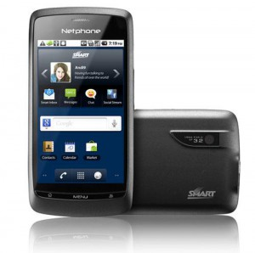
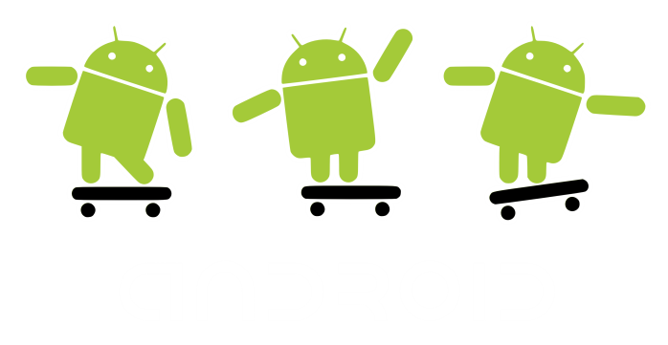
Android for the Masses: Smart’s Netphone
I am also known as the ZTE Blade
Notes:
The “masa” will never spend too much on a cellphone nowadays. Just take a look at the popularity of china phones and brands like Cherry and myPhone. They gravitate towards the cheapest phones with the most features. Smart aims to make Android phones reachable by the masses via the Netphone.
Show video: 04 -SMART Introduces the Red Bend-Enabled Netphone

Slide 18

App development is not rocket science
Notes:
The greatest apps came from the simplest ideas

Slide 19
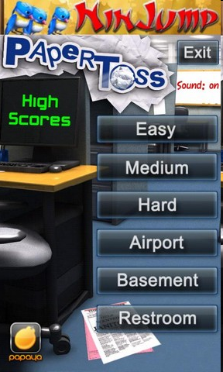
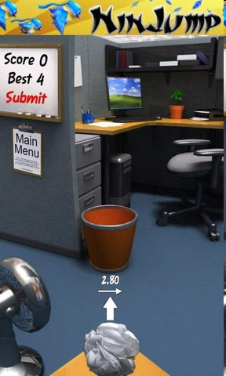
Paper Toss
Notes:
Just physics and graphics.
It wins because it is so, so easy and a great way to pass up time.

Slide 20
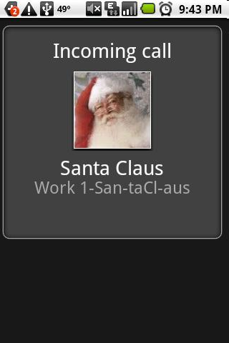
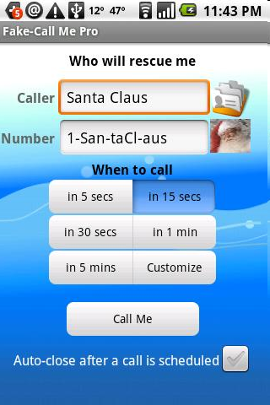
Fake Caller
Notes:
SIMPLE and entertaining. And it does serve a purpose.

Slide 21
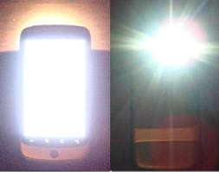
Flashlight
Notes:
SIMPLE and entertaining. And it does serve a purpose.

Slide 22
Mobile development can rival Desktop Applications
Notes:
The greatest apps came from the simplest ideas

Slide 23
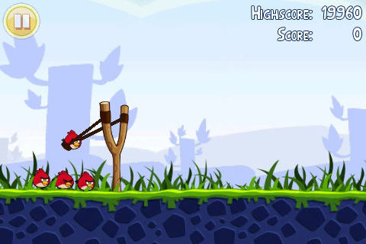
Angry Birds
Notes:
SIMPLE and entertaining. And it does serve a purpose.

Slide 24
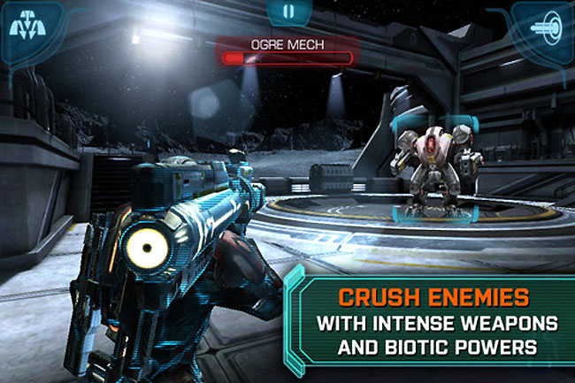
Mass Effect Infiltrator

Slide 25
What is Android?
Android is an open mobile phone platform that was developed by Google and later by Open Handset Alliance. Google defines Android as a "software stack" for mobile phones.
A software stack is made up of operating system(the platform on which everything runs), the middleware (the programming that allows applications to talk to a network and to one another) and the applications (the actual programs that phone will run)

Slide 26
Brief History
July 2005 - Google Inc. bought from Danger Inc
Open Handset Alliance was formed headed by Google which is composed of companies like Intel, T-Mobile, Spring Nextel and more.
In 2008, Android became available as an open source and the ASOP(Android Open Source Project) is responsible for maintainance and development of android.
February 2009, the first android version was released, Android 1.1. for Mobile G1.

Slide 27
Android Versions
Version Number | Name
1.1
1.5 | Cupcake
1.6 | Donut
2.0/2.1 | Éclair
2.2.x | Froyo
2.3.x | Gingerbread
3.X | Honeycomb
4.0-4.0.4 | Ice Cream Sandwich
4.1-4.3.1 | Jelly Bean
4.4 | KitKat
5 | Lollipop

Slide 28
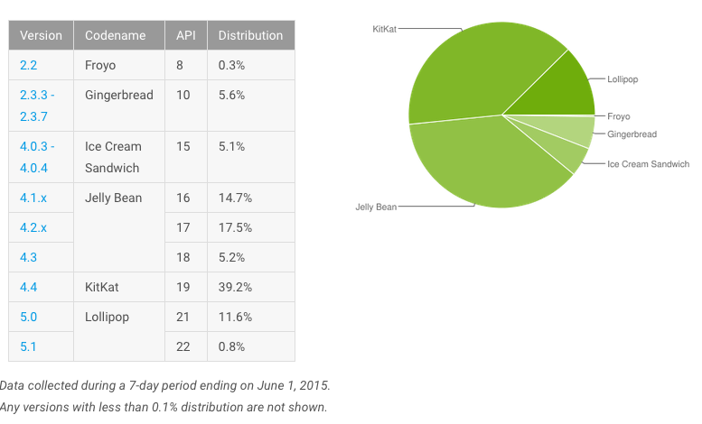
Android Version Market Share
Note: When developing an application, consider the market share of the android version. The higher the market share, the higher number your target market is.
Notes:
https://developer.android.com/about/dashboards/index.html

Slide 29
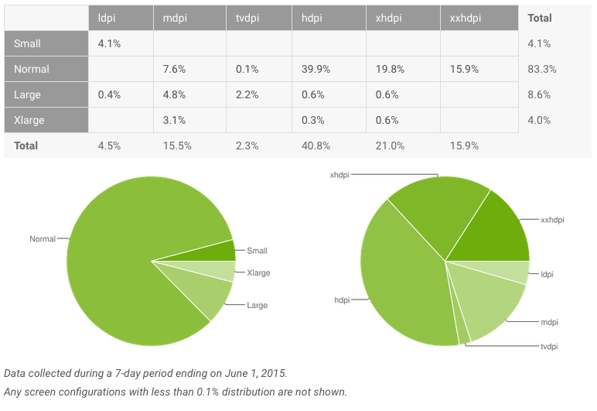
Screen Densities Distribution

Slide 30
Why develop for Android?
Android is an open-source platform based on the Linux kernel, and is installed on thousands of devices from a wide range of manufacturers.
Android exposes your application to all sorts of hardware that you’ll find in modern mobile devices — digital compasses, video cameras, GPS, orientation sensors, and more.
Android’s free development tools make it possible for you to start writing software at little or no cost.
When you’re ready to show off your application to the world, you can publish it to Google’s Android Market. Publishing to Android Market incurs a one-off registration fee (US $25 at the time of writing) and, unlike Apple’s App Store which famously reviews each submission, makes your application available for customers to download and buy after a quick review process — unless the application is blatantly illegal.

Slide 31
More Android Advantages
The Android SDK is available for Windows, Mac and Linux, so you don’t need to pay for new hardware to start writing applications.
An SDK built on Java. If you’re familiar with the Java programming language, you’re already halfway there.
By distributing your application on Android Market, it’s available to hundreds of thousands of users instantly. You’re not just limited to one store, because there are alternatives, too. For instance, you can release your application on your own blog. Amazon have recently launched their own Android app store also.
As well as the technical SDK documentation, new resources are being published for Android developers as the platform gains popularity among both users and developers.

Slide 32
Setting up the Android Development Environment

Slide 33
What you’ll need
Computer running Windows, Linux, or Mac OS X
Android Studio (IDE with SDK)
The Bundle is found on developer.android.com

Slide 34
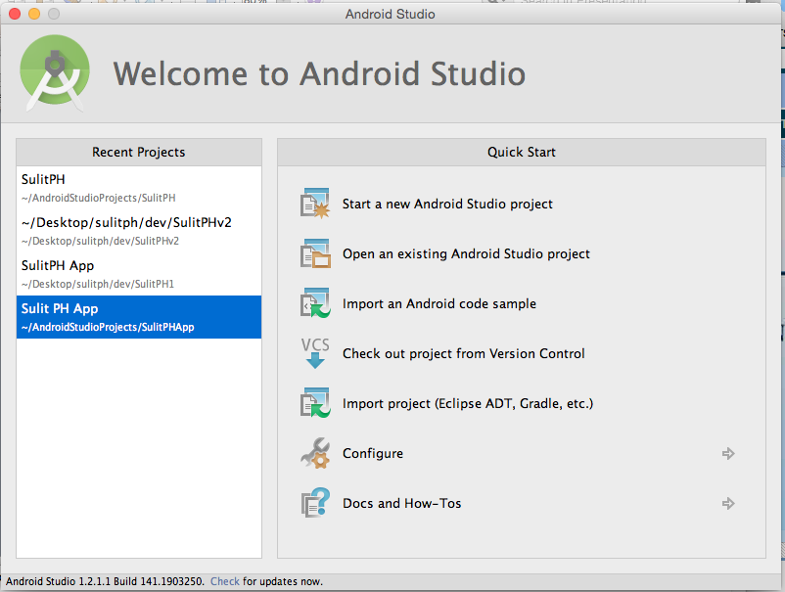
Android Studio
http://developer.android.com/tools/studio/index.html
Android Studio is the official IDE for Android application development, based on IntelliJ IDEA
Notes:
http://developer.android.com/tools/studio/index.html

Slide 35
Hello World
Creating your first project

Slide 36
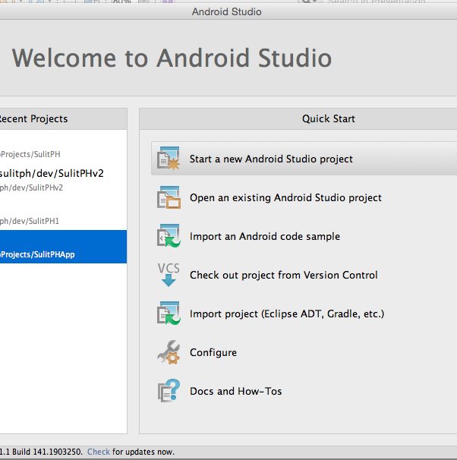
Creating a New Android Project
Open Android Studio
Select “Start a new Android Studio Project”

Slide 37
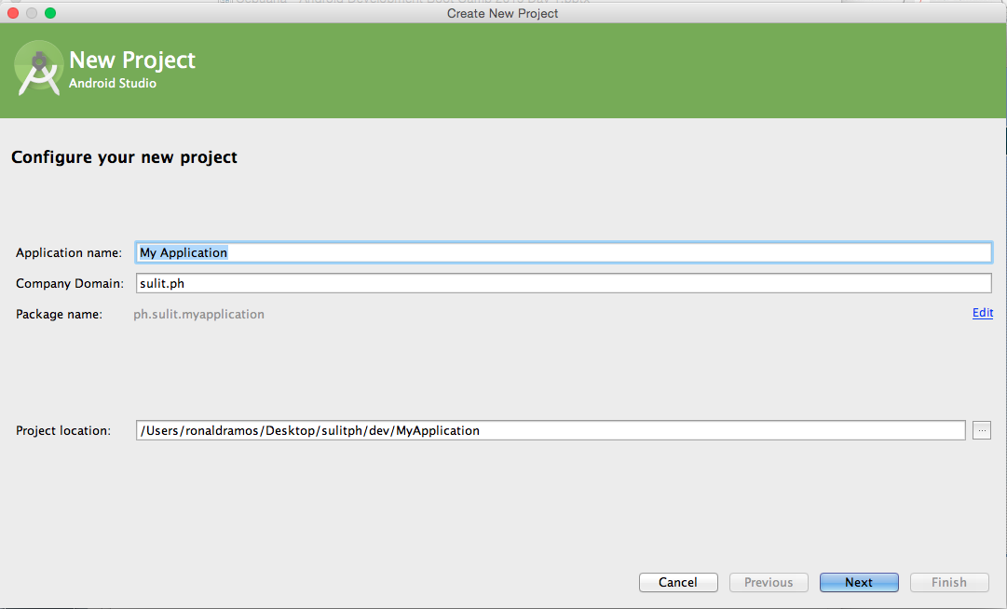
Configure project

Slide 38
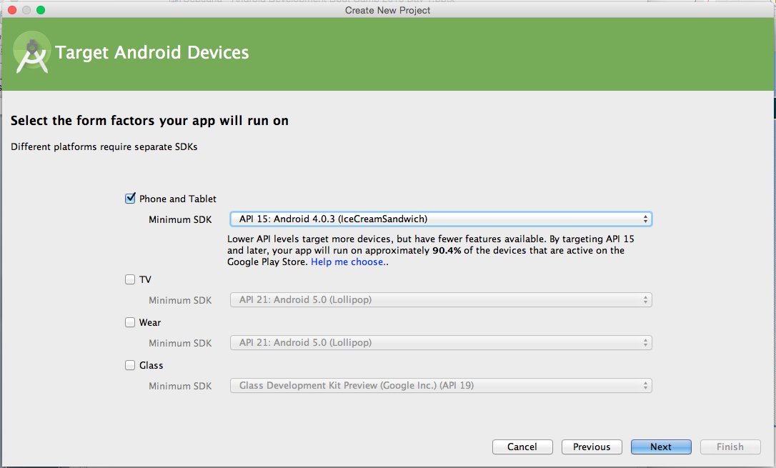
Select Target Devices

Slide 39
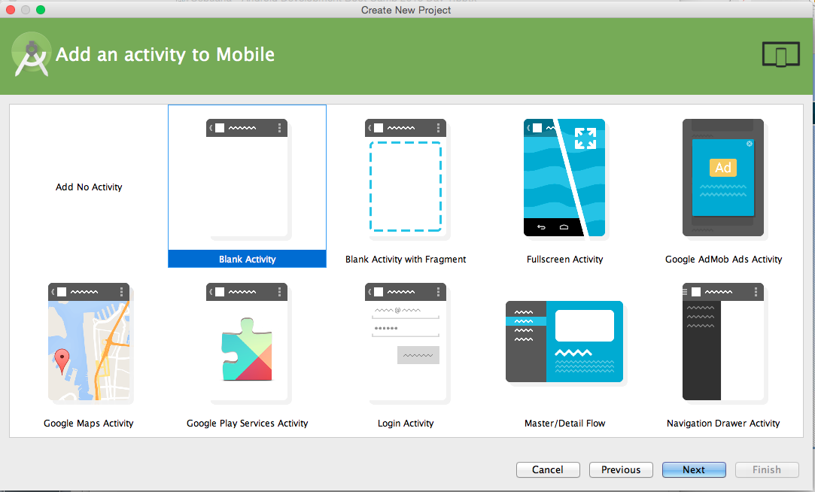
Select Activity Template
Notes:
An activity is the basic program module in Android. An app has at least one Activity

Slide 40
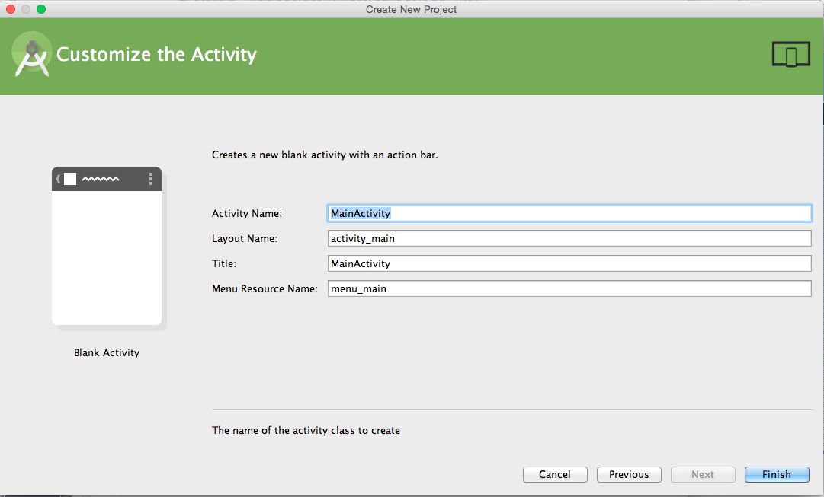
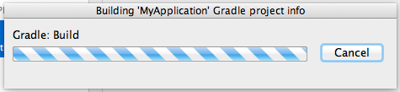
Name the default files

Slide 41
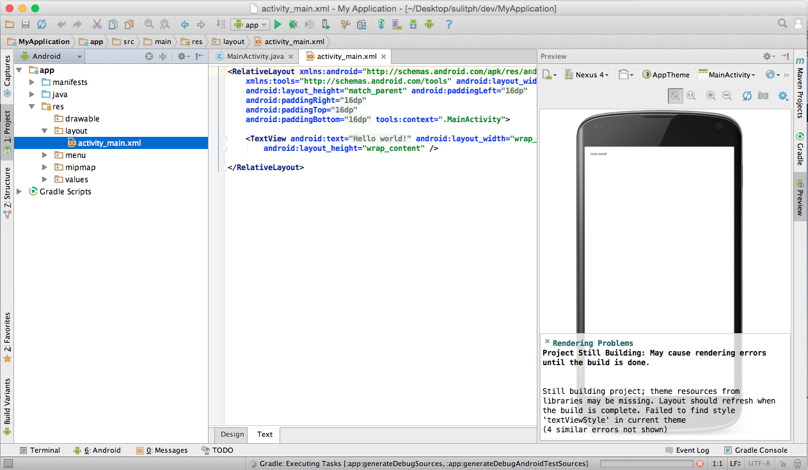
The workbench
Notes:
Once gradle has finished building your new project you will be taken to the AS workbench

Slide 42
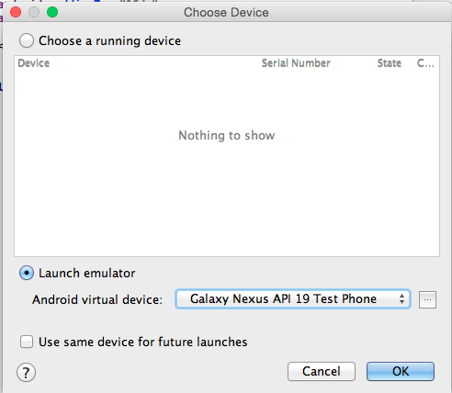
Running the project
Click “Play” on the toolbar
You will be asked where to run your app.
Choose “Launch Emulator”

Slide 43
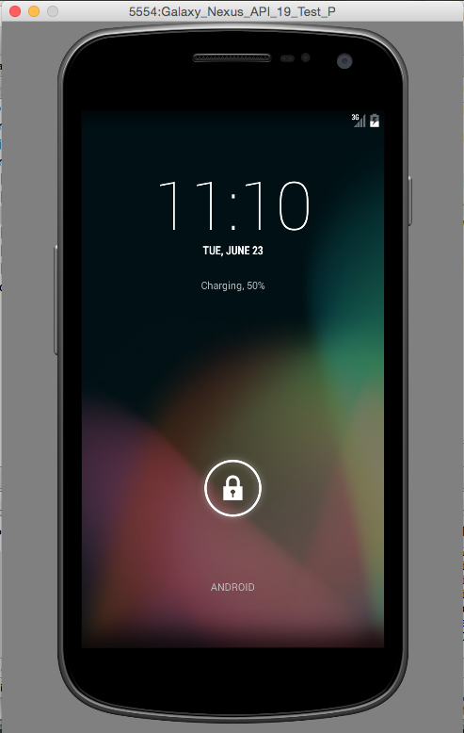
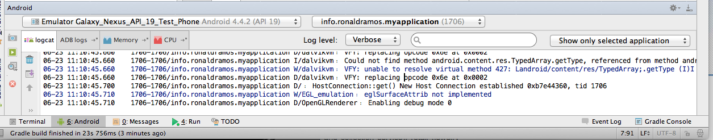
Running the emulator
Notes:
The console on Android Studio will display status messages regarding the running app.
The emulator should also boot up on your PC

Slide 44
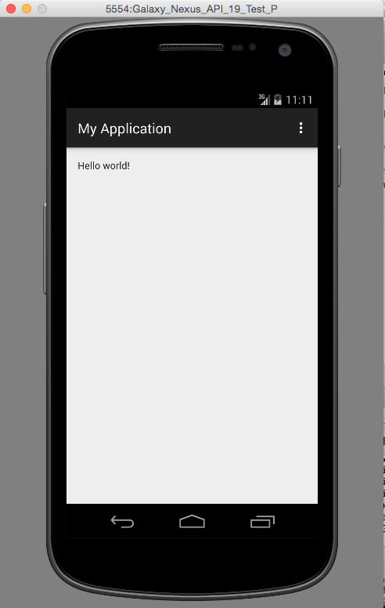
The running app

Slide 45
Your first Android App

Slide 46
Create a New Android Project
Click on File > New > Project
Select Android Application

Slide 47
Create a new Android Project
Project Name:
  MyFirstForm
Min SDK: Android 4.0
Application Name:
  My First Form
Package Name
  com.yourname.myfirstproject
Activity Name:
  MyFirstActivity
Notes:
Create a new android project in Android Studio

Slide 48
Create a New Android Project
Click on Finish
Once the project appears in project explorer you have just completed your first android app
Try it by clicking run

Slide 49
Modifying Your Project

Slide 50
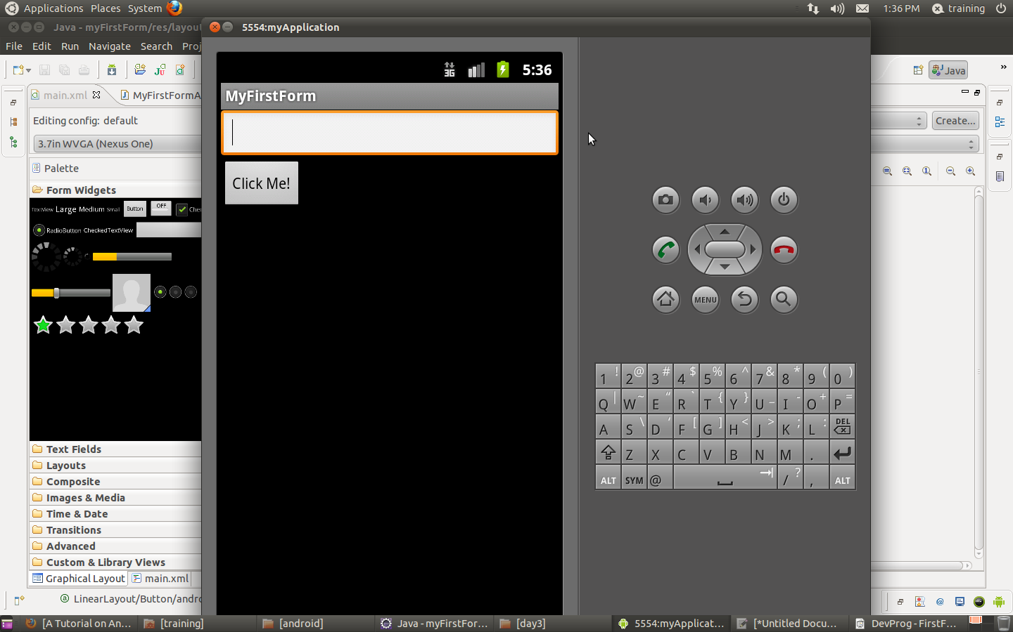
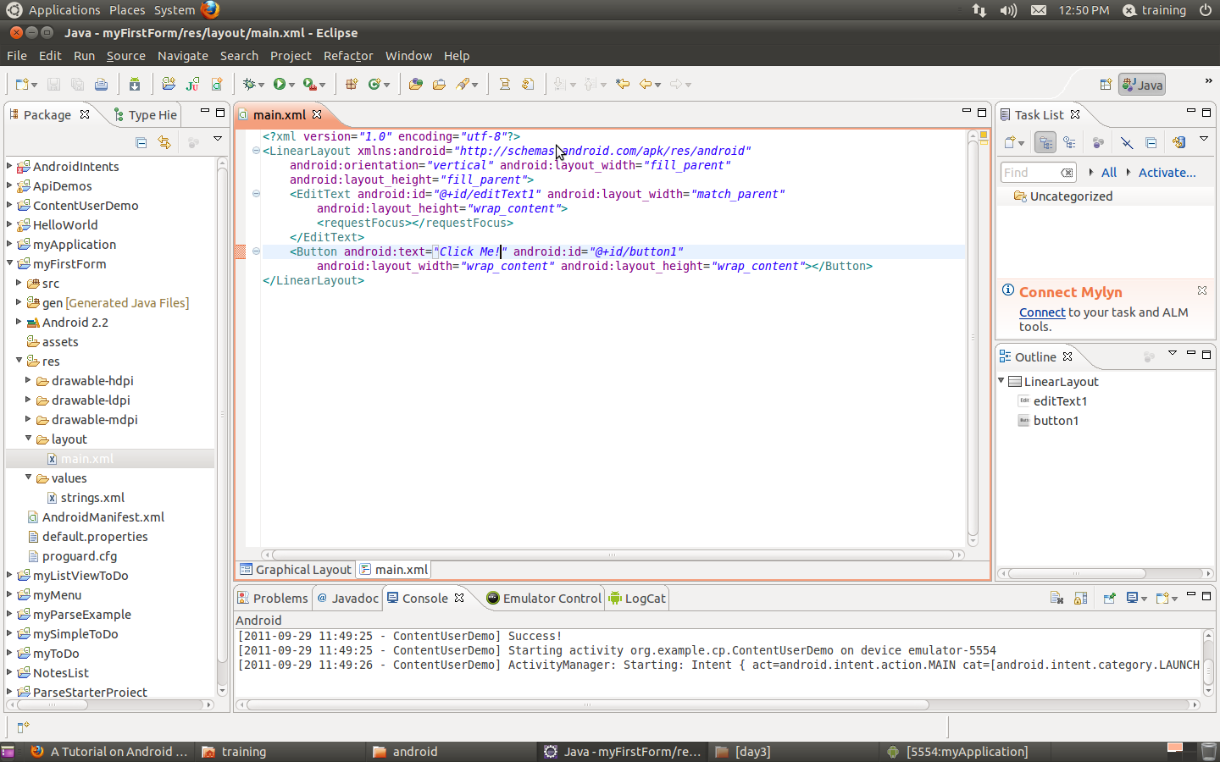
Modify main.xml in res\layout
Notes:
Modify the layout main.xml in the res\layout folder
It will contain one EditText (a textbox) and one Button

Slide 51
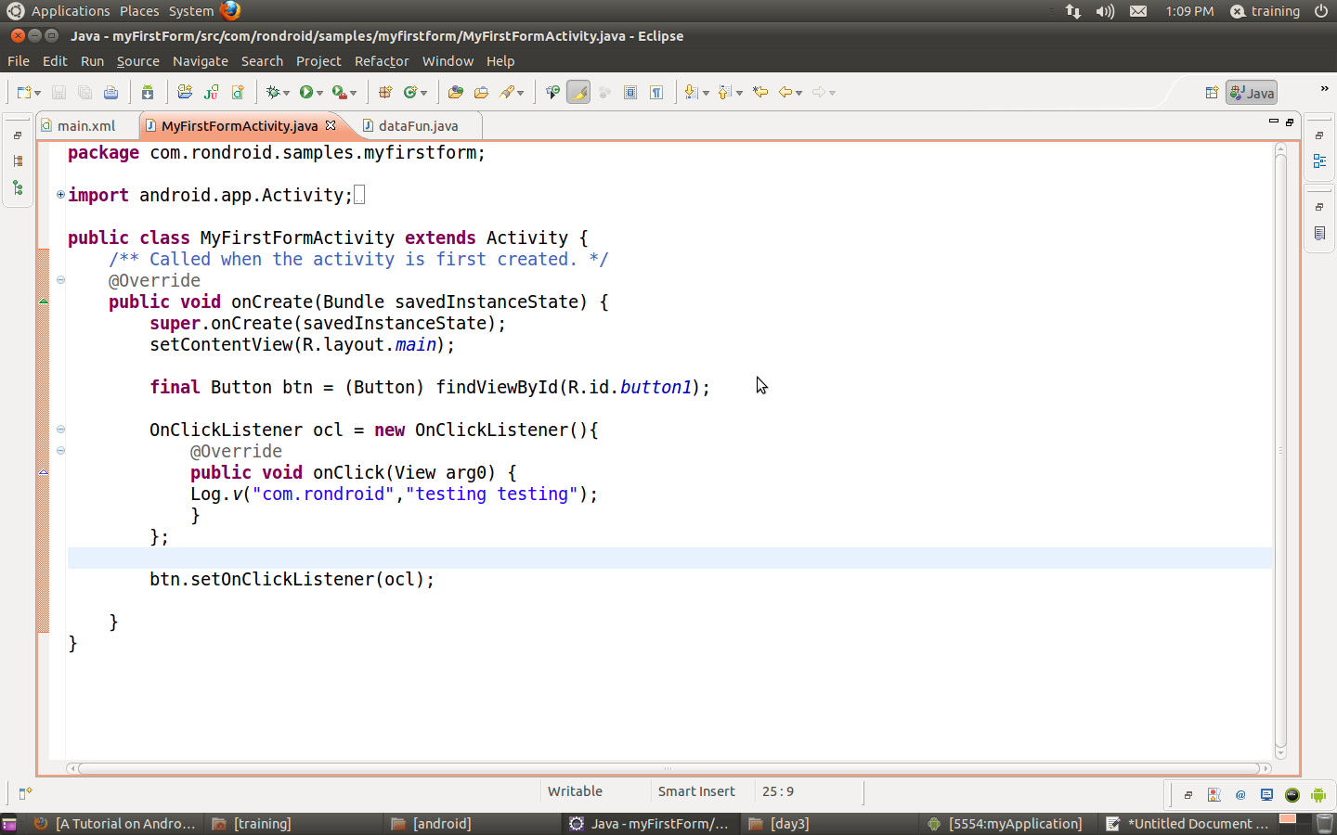
Modify the Activity
Notes:
Code the activity.
The activity will do the following:
1. Add an event listener (onClick) to the button
2. When someone clicks an entry will be posted to Android's built in log

Slide 52
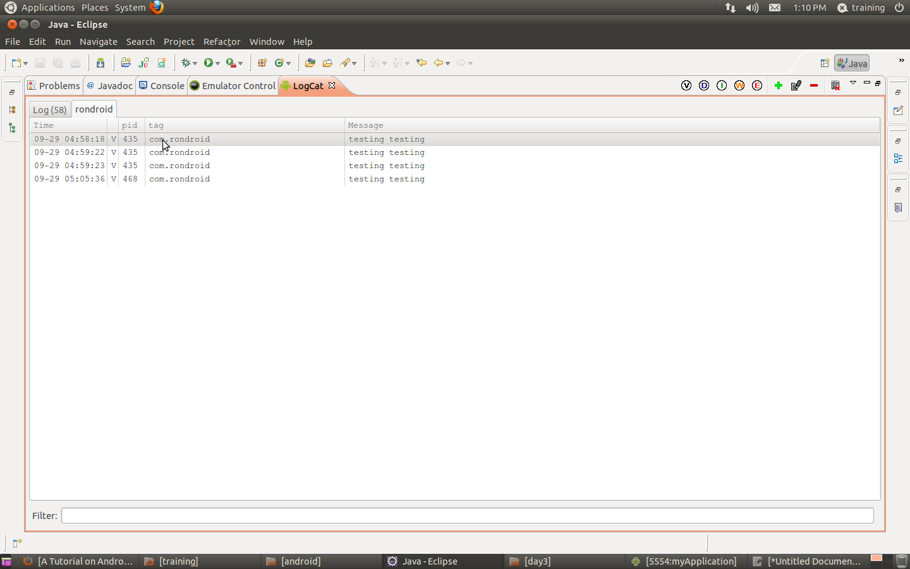
Run the Activity
Make sure you have the LogCat screen
Notes:
To see the result add a log filter to Eclipse's logcat window
Everytime you click on the button it will reflect in logcat

Slide 53
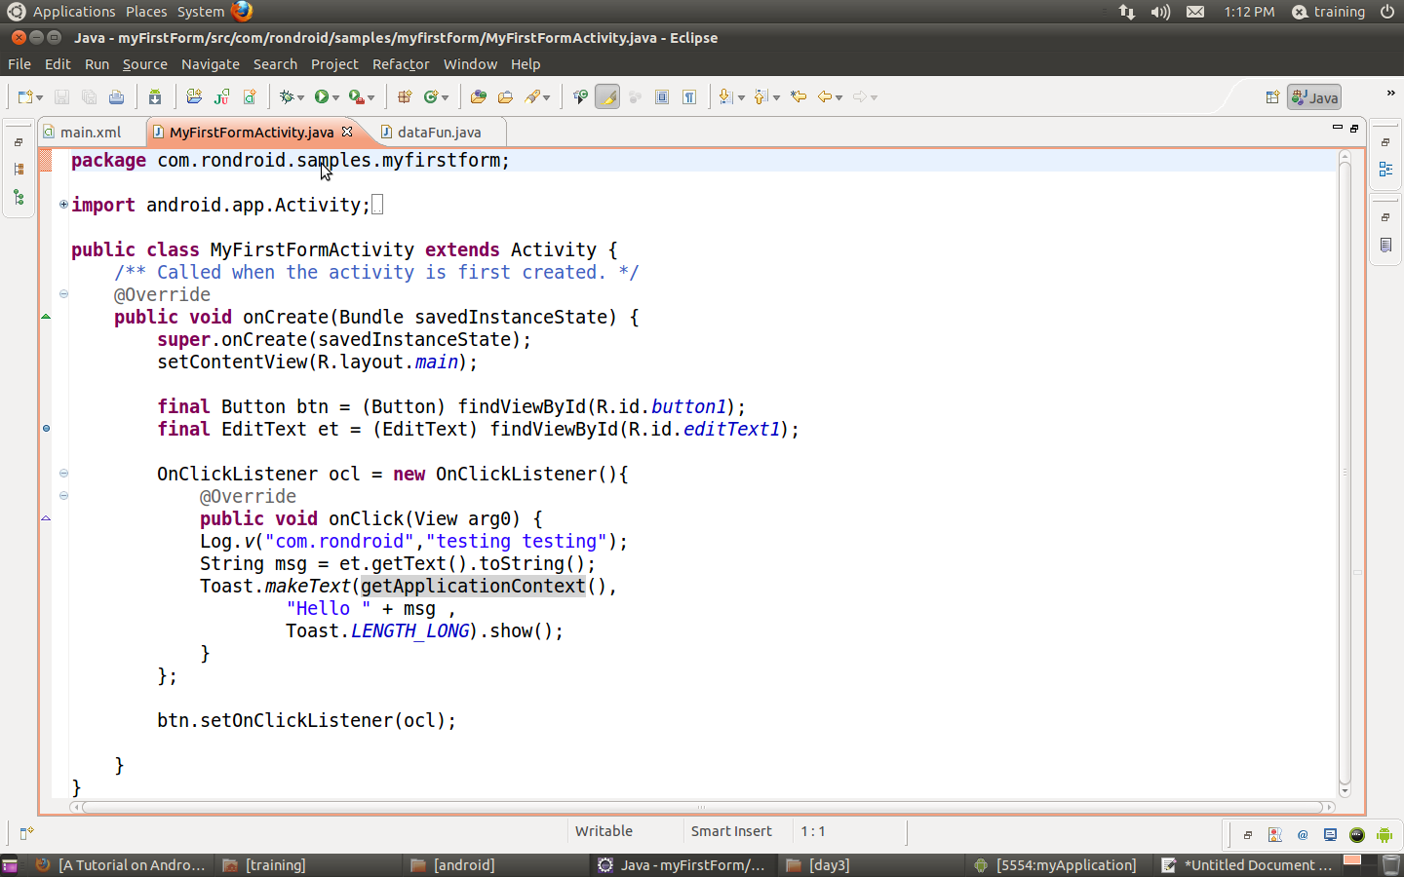
Modify the Activity again
Notes:
Now that we know our button is working we can add more complex code.
The code we are adding will get whatever text is in the EditText and display it in a pop-up message.

Slide 54
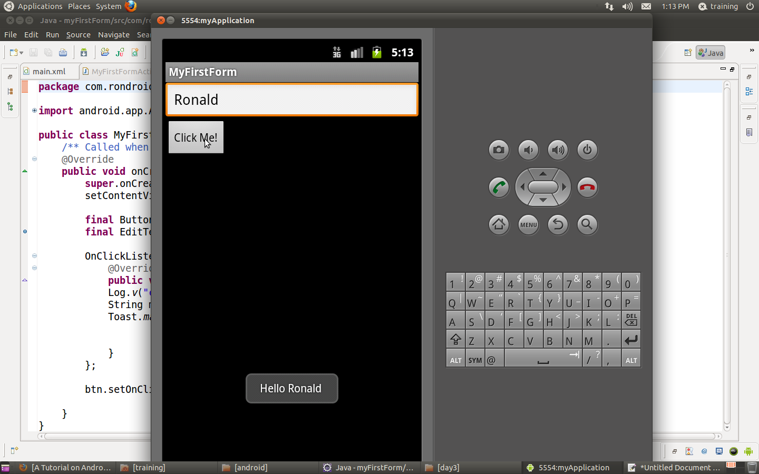
2nd run of application
Toast message appears on the screen reflecting value in EditText control

Slide 55
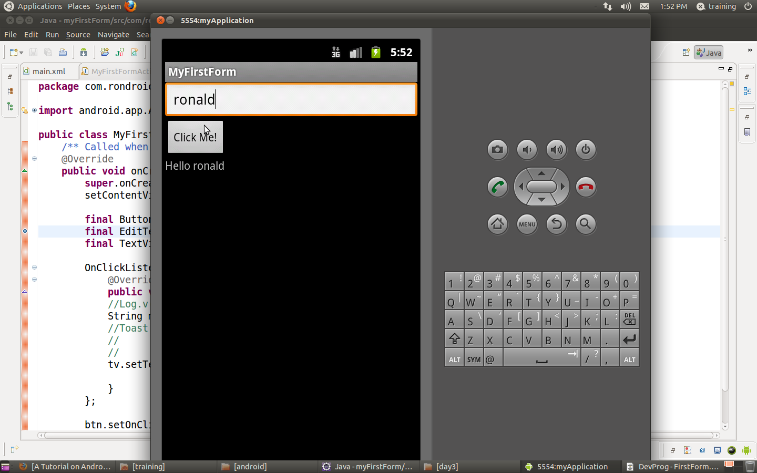
Example:
Create the following form
  It contains an EditText, Button and TextView
Whenever you click the button it will display ”Hello ” + the content of the EditText in the TextView

Slide 56
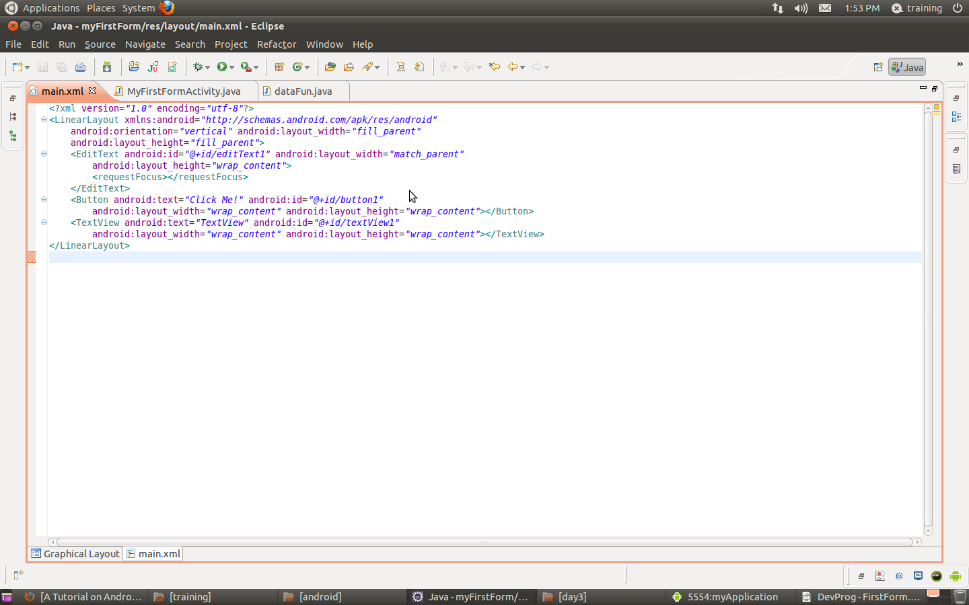
Main.xml

Slide 57
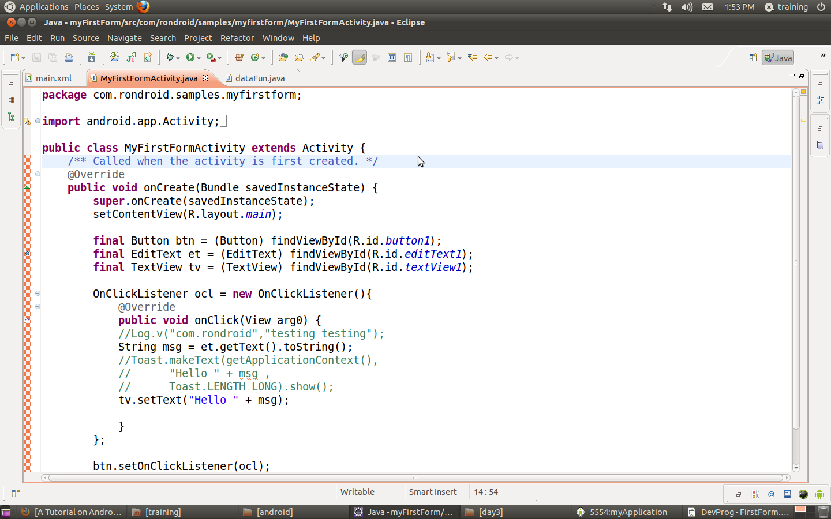
Activity code

Slide 58
END OF Day 1

