Slide 1
Android & Database
SWEEP Android Module 2
Ronald L. Ramos
April 3-5, 2017

Slide 2
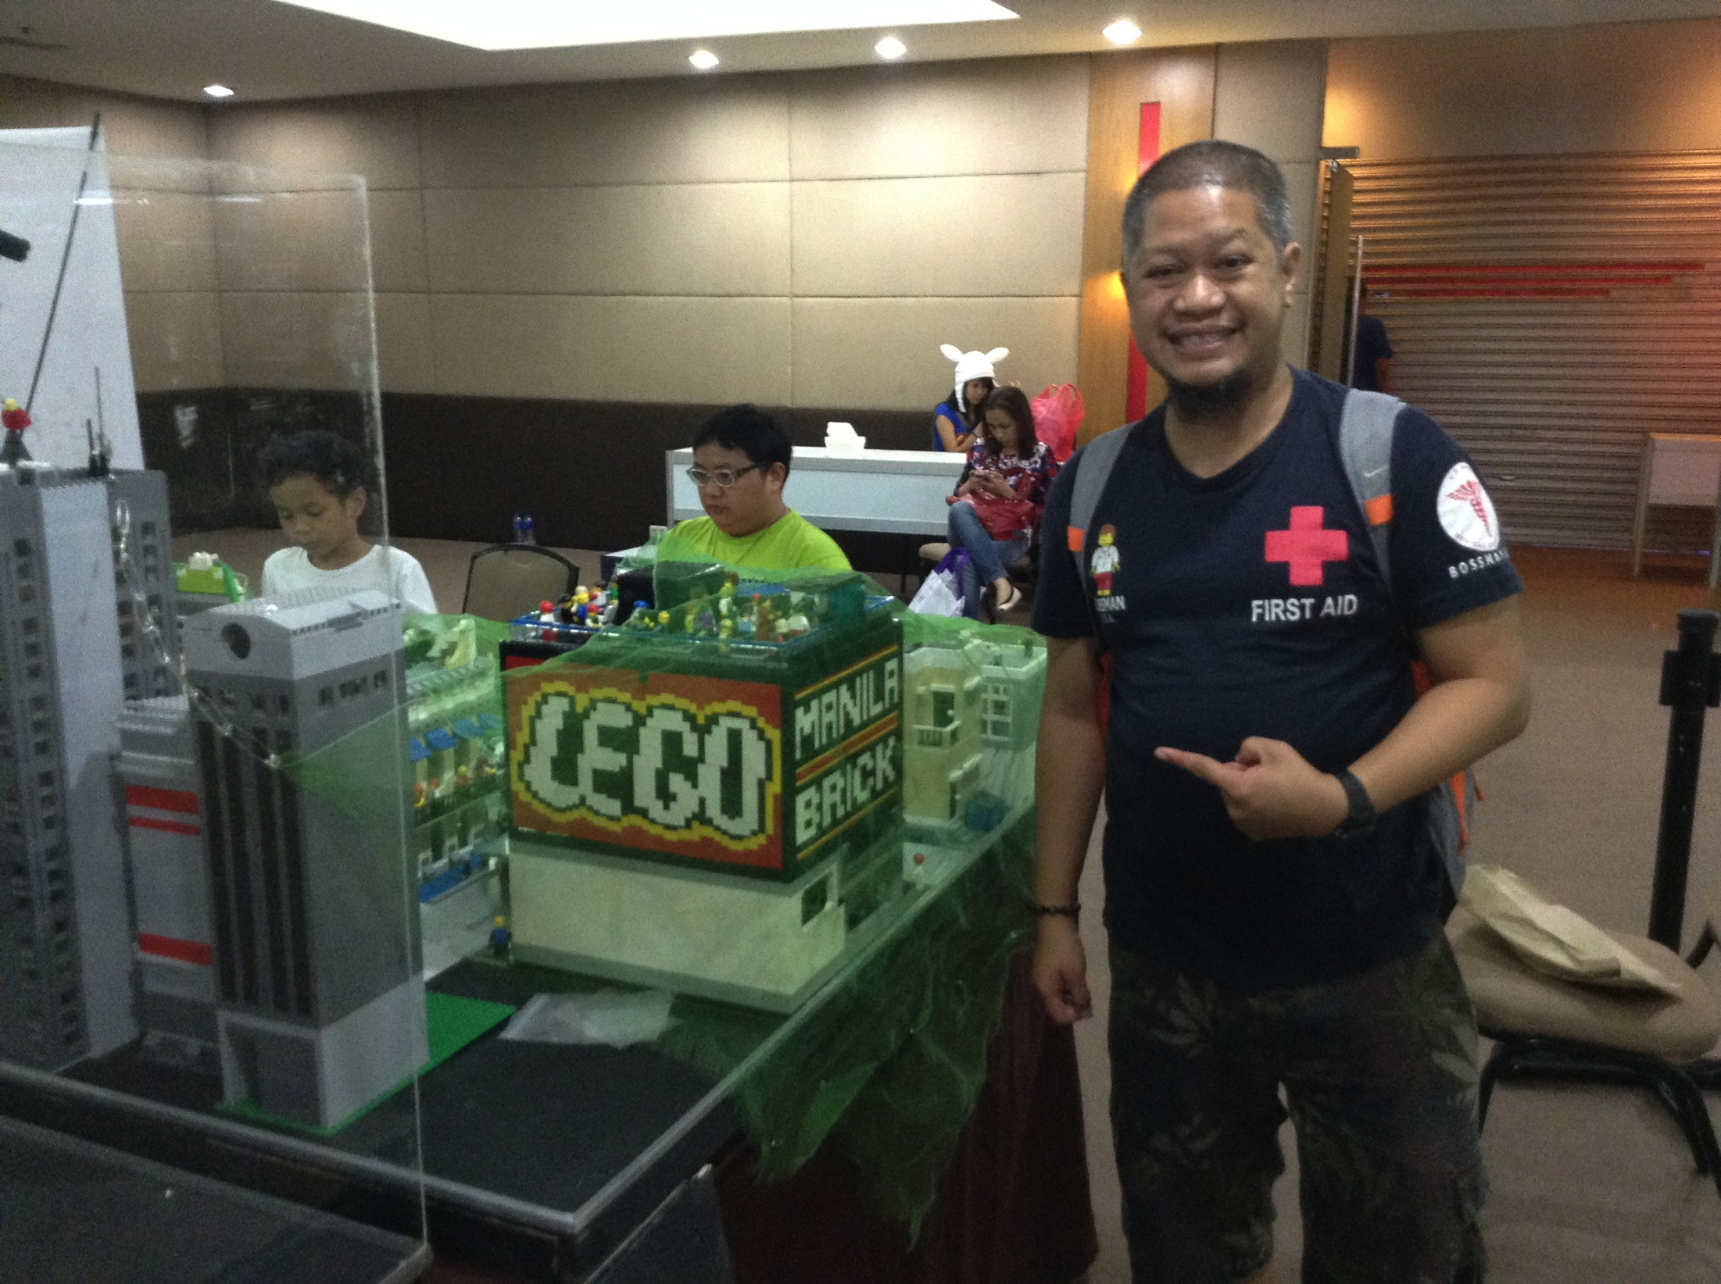
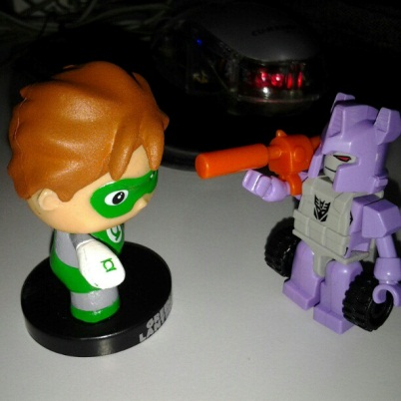
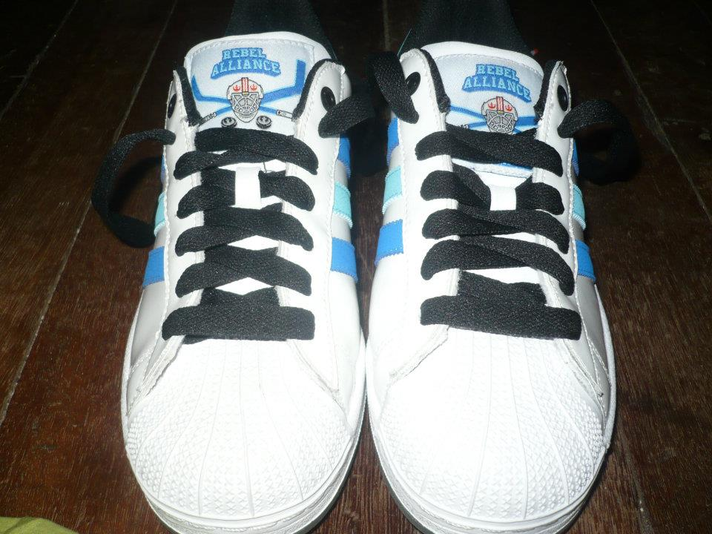
Ronald L. Ramos, Technology Group

Slide 3
Ronald L. Ramos
rlramos@smart.com.ph
09298874076/ 5113175
Twitter: @taleweaver
Facebook: rlramos@gmail.com
Blog: http://brickstories.blogspot.com
Instagram: taleweaver

Slide 4
Get the presentation here:
http://mobiledev.ronaldramos.info/ndmu2017/

Slide 5
Introduce yourself
Name/Nickname
Android Dev experience
Expectations for the training
Smartphone user? What’s your smartphone?
Favorite tv show? Why?

Slide 6
Topics
ListViews
Creating DBs local to the device

Slide 7
Presenting Data: Listviews

Slide 8
What is a ListView?
Android provides the view "ListView" which is capable of displaying a scrollable list of items.
"ListView" gets the data to display via an adapter.
An adapter which must extend "BaseAdapter" and is responsible for providing the data model for the list and for converting the data into the fields of the list.
Android has two standard adapters, ArrayAdapter and CursorAdapter .
"ArrayAdapter" can handle data based on Arrays or Lists
"SimpleCursorAdapter" handle database related data.
You can develop your own Adapter by extending these classes or the BaseAdapter class.

Slide 9
ListView Examples
Notes:
http://www.codelearn.org/android-tutorial/android-listview

Slide 10
ListItem
An Android listview is made from a group of list items.
List items are individual rows in listview where the data will be displayed.
Any data in listview is displayed only through listItem. Consider Listview as scrollable group of list items.
Notes:
An Android listview is made from a group of list items. List items are individual rows in listview where the data will be displayed. Any data in listview is displayed only through listItem. Consider Listview as scrollable group of list items.
List items are just layouts in a separate layout file. Let us understand the following example.
Android Listview Twitter tweet example
Here we can see a listitem for the twitter application. This list Item is arranged in a Relative layout with images and multiple text views aligned to each other. This is how an Android listview is designed.
Once we have the listitem, we bind the listview to the Adapter and then use list items to display the data in listview.

Slide 11
Main.xml
<?xml version="1.0" encoding="utf-8"?>
<LinearLayout android:id="@+id/LinearLayout01"
android:layout_width="fill_parent" android:layout_height="fill_parent"
xmlns:android="http://schemas.android.com/apk/res/android">
<ListView android:id="@+id/ListView01" android:layout_width="wrap_content"
android:layout_height="wrap_content" />
</LinearLayout>

Slide 12
Activity code
public class MyListViewActivity extends Activity {
/** Called when the activity is first created. */
private ListView lv1;
private String lv_arr[]={"Android","iPhone","BlackBerry","AndroidPeople"};
@Override
public void onCreate(Bundle savedInstanceState) {
super.onCreate(savedInstanceState);
setContentView(R.layout.main);
lv1=(ListView)findViewById(R.id.ListView01);
// By using setAdapter method in listview we an add string array in list.
lv1.setAdapter(new ArrayAdapter<String>(this,android.R.layout.simple_list_item_1 , lv_arr));
}

Slide 13
Adding Click Reactions
private ListView lv1;
private String lv_arr[]={"Android","iPhone","BlackBerry","AndroidPeople"};
@Override
public void onCreate(Bundle savedInstanceState) {
super.onCreate(savedInstanceState);
setContentView(R.layout.main);
lv1=(ListView)findViewById(R.id.ListView01);
lv1.setOnItemClickListener(this);
// By using setAdpater method in listview we an add string array in list.
lv1.setAdapter(new ArrayAdapter<String>(this,android.R.layout.simple_list_item_1 , lv_arr));
}
public void onItemClick(AdapterView arg0, View v, int position, long arg3) {
// TODO Auto-generated method stub
Toast.makeText(this, "u clicked " + lv_arr[position] ,Toast.LENGTH_LONG).show();
}

Slide 14
Adapters
Android Adapter is a bridge between the View (e.g. ListView) and the underlying data for that view. An adapter manages the data and adapts the data to the individual rows (listItems) of the view.
We bind the adapter with Android listview via setAdapter method.
Notes:
Adapter
Android Adapter is a bridge between the View (e.g. ListView) and the underlying data for that view. An adapter manages the data and adapts the data to the individual rows (listItems) of the view.
We bind the adapter with Android listview via setAdapter method. Now, Let us see how adapter works with the help of the following image.
Android Listview Adapters
As stated earlier, Adapters act as a bridge to the views. To interact with the view, adapters call the getView() method which returns a view for each item within the adapter view. This is a listitem which we have seen earlier. The layout format and the corresponding data for an item within the adapter view are set in the getView() method.
Once we have a reference to the view, we can get the data from the data source either in an Array list or a cursor. We can then bind the data to the view items. All this is done in getView Method. In coming sections, we will look as to how we can achieve this in our code.
Watchout: Typically as you scroll the listview to improve the performance and save time in creating a new view , Android recycles the views that go out of focus.
Typically you do not have to deal directly with the Adapter class. Android provides you commonly used Adapters like :
Array Adapter Cursor Adapter *Simple Cursor Adapter
Most of the time we tend to write our own Adapter by extending BaseAdapter
Watchout: Always remember that any adapter will always expect a Layout to be bound to(i.e listitem).

Slide 15
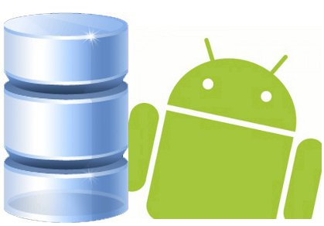
SQLite Databases and Android
Android’s built-in DB

Slide 16
SQLite is an Open Source Database which is embedded into Android. SQLite supports standard relational database features like SQL syntax, transactions and prepared statements. In addition it requires only little memory at runtime (approx. 250 KByte).
Using SQLite in Android does not require any database setup or administration. You specify the SQL for working with the database and the database is automatically managed for you.
Notes:
Working with databases in Android can be slow due to the necessary I/O. Therefore is it recommended to perform this task in an AsyncTask .
SQLite supports the data types TEXT (similar to String in Java), INTEGER (similar to long in Java) and REAL (similar to double in Java). All other types must be converted into on of these fields before saving them in the database. SQLite itself does not validate if the types written to the columns are actually of the defined type, you can write an integer into a string column.
If your application creates an database this database is saved in the directory "DATA/data/APP_NAME/databases/FILENAME". "DATA" is the path which Environment.getDataDirectory() returns, "APP_NAME" is your application name and "FILENAME" is the name you give the database during creation. Environment.getDataDirectory() usually return the SD card as location.
A SQlite database is private to the application which creates it. If you want to share data with other applications you can use a Content Provider.

Slide 17
SQLiteOpenHelper
To create and upgrade a database in your Android application you usually subclass "SQLiteOpenHelper". In this class you need to override the methods onCreate() to create the database and onUpgrade() to upgrade the database in case of changes in the database schema. Both methods receive an "SQLiteDatabase" object.
SQLiteOpenHelper provides the methods getReadableDatabase() and getWriteableDatabase() to get access to an "SQLiteDatabase" object which allows database access either in read or write mode.
For the primary key of the database you should always use the identifier "_id" as some of Android functions rely on this standard.

Slide 18
SQLiteDatabase methods
"SQLiteDatabase" provides the methods insert(), update() and delete() and execSQL() method which allows to execute SQL directly.
The object "ContentValues" allow to define key/values for insert and update. The key is the column and the value is the value for this column.
Queries can be created via the method rawQuery() which accepts SQL or query() which provides an interface for specifying dynamic data or SQLiteQueryBuilder.
Notes:
SQLiteBuilder is similar to the interface of an content provider therefore it is typically used in ContentProviders. A query always returns a "Cursor".
The method query has the parameters String dbName, int[] columnNames, String whereClause, String[] valuesForWhereClause, String[] groupBy, String[] having, String[] orderBy. If all data should be selected you can pass "null" as the where clause. The where clause is specified without "where", for example "_id=19 and summary=?". If several values are required via ? you pass them in the valuesForWhereClause array to the query. In general if something is not required you can pass "null", e.g. for the group by clause.

Slide 19
Cursor
A Cursor represents the result of a query. To get the number of elements use the method getCount(). To move between individual data rows, you can use the methods moveToFirst() and moveToNext(). Via the method isAfterLast() you can check if there is still some data.
A Cursor can be directly used via the "SimpleCursorAdapter" in ListViews.

Slide 20
A Sample DB App
Getting your hands dirty…

Slide 21
Create a new project

Slide 22
Create a new project

Slide 23
Create a new project

Slide 24
How the app components are split
App layer
UI
Data storage layer
application specific and deals with creating the database and operations on it but these are still database independent.
SQLite layer
deals with DB access
Specific operations through a db helper
Notes:
Systems Design
While the app is very simple the plumbing around constructing a database is complex at first. The layered architecture is shown i the figure below. The operation on the SQLite database is wrapped in a few layers of abstraction. I view these layers as follows:
app layer -- just deals with comments and the UI
data storage layer -- application specific and deals with creating the database and operations on it but these are still database independent.
SQLIte layer -- this deals with all the plumbing and database
specific operations through a db helper
You won't see these layers necessarily like this in the literature but I think it helps explain the architecture and operations. There is a separation of concerns: the app deals with objects that matter to it, i.e., comments; and the lower layers deal with storage of data, and eventually the detail operations of an SQL database. You want to hide these details from the user. For example, I'm sure you are thinking -- why make this so hard? Why not have the app reach down into the SQLite code and just leave it like that. But we use abstraction -- of layering -- to hid the grubby details from the app layer.

Slide 25
Person class
Notes:
This class will represent one record in the table. The application simply allows the user to add names to the database and display them to the UI. Names can be added one at a time, deleted (from the top) one at a time or all names can be deleted. So Person is the main object that the user deals with. The Person class includes getters/setters for id and name. Every time a person needs to be added a Person is instantiated. The Person class is the app model and contains the data that is inserted, queried and deleted in the database. Names are also shown in the UI.
CODE:
package ronaldramos.info.myinternaldbsample; /** * Class to hold a single Person (1 record) */ public class Person { private long id; private String name; public void setId(long id){ this.id = id; } public long getId(){ return this.id; } public void setName(String name){ this.name = name; } public String getName(){ return this.name; } // Will be used by the ArrayAdapter in the ListView @Override public String toString() { return name; } }

Slide 26
SQLiteHelper class
Notes:
The MySQLiteHelper (which extends SQLiteOpenHelper) implements the helper class to manage database creation and version management. It implements onCreate() and onUpgrade() to take care of opening the database if it exists, creating it if it does not, and upgrading it as necessary. Transactions are used to make sure the database is always in a sensible state (e.g., database.execSQL(DATABASE_CREATE)).
Code:
package ronaldramos.info.myinternaldbsample; import android.content.Context; import android.database.sqlite.SQLiteDatabase; import android.database.sqlite.SQLiteOpenHelper; import android.util.Log; /**Class to facilitate creation and upgrade of DB*/ public class MySQLiteHelper extends SQLiteOpenHelper { public static final String TABLE_NAME = "persons"; public static final String COLUMN_ID = "_id"; public static final String COLUMN_NAME = "name"; private static final String DATABASE_NAME = "personsDB"; private static final int DATABASE_VERSION = 1; // Database creation sql statement private static final String DATABASE_CREATE = "create table " + TABLE_NAME + "(" + COLUMN_ID + " integer primary key autoincrement, " + COLUMN_NAME + " text not null);"; public MySQLiteHelper(Context context) { super(context, DATABASE_NAME, null, DATABASE_VERSION); } @Override public void onCreate(SQLiteDatabase database) { database.execSQL(DATABASE_CREATE); } @Override public void onUpgrade(SQLiteDatabase db, int oldVersion, int newVersion) { Log.w(MySQLiteHelper.class.getName(), "Upgrading database from version " + oldVersion + " to " + newVersion + ", which will destroy all old data"); db.execSQL("DROP TABLE IF EXISTS " + TABLE_NAME); onCreate(db); } }

Slide 27
The Data Storage Layer: DBHelper class
Notes:
DBHelpermaintains the database connection and supports adding, fetching and deleting comments. CommentsDataSource creates the MySQLiteHelper class which details with the actual SQLite database. Very little of the internal details of the SQLite layer are exposed to the data storage layer, as you can see in the code below. The database constants such as the column names are exposed; in our case just one column name: COLUMN_COMMENT and the column ID: COLUMN_ID. These database constants are made public by the SQLite layer discussed in the next section. These public constants are needed for inserting and querying comment objects in the database.
The constructor creates the database. It first creates a db helper MySQLiteOpenHelper to deal with operations on the database. After the db helper is created the constructor opens the database, as shown the code below.
The database is a SQLiteDatabase object, exposing methods to manage a SQLite database. SQLiteDatabase has methods to create, delete, execute SQL commands, and perform other common database management tasks.
The code calls getWritableDatabase() to open and obtain a writable instance of the underlying database using the db helper implemented in the SQLite layer. If the database does not exist the helper executes its onCreate() handler -- see MySQLiteHelper code. Whether the database has already been created or not the getWritableDatabase() returns a reference to the database.
When a database has been opened successfully for the first time it will be cached by the MySQLiteHelper within MySQLiteHelper. If there is an exception in trying to open the database due to an error with SQL parsing or execution then an SQLException is thrown.
The code below shows the initial functionality of DBHelper
Code:
package ronaldramos.info.myinternaldbsample; import android.content.Context; import android.database.sqlite.SQLiteDatabase; import java.sql.SQLException; /**Class to facilitate data manipulation.*/ public class DBHelper { // Database fields private SQLiteDatabase database; private MySQLiteHelper SQLHelper; private String[] allColumns = { MySQLiteHelper.COLUMN_ID, MySQLiteHelper.COLUMN_NAME }; private static final String TAG = "DBDEMO"; public DBHelper(Context context) { SQLHelper = new MySQLiteHelper(context); } public void open() throws SQLException { database = SQLHelper.getWritableDatabase(); } public void close() { SQLHelper.close(); } }

Slide 28
App specific operations on storage: insert and deleting
The data storage layer also provides the key operations on the database in terms of the application specific data object, in our case: Person. These operations are:
createPerson(String person), which inserts a Person in the database as content values. This method also issues a query to read back what was written.
deletePerson(Person person), which deletes a Person
deleteAllPersons(), empties the database.
getAllPersons() , which gets all the persons listed in the DB

Slide 29
DBHelper – Create a Person
Notes:
CODE:
public Person createPerson(String name) { ContentValues values = new ContentValues(); values.put(MySQLiteHelper.COLUMN_NAME, name); long insertId = database.insert(MySQLiteHelper.TABLE_NAME, null, values); Cursor cursor = database.query(MySQLiteHelper.TABLE_NAME, allColumns, MySQLiteHelper.COLUMN_ID + " = " + insertId, null, null, null, null); cursor.moveToFirst(); Person newPerson = cursorToPerson(cursor); // Log the comment stored Log.d(TAG, "comment = " + cursorToPerson(cursor).toString() + " insert ID = " + insertId); cursor.close(); return newPerson; }

Slide 30
DBHelper – Delete records
Notes:
CODE:
public void deletePerson(Person person) { long id = person.getId(); Log.d(TAG, "delete comment = " + id); System.out.println("Person deleted with id: " + id); database.delete(MySQLiteHelper.TABLE_NAME, MySQLiteHelper.COLUMN_ID + " = " + id, null); } public void deleteAllPersons() { System.out.println("All persons deleted all"); Log.d(TAG, "delete all = "); database.delete(MySQLiteHelper.TABLE_NAME, null, null); }

Slide 31
DBHelper – Other functions
Notes:
CODE:
public List<Person> getAllComments() { List<Person> persons = new ArrayList<Person>(); Cursor cursor = database.query(MySQLiteHelper.TABLE_NAME, allColumns, null, null, null, null, null); cursor.moveToFirst(); while (!cursor.isAfterLast()) { Person person = cursorToPerson(cursor); Log.d(TAG, "get comment = " + cursorToPerson(cursor).toString()); persons.add(person); cursor.moveToNext(); } // Make sure to close the cursor cursor.close(); return persons; } private Person cursorToPerson(Cursor cursor) { Person person = new Person(); person.setId(cursor.getLong(0)); person.setName(cursor.getString(1)); return person; }

Slide 32
Using the Helper Classes

Slide 33
The App

Slide 34
Main XML
Notes:
CODE:
<?xml version="1.0" encoding="utf-8"?> <RelativeLayout xmlns:android="http://schemas.android.com/apk/res/android" xmlns:tools="http://schemas.android.com/tools" android:layout_width="match_parent" android:layout_height="match_parent" android:paddingLeft="@dimen/activity_horizontal_margin" android:paddingRight="@dimen/activity_horizontal_margin" android:paddingTop="@dimen/activity_vertical_margin" android:paddingBottom="@dimen/activity_vertical_margin" tools:context=".MainActivity"> <LinearLayout android:layout_width="match_parent" android:layout_height="wrap_content" android:orientation="horizontal" android:id="@+id/linearLayout" android:gravity="center"> <Button android:layout_width="wrap_content" android:layout_height="wrap_content" android:text="ADD" android:id="@+id/add" android:onClick="process" /> <Button android:layout_width="wrap_content" android:layout_height="wrap_content" android:text="Delete" android:id="@+id/delete" android:onClick="process" /> <Button android:layout_width="wrap_content" android:layout_height="wrap_content" android:text="Delete All" android:id="@+id/deleteAll" android:onClick="process" /> </LinearLayout> <EditText android:layout_width="match_parent" android:layout_height="wrap_content" android:id="@+id/inputName" android:layout_below="@+id/linearLayout" android:layout_alignParentLeft="true" android:layout_alignParentStart="true" /> <ListView android:layout_width="wrap_content" android:layout_height="wrap_content" android:id="@+id/listView" android:layout_below="@+id/inputName" android:layout_alignParentLeft="true" android:layout_alignParentStart="true" /> </RelativeLayout>

Slide 35
MainActivity
onCreate()
Process()
Notes:
CODE
package ronaldramos.info.myinternaldbsample; import android.os.Bundle; import android.support.v7.app.AppCompatActivity; import android.view.View; import android.widget.ArrayAdapter; import android.widget.EditText; import android.widget.ListView; import java.sql.SQLException; import java.util.List; import java.util.Random; public class MainActivity extends AppCompatActivity{ private DBHelper datasource; @Override protected void onCreate(Bundle savedInstanceState) { super.onCreate(savedInstanceState); setContentView(R.layout.activity_main); datasource = new DBHelper(this); try{ datasource.open(); } catch (Exception e){ } ListView lv = (ListView)findViewById(R.id.listView); List<Person> values = datasource.getAllComments(); // Use the SimpleCursorAdapter to show the // elements in a ListView ArrayAdapter<Person> adapter = new ArrayAdapter<Person>(this, android.R.layout.simple_list_item_1, values); lv.setAdapter(adapter); } public void process(View view) { @SuppressWarnings("unchecked") ListView lv = (ListView)findViewById(R.id.listView); ArrayAdapter<Person> adapter = (ArrayAdapter<Person>) lv.getAdapter(); Person person = null; EditText et = (EditText)findViewById(R.id.inputName); switch (view.getId()) { case R.id.add: String name = et.getText().toString(); // Save the new comment to the database person = datasource.createPerson(name); adapter.add(person); break; case R.id.delete: if (lv.getAdapter().getCount() > 0) { person = (Person) lv.getAdapter().getItem(0); datasource.deletePerson(person); adapter.remove(person); } break; case R.id.deleteAll: if (lv.getAdapter().getCount() > 0) { datasource.deleteAllPersons(); adapter.clear(); } break; } adapter.notifyDataSetChanged(); } }

Slide 36
END DAY 1

