Slide 1
Using the Text Field
Data Input and the on screen keyboard

Slide 2
The user interface

Slide 3
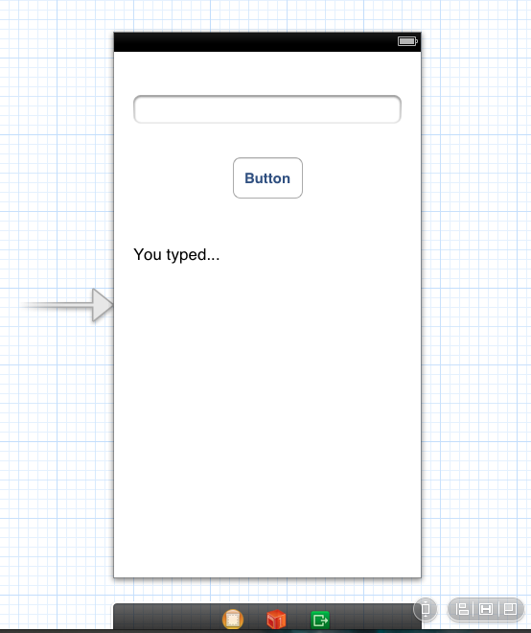
The user interface
Notes:
The user types a value in the text field and when the button is clicked the text is copied into the label

Slide 4
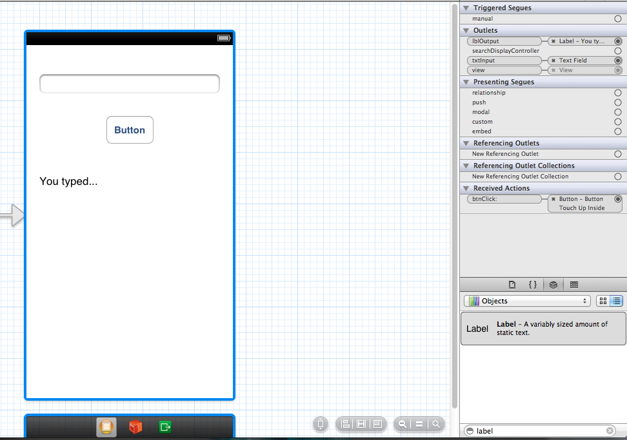
Connections
Notes:
IBOutlet is a special keyword that is used only to tell Xcode to treat the object as an outlet. It’s actually defined as nothing so it has no effect at compile time.
Xcode established a connection from the view controller to the text field.By establishing the connection between the view controller and the text field, the text that the user enters can be passed to the view controller. As Xcode did with the changeGreeting: method declaration, it indicates that the connection has been made by displaying a filled-in circle to the left of the text field declaration.
Note: Earlier versions of Xcode add an @synthesize directive in the implementation block for each property you declare using the Control-drag approach. Because the compiler automatically synthesizes accessor methods, these directives are unnecessary. You may safely delete them.
Now add an outlet for the label and configure the connection. Establishing a connection between the view controller and the label allows the view controller to update the label with a string that contains the user’s text.

Slide 5
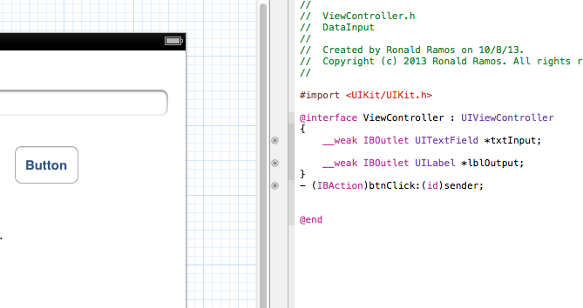
Connections (viewcontroller.h)

Slide 6
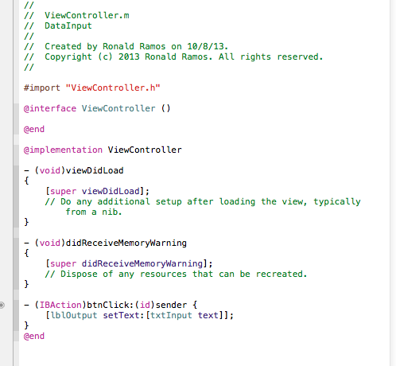
viewcontroller.m

Slide 7
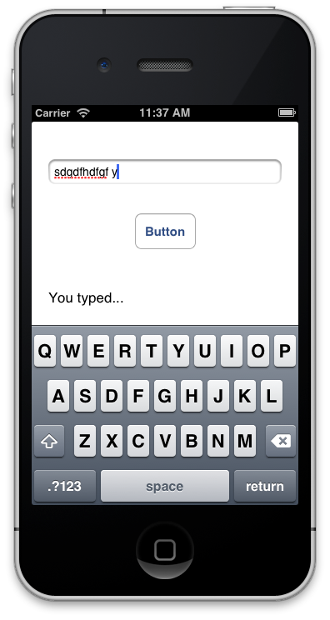
Run the App!
Notice how the keyboard does not disappear no matter where you click on the screen or no matter how many times you click on return.

Slide 8
Making the keyboard disappear

Slide 9
Delegates

Slide 10
The Delegate Pattern
Delegation is a simple and powerful pattern in which one object in a program acts on behalf of, or in coordination with, another object.
The idea behind delegates is that instead of class A executing some code, it tells it’s delegate to execute that code. The delegate is tied to another class (let’s call it class B).
  In order to facilitate this, class A creates something called a protocol. This protocol has a list of methods in it (with no definition).
  Class A then has an instance of the protocol as a property.
  Class B has to implement the protocol defined in class A.
  Lastly, when class A is created, it’s delegate property is set to class B.

Slide 11
Delegate Behavior
Let's assume an object A calls object B to perform an action, once the action is complete object A should know that B has completed the task and take necessary action. This is achieved with the help of delegates.
The key concepts in the above example are:
  A is delegate object of B
  B will have a reference of A
  A will implement the delegate methods of B.
  B will notify A through the delegate methods.

Slide 12
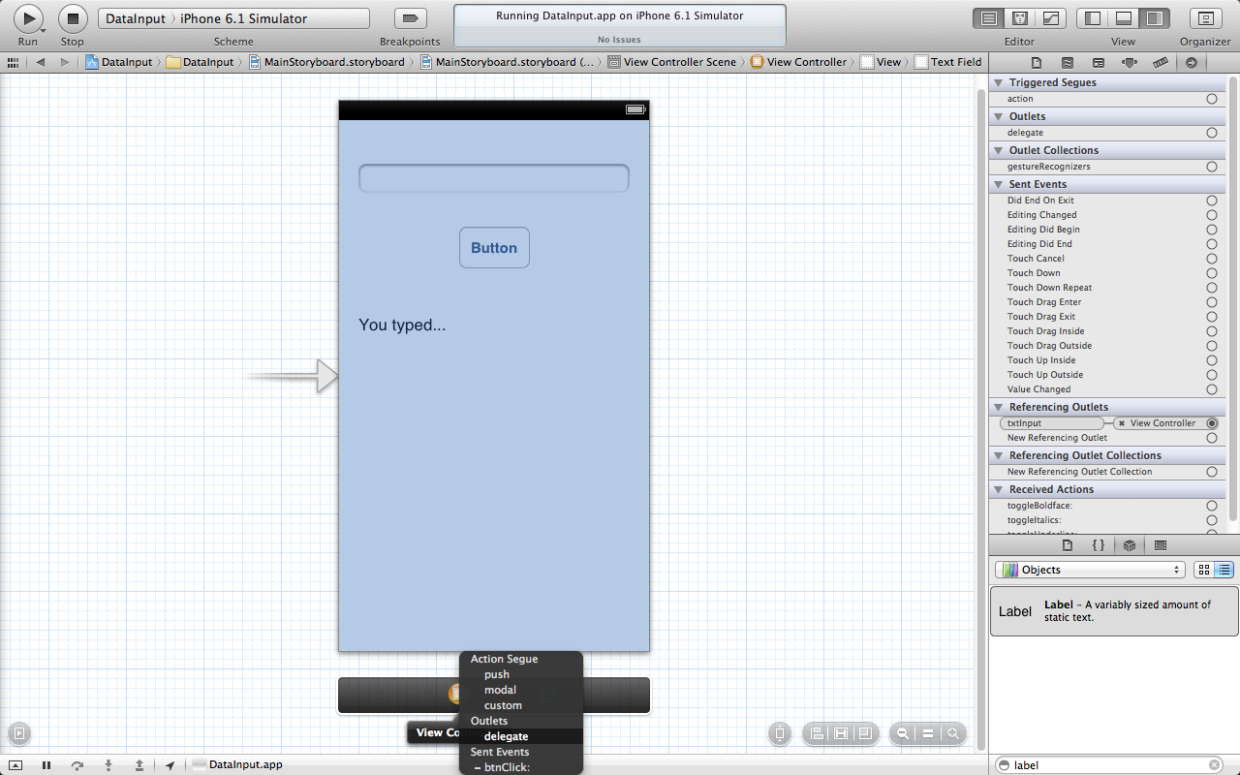
Setting up Text Field as a delegate of ViewController
Control-Drag the label to the yellow viewcontroller at the bottom of the iphone screen
You will get a pop up menu asking you what connection you want to set.
Select “delegate”
Notes:
In an iOS app, the keyboard is shown automatically when an element that allows text entry becomes the first responder; it is dismissed automatically when the element loses first responder status. (Recall that the first responder is the object that first receives notice of various events, such as tapping a text field to bring up the keyboard.) Although there’s no way to directly send a message to the keyboard from your app, you can make it appear or disappear as a side effect of toggling the first responder status of a text-entry UI element.
First Responder status is known as “getting focus” in other graphical based UI programming.

Slide 13
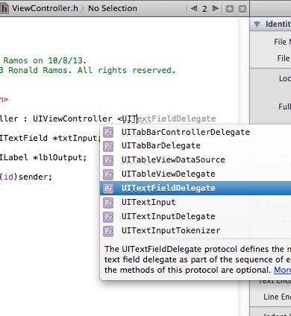
Referencing the UITextLabelDelegate
We add a reference to ViewController.h

Slide 14
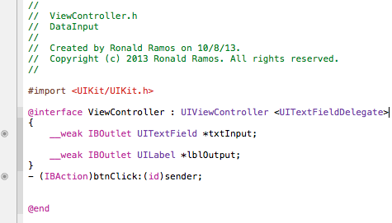
The TextFieldDelegate added to ViewController.h

Slide 15
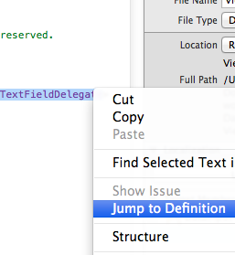
Getting the method definitions of the delegate
In ViewController.h select UITextFieldDelegate and right click on it
Select “Jump to Definition”

Slide 16
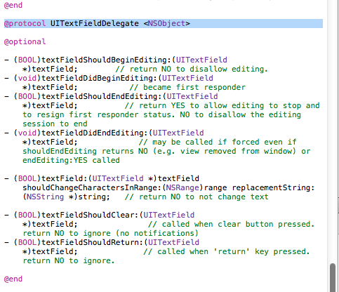
Getting the method definitions of the delegate
You will be taken to the template of the UITextFieldDelegate
Notice the skeleton methods defined in this section of code
These skeleton methods are know as the Protocols of the UITextFieldDelegate
Notes:
The UITextFieldDelegate protocol is defined by the UIKit framework, and it includes the textFieldShouldReturn: method that the text field calls when the user taps the Return button (regardless of the actual title of this button).
Note: A protocol is basically just a list of methods. If a class conforms to (or adopts) a protocol, it guarantees that it implements the required methods of a protocol. (Protocols can also include optional methods.) A delegate protocol specifies all the messages an object might send to its delegate.

Slide 17
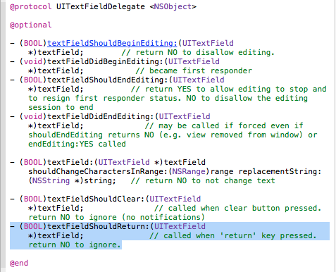
Getting the method definitions of the delegate
Copy the method skeleton for “textFieldShallReturn
This method is activated whenever the user taps on the “Return” button on the iOS keyboard
Notes:
Because you set the view controller as the text field’s delegate, you can implement this method to force the text field to lose first responder status by sending it the “resignFirstResponder” message—which has the side effect of dismissing the keyboard.

Slide 18
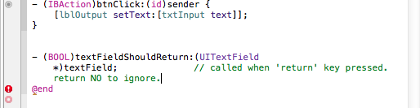
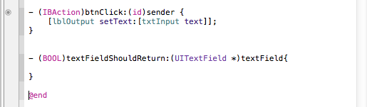
Paste the method skeleton to ViewController.m
Notes:
After copying the method skeleton from the UIKIT file we paste it in ViewController.m so that we can implement its code

Slide 19
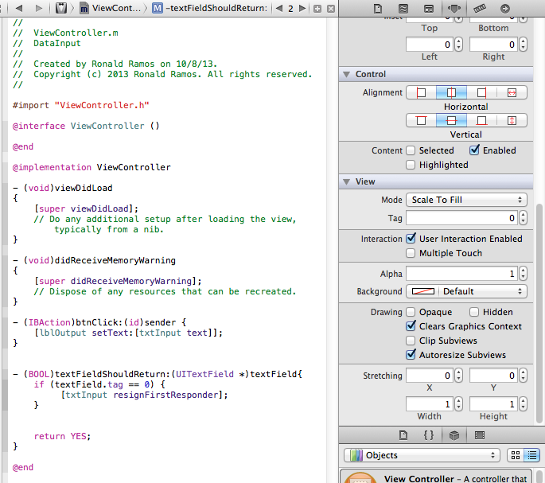
Implementing the method
Notes:
In this app, it’s not really necessary to test the (textField.tag == 0) expression because there’s only one text field. This is a good pattern to use, though, because there may be occasions when your object is the delegate of more than one object of the same type and you might need to differentiate between them.
Complete code for ViewController.m
//
// ViewController.m
// DataInput
//
// Created by Ronald Ramos on 10/8/13.
// Copyright (c) 2013 Ronald Ramos. All rights reserved.
//
#import "ViewController.h"
@interface ViewController ()
@end
@implementation ViewController
- (void)viewDidLoad
{
[super viewDidLoad];
// Do any additional setup after loading the view, typically from a nib.
}
- (void)didReceiveMemoryWarning
{
[super didReceiveMemoryWarning];
// Dispose of any resources that can be recreated.
}
- (IBAction)btnClick:(id)sender {
[lblOutput setText:[txtInput text]];
}
- (BOOL)textFieldShouldReturn:(UITextField *)textField{
if (textField.tag == 0) {
[txtInput resignFirstResponder];
}
return YES;
}
@end

Slide 20
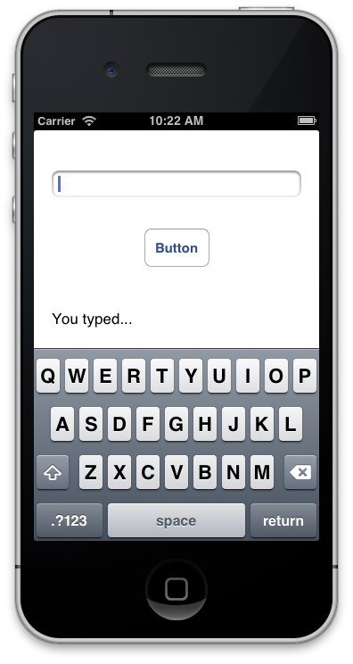
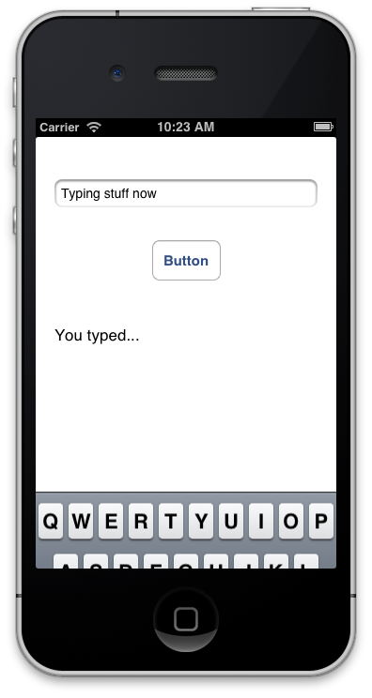
Run the app!
Tapping in the text box brings out the keyboard
Tapping on “Return” hides it again

Slide 21
END OF PRESENTATION

