Slide 1
Mobile Apps Overview
Ronald L. Ramos

Slide 2

A copy of this presentation can be found at:
http://mobiledev.ronaldramos.info/mobileapps/

Slide 3
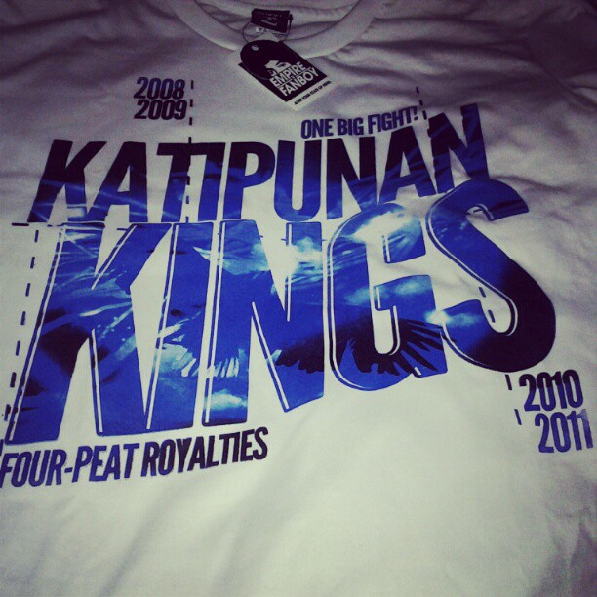
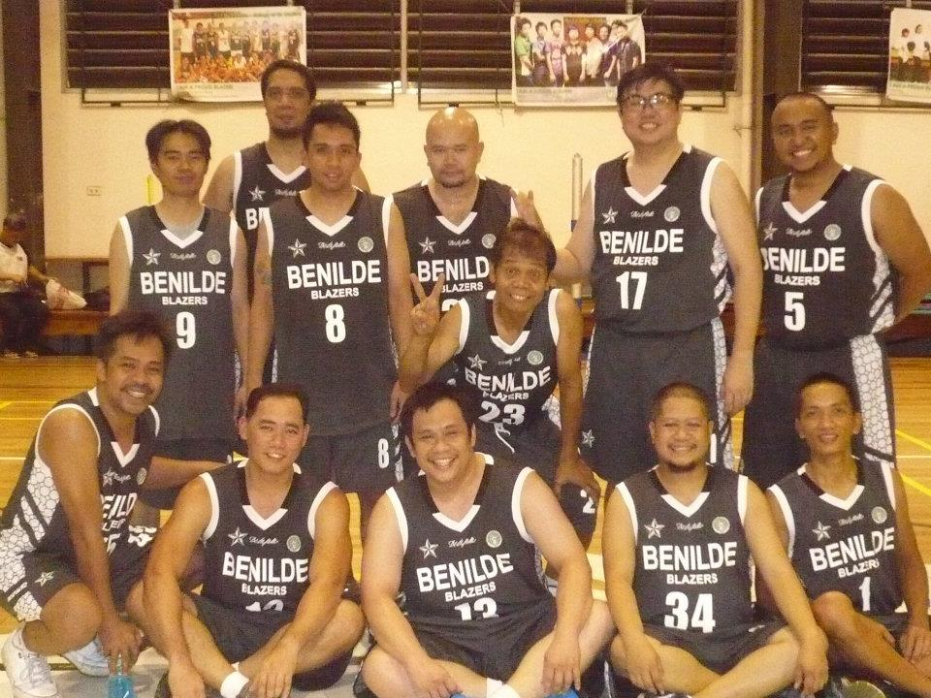
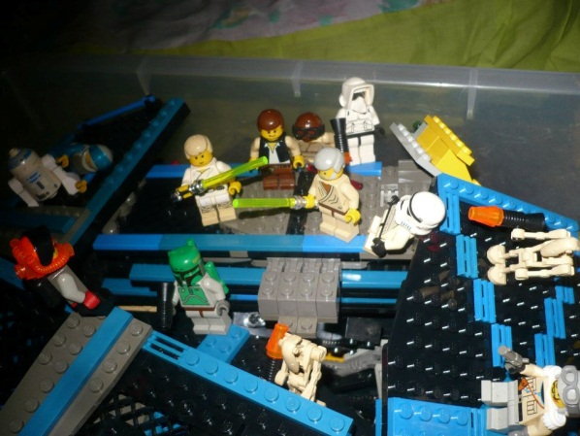
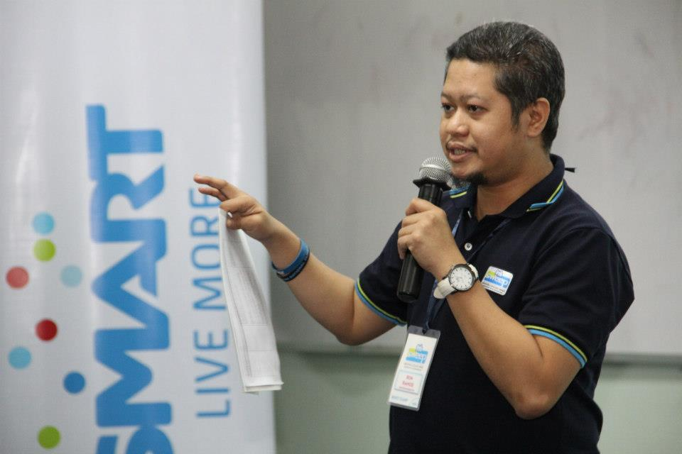


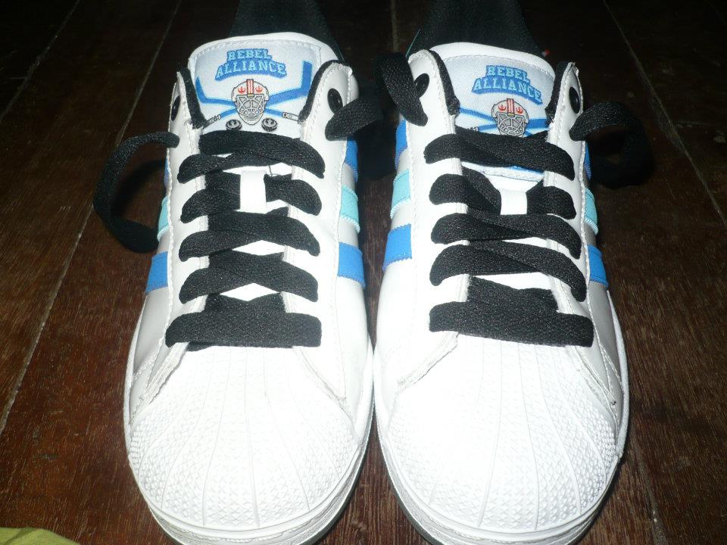
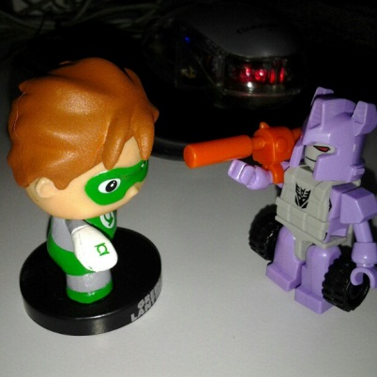
Hello I’m Ronald L. Ramos

Slide 4
The World of Apps
Mock-Ups
App Generators
Building more complex apps

Slide 5
It’s a world of mobile apps!

Slide 6

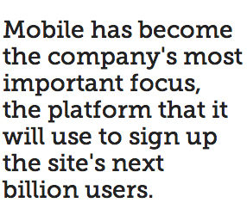
Mark Zuckerberg, Founder, Facebook
Notes:
Mobile has become the company's most important focus, the platform that it will use to sign up the site's next billion users. (And probably the billion after that, too.) Since launching native iOS and Android apps last fall, Facebook has taken a mobile first approach both publicly and internally.
The part of the company that was once a black eye is now the center of attention as Facebook advances on its quest to get the entire world not only onto the Internet, but onto the platform. “If you rewind like two years ago, everyone was, like, ‘mobile is coming, mobile is coming, mobile is coming,'" said Mike Vernal, Facebook's director of engineering. "For Facebook and specifically our developers, for the past year-plus we’ve just been focused on, ‘Ok, it’s just about mobile, how can we help mobile developers?'"
It's no secret that mobile users are important to the company. Of the 699 million daily active users who logged onto the site in June, more than two-thirds did so from a mobile device. Mobile ads (which didn't even exist a year ago) made up 41% of the company's total ad revenue in Q2, more than $655 million. Mobile users spend one in every five minutes online using Facebook; web users spend one in every seven minutes, Zuckerberg said.

Slide 7
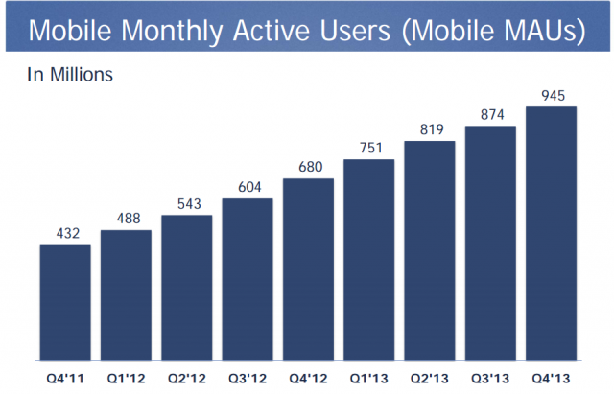
Monthly Active Users - FB
Notes:
Facebook now has 1.23 billion monthly active users, up 16% year-over-year. Even more impressive: Facebook's daily active users increased 22% year-over-year to 757 million.
For the 2013 fiscal year as a whole, Facebook generated $7.87 billion in revenue. That's up 55% from just more than $5 billion in the 2012 fiscal year.
The company's stock doubled in 2013 thanks to renewed confidence in the company's prospects on mobile, as well as optimism for new and existing revenue streams from video ads, Instagram ads and mobile app install ads.
The stock jumped by more than 5% in after hours trading following the earnings report.

Slide 8
Facebook’s Turn Around
Then:
  Facebook had fewer than 20 people on their core mobile team in early 2012
  Changes to the mobile app came every three to six months — compared to the desktop version, which was updated twice per day
Now:
  Zuckerberg refocused the company, giving each team mobile engineers and developers so that updates and new features could be built with the mobile experience in mind.
  “You know, we need to think about maybe putting mobile first and being a mobile-first company”
  "We realigned the company around, so everybody was responsible for mobile.” - Facebook Vice President of Business and Marketing Partnerships David Fischer, February (2013).
  Facebook has since put hundreds of engineers through week-long iOS and Android classes on campus
Notes:
Article Date: Sept. 2013
With such a major part of the company reliant on mobile, it's interesting to think how little attention was spent on building a great mobile offering even 18 months ago.
Eighteen months ago, Mark Zuckerberg was not happy with Facebook's mobile strategy. The world's largest social network was offering up a weak product — a hybrid app running on HTML5 instead of native apps for iOS and Android — essentially ignoring the platform (mobile) that it now deems most important. A change needed to be made, and Zuckerberg now openly admits it.
"We took a bad bet," the Facebook CEO said during last week's TechCrunch Disrupt conference in San Francisco. "Our legacy as a company was building this big website and focusing on being able to develop for the web. So naturally we tried to look at things and see if we could build an HTML5 system for across these different platforms and we just realized pretty quickly that we weren't going to get the quality level that we needed.
"So we took a year and it was painful and we retooled that.”
When Facebook decided to revamp its mobile approach last summer, Zuckerberg refocused the company, giving each team mobile engineers and developers so that updates and new features could be built with the mobile experience in mind. "[Mark] said, 'You know, we need to think about maybe putting mobile first and being a mobile-first company,'" Facebook Vice President of Business and Marketing Partnerships David Fischer told Fortune's Adam Lashinsky in February. "We realigned the company around, so everybody was responsible for mobile."
Facebook has since put hundreds of engineers through week-long iOS and Android classes on campus, Ondrejka said, and updates to the native apps come each month instead of three to four times a year.

Slide 9
App Development Costs
A study by backend-as-a-service (BaaS) platform provider AnyPresence revealed the majority of companies, 54 percent, are spending between $25,000 and $100,000 on each mobile apps they develop, whether it be for customer or employee use.
Additionally, another quarter are investing more than $100,000 into each app.
Notes:
http://www.businessnewsdaily.com/4773-cost-to-build-a-mobile-app.html
"The high cost of development among respondents reflects the inherent complexity of enterprise apps," said Richard Mendis, AnyPresence chief marketing officer and co-founder. "Whether the app is targeted at employees, partner, or customers, enterprise mobile applications can have sophisticated integration, security and performance needs that often make them more complex to develop, test and maintain than the typical consumer app."

Slide 10
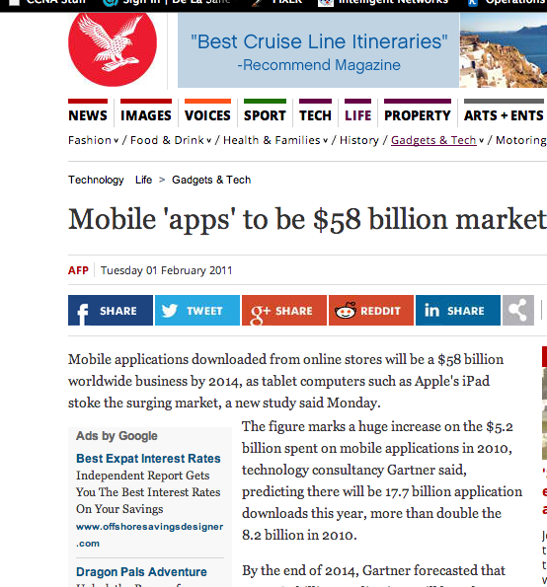
In 2011

Slide 11
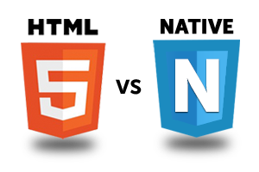
What type of Apps are out there?
Native Apps versus Hybrid/Web apps

Slide 12
What they are
Native Apps
Web Apps/Hybrid apps
an app developed essentially for one particular mobile device and is installed directly onto the device itself.
Users of native apps usually download them via app stores online or the app marketplace, such as the Apple App Store, the Google Play store and so on.
An example of a native app is the Camera+ app for Apple’s iOS devices.
basically Internet-enabled apps that are accessible via the mobile device’s Web browser.
They need not be downloaded to the user’s mobile device in order to be accessed.
The Safari browser is a good example of a mobile Web app.

Slide 13
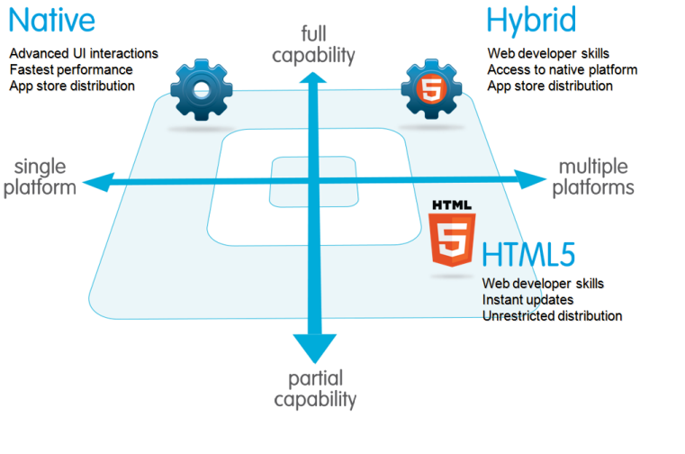
Native versus Hybrid/Web apps

Slide 14
Monetizing Smart Apps
Notes:
Version – increments of 1

Slide 15
App Monetization
Native Apps
Web Apps
App monetization with native apps can be tricky, since certain mobile device manufacturers may lay restrictions on integrating services with certain mobile ad platforms and networks.
The app store takes care of your revenue and commissions
Web apps enable you to monetize apps by way of advertisements, charging membership fees and so on
You need to setup your own payment system in case of a Web app.

Slide 16
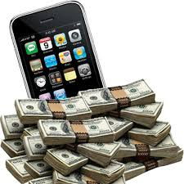
How to monetize in Apps?
Selling
Advertisement
Subscription fees

Slide 17

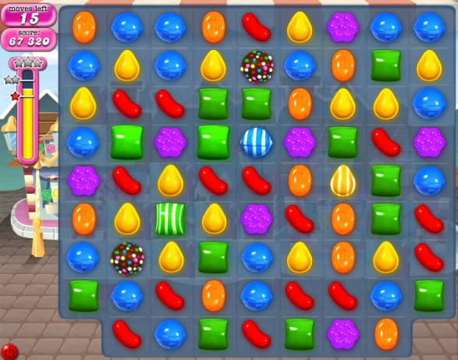

Free apps with in-app purchases generate
'majority of revenue'
source: Distimo, MEF report says free apps with in-app purchases generate 'majority of revenue' - FierceDeveloper http://www.fiercedeveloper.com/story/distimo-mef-report-says-free-apps-app-purchases-generate-majority-revenue/2013-11-05#ixzz2x8d1ergR

Slide 18
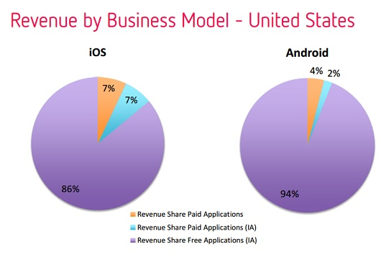
Market Stats
http://www.fiercedeveloper.com/story/distimo-mef-report-says-free-apps-app-purchases-generate-majority-revenue/2013-11-05 as of Nov 5 2013
Notes:
Pain points in creating a game
Game Concept – where the story will revolve
Mechanics – a construct of rules that makes the game engaging to players
In-App Purchase elements – will depend on the creativity of the mind, this is also where

Slide 19
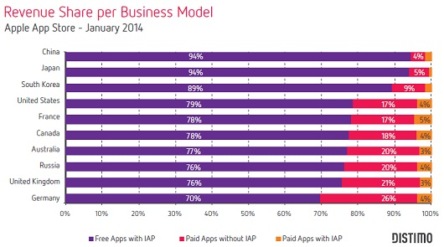
Market Stats
http://www.fiercedeveloper.com/story/distimo-app-purchases-accounted-79-ios-revenue-january/2014-03-24
Notes:
Pain points in creating a game
Game Concept – where the story will revolve
Mechanics – a construct of rules that makes the game engaging to players
In-App Purchase elements – will depend on the creativity of the mind, this is also where

Slide 20
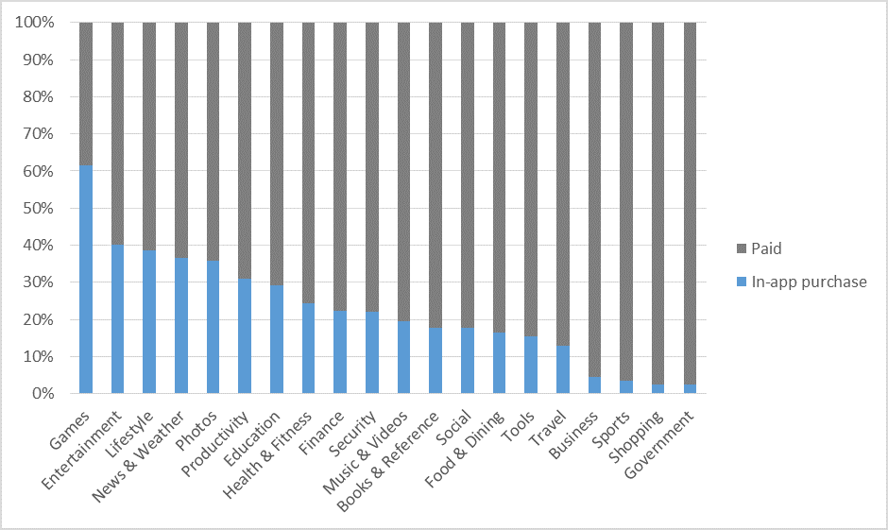
Market Stats
http://www.winbeta.org/news/fastest-growing-revenue-model-windows-store-app-purchases as of Feb 27, 2014
Notes:
Pain points in creating a game
Game Concept – where the story will revolve
Mechanics – a construct of rules that makes the game engaging to players
In-App Purchase elements – will depend on the creativity of the mind, this is also where

Slide 21
Anime Otaku Stats (In-App Billing)
Active Users for 15 days | 2372
In-App Purchases for 15 days | $ 77.00
In-App Purchase per Active User | $ 0.032462
10M Users (1 month extrapolated) | $324,620.57 | Php 14,283,305.23
25M Users (1 month extrapolated) | $811,551.43 | Php 35,708,263.07
Notes:
Pain points in creating a game
Game Concept – where the story will revolve
Mechanics – a construct of rules that makes the game engaging to players
In-App Purchase elements – will depend on the creativity of the mind, this is also where

Slide 22
Mobile Ads Integration
AdMob for Android (and/or iOS)
  If Dev account to be associated to the AdMob account will apply as a company, bank account where the ad revenue will be credited should be under the company’s name.
  In-house ads can also be used for cross-selling company’s products and services
  Unwanted ads from competitors can also be blocked
iAd for iOS
  Earn 70% of ad revenue generated
  Can run only on iOS apps compatible for iOS4 or later
  Optimized for rich user experience when using Apple devices. Highly recommended for iOS apps

Slide 23
Anime Otaku Stats (Ad Revenue)
Active Users for the Month | 11,860
Ad Revenue for the Month | $435.17
Ad Revenue per Active User | $0.036692
10M Users | $366,922.43 | Php 16,144,586.85
25M Users | $917,306.07 | Php 40,361,467.12
Notes:
Pain points in creating a game
Game Concept – where the story will revolve
Mechanics – a construct of rules that makes the game engaging to players
In-App Purchase elements – will depend on the creativity of the mind, this is also where

Slide 24
Potential Revenue for Smart
¹As of August 2013, the PLDT group’s subscriber base is 74.4 million (combined subscriber base of Smart, Talk N Text and Sun)
Assuming that among the 74.4 million subscribers, 40% are smart phone users of which 20% are ACTIVE app users, if we are to incorporate In-App purchases and/or Ads for mobile apps which can be used across brands:
*Projection for 1 month assuming users will be frequently using the app . Also note that this does not use Smart’s operator
billing functionality or Mobile Ads platform.
What more if we create apps that can be Smart-themed (colors, graphics style) but not limited for use of Smart, TnT or Sun subscribers (Games, Productivity Tools etc.)? ☺
Number of Active Users | Revenue Stream | Potential Revenue | Est. Potential Revenue in PHP ($1=43.99)
5.952 M | In-App Billing | $193,213.82 | 8,499,475.941
 | Mobile Ads | $218,390.78 | 9,607,010.412

Slide 25
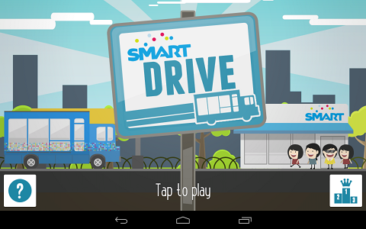
Analyzing Smart Drive
- Showcase Smart brand
- The App is for Cross-Sell not for Upsell
- Most effective way to make it revenue generating is through ad revenue

Slide 26
Create an “In-app purchase” ready game
Game Concept
Mechanics
In-app purchase elements
Notes:
Pain points in creating a game
Game Concept – where the story will revolve
Mechanics – a construct of rules that makes the game engaging to players
In-App Purchase elements – will depend on the creativity of the mind, this is also where

Slide 27
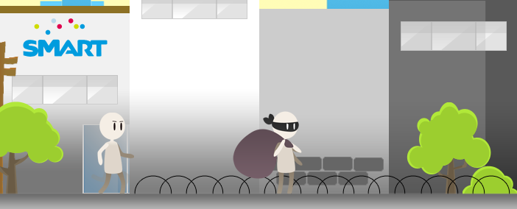
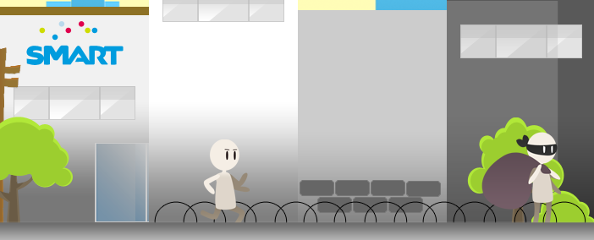
Game Concept: Food Chaser
It is about Cylol chasing the bad guy who robbed a food shop.
Cylol must catch the bad guy and other members of the gang in order to retrieve what was stolen.
Notes:
Pain points in creating a game
Game Concept – where the story will revolve
Mechanics – a construct of rules that makes the game engaging to players
In-App Purchase elements – will depend on the creativity of the mind, this is also where

Slide 28
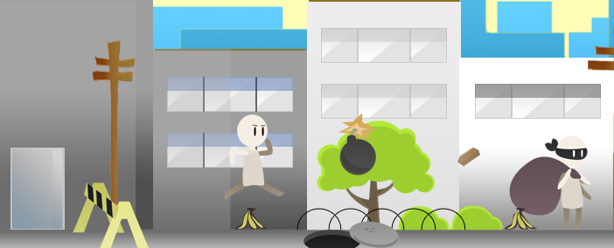
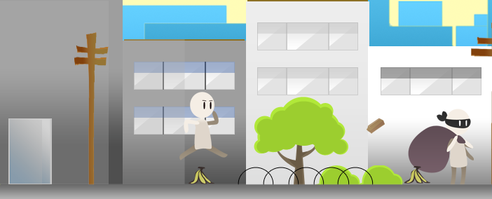
Mechanics
Player(Cylol) must collect the food dropped during the chase
Evade things(anything that could hurt Cylol ex. Bomb, Bricks, etc.) that is thrown by the bad guy.
Notes:
Pain points in creating a game
Game Concept – where the story will revolve
Mechanics – a construct of rules that makes the game engaging to players
In-App Purchase elements – will depend on the creativity of the mind, this is also where

Slide 29


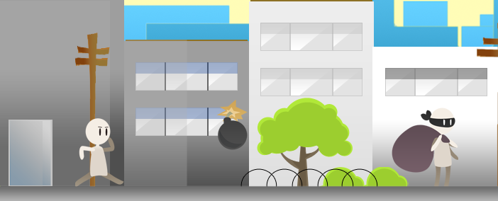
Possible In-app Purchases
Life packs
Power Ups upgrade
Consumable Power Up
Notes:
Pain points in creating a game
Game Concept – where the story will revolve
Mechanics – a construct of rules that makes the game engaging to players
In-App Purchase elements – will depend on the creativity of the mind, this is also where

Slide 30
“Putting something to Play Store or to the AppStore means selling something to the whole world”
END
Notes:
Pain points in creating a game
Game Concept – where the story will revolve
Mechanics – a construct of rules that makes the game engaging to players
In-App Purchase elements – will depend on the creativity of the mind, this is also where

Slide 31
App Development

Slide 32
Development
Native Apps
Web Apps
Every mobile platform uses a different native programming language. While iOS uses Objective-C, Android uses Java, Windows Mobile uses C# and so on.
Each mobile platform offers the developer its own standardized SDK, development tools and other user interface elements, which they can use to develop their native app with relative ease.
There are no standard tools or sdks.
Web apps use languages such as JavaScript, HTML 5, CSS3 or other Web application frameworks as per the developer’s preferences.
Notes:
Each mobile platform that the native app is developed for, stipulates its own unique development process. In the case of Web apps running on a mobile device’s Web browser, the problem that arises is that each of these mobile devices have unique features and come with their unique problems as well.

Slide 33
Platforms and associated development tools
Android
  Android SDK
  Java
  Android Development Tools
iOS
  iOS SDK
  Objective-C
  xCode Development Tool
Windows Phone
  Windows Phone SDK
  C++/C#

Slide 34
Android versus Apple costs
Android
Apple
USD$ 25 lifetime to register as a developer
Free software development kit (SDK)
Free development tools:
  Eclipse
  IntelliJ
Free testing on any android device
Use any PC and OS (Windows, Mac, Unix/Linux)
USD$ 99 a year to register as a developer
Free software development kit and development tool:
  Xcode
Testing cannot be done on an actual device until you are a registered developer
Needs a Mac computer

Slide 35
Mock-Ups
I have an idea but I can’t put it into words

Slide 36
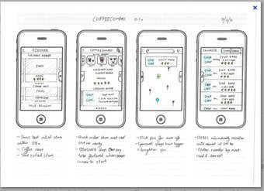
Sample Wireframe/Mock-up

Slide 37
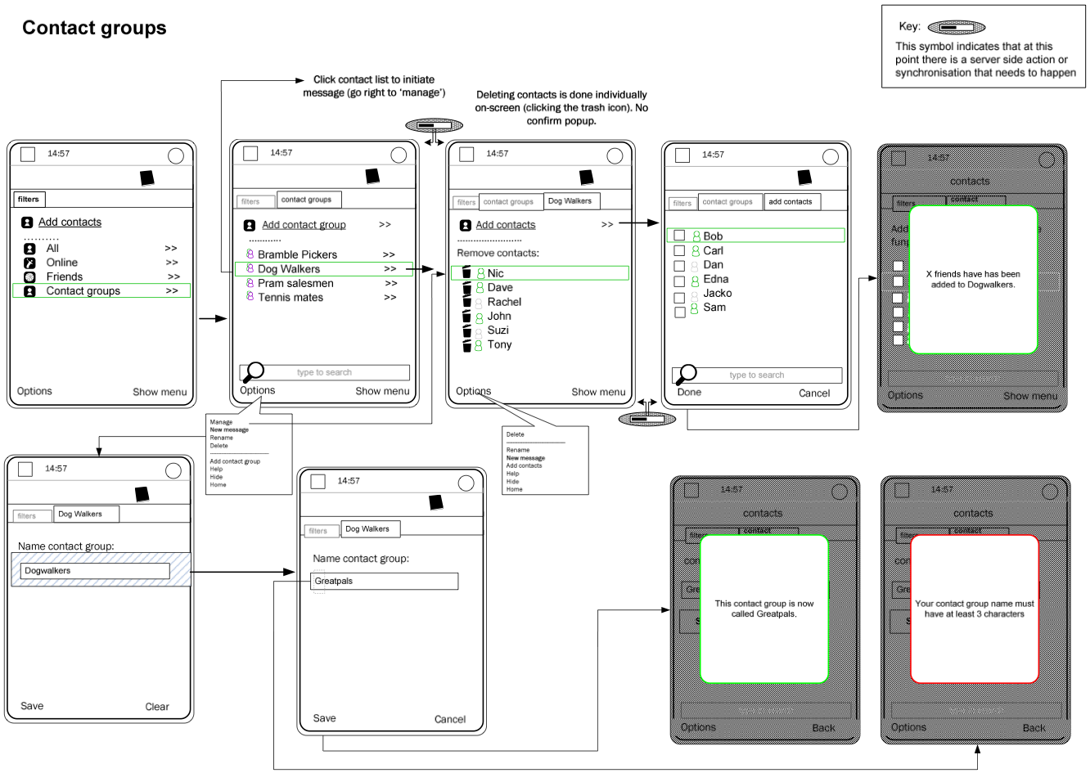
Sample Wireframe/Mock-up

Slide 38
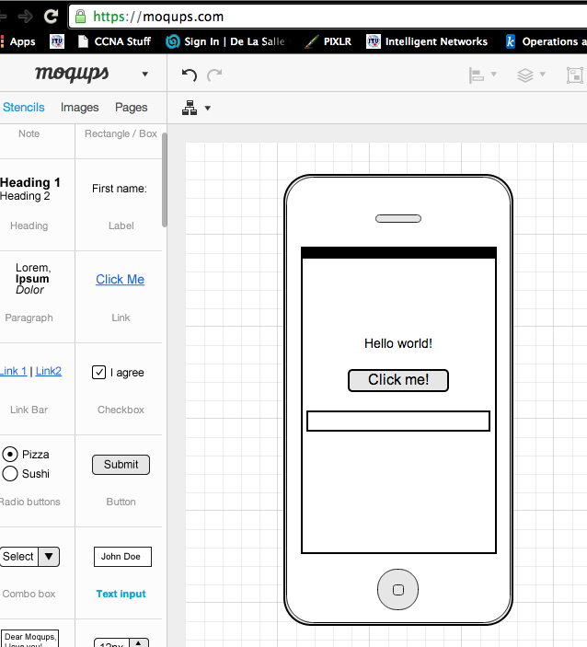
Wireframing
Wireframing is a technique that enables people to express their app ideas in a visual manner.
For a screen design, you can't start building pixel layers in photoshop, or writing blocks of code, without knowing where the information is going to go.
At a deeper level, a wireframe is also very useful in determining how the user interacts with the interface.
Notes:
It's like an architectural blueprint; you need to see it in two-dimensional black and white diagrams before you understand how to build the actual house. Similarly for a screen design, you can't start building pixel layers in photoshop, or writing blocks of code, without knowing where the information is going to go.
At a deeper level, a wireframe is also very useful in determining how the user interacts with the interface. For example, wireframes can contain various states of button or menu behaviors.

Slide 39
Demo: Wireframes
Make your own:
  http://moqups.com
Look at sample Wireframes/Mock-ups:
  http://blog.mockupbuilder.com/12-best-wireframe-examples-for-android-app/

Slide 40
Mobile App Generators
I want to make my own app but I have no developers!?!?!

Slide 41
Want to build an app?
Do-it-yourself (DIY) app builders let businesses craft their own apps with no technical skills required.
Technologies:
  HTML5
  CSS3
  Javascript
Notes:
http://www.businessnewsdaily.com/4901-best-app-makers-creators.html
While developing a robust app from scratch can cost tens or even hundreds of thousands of dollars, DIY app-making platforms enable budget-conscious businesses to build functional mobile apps at a fraction of the cost.

Slide 42
Some app generators
http://appsgeyser.com
http://www.infinitemonkeys.mobi/
http://appypie.com
http://appery.io/
https://mainstreet-apps.com/
http://www.appsbar.com/

Slide 43
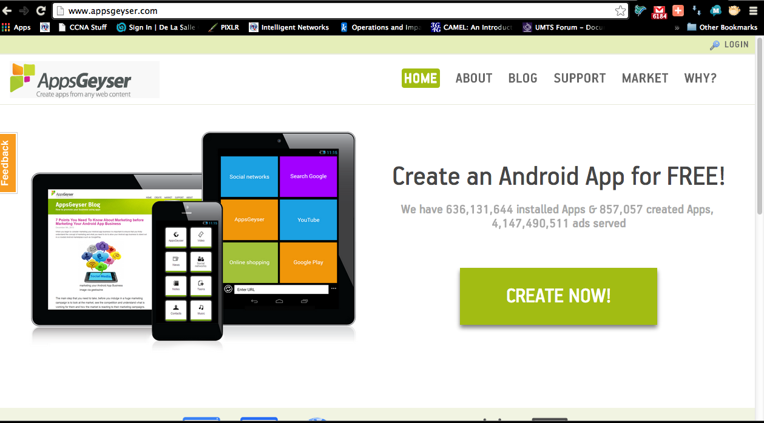
Make your own app now!
http://appsgeyser.com/

Slide 44
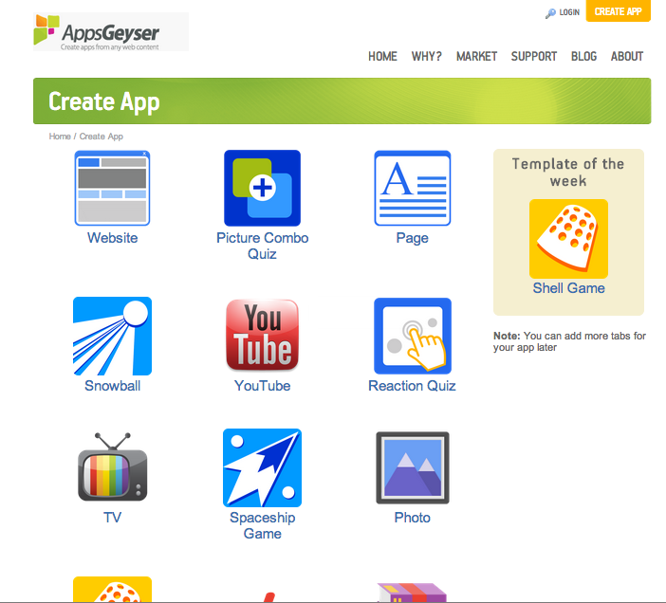
Pick a template!

Slide 45
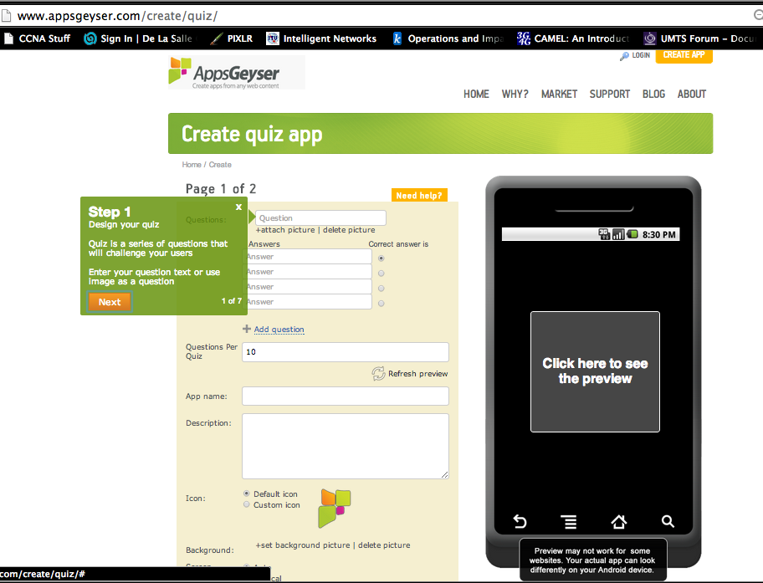
Fill in the details!

Slide 46
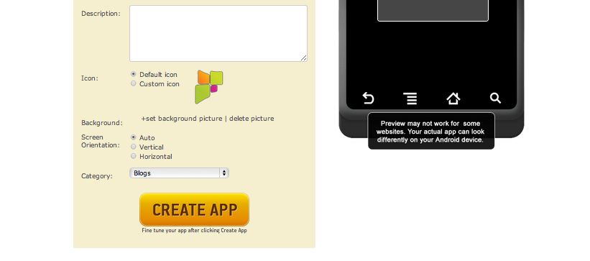
Click on create app!

Slide 47
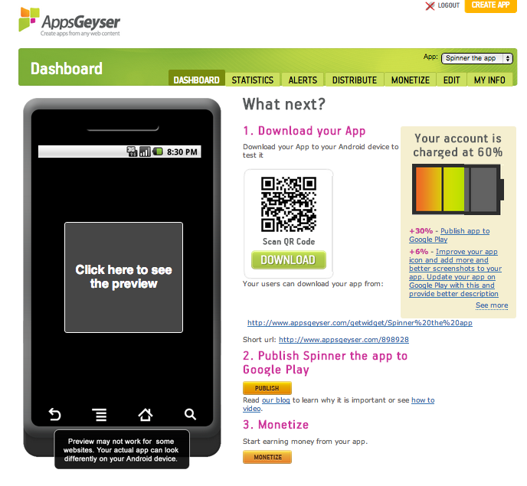
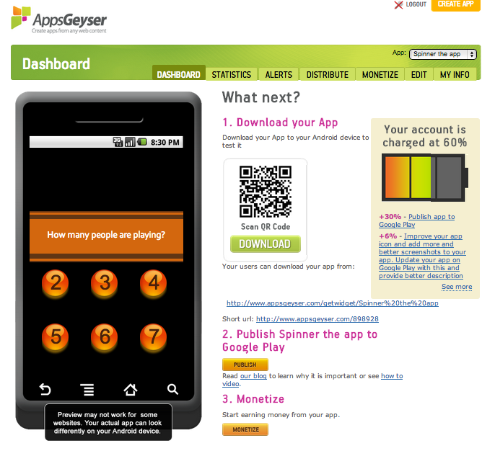
Preview your app!

Slide 48
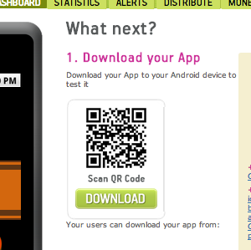
Install your app to your device!
Notes:
Scan the QR code to get the download link for your application.

Slide 49
Remember
Most DIY app generators create limited functionality like content generator/link summary apps.

Slide 50
Making more complicated apps
MIT’s App Inventor

Slide 51
Something in between
MIT App Inventor provides the fastest way to build apps for Android phones and tablets. Even with no prior experience, you can learn to build apps within hours.
The MIT site:
  http://appinventor.mit.edu/explore/
Learning materials/Tutorials:
  http://www.appinventor.org/

Slide 52
What is it?
App Inventor is a visual programming language designed specifically for beginners.
Students are highly motivated to learn because they can create mobile apps for phones and tablets, and because the visual blocks language allows them to build interesting things right from the start.
Because they are not bogged down in syntax and error messages, students are able to work on real world problems, explore logic and problem-solving, and develop a passion for computing.

Slide 53
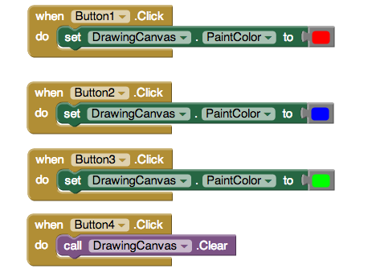
Can you tell what’s supposed to happen?
Notes:
http://www.appinventor.org/

Slide 54
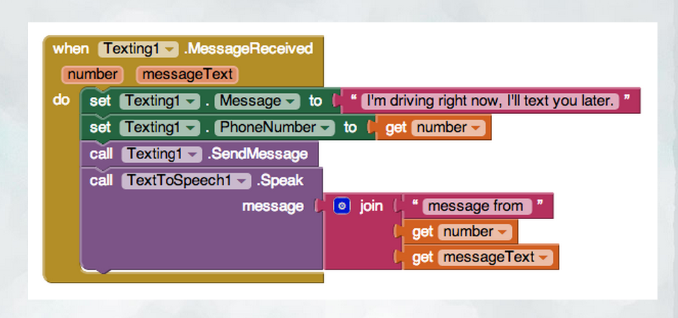
Can you tell what’s supposed to happen?
Notes:
http://www.appinventor.org/

Slide 55
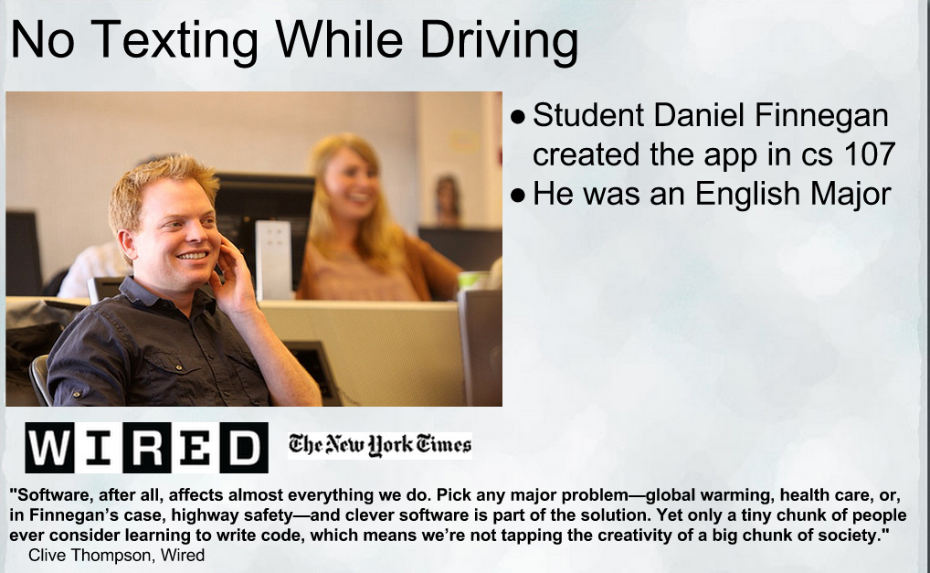

Slide 56
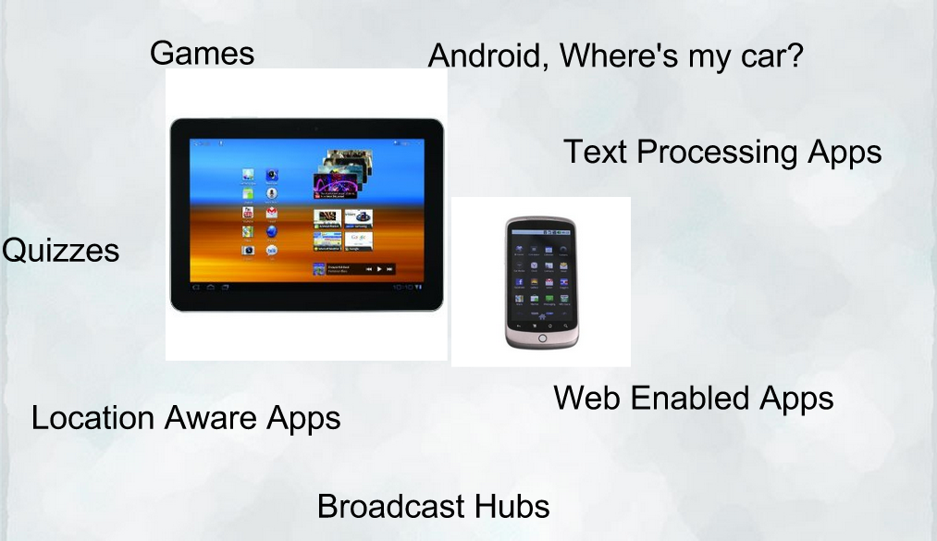
What’s possible!

Slide 57
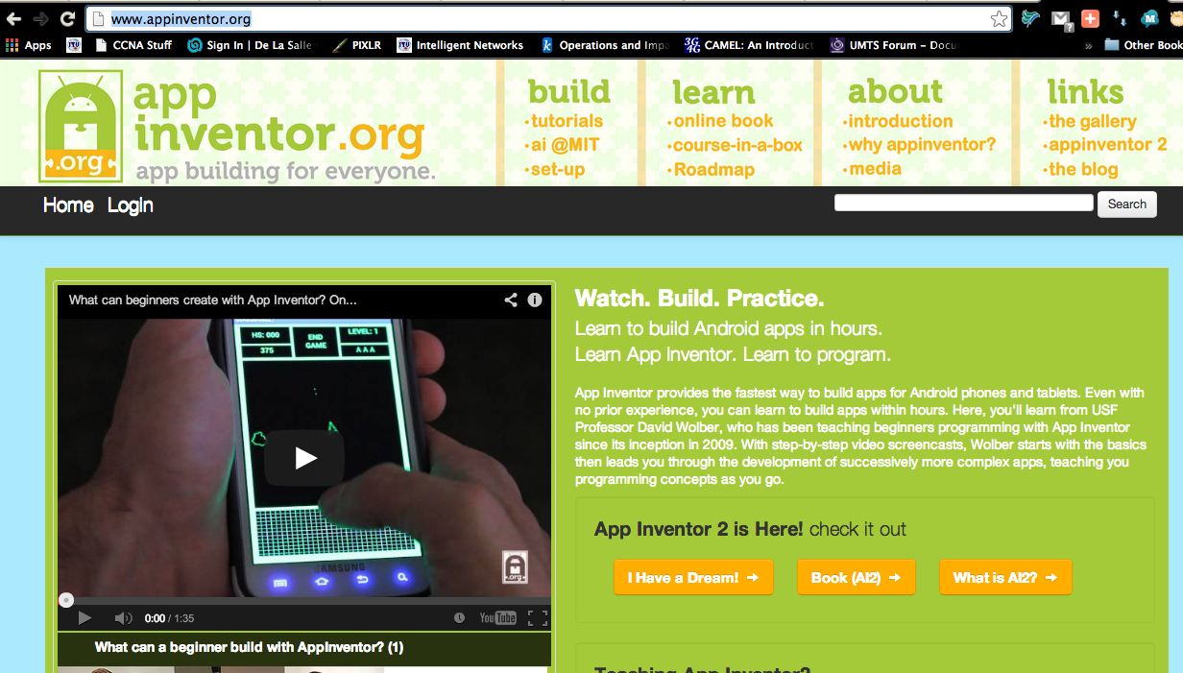
Demo! MIT’s App Inventor
http://ai2.appinventor.mit.edu/

Slide 58
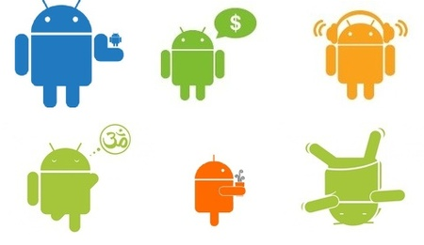
This is the end of the presentation.
Thank you for attending!
For questions or inquiries :
  eMail: rlramos@smart.com.ph
  Mobile: 09298874076
  Office #: 5113175
  Facebook: rlramos@gmail.com

Slide 59
Thank you!
End of Presentation

