Slide 1
Firebase + Android

Slide 2
What is Firebase?

Slide 3
What is Firebase?
Firebase is a Backend-as-a-Service — BaaS — that started as a YC11 startup and grew up into a next-generation app-development platform on Google Cloud Platform.
Firebase frees developers to focus crafting fantastic user experiences. You don’t need to manage servers. You don’t need to write APIs. Firebase is your server, your API and your datastore, all written so generically that you can modify it to suit most needs. Yeah, you’ll occasionally need to use other bits of the Google Cloud for your advanced applications. Firebase can’t be everything to everybody. But it gets pretty close.

Slide 4
Features of Firebase

Slide 5
Advantages of Firebase
Super easy and quick to implement.
No server side configuration needed. No PHP Scripts and No Database Designs.
Realtime update without using GCM.
Autoscaling built-in
Can start for free (only need to start paying once we hit 50 connections)
Robust APIs for Javascript (including several frameworks like Angular), iOS, and Android
Built-in support for authentication services like Facebook, Google, and Twitter
Declarative Security Rules model allows us to enforce read/write privileges and data validation throughout the tree

Slide 6
Disadvantages
Need to build indexes manually
May need to build “event log” manually as well (in separate sub-tree?)
Implementation of REST API could be difficult on embedded platforms
Data validation rules do not support complex objects directly (you’d need to validate individual child nodes separately)

Slide 7
Prepare the project

Slide 8
Create a new project

Slide 9
Setup Firebase Authentication

Slide 10
Setup Firebase Authentication

Slide 11
Connecting to Firebase – Google Sign In

Slide 12
Connecting to Firebase – Google Sign In – Android Studio

Slide 13
Add Firebase Authentication to your App Project

Slide 14
Check Firebase Console for Extra Configuration

Slide 15
Enable email/password authentication

Slide 16
Complete SDK Setup

Slide 17
Add google-services JSON to your project

Slide 18
Add google-services JSON to your project

Slide 19
Modify Android Manifest

Slide 20
Preliminary Files

Slide 21
dimens.xml
Notes:
CODE:
<?xml version="1.0" encoding="utf-8"?> <resources> <!-- Default screen margins, per the Android Design guidelines. --> <dimen name="activity_horizontal_margin">16dp</dimen> <dimen name="activity_vertical_margin">16dp</dimen> <dimen name="fab_margin">16dp</dimen> <dimen name="logo_w_h">100dp</dimen> </resources>

Slide 22
colors.xml
Notes:
CODE:
<?xml version="1.0" encoding="utf-8"?>
<resources>
<color name="colorPrimary">#00bcd4</color>
<color name="colorPrimaryDark">#0097a7</color>
<color name="colorAccent">#f2fe71</color>
<color name="bg_login">#26ae90</color>
<color name="bg_register">#2e3237</color>
<color name="bg_main">#428bca</color>
<color name="white">#ffffff</color>
<color name="input_login">#222222</color>
<color name="input_login_hint">#999999</color>
<color name="input_register">#888888</color>
<color name="input_register_bg">#3b4148</color>
<color name="input_register_hint">#5e6266</color>
<color name="btn_login">#26ae90</color>
<color name="btn_login_bg">#eceef1</color>
<color name="lbl_name">#333333</color>
<color name="btn_logut_bg">#ff6861</color>
</resources>

Slide 23
strings.xml
Notes:
CODE:
<resources>
<string name="app_name">Firebase Auth</string>
<string name="action_sign_in_short">Register</string>
<string name="email">Email</string>
<string name="minimum_password">Password too short, enter minimum 6 characters!</string>
<string name="auth_failed">Authentication failed, check your email and password or sign up</string>
<string name="change_email">Change Email</string>
<string name="change_password">Change Password</string>
<string name="send_password_reset_email">Send Password reset email</string>
<string name="remove_user">Remove user</string>
<string name="new_pass">New Password</string>
<string name="title_activity_profile">Firebase</string>
<string name="title_activity_login">Sign in</string>
<string name="hint_email">Email</string>
<string name="hint_password">Password</string>
<string name="hint_name">Fullname</string>
<string name="btn_login">LOGIN</string>
<string name="btn_link_to_register">Not a member? Get registered in Firebase now!</string>
<string name="btn_link_to_login">Already registered. Login Me!</string>
<string name="title_activity_reset_password">ResetPasswordActivity</string>
<string name="btn_forgot_password">Forgot your password?</string>
<string name="btn_reset_password">Reset Password</string>
<string name="btn_back"><![CDATA[<< Back]]></string>
<string name="hint_new_email">New Email</string>
<string name="btn_change">Change</string>
<string name="btn_send">Send</string>
<string name="btn_remove">Remove</string>
<string name="btn_sign_out">Sign Out</string>
<string name="lbl_forgot_password">Forgot password?</string>
<string name="forgot_password_msg">We just need your registered Email Id to sent you password reset instructions.</string>
</resources>

Slide 24
Sign up with eMail and Password
Java Code + XML Layouts

Slide 25
Make a new activity called SignupActivity.java

Slide 26
XML: activity_signup.xml
Notes:
Code:
<?xml version="1.0" encoding="utf-8"?>
<android.support.design.widget.CoordinatorLayout xmlns:android="http://schemas.android.com/apk/res/android"
xmlns:app="http://schemas.android.com/apk/res-auto"
xmlns:tools="http://schemas.android.com/tools"
android:layout_width="match_parent"
android:layout_height="match_parent"
android:fitsSystemWindows="true"
tools:context="info.androidhive.firebase.LoginActivity">
<LinearLayout
android:layout_width="fill_parent"
android:layout_height="fill_parent"
android:background="@color/colorPrimaryDark"
android:gravity="center"
android:orientation="vertical"
android:padding="@dimen/activity_horizontal_margin">
<ImageView
android:layout_width="@dimen/logo_w_h"
android:layout_height="@dimen/logo_w_h"
android:layout_gravity="center_horizontal"
android:layout_marginBottom="30dp"
android:src="@mipmap/ic_launcher" />
<android.support.design.widget.TextInputLayout
android:layout_width="match_parent"
android:layout_height="wrap_content">
<EditText
android:id="@+id/email"
android:layout_width="match_parent"
android:layout_height="wrap_content"
android:hint="@string/email"
android:inputType="textEmailAddress"
android:maxLines="1"
android:singleLine="true"
android:textColor="@android:color/white" />
</android.support.design.widget.TextInputLayout>
<android.support.design.widget.TextInputLayout
android:layout_width="match_parent"
android:layout_height="wrap_content">
<EditText
android:id="@+id/password"
android:layout_width="match_parent"
android:layout_height="wrap_content"
android:focusableInTouchMode="true"
android:hint="@string/hint_password"
android:imeActionId="@+id/login"
android:imeOptions="actionUnspecified"
android:inputType="textPassword"
android:maxLines="1"
android:singleLine="true"
android:textColor="@android:color/white" />
</android.support.design.widget.TextInputLayout>
<Button
android:id="@+id/sign_up_button"
style="?android:textAppearanceSmall"
android:layout_width="match_parent"
android:layout_height="wrap_content"
android:layout_marginTop="16dp"
android:background="@color/colorAccent"
android:text="@string/action_sign_in_short"
android:textColor="@android:color/black"
android:textStyle="bold" />
<Button
android:id="@+id/btn_reset_password"
android:layout_width="fill_parent"
android:layout_height="wrap_content"
android:layout_marginTop="20dip"
android:background="@null"
android:text="@string/btn_forgot_password"
android:textAllCaps="false"
android:textColor="@color/colorAccent" />
<!-- Link to Login Screen -->
<Button
android:id="@+id/sign_in_button"
android:layout_width="fill_parent"
android:layout_height="wrap_content"
android:layout_marginTop="20dip"
android:background="@null"
android:text="@string/btn_link_to_login"
android:textAllCaps="false"
android:textColor="@color/white"
android:textSize="15dp" />
</LinearLayout>
<ProgressBar
android:id="@+id/progressBar"
android:layout_width="30dp"
android:layout_height="30dp"
android:layout_gravity="center|bottom"
android:layout_marginBottom="20dp"
android:visibility="gone" />
</android.support.design.widget.CoordinatorLayout>

Slide 27
Java: SignupActivity.java
Notes:
CODE:
package info.androidhive.firebase;
import android.content.Intent;
import android.os.Bundle;
import android.support.annotation.NonNull;
import android.support.v7.app.AppCompatActivity;
import android.text.TextUtils;
import android.view.View;
import android.widget.Button;
import android.widget.EditText;
import android.widget.ProgressBar;
import android.widget.Toast;
import com.google.android.gms.tasks.OnCompleteListener;
import com.google.android.gms.tasks.Task;
import com.google.firebase.auth.AuthResult;
import com.google.firebase.auth.FirebaseAuth;
public class SignupActivity extends AppCompatActivity {
private EditText inputEmail, inputPassword;
private Button btnSignIn, btnSignUp, btnResetPassword;
private ProgressBar progressBar;
private FirebaseAuth auth;
@Override
protected void onCreate(Bundle savedInstanceState) {
super.onCreate(savedInstanceState);
setContentView(R.layout.activity_signup);
//Get Firebase auth instance
auth = FirebaseAuth.getInstance();
btnSignIn = (Button) findViewById(R.id.sign_in_button);
btnSignUp = (Button) findViewById(R.id.sign_up_button);
inputEmail = (EditText) findViewById(R.id.email);
inputPassword = (EditText) findViewById(R.id.password);
progressBar = (ProgressBar) findViewById(R.id.progressBar);
btnResetPassword = (Button) findViewById(R.id.btn_reset_password);
btnResetPassword.setOnClickListener(new View.OnClickListener() {
@Override
public void onClick(View v) {
startActivity(new Intent(SignupActivity.this, ResetPasswordActivity.class));
}
});
btnSignIn.setOnClickListener(new View.OnClickListener() {
@Override
public void onClick(View v) {
finish();
}
});
btnSignUp.setOnClickListener(new View.OnClickListener() {
@Override
public void onClick(View v) {
String email = inputEmail.getText().toString().trim();
String password = inputPassword.getText().toString().trim();
if (TextUtils.isEmpty(email)) {
Toast.makeText(getApplicationContext(), "Enter email address!", Toast.LENGTH_SHORT).show();
return;
}
if (TextUtils.isEmpty(password)) {
Toast.makeText(getApplicationContext(), "Enter password!", Toast.LENGTH_SHORT).show();
return;
}
if (password.length() < 6) {
Toast.makeText(getApplicationContext(), "Password too short, enter minimum 6 characters!", Toast.LENGTH_SHORT).show();
return;
}
progressBar.setVisibility(View.VISIBLE);
//create user
auth.createUserWithEmailAndPassword(email, password)
.addOnCompleteListener(SignupActivity.this, new OnCompleteListener<AuthResult>() {
@Override
public void onComplete(@NonNull Task<AuthResult> task) {
Toast.makeText(SignupActivity.this, "createUserWithEmail:onComplete:" + task.isSuccessful(), Toast.LENGTH_SHORT).show();
progressBar.setVisibility(View.GONE);
// If sign in fails, display a message to the user. If sign in succeeds
// the auth state listener will be notified and logic to handle the
// signed in user can be handled in the listener.
if (!task.isSuccessful()) {
Toast.makeText(SignupActivity.this, "Authentication failed." + task.getException(),
Toast.LENGTH_SHORT).show();
} else {
startActivity(new Intent(SignupActivity.this, MainActivity.class));
finish();
}
}
});
}
});
}
@Override
protected void onResume() {
super.onResume();
progressBar.setVisibility(View.GONE);
}
}

Slide 28
Modify Android Manifest and make SignupActivity as default

Slide 29
Run the App!

Slide 30
Check the Firebase Console

Slide 31
LoginActivity!

Slide 32
XML: acvtivity_login.xml
Notes:
CODE:
<?xml version="1.0" encoding="utf-8"?>
<android.support.design.widget.CoordinatorLayout xmlns:android="http://schemas.android.com/apk/res/android"
xmlns:app="http://schemas.android.com/apk/res-auto"
xmlns:tools="http://schemas.android.com/tools"
android:layout_width="match_parent"
android:layout_height="match_parent"
android:fitsSystemWindows="true"
tools:context="info.androidhive.firebase.LoginActivity">
<LinearLayout
android:layout_width="fill_parent"
android:layout_height="fill_parent"
android:background="@color/colorPrimary"
android:gravity="center"
android:orientation="vertical"
android:padding="@dimen/activity_horizontal_margin">
<ImageView
android:layout_width="@dimen/logo_w_h"
android:layout_height="@dimen/logo_w_h"
android:layout_gravity="center_horizontal"
android:layout_marginBottom="30dp"
android:src="@mipmap/ic_launcher" />
<android.support.design.widget.TextInputLayout
android:layout_width="match_parent"
android:layout_height="wrap_content">
<EditText
android:id="@+id/email"
android:layout_width="match_parent"
android:layout_height="wrap_content"
android:layout_marginBottom="10dp"
android:hint="@string/hint_email"
android:inputType="textEmailAddress"
android:textColor="@android:color/white"
android:textColorHint="@android:color/white" />
</android.support.design.widget.TextInputLayout>
<android.support.design.widget.TextInputLayout
android:layout_width="match_parent"
android:layout_height="wrap_content">
<EditText
android:id="@+id/password"
android:layout_width="fill_parent"
android:layout_height="wrap_content"
android:layout_marginBottom="10dp"
android:hint="@string/hint_password"
android:inputType="textPassword"
android:textColor="@android:color/white"
android:textColorHint="@android:color/white" />
</android.support.design.widget.TextInputLayout>
<!-- Login Button -->
<Button
android:id="@+id/btn_login"
android:layout_width="fill_parent"
android:layout_height="wrap_content"
android:layout_marginTop="20dip"
android:background="@color/colorAccent"
android:text="@string/btn_login"
android:textColor="@android:color/black" />
<Button
android:id="@+id/btn_reset_password"
android:layout_width="fill_parent"
android:layout_height="wrap_content"
android:layout_marginTop="20dip"
android:background="@null"
android:text="@string/btn_forgot_password"
android:textAllCaps="false"
android:textColor="@color/colorAccent" />
<!-- Link to Login Screen -->
<Button
android:id="@+id/btn_signup"
android:layout_width="fill_parent"
android:layout_height="wrap_content"
android:layout_marginTop="20dip"
android:background="@null"
android:text="@string/btn_link_to_register"
android:textAllCaps="false"
android:textColor="@color/white"
android:textSize="15dp" />
</LinearLayout>
<ProgressBar
android:id="@+id/progressBar"
android:layout_width="30dp"
android:layout_height="30dp"
android:layout_gravity="center|bottom"
android:layout_marginBottom="20dp"
android:visibility="gone" />
</android.support.design.widget.CoordinatorLayout>

Slide 33
Java: LoginActivity.java
Notes:
CODE:
package info.androidhive.firebase;
import android.content.Intent;
import android.os.Bundle;
import android.support.annotation.NonNull;
import android.support.v7.app.AppCompatActivity;
import android.support.v7.widget.Toolbar;
import android.text.TextUtils;
import android.view.View;
import android.widget.Button;
import android.widget.EditText;
import android.widget.ProgressBar;
import android.widget.Toast;
import com.google.android.gms.tasks.OnCompleteListener;
import com.google.android.gms.tasks.Task;
import com.google.firebase.auth.AuthResult;
import com.google.firebase.auth.FirebaseAuth;
public class LoginActivity extends AppCompatActivity {
private EditText inputEmail, inputPassword;
private FirebaseAuth auth;
private ProgressBar progressBar;
private Button btnSignup, btnLogin, btnReset;
@Override
protected void onCreate(Bundle savedInstanceState) {
super.onCreate(savedInstanceState);
//Get Firebase auth instance
auth = FirebaseAuth.getInstance();
if (auth.getCurrentUser() != null) {
startActivity(new Intent(LoginActivity.this, MainActivity.class));
finish();
}
// set the view now
setContentView(R.layout.activity_login);
Toolbar toolbar = (Toolbar) findViewById(R.id.toolbar);
setSupportActionBar(toolbar);
inputEmail = (EditText) findViewById(R.id.email);
inputPassword = (EditText) findViewById(R.id.password);
progressBar = (ProgressBar) findViewById(R.id.progressBar);
btnSignup = (Button) findViewById(R.id.btn_signup);
btnLogin = (Button) findViewById(R.id.btn_login);
btnReset = (Button) findViewById(R.id.btn_reset_password);
//Get Firebase auth instance
auth = FirebaseAuth.getInstance();
btnSignup.setOnClickListener(new View.OnClickListener() {
@Override
public void onClick(View v) {
startActivity(new Intent(LoginActivity.this, SignupActivity.class));
}
});
btnReset.setOnClickListener(new View.OnClickListener() {
@Override
public void onClick(View v) {
startActivity(new Intent(LoginActivity.this, ResetPasswordActivity.class));
}
});
btnLogin.setOnClickListener(new View.OnClickListener() {
@Override
public void onClick(View v) {
String email = inputEmail.getText().toString();
final String password = inputPassword.getText().toString();
if (TextUtils.isEmpty(email)) {
Toast.makeText(getApplicationContext(), "Enter email address!", Toast.LENGTH_SHORT).show();
return;
}
if (TextUtils.isEmpty(password)) {
Toast.makeText(getApplicationContext(), "Enter password!", Toast.LENGTH_SHORT).show();
return;
}
progressBar.setVisibility(View.VISIBLE);
//authenticate user
auth.signInWithEmailAndPassword(email, password)
.addOnCompleteListener(LoginActivity.this, new OnCompleteListener<AuthResult>() {
@Override
public void onComplete(@NonNull Task<AuthResult> task) {
// If sign in fails, display a message to the user. If sign in succeeds
// the auth state listener will be notified and logic to handle the
// signed in user can be handled in the listener.
progressBar.setVisibility(View.GONE);
if (!task.isSuccessful()) {
// there was an error
if (password.length() < 6) {
inputPassword.setError(getString(R.string.minimum_password));
} else {
Toast.makeText(LoginActivity.this, getString(R.string.auth_failed), Toast.LENGTH_LONG).show();
}
} else {
Intent intent = new Intent(LoginActivity.this, MainActivity.class);
startActivity(intent);
finish();
}
}
});
}
});
}
}

Slide 34
Modify AndroidManifest to make LoginActivity as startup

Slide 35
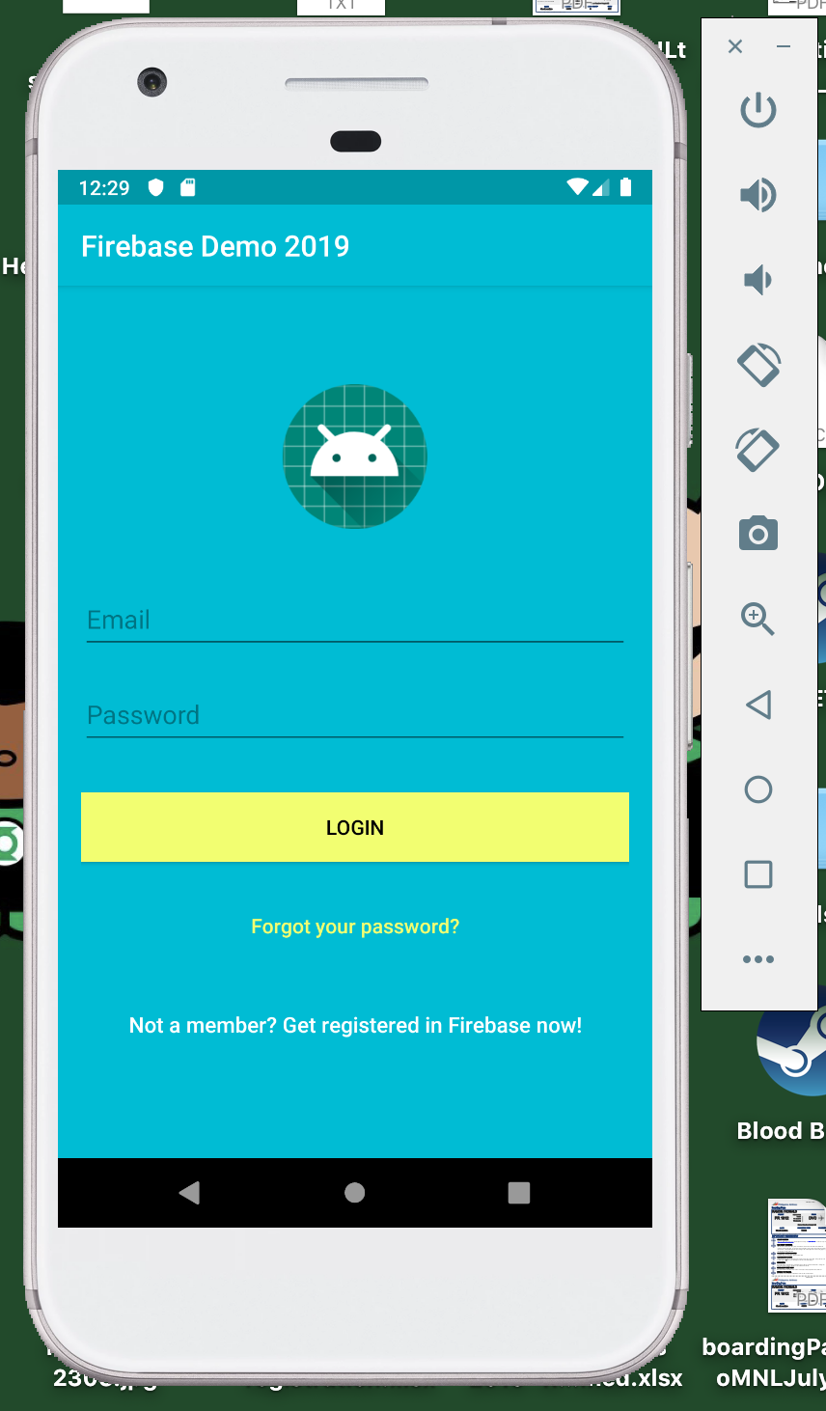
Run the App!

Slide 36
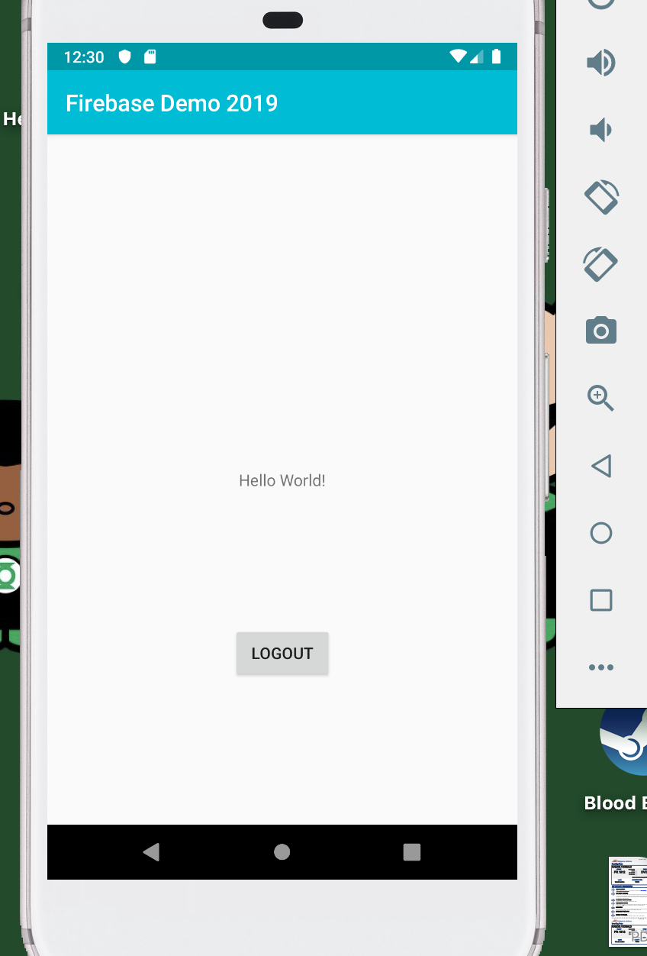
Logout button code
Notes:
CODE:
XML
<?xml version="1.0" encoding="utf-8"?> <android.support.constraint.ConstraintLayout xmlns:android="http://schemas.android.com/apk/res/android" xmlns:app="http://schemas.android.com/apk/res-auto" xmlns:tools="http://schemas.android.com/tools" android:layout_width="match_parent" android:layout_height="match_parent" tools:context=".MainActivity"> <TextView android:id="@+id/textView" android:layout_width="wrap_content" android:layout_height="wrap_content" android:text="Hello World!" app:layout_constraintBottom_toBottomOf="parent" app:layout_constraintLeft_toLeftOf="parent" app:layout_constraintRight_toRightOf="parent" app:layout_constraintTop_toTopOf="parent" /> <Button android:id="@+id/button" android:layout_width="wrap_content" android:layout_height="wrap_content" android:layout_marginStart="8dp" android:layout_marginEnd="8dp" android:layout_marginBottom="8dp" android:onClick="doLogout" android:text="Logout" app:layout_constraintBottom_toBottomOf="parent" app:layout_constraintEnd_toEndOf="parent" app:layout_constraintStart_toStartOf="parent" app:layout_constraintTop_toBottomOf="@+id/textView" /> </android.support.constraint.ConstraintLayout>
Java:
package info.ronaldramos.firebasedemo2019; import android.content.Intent; import android.support.v7.app.AppCompatActivity; import android.os.Bundle; import android.util.Log; import android.view.View; import com.google.firebase.auth.FirebaseAuth; public class MainActivity extends AppCompatActivity { private FirebaseAuth auth; @Override protected void onCreate(Bundle savedInstanceState) { super.onCreate(savedInstanceState); setContentView(R.layout.activity_main); //Get Firebase auth instance auth = FirebaseAuth.getInstance(); } public void doLogout(View v){ try { auth.signOut(); Intent i = new Intent(getApplicationContext(), LoginActivity.class); startActivity(i); // signed out } catch (Exception e){ // an error } } }

Slide 37
Reset Password!

Slide 38
XML: activity_reset_password.xml
Notes:
CODE:
<android.support.design.widget.CoordinatorLayout xmlns:android="http://schemas.android.com/apk/res/android"
xmlns:app="http://schemas.android.com/apk/res-auto"
xmlns:tools="http://schemas.android.com/tools"
android:layout_width="match_parent"
android:layout_height="match_parent"
android:layout_gravity="center"
android:background="@color/colorPrimary"
android:fitsSystemWindows="true"
tools:context="info.androidhive.firebase.LoginActivity">
<LinearLayout
android:layout_width="fill_parent"
android:layout_height="wrap_content"
android:layout_marginTop="30dp"
android:gravity="center"
android:orientation="vertical"
android:padding="@dimen/activity_horizontal_margin">
<ImageView
android:layout_width="@dimen/logo_w_h"
android:layout_height="@dimen/logo_w_h"
android:layout_gravity="center_horizontal"
android:layout_marginBottom="10dp"
android:src="@mipmap/ic_launcher" />
<TextView
android:layout_width="wrap_content"
android:layout_height="wrap_content"
android:layout_gravity="center_horizontal"
android:padding="10dp"
android:text="@string/lbl_forgot_password"
android:textColor="@android:color/white"
android:textSize="20dp" />
<TextView
android:layout_width="wrap_content"
android:layout_height="wrap_content"
android:layout_marginBottom="10dp"
android:gravity="center_horizontal"
android:padding="@dimen/activity_horizontal_margin"
android:text="@string/forgot_password_msg"
android:textColor="@android:color/white"
android:textSize="14dp" />
<android.support.design.widget.TextInputLayout
android:layout_width="match_parent"
android:layout_height="wrap_content">
<EditText
android:id="@+id/email"
android:layout_width="match_parent"
android:layout_height="wrap_content"
android:layout_marginBottom="10dp"
android:layout_marginTop="20dp"
android:hint="@string/hint_email"
android:inputType="textEmailAddress"
android:textColor="@android:color/white"
android:textColorHint="@android:color/white" />
</android.support.design.widget.TextInputLayout>
<!-- Login Button -->
<Button
android:id="@+id/btn_reset_password"
android:layout_width="fill_parent"
android:layout_height="wrap_content"
android:layout_marginTop="20dip"
android:background="@color/colorAccent"
android:text="@string/btn_reset_password"
android:textColor="@android:color/black" />
<Button
android:id="@+id/btn_back"
android:layout_width="wrap_content"
android:layout_height="wrap_content"
android:layout_marginTop="10dp"
android:background="@null"
android:text="@string/btn_back"
android:textColor="@color/colorAccent" />
</LinearLayout>
<ProgressBar
android:id="@+id/progressBar"
android:layout_width="30dp"
android:layout_height="30dp"
android:layout_gravity="center|bottom"
android:layout_marginBottom="20dp"
android:visibility="gone" />
</android.support.design.widget.CoordinatorLayout>

Slide 39
Java: ResetPasswordActivity.java
Notes:
CODE:

Slide 40
FIN!

