Slide 1
Summer Android Bootcamp 2014
Day 3
Ronald L. Ramos

Slide 2
Touch

Slide 3
User Input
There are several ways to get user input on an Android device.
The most common form of input on the newest devices is with a multi-touch capable screen.
Other forms of input include the keyboard, compass and the accelerometer.
For game design we will concentrate only on touch input.

Slide 4
“Listening” for Touch Events
Import OnTouchListener
  A subclass of View
  Import android.view.View.OnTouchListener;
A class must implement OnTouchListener
  Most common implementer is the Activity class
  The other way is to create your own custom class.
  public class Game extends Activity implements OnTouchListener{
  }
  Our end goal: Create our own Game class with lots of reusable code

Slide 5
“Listening” for Touch Events
Any class implementing OnTouchListener must implement the method/function called onTouch().
@Override public boolean
onTouch(View v, MotionEvent event){
return false;
}
Notes:
The emulator only allows for testing of single touch events. Multi-touch input must be tested on a real device

Slide 6
Example App

Slide 7
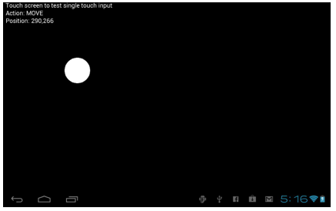
Dragging/Moving

Slide 8
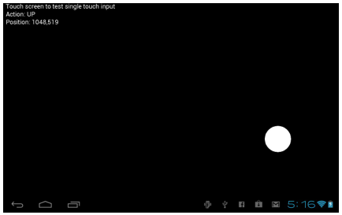
Registering up/down

Slide 9
Complete code
See complete code in the notes section
Notes:
/**
* Touch Input Demo
*/
package android.program;
import android.app.Activity;
import android.content.Context;
import android.content.res.AssetManager;
import android.graphics.*;
import android.os.Bundle;
import android.view.*;
import android.view.View.OnTouchListener;
public class Game extends Activity implements OnTouchListener {
DrawView drawView;
//input variables
Point touch = new Point(0,0);
String inputAction = "";
@Override public void onCreate(Bundle savedInstanceState) {
super.onCreate(savedInstanceState);
requestWindowFeature(Window.FEATURE_NO_TITLE);
drawView = new DrawView(this);
setContentView(drawView);
//turn on touch listening
drawView.setOnTouchListener(this);
}
@Override public void onResume() {
super.onResume();
drawView.resume();
}
@Override public void onPause() {
super.onPause();
drawView.pause();
}
//touch listener event
@Override public boolean onTouch(View v, MotionEvent event) {
switch(event.getAction()) {
case MotionEvent.ACTION_DOWN:
inputAction = "DOWN";
break;
case MotionEvent.ACTION_MOVE:
inputAction = "MOVE";
break;
case MotionEvent.ACTION_UP:
inputAction = "UP";
break;
}
//remember this touch position
touch.x = (int)event.getX();
touch.y = (int)event.getY();
//notify touch handler that we used it
return true;
}
public class DrawView extends SurfaceView implements Runnable
{
//game loop thread
Thread gameloop = null;
//surface holder
SurfaceHolder surface = null;
//thread-safe running var
volatile boolean running = false;
//asset manager
AssetManager assets = null;
//constructor method
public DrawView(Context context) {
super(context);
//get the SurfaceHolder object
surface = getHolder();
//create the asset manager
assets = context.getAssets();
}
public void resume() {
running = true;
gameloop = new Thread(this);
gameloop.start();
}
public void pause() {
running = false;
while (true) {
try {
gameloop.join();
}
catch (InterruptedException e) { }
}
}
//thread run method
@Override public void run() {
while (running) {
if (!surface.getSurface().isValid()) continue;
//open the canvas for drawing
Canvas canvas = surface.lockCanvas();
canvas.drawColor(Color.BLACK);
//draw circle at touch position
Paint paint = new Paint();
paint.setColor(Color.WHITE);
paint.setTextSize(24);
canvas.drawText("Touch screen to test single touch input", 10, 20, paint);
canvas.drawText("Action: " + inputAction, 10, 50, paint);
canvas.drawText("Position: " + touch.x + "," + touch.y, 10, 80, paint);
if (touch.x != 0 && touch.y != 0)
canvas.drawCircle(touch.x, touch.y, 50, paint);
//close the canvas
surface.unlockCanvasAndPost(canvas);
try {
Thread.sleep(20);
}
catch(InterruptedException e) {
e.printStackTrace();
}
}
}
}
}

Slide 10
Simple Animation

Slide 11
Android Animation
Android supports three types of animation:
Frame-by-frame animation
  A series of frames is drawn one after the other at regular intervals.
Layout animation
  Animate views inside a container view such as lists and tables.
View animation
  Animate any general-purpose view.
Notes:
Types#2 and #3 are tweening animation which involves the drawing in between the key drawings. The idea is that knowing the beginning state and ending state of a drawing allows us to vary certain aspect of the drawing in time. This varying aspect could be color, position, size, etc.

Slide 12
Layout Animation

Slide 13
Layout Animation
Layout animation works by applying tweening to each view that is part of the layout being animated. Here are four types of tweening animation:
Scale animation
  We use this type of animation to make a view smaller or larger either on x axis or on the y axis. We can also specify the pivot point around which we want the animation to take place.
Rotate animation
  We use this to rotate a view around a pivot point by a certain number of degrees.
Translate animation
  We use this to move a view along the x or y axis.
Alpha animation
  We use this to change the transparency of a view.
Notes:
We'll use layout animation with the ListView and GridView, which are the two most commonly-used controls in Android. Specifically, we'll use layout animation to add visual effects to the way each item in a ListView or GridView is displayed. Actually, we can use this type of animation on all controls derived from a ViewGroup.

Slide 14
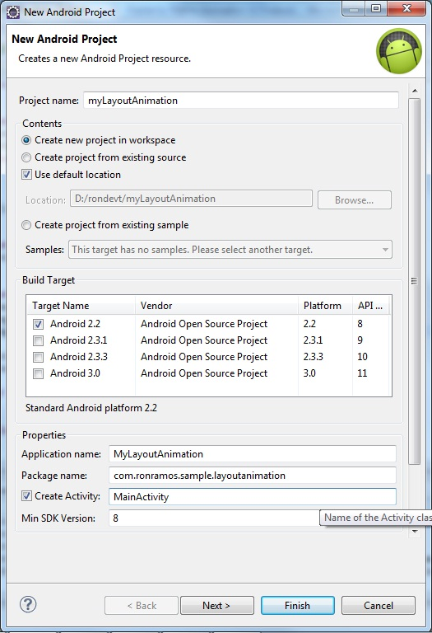
The project
Name: myLayoutAnimation
Min SDK: Android 2.3
Application name: ALayoutAnimation
Pkg: com.ronramos.alayoutanimation
Activity: MainActivity
Layout: Main

Slide 15
Main.xml
<?xml version="1.0" encoding="utf-8"?>
<LinearLayout xmlns:android="http://schemas.android.com/apk/res/android"
android:orientation="vertical"
android:layout_width="fill_parent"
android:layout_height="fill_parent">
<ListView
android:id="@+id/list_view_id"
android:persistentDrawingCache="animation|scrolling"
android:layout_width="fill_parent"
android:layout_height="fill_parent"
android:layoutAnimation="@anim/list_layout_controller" />
</LinearLayout>
Notes:
Once we have a ListView, we can attach an animation to it so that each list item will go through that animation.
We can define both the individual animation and the mediator in XML files in the /res/anim subdirectory. Once we have the mediator XML file, we can use that file as an input to the ListView in its own XML layout definition.
Let's start by creating XML layout for the ListView so we can load that layout in a basic activity.
The file shows a simple LinearLayout with a single ListView in it.
Here is the file, /res/layout/list_layout.xml:
<?xml version="1.0" encoding="utf-8"?>
<LinearLayout xmlns:android="http://schemas.android.com/apk/res/android"
android:orientation="vertical"
android:layout_width="fill_parent"
android:layout_height="fill_parent">
<ListView
android:id="@+id/list_view_id"
android:persistentDrawingCache="animation|scrolling"
android:layout_width="fill_parent"
android:layout_height="fill_parent"
android:layoutAnimation="@anim/list_layout_controller" />
</LinearLayout>

Slide 16
List_layout_controller.xml
<?xml version="1.0" encoding="utf-8"?>
<layoutAnimation xmlns:android="http://schemas.android.com/apk/res/android"
android:delay="30%"
android:animationOrder="reverse"
android:animation="@anim/alpha" />
Notes:
We need another XML file that acts as a mediator between itself and the animation set. Here is the mediator XML file:
/res/anim/list_layout_controller.xml
<?xml version="1.0" encoding="utf-8"?>
<layoutAnimation xmlns:android="http://schemas.android.com/apk/res/android"
android:delay="30%"
android:animationOrder="reverse"
android:animation="@anim/alpha" />
The mediator file, in this case, is for the transparency animation as we can see it from the line:
android:animation="@anim/alpha" />

Slide 17
Animation set:
/res/anim/alpha.xml
<alpha xmlns:android="http://schemas.android.com/apk/res/android"
android:interpolator="@android:anim/accelerate_interpolator"
android:fromAlpha="0.0" android:toAlpha="1.0" android:duration="5000" />
/res/anim/rotation.xml
<rotate xmlns:android="http://schemas.android.com/apk/res/android"
android:interpolator="@android:anim/accelerate_interpolator"
android:fromDegrees="0.0"
android:toDegrees="360"
android:pivotX="50%"
android:pivotY="50%"
android:duration="500" />
/res/anim/scale.xml
<set xmlns:android="http://schemas.android.com/apk/res/android"
android:interpolator="@android:anim/accelerate_interpolator">
<scale
android:fromXScale="1"
android:toXScale="1"
android:fromYScale="0.1"
android:toYScale="1.0"
android:duration="500"
android:pivotX="50%"
android:pivotY="50%"
android:startOffset="100" />
</set>
/res/anim/translate_alpha.xml
<set xmlns:android="http://schemas.android.com/apk/res/android"
android:interpolator="@android:anim/accelerate_interpolator">
<translate android:fromYDelta="-100%" android:toYDelta="0"
android:duration="500" />
<alpha android:fromAlpha="0.0" android:toAlpha="1.0"
android:duration="500" />
</set>
Notes:
Here are the XML files for the animation set:
/res/anim/alpha.xml
<alpha xmlns:android="http://schemas.android.com/apk/res/android"
android:interpolator="@android:anim/accelerate_interpolator"
android:fromAlpha="0.0" android:toAlpha="1.0" android:duration="5000" />
/res/anim/rotation.xml
<rotate xmlns:android="http://schemas.android.com/apk/res/android"
android:interpolator="@android:anim/accelerate_interpolator"
android:fromDegrees="0.0"
android:toDegrees="360"
android:pivotX="50%"
android:pivotY="50%"
android:duration="500" />
/res/anim/scale.xml
<set xmlns:android="http://schemas.android.com/apk/res/android"
android:interpolator="@android:anim/accelerate_interpolator">
<scale
android:fromXScale="1"
android:toXScale="1"
android:fromYScale="0.1"
android:toYScale="1.0"
android:duration="500"
android:pivotX="50%"
android:pivotY="50%"
android:startOffset="100" />
</set>
/res/anim/translate_alpha.xml
<set xmlns:android="http://schemas.android.com/apk/res/android"
android:interpolator="@android:anim/accelerate_interpolator">
<translate android:fromYDelta="-100%" android:toYDelta="0"
android:duration="500" />
<alpha android:fromAlpha="0.0" android:toAlpha="1.0"
android:duration="500" />
</set>

Slide 18
MainActivity.java
public class MainActivity extends Activity {
@Override
public void onCreate(Bundle savedInstanceState){
super.onCreate(savedInstanceState);
setContentView(R.layout.main);
setupListView();
}
private void setupListView(){
String[] listItems = new String[] {
"Item 1", "Item 2", "Item 3",
"Item 4", "Item 5", "Item 6",
};
ArrayAdapter listItemAdapter =
new ArrayAdapter(this
,android.R.layout.simple_list_item_1
,listItems);
ListView lv = (ListView)this.findViewById(R.id.list_view_id);
lv.setAdapter(listItemAdapter);
}
}
Notes:
The code:
public class MainActivity extends Activity {
@Override
public void onCreate(Bundle savedInstanceState){
super.onCreate(savedInstanceState);
setContentView(R.layout.main);
setupListView();
}
private void setupListView(){
String[] listItems = new String[] {
"Item 1", "Item 2", "Item 3",
"Item 4", "Item 5", "Item 6",
};
ArrayAdapter listItemAdapter =
new ArrayAdapter(this
,android.R.layout.simple_list_item_1
,listItems);
ListView lv = (ListView)this.findViewById(R.id.list_view_id);
lv.setAdapter(listItemAdapter);
}
}

Slide 19
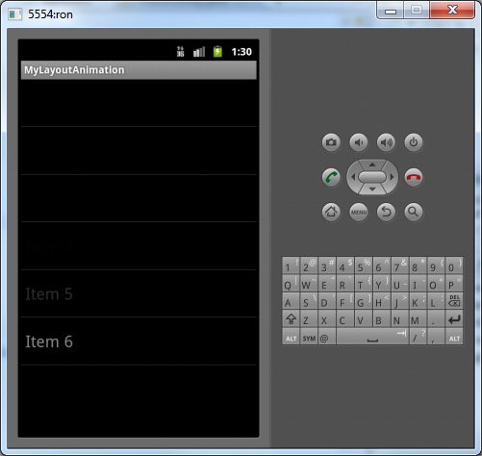
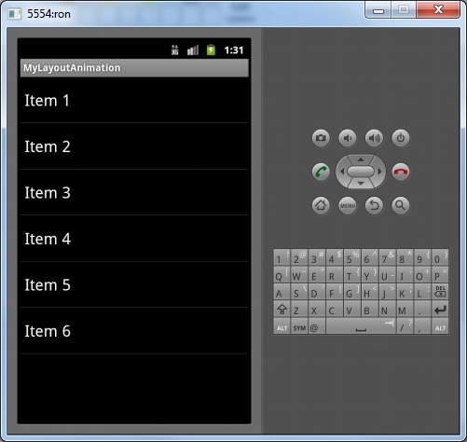
Running the App

Slide 20
The Android App Life Cycle

Slide 21
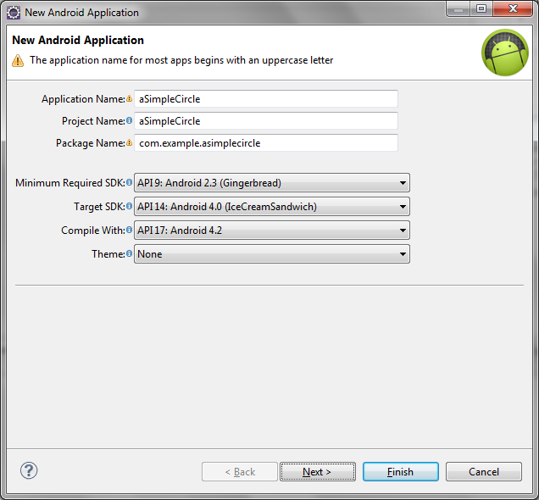
Create a new Project

Slide 22
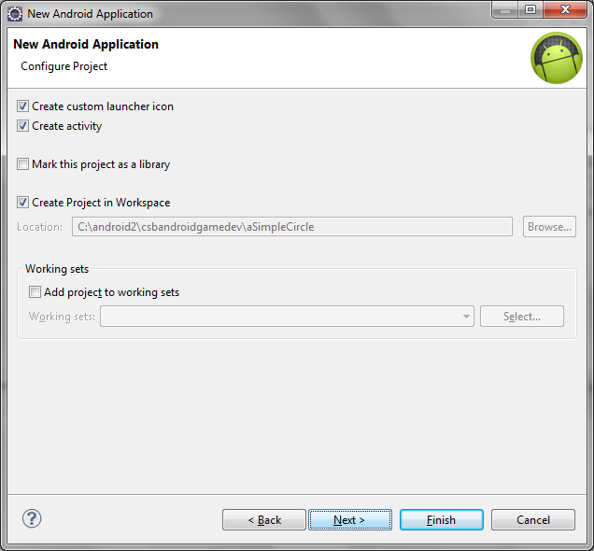
Create a new Project

Slide 23
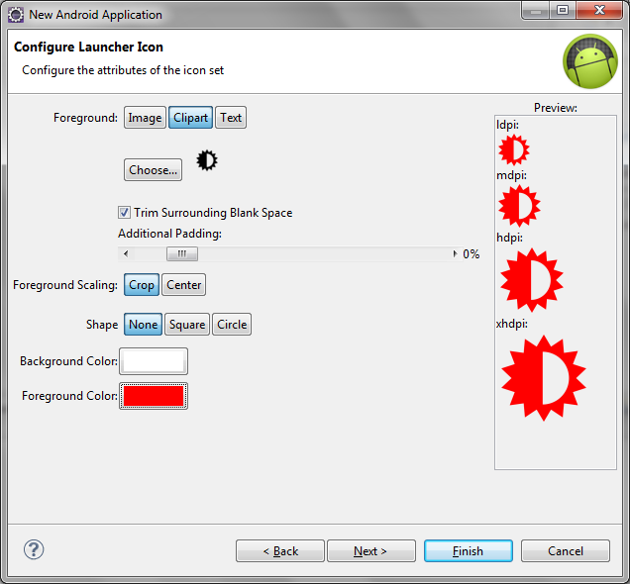
Create a new Project

Slide 24
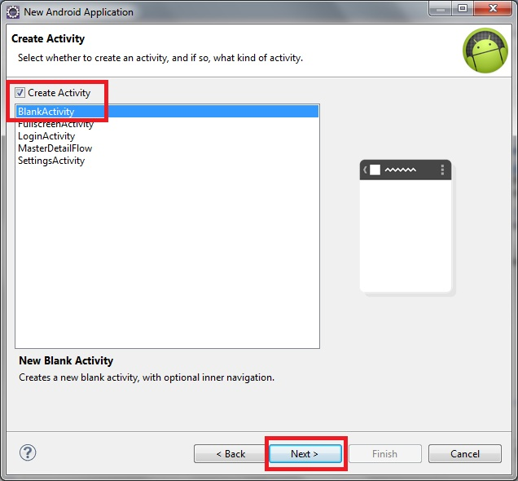
Create a new Project

Slide 25
Add the following code to the main activity
See notes section for complete code
Notes:
CODE
package com.example.asimplecircle;
import android.os.Bundle;
import android.app.Activity;
import android.view.Menu;
import android.widget.TextView;
public class CircleActivity extends Activity {
TextView tv;
@Override
protected void onCreate(Bundle savedInstanceState) {
super.onCreate(savedInstanceState);
setContentView(R.layout.mainscreen);
tv = new TextView(this);
setContentView(tv);
this.setTitle("Create Canvas Demo");
tv.setText("now in onCreate event \n");
}
@Override
protected void onDestroy() {
// TODO Auto-generated method stub
super.onDestroy();
tv.append("Now in onDestroy event \n");
}
@Override
protected void onPause() {
// TODO Auto-generated method stub
super.onPause();
tv.append("Now in onPause event \n");
}
@Override
protected void onRestart() {
// TODO Auto-generated method stub
super.onRestart();
tv.append("Now in onRestart event \n");
}
@Override
protected void onResume() {
// TODO Auto-generated method stub
super.onResume();
tv.append("Now in onResume event \n");
}
@Override
protected void onStart() {
// TODO Auto-generated method stub
super.onStart();
tv.append("Now in onStart event \n");
}
@Override
protected void onStop() {
// TODO Auto-generated method stub
super.onStop();
tv.append("Now in onStop event \n");
}
@Override
public boolean onCreateOptionsMenu(Menu menu) {
// Inflate the menu; this adds items to the action bar if it is present.
getMenuInflater().inflate(R.menu.mainscreen, menu);
return true;
}
}

Slide 26
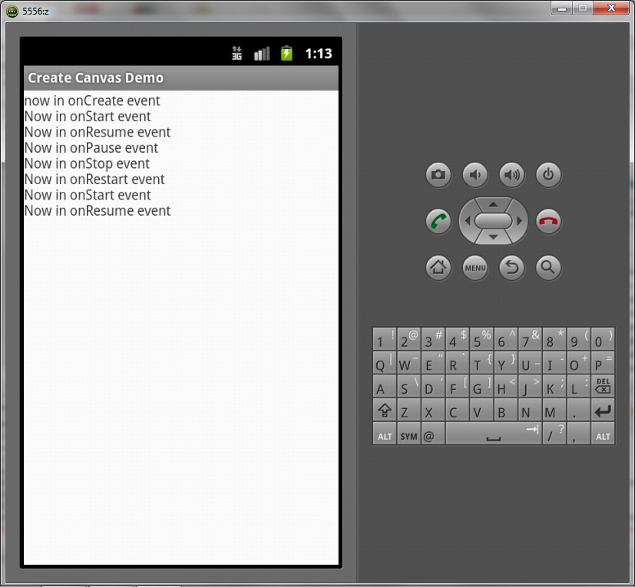
Run the project on the emulator

Slide 27
Android App Life Cycle
Android applications are written in the Java programming language. The Android SDK tools compile the code—along with any data and resource files—into an Android package, an archive file with an .apk suffix. All the code in a single .apk file is considered to be one application and is the file that Android-powered devices use to install the application.
Once installed on a device, each Android application lives in its own security sandbox:
  The Android operating system is a multi-user Linux system in which each application is a different user.
  By default, the system assigns each application a unique Linux user ID (the ID is used only by the system and is unknown to the application). The system sets permissions for all the files in an application so that only the user ID assigned to that application can access them.
  Each process has its own virtual machine (VM), so an application's code runs in isolation from other applications.
  By default, every application runs in its own Linux process. Android starts the process when any of the application's components need to be executed, then shuts down the process when it's no longer needed or when the system must recover memory for other applications.
In this way, the Android system implements the principle of least privilege. That is, each application, by default, has access only to the components that it requires to do its work and no more. This creates a very secure environment in which an application cannot access parts of the system for which it is not given permission.

Slide 28
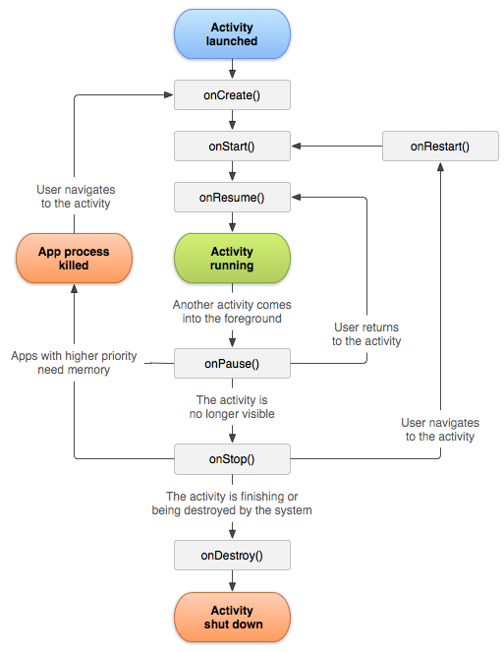
Activity Lifecycle
Notes:
Activities in the system are managed as an activity stack. When a new activity is started, it is placed on the top of the stack and becomes the running activity -- the previous activity always remains below it in the stack, and will not come to the foreground again until the new activity exits.
An activity has essentially four states:
If an activity in the foreground of the screen (at the top of the stack), it is active or running.
If an activity has lost focus but is still visible (that is, a new non-full-sized or transparent activity has focus on top of your activity), it is paused. A paused activity is completely alive (it maintains all state and member information and remains attached to the window manager), but can be killed by the system in extreme low memory situations.
If an activity is completely obscured by another activity, it is stopped. It still retains all state and member information, however, it is no longer visible to the user so its window is hidden and it will often be killed by the system when memory is needed elsewhere.
If an activity is paused or stopped, the system can drop the activity from memory by either asking it to finish, or simply killing its process. When it is displayed again to the user, it must be completely restarted and restored to its previous state.

Slide 29
Items to Monitor
There are three key loops you may be interested in monitoring within your activity:
  The entire lifetime of an activity happens between the first call to onCreate(Bundle) through to a single final call to onDestroy(). An activity will do all setup of "global" state in onCreate(), and release all remaining resources in onDestroy(). For example, if it has a thread running in the background to download data from the network, it may create that thread in onCreate() and then stop the thread in onDestroy().
  The visible lifetime of an activity happens between a call to onStart() until a corresponding call to onStop(). During this time the user can see the activity on-screen, though it may not be in the foreground and interacting with the user. Between these two methods you can maintain resources that are needed to show the activity to the user. For example, you can register a BroadcastReceiver in onStart() to monitor for changes that impact your UI, and unregister it in onStop() when the user no longer sees what you are displaying. The onStart() and onStop() methods can be called multiple times, as the activity becomes visible and hidden to the user.
  The foreground lifetime of an activity happens between a call to onResume() until a corresponding call to onPause(). During this time the activity is in front of all other activities and interacting with the user. An activity can frequently go between the resumed and paused states -- for example when the device goes to sleep, when an activity result is delivered, when a new intent is delivered -- so the code in these methods should be fairly lightweight.

Slide 30
Drawing a Circle

Slide 31
The Canvas
The Android framework APIs provides a set 2D drawing APIs that allow you to render your own custom graphics onto a canvas or to modify existing Views to customize their look and feel. When drawing 2D graphics, you'll typically do so in one of two ways:
  Draw your graphics or animations into a View object from your layout. In this manner, the drawing of your graphics is handled by the system's normal View hierarchy drawing process — you simply define the graphics to go inside the View.
  Draw your graphics directly to a Canvas. This way, you personally call the appropriate class's onDraw() method (passing it your Canvas), or one of the Canvas draw...() methods (like drawPicture()). In doing so, you are also in control of any animation.
Notes:
Option "a," drawing to a View, is your best choice when you want to draw simple graphics that do not need to change dynamically and are not part of a performance-intensive game. For example, you should draw your graphics into a View when you want to display a static graphic or predefined animation, within an otherwise static application. Read Drawables for more information.
Option "b," drawing to a Canvas, is better when your application needs to regularly re-draw itself. Applications such as video games should be drawing to the Canvas on its own. However, there's more than one way to do this:
In the same thread as your UI Activity, wherein you create a custom View component in your layout, call invalidate() and then handle the onDraw() callback.
Or, in a separate thread, wherein you manage a SurfaceView and perform draws to the Canvas as fast as your thread is capable (you do not need to request invalidate()).

Slide 32
Draw with a Canvas
When you're writing an application in which you would like to perform specialized drawing and/or control the animation of graphics, you should do so by drawing through a Canvas. A Canvas works for you as a pretense, or interface, to the actual surface upon which your graphics will be drawn — it holds all of your "draw" calls. Via the Canvas, your drawing is actually performed upon an underlying Bitmap, which is placed into the window.
In the event that you're drawing within the onDraw() callback method, the Canvas is provided for you and you need only place your drawing calls upon it. You can also acquire a Canvas from SurfaceHolder.lockCanvas(), when dealing with a SurfaceView object. (Both of these scenarios are discussed in the following sections.) However, if you need to create a new Canvas, then you must define the Bitmap upon which drawing will actually be performed. The Bitmap is always required for a Canvas. You can set up a new Canvas like this:

Slide 33
Imports
import android.os.Bundle;
import android.app.Activity;
import android.content.Context;
import android.graphics.Canvas;
import android.graphics.Color;
import android.graphics.Paint;
import android.view.Menu;
import android.view.View;

Slide 34
onCreate()
@Override
protected void onCreate(Bundle savedInstanceState) {
super.onCreate(savedInstanceState);
setContentView(R.layout.activity_main);
setContentView(new DrawView (this));
this.setTitle("Create Canvas Demo");
}

Slide 35
DrawView Class
public class DrawView extends View{
public DrawView(Context context){
super (context);
}
@Override
public void onDraw(Canvas canvas){
super.onDraw(canvas);
//fill canvas with white
Paint paint = new Paint();
paint.setAntiAlias(true);
canvas.drawColor(Color.WHITE);
//draw blue
paint.setColor(Color.BLUE);
canvas.drawCircle(100, 100, 50, paint);
}
}

Slide 36
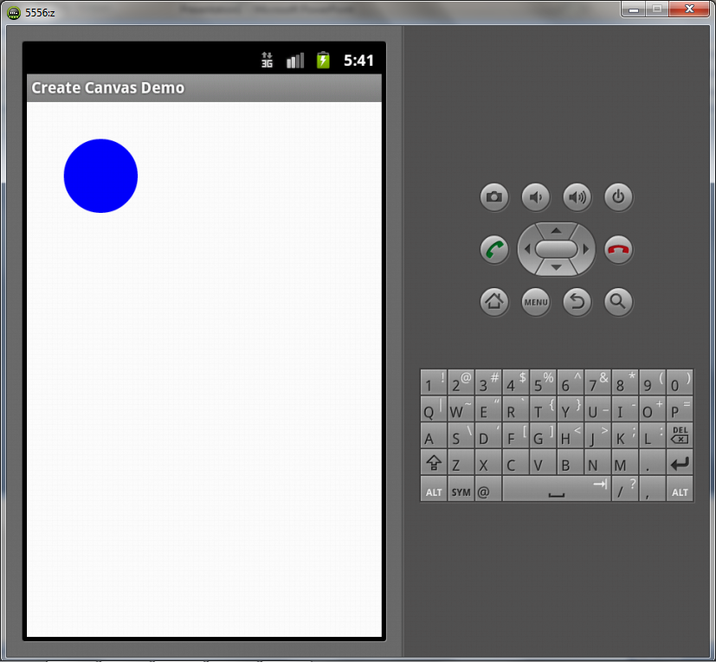
Running the App

Slide 37
Congratulations You have Rendered a Circle!

Slide 38
Vector Graphics

Slide 39
Drawing Basic Vector Shapes
You can draw to the Android screen using Canvas and View.
Notes:
We take a look at most of the Canvas drawing methods here. Although you might not consider vector shapes useful, they can be handy for in-game editors, for highlighting game objects, for underlining or boxing areas, and even for simple games.

Slide 40
Drawing Circles
The Canvas.drawCircle() method is used to draw circles:
public void drawCircle (float cx, float cy, float radius, Paint paint)

Slide 41
Drawing Lines
The Canvas class has a method called drawLine() that will draw a single line, and a method called drawLines() that will draw several lines passed in an array.
Single line drawing method:
public void drawLine (float startX, float startY, float stopX, float stopY, Paint paint)

Slide 42
Changing the Style: Stroke and Fill
Some basic shapes can be drawn either as an outline or border (stroked) or filled in with a color (filled).
The stroke constant is Style.STROKE, and the filled constant is Style.FILL.
You can set the draw style with a Paint object.
Paint.setStyle() and Paint.setColor() work in tandem to draw shapes with any color or draw style you specify.
For instance, the following sets the draw color to green and style to filled:
    paint.setColor( Color.GREEN );
    paint.setStyle( Style.FILL );

Slide 43
Sample Code
See slide notes section
Notes:
Sample Code:
import android.os.Bundle;
import android.app.Activity;
import android.content.Context;
import android.util.*;
import java.util.Random;
import android.graphics.*;
import android.graphics.Paint.Style;
import android.view.*;
public class Main extends Activity {
@Override public void onCreate(Bundle savedInstanceState) {
super.onCreate(savedInstanceState);
requestWindowFeature(Window.FEATURE_NO_TITLE);
setContentView(new DrawView(this));
}
public class DrawView extends View {
Random rand = new Random();
public DrawView(Context context) {
super(context);
DisplayMetrics metrics = new DisplayMetrics();
getWindowManager().getDefaultDisplay().getMetrics(metrics);
}
@Override public void onDraw(Canvas canvas) {
super.onDraw(canvas);
float px, py;
//create a paint object
Paint paint = new Paint();
paint.setAntiAlias( true );
paint.setColor( Color.WHITE );
//clear the screen with dark blue
canvas.drawColor( Color.rgb(0,0,80) );
//draw some boxes
for (int n=0; n<100; n+=4) {
drawBox( canvas, 10+n, 10+n, 220-n, 220-n, paint );
}
//draw a yellow triangle
paint.setColor( Color.YELLOW );
drawTriangle( canvas, 225,220, 325,20, 425,220, paint );
//draw small boxes in the path of a circle
float radius=100f;
float loops=6.0f;
for (double angle = 0.0; angle < 2*Math.PI*loops; angle += 0.15) {
px = (float)(110 + Math.cos(angle) * radius);
py = (float)(330 + Math.sin(angle) * radius);
radius -= 0.3f;
paint.setColor( Color.rgb(rand.nextInt(256),
rand.nextInt(256), rand.nextInt(256)) );
canvas.drawRect( px-4, py-4, px+4, py+4, paint );
}
//draw a circle outline
paint.setColor( Color.CYAN );
paint.setStyle( Style.STROKE );
canvas.drawCircle( 325, 325, 100, paint );
paint.setStyle( Style.FILL );
canvas.drawRoundRect( new RectF(325-70,325-70,325+70,325+70),
20, 20, paint );
//draw a filled circle
paint.setColor( Color.GREEN );
paint.setStyle( Style.FILL );
canvas.drawCircle( 325, 530, 100, paint );
//draw a filled oval
paint.setColor( Color.RED );
canvas.drawOval(new RectF(60,450,140,630), paint);
}
public void drawBox( Canvas canvas, float x1, float y1, float x2, float y2, Paint paint ){
drawBox( canvas, (int)x1, (int)y1, (int)x2, (int)y2, paint );
}
public void drawBox( Canvas canvas, int x1, int y1, int x2, int y2, Paint paint) {
drawBox( canvas, new Point(x1,y1), new Point(x2,y2), paint );
}
public void drawBox( Canvas canvas, Point p1, Point p2, Paint paint ) {
canvas.drawLine( p1.x, p1.y, p2.x, p1.y, paint);
canvas.drawLine( p2.x, p1.y, p2.x, p2.y+1, paint);
canvas.drawLine( p1.x, p1.y, p1.x, p2.y, paint);
canvas.drawLine( p1.x, p2.y, p2.x+1, p2.y+1, paint);
}
public void drawTriangle( Canvas canvas, int x1,int y1, int x2,int y2, int x3,int y3, Paint paint ) {
drawTriangle(canvas, new Point(x1,y1), new Point(x2,y2),
new Point(x3,y3), paint);
}
public void drawTriangle( Canvas canvas, Point p1, Point p2, Point p3, Paint paint ) {
canvas.drawLine(p1.x,p1.y,p2.x,p2.y, paint);
canvas.drawLine(p2.x,p2.y,p3.x,p3.y, paint);
canvas.drawLine(p3.x,p3.y,p1.x,p1.y, paint);
}
}
}

Slide 44
Accessing Online Data
Android and JSON
Notes:
http://www.informit.com/articles/article.aspx?p=2154675&seqNum=4

Slide 45
The Project
Create a new Android project called AccessWebServiceActivity
Name the main activity as: AccessWebServiceActivity.java

Slide 46
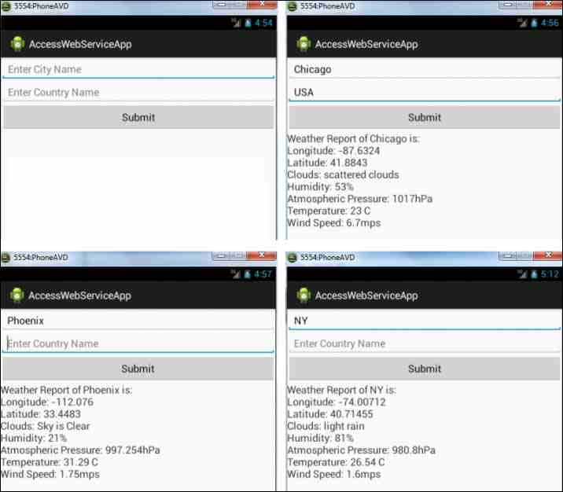
The interface
Code for activity_main.xml
The screen
Code for activity_main.xml file.
<LinearLayout xmlns:android="http://schemas.android.com/apk/res/android"
android:orientation="vertical"
android:layout_width="match_parent"
android:layout_height="match_parent">
<EditText
android:layout_width="match_parent"
android:layout_height="wrap_content"
android:id="@+id/city_name"
android:hint="Enter City Name"
android:textSize="18dp" />
<EditText
android:layout_width="match_parent"
android:layout_height="wrap_content"
android:id="@+id/country_name"
android:hint="Enter Country Name"
android:textSize="18dp" />
<Button
android:layout_width="match_parent"
android:layout_height="wrap_content"
android:id="@+id/submit_btn"
android:text="Submit"
android:textSize="18dp" />
<TextView
android:layout_width="match_parent"
android:layout_height="wrap_content"
android:id="@+id/response"
android:textSize="18dp" />
</LinearLayout>
Notes:
Code for activity_main.xml file:
<LinearLayout xmlns:android="http://schemas.android.com/apk/res/android"
android:orientation="vertical"
android:layout_width="match_parent"
android:layout_height="match_parent">
<EditText
android:layout_width="match_parent"
android:layout_height="wrap_content"
android:id="@+id/city_name"
android:hint="Enter City Name"
android:textSize="18dp" />
<EditText
android:layout_width="match_parent"
android:layout_height="wrap_content"
android:id="@+id/country_name"
android:hint="Enter Country Name"
android:textSize="18dp" />
<Button
android:layout_width="match_parent"
android:layout_height="wrap_content"
android:id="@+id/submit_btn"
android:text="Submit"
android:textSize="18dp" />
<TextView
android:layout_width="match_parent"
android:layout_height="wrap_content"
android:id="@+id/response"
android:textSize="18dp" />
</LinearLayout>
The layout file in the code abouve uses EditText, Button, and TextView controls as follows:
The two EditText controls display two textboxes to accept city and country names. The EditText controls are assigned the IDs city_name and country_name, respectively. Some hint text is displayed in each EditText control to guide the user about the type of data to enter there. Enter City Name is displayed in the EditText control with the ID city_name, and Enter Country Name is displayed as hint text in the EditText control with the ID country_name. The hint text automatically vanishes when the user types any text in each EditText control.
The Button control is assigned the ID submit_btn, and it's labeled Submit.
The TextView control is assigned the ID response. It will be used to display the weather information returned by the web service.
Two EditText controls and a Button control are displayed on application startup (top left). Weather information for the specified city and country of Chicago, USA is displayed (top right). Weather information can also be displayed when the user enters only the city name, such as Phoenix (bottom left), or nickname, such as NY (bottom right) for New York.

Slide 47
AccessWebServiceActivity.java
The Java activity file shown in the notes section performs the following tasks to access data from the web service:
Using HTTP, connect to the server.
Because the HTTP POST method is used for sending requests to the server, the HttpPost class is used to specify the URL of the server. The city and country names entered in the two EditText controls are accessed and appended to the URL.
The HttpClient class is used to connect to the server.
The HttpResponse class is used to get the connection status from the server. If the status code is 200, it means that the connection is successfully established with the server.
On establishing connection with the server, the BufferedReader and InputStreamReader classes are used to fetch the information returned by the web service. Remember that the information returned by the service is in JSON format.
From the received JSON format, the latitude, longitude, cloud description, humidity, temperature, and so on are accessed and displayed via the TextView control.
In simple terms, the fetched content is received as a JSONArray. The latitude, longitude, cloud description, humidity, atmospheric pressure, temperature, and wind speed values are accessed from the JSONArray and displayed through the TextView control.
Notes:
Code for Java activity file AccessWebServiceActivity.java:
package com.ronaldramos.accesswebserviceapp;
import android.os.Bundle;
import android.app.Activity;
import android.widget.Button;
import android.widget.EditText;
import android.widget.TextView;
import android.view.View;
import org.apache.http.client.methods.HttpPost;
import org.json.JSONException;
import org.apache.http.impl.client.DefaultHttpClient;
import org.apache.http.client.HttpClient;
import org.apache.http.HttpResponse;
import org.apache.http.HttpEntity;
import java.io.InputStream;
import java.io.BufferedReader;
import java.io.InputStreamReader;
import android.os.AsyncTask;
import org.json.JSONObject;
import org.apache.http.StatusLine;
import org.json.JSONArray;
import java.text.NumberFormat;
public class AccessWebServiceActivity extends Activity {
String city="";
@Override
public void onCreate(Bundle savedInstanceState) {
super.onCreate(savedInstanceState);
setContentView(R.layout.activity_main);
Button submitButton = (Button)this.findViewById(R.id.submit_btn);
submitButton.setOnClickListener(new Button.OnClickListener(){
public void onClick(View v) {
String country="";
EditText cityName = (EditText) findViewById(R.id.city_name);
city=cityName.getText().toString();
EditText countryName = (EditText) findViewById(R.id.country_name);
country=countryName.getText().toString();
String url="http://api.openweathermap.org/data/2.5/weather?q="+city+","+country;
new ReadJSONFeed().execute(url);
}
});
}
private class ReadJSONFeed extends AsyncTask<String, String, String> {
protected void onPreExecute() {}
@Override
protected String doInBackground(String... urls) {
HttpClient httpclient = new DefaultHttpClient();
StringBuilder builder = new StringBuilder();
HttpPost httppost = new HttpPost(urls[0]);
try {
HttpResponse response = httpclient.execute(httppost);
StatusLine statusLine = response.getStatusLine();
int statusCode = statusLine.getStatusCode();
if (statusCode == 200) {
HttpEntity entity = response.getEntity();
InputStream content = entity.getContent();
BufferedReader reader = new BufferedReader(new InputStreamReader(content));
String line;
while ((line = reader.readLine()) != null) {
builder.append(line);
}
}
} catch (Exception e) {
e.printStackTrace();
}
return builder.toString();
}
protected void onPostExecute(String result) {
String weatherInfo="Weather Report of "+city +" is: \n";
try{
JSONObject jsonObject = new JSONObject(result);
JSONObject jscoordObject = new JSONObject(jsonObject.getString("coord"));
weatherInfo+="Longitude: "+jscoordObject.getString("lon")+"\n";
weatherInfo+="Latitude: "+jscoordObject.getString("lat")+"\n";
JSONArray jsweatherObject = new JSONArray(jsonObject.getString("weather"));
JSONObject jweatherObject = jsweatherObject.getJSONObject(0);
weatherInfo+="Clouds: "+jweatherObject.getString("description")+"\n";
JSONObject jsmainObject = new JSONObject(jsonObject.getString("main"));
weatherInfo+="Humidity: "+jsmainObject.getString("humidity")+"% \n";
weatherInfo+="Atmospheric Pressure: "+jsmainObject.getString("pressure")+"hPa \n";
float temp=Float.parseFloat(jsmainObject.getString("temp"));
temp = temp - (float) 273.15;
NumberFormat df = NumberFormat.getNumberInstance();
df.setMaximumFractionDigits(2);
weatherInfo+="Temperature: "+ String.valueOf(df.format(temp)) +" C\n";
JSONObject jswindObject = new JSONObject(jsonObject.getString("wind"));
weatherInfo+="Wind Speed: "+jswindObject.getString("speed")+"mps \n";
}
catch (JSONException e) {
e.printStackTrace();
}
TextView resp = (TextView) findViewById(R.id.response);
if(weatherInfo.trim().length() >0 )
resp.setText(weatherInfo);
else
resp.setText("Sorry no match found");
}
}
}

Slide 48
Android Manifest
To access the web service uploaded on a server, we need to add Internet permission to the Android project. Nest the following statement in the <manifest> element in the AndroidManifest.xml file:
<uses-permission android:name="android.permission.INTERNET"/>

Slide 49
Running the App
Our Android application is finally ready!
When the application runs, a screen appears, prompting the user to enter the city and (optionally) country name whose weather information is required, and click the Submit button, after which our application uses the Internet to access the web service and returns the requested data to the user's screen.

Slide 50
Summary
You've learned how you can access publicly available web services and enhance features in your Android application.
The only thing you need to understand is the format in which the JSON data is returned by the web service.
As you construct your applications, analyze the JSON structure so you can use the supplied attributes correctly to access and return the desired information.

Slide 51
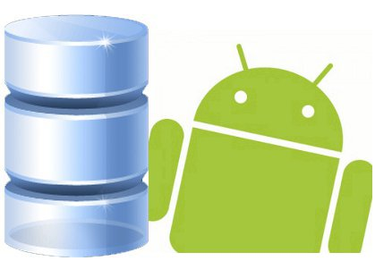
SQLite Databases and Android
Android’s built-in DB

Slide 52

SQLite is an Open Source Database which is embedded into Android. SQLite supports standard relational database features like SQL syntax, transactions and prepared statements. In addition it requires only little memory at runtime (approx. 250 KByte).
Using SQLite in Android does not require any database setup or administration. You specify the SQL for working with the database and the database is automatically managed for you.
Notes:
Working with databases in Android can be slow due to the necessary I/O. Therefore is it recommended to perform this task in an AsyncTask .
SQLite supports the data types TEXT (similar to String in Java), INTEGER (similar to long in Java) and REAL (similar to double in Java). All other types must be converted into on of these fields before saving them in the database. SQLite itself does not validate if the types written to the columns are actually of the defined type, you can write an integer into a string column.
If your application creates an database this database is saved in the directory "DATA/data/APP_NAME/databases/FILENAME". "DATA" is the path which Environment.getDataDirectory() returns, "APP_NAME" is your application name and "FILENAME" is the name you give the database during creation. Environment.getDataDirectory() usually return the SD card as location.
A SQlite database is private to the application which creates it. If you want to share data with other applications you can use a Content Provider.

Slide 53
SQLiteOpenHelper
To create and upgrade a database in your Android application you usually subclass "SQLiteOpenHelper". In this class you need to override the methods onCreate() to create the database and onUpgrade() to upgrade the database in case of changes in the database schema. Both methods receive an "SQLiteDatabase" object.
SQLiteOpenHelper provides the methods getReadableDatabase() and getWriteableDatabase() to get access to an "SQLiteDatabase" object which allows database access either in read or write mode.
For the primary key of the database you should always use the identifier "_id" as some of Android functions rely on this standard.

Slide 54
SQLiteDatabase methods
"SQLiteDatabase" provides the methods insert(), update() and delete() and execSQL() method which allows to execute directly SQL.
The object "ContentValues" allow to define key/values for insert and update. The key is the column and the value is the value for this column.
Queries can be created via the method rawQuery() which accepts SQL or query() which provides an interface for specifying dynamic data or SQLiteQueryBuilder.
Notes:
SQLiteBuilder is similar to the interface of an content provider therefore it is typically used in ContentProviders. A query always returns a "Cursor".
The method query has the parameters String dbName, int[] columnNames, String whereClause, String[] valuesForWhereClause, String[] groupBy, String[] having, String[] orderBy. If all data should be selected you can pass "null" as the where clause. The where clause is specified without "where", for example "_id=19 and summary=?". If several values are required via ? you pass them in the valuesForWhereClause array to the query. In general if something is not required you can pass "null", e.g. for the group by clause.

Slide 55
Cursor
A Cursor represents the result of a query. To get the number of elements use the method getCount(). To move between individual data rows, you can use the methods moveToFirst() and moveToNext(). Via the method isAfterLast() you can check if there is still some data.
A Cursor can be directly used via the "SimpleCursorAdapter" in ListViews.

Slide 56
A Sample DB App
Getting your hands dirty…

Slide 57
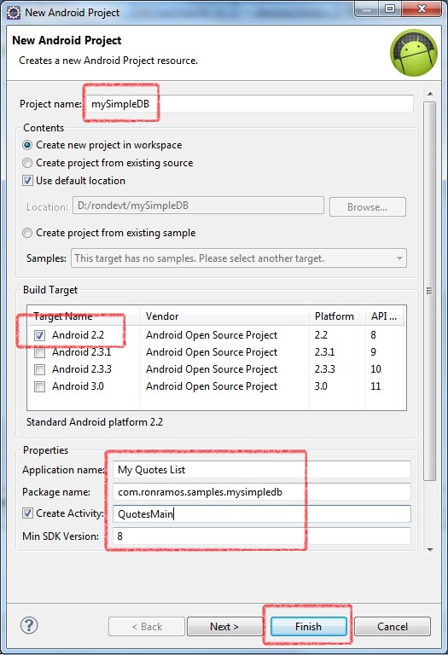

Create a new project

Slide 58
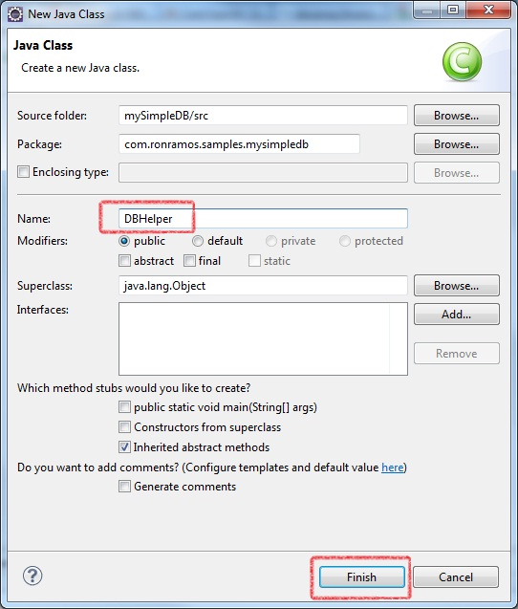
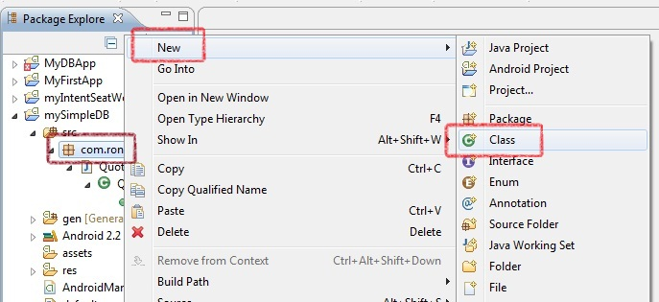
Add a DBHelper class

Slide 59
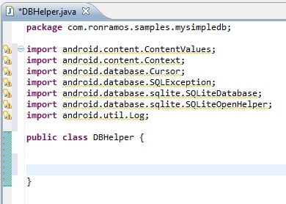
DBHelper class
import android.content.ContentValues;
import android.content.Context;
import android.database.Cursor;
import android.database.SQLException;
import android.database.sqlite.SQLiteDatabase;
import android.database.sqlite.SQLiteOpenHelper;
import android.util.Log;
public class DBAdapter
{
}
Notes:
Code:
import android.content.ContentValues;
import android.content.Context;
import android.database.Cursor;
import android.database.SQLException;
import android.database.sqlite.SQLiteDatabase;
import android.database.sqlite.SQLiteOpenHelper;
import android.util.Log;
public class DBAdapter
{
}

Slide 60
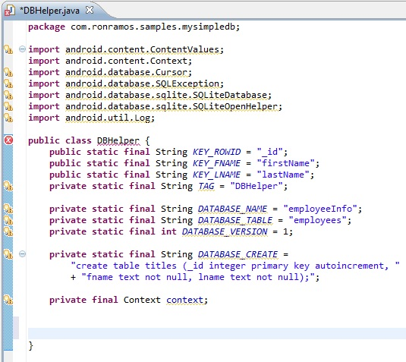
DBHelper class – initialize values
Notes:
Code:
import android.content.ContentValues;
import android.content.Context;
import android.database.Cursor;
import android.database.SQLException;
import android.database.sqlite.SQLiteDatabase;
import android.database.sqlite.SQLiteOpenHelper;
import android.util.Log;
public class DBHelper {
public static final String KEY_ID = "_id";
public static final String KEY_QUOTE = "quote";
private static final String TAG = "DBHelper";
private static final String DATABASE_NAME = "QuotesDB";
private static final String DATABASE_TABLE = "quotes";
private static final int DATABASE_VERSION = 1;
private static final String DATABASE_CREATE =
"create table quotes (_id integer primary key autoincrement, "
+ "quote text not null);";
private final Context context;

Slide 61
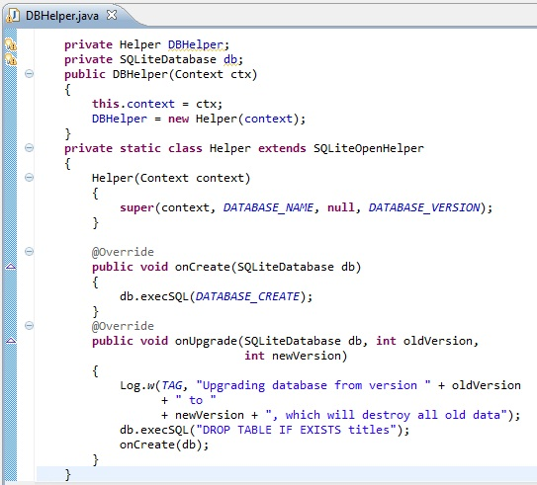
DBHelper – inner class
Within the DBAdapter class, you extend the SQLiteOpenHelper class—an Android helper class for database creation and versioning management.
In particular, you override the onCreate() and onUpgrade() methods
Notes:
The onCreate() method creates a new database if the required database is not present. The onUpgrade() method is called when the database needs to be upgraded. This is achieved by checking the value defined in the DATABASE_VERSION constant. For this implementation of the onUpgrade() method, you will simply drop the table and create the table again.
Code:
import android.content.ContentValues;
import android.content.Context;
import android.database.Cursor;
import android.database.SQLException;
import android.database.sqlite.SQLiteDatabase;
import android.database.sqlite.SQLiteOpenHelper;
import android.util.Log;
public class DBHelper {
public static final String KEY_ID = "_id";
public static final String KEY_QUOTE = "quote";
private static final String TAG = "DBHelper";
private static final String DATABASE_NAME = "QuotesDB";
private static final String DATABASE_TABLE = "quotes";
private static final int DATABASE_VERSION = 1;
private static final String DATABASE_CREATE =
"create table quotes (_id integer primary key autoincrement, "
+ "quote text not null);";
private final Context context;
// -- end initializers
private Helper DBH;
private SQLiteDatabase db;
public DBHelper(Context ctx)
{
this.context = ctx;
DBH = new Helper(context);
}
private static class Helper extends SQLiteOpenHelper
{
Helper(Context context)
{
super(context, DATABASE_NAME, null, DATABASE_VERSION);
}
@Override
public void onCreate(SQLiteDatabase db)
{
db.execSQL(DATABASE_CREATE);
}
@Override
public void onUpgrade(SQLiteDatabase db, int oldVersion,
int newVersion)
{
Log.w(TAG, "Upgrading database from version " + oldVersion
+ " to "
+ newVersion + ", which will destroy all old data");
db.execSQL("DROP TABLE IF EXISTS titles");
onCreate(db);
}
}
}

Slide 62
DBHelper – Open and Close
//---opens the database---
public DBHelper open() throws SQLException
{
db = DBH.getWritableDatabase();
return this;
}
//---closes the database---
public void close()
{
DBH.close();
}
Notes:
You can now define the various methods for opening and closing the database, as well as the methods for adding/editing/deleting rows in the table

Slide 63
DBHelper – Insert
//---insert a quote into the database---
public long insertQuote(String quote)
{
ContentValues initialValues = new ContentValues();
initialValues.put(KEY_QUOTE, quote);
return db.insert(DATABASE_TABLE, null, initialValues);
}

Slide 64
DBHelper – Update
//---updates an quote---
public boolean updateQuote(long rowId, String quote)
{
ContentValues args = new ContentValues();
args.put(KEY_QUOTE, quote);
return db.update(DATABASE_TABLE, args,
KEY_ID + "=" + rowId, null) > 0;
}

Slide 65
DBHelper – Delete
//---deletes a particular quotes---
public boolean deleteQuote(long rowId)
{
return db.delete(DATABASE_TABLE, KEY_ID + "=" + rowId, null) > 0;
}

Slide 66
DBHelper – GetAll
//---retrieves all the quotes---
public Cursor getAllQuotes()
{
return db.query(DATABASE_TABLE, new String[] {
KEY_ID,
KEY_QUOTE},
null,
null,
null,
null,
null);
}
Notes:
Notice that Android uses the Cursor class as a return value for queries. Think of the Cursor as a pointer to the result set from a database query. Using Cursor allows Android to more efficiently manage rows and columns as and when needed. You use a ContentValues object to store key/value pairs. Its put() method allows you to insert keys with values of different data types.

Slide 67
The Complete Code DBHelper
Notes:
package com.ronramos.samples.mysimpledb;
import android.content.ContentValues;
import android.content.Context;
import android.database.Cursor;
import android.database.SQLException;
import android.database.sqlite.SQLiteDatabase;
import android.database.sqlite.SQLiteOpenHelper;
import android.util.Log;
public class DBHelper {
public static final String KEY_ID = "_id";
public static final String KEY_QUOTE = "quote";
private static final String TAG = "DBHelper";
private static final String DATABASE_NAME = "QuotesDB";
private static final String DATABASE_TABLE = "quotes";
private static final int DATABASE_VERSION = 1;
private static final String DATABASE_CREATE =
"create table quotes (_id integer primary key autoincrement, "
+ "quote text not null);";
private final Context context;
// -- end initializers
private Helper DBH;
private SQLiteDatabase db;
public DBHelper(Context ctx)
{
this.context = ctx;
DBH = new Helper(context);
}
private static class Helper extends SQLiteOpenHelper
{
Helper(Context context)
{
super(context, DATABASE_NAME, null, DATABASE_VERSION);
}
@Override
public void onCreate(SQLiteDatabase db)
{
db.execSQL(DATABASE_CREATE);
}
@Override
public void onUpgrade(SQLiteDatabase db, int oldVersion,
int newVersion)
{
Log.w(TAG, "Upgrading database from version " + oldVersion
+ " to "
+ newVersion + ", which will destroy all old data");
db.execSQL("DROP TABLE IF EXISTS titles");
onCreate(db);
}
}
//---opens the database---
public DBHelper open() throws SQLException
{
db = DBH.getWritableDatabase();
return this;
}
//---closes the database---
public void close()
{
DBH.close();
}
//---insert a quote into the database---
public long insertQuote(String quote)
{
ContentValues initialValues = new ContentValues();
initialValues.put(KEY_QUOTE, quote);
return db.insert(DATABASE_TABLE, null, initialValues);
}
//---deletes a particular quotes---
public boolean deleteQuote(long rowId)
{
return db.delete(DATABASE_TABLE, KEY_ID + "=" + rowId, null) > 0;
}
//---retrieves all the quotes---
public Cursor getAllQuotes()
{
return db.query(DATABASE_TABLE, new String[] {
KEY_ID,
KEY_QUOTE},
null,
null,
null,
null,
null);
}
//---retrieves a particular quote---
public Cursor getQuote(long rowId) throws SQLException
{
Cursor mCursor =
db.query(true, DATABASE_TABLE, new String[] {
KEY_ID,
KEY_QUOTE
},
KEY_ID + "=" + rowId,
null,
null,
null,
null,
null);
if (mCursor != null) {
mCursor.moveToFirst();
}
return mCursor;
}
//---updates an quote---
public boolean updateQuote(long rowId, String quote)
{
ContentValues args = new ContentValues();
args.put(KEY_QUOTE, quote);
return db.update(DATABASE_TABLE, args,
KEY_ID + "=" + rowId, null) > 0;
}
}

Slide 68
Using DBHelper
Or why we had to do all that stuff

Slide 69
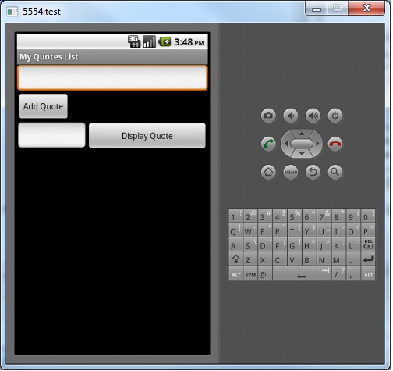
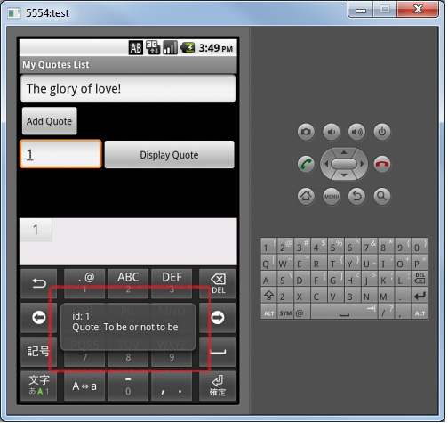
The app in action

Slide 70
Main.xml
<?xml version="1.0" encoding="utf-8"?>
<LinearLayout xmlns:android="http://schemas.android.com/apk/res/android"
android:orientation="vertical" android:layout_width="fill_parent"
android:layout_height="fill_parent">
<EditText android:layout_height="wrap_content"
android:layout_width="match_parent" android:id="@+id/editText1">
<requestFocus></requestFocus>
</EditText>
<Button android:text="Add Quote" android:id="@+id/button1"
android:layout_width="wrap_content" android:layout_height="wrap_content"></Button>
<LinearLayout android:layout_height="wrap_content"
android:layout_width="match_parent" android:id="@+id/linearLayout1">
<EditText android:layout_height="wrap_content"
android:layout_width="wrap_content" android:id="@+id/editText2"
android:layout_weight="0.30"></EditText>
<Button android:layout_height="wrap_content"
android:layout_width="wrap_content" android:layout_weight="0.30"
android:id="@+id/button2" android:text="Display Quote"></Button>
</LinearLayout>
</LinearLayout>
Notes:
<?xml version="1.0" encoding="utf-8"?>
<LinearLayout xmlns:android="http://schemas.android.com/apk/res/android"
android:orientation="vertical" android:layout_width="fill_parent"
android:layout_height="fill_parent">
<EditText android:layout_height="wrap_content"
android:layout_width="match_parent" android:id="@+id/editText1">
<requestFocus></requestFocus>
</EditText>
<Button android:text="Add Quote" android:id="@+id/button1"
android:layout_width="wrap_content" android:layout_height="wrap_content"></Button>
<LinearLayout android:layout_height="wrap_content"
android:layout_width="match_parent" android:id="@+id/linearLayout1">
<EditText android:layout_height="wrap_content"
android:layout_width="wrap_content" android:id="@+id/editText2"
android:layout_weight="0.30"></EditText>
<Button android:layout_height="wrap_content"
android:layout_width="wrap_content" android:layout_weight="0.30"
android:id="@+id/button2" android:text="Display Quote"></Button>
</LinearLayout>
</LinearLayout>

Slide 71
QuotesMain activity – initial values
final DBHelper db = new DBHelper(this);
Button btnAdd = (Button) findViewById(R.id.button1);
Button btnShow = (Button) findViewById(R.id.button2);
final EditText txtQuote = (EditText) findViewById(R.id.editText1);
final EditText txtRow = (EditText) findViewById(R.id.editText2);

Slide 72
QuotesMain activity – The add button
OnClickListener add = new OnClickListener(){
public void onClick(View view){
db.open();
long id;
id = db.insertQuote(txtQuote.getText().toString());
db.close();
}
};

Slide 73
QuotesMain activity – The show button
OnClickListener show = new OnClickListener(){
public void onClick(View view){
db.open();
Cursor c = db.getQuote(Long.parseLong(txtRow.getText().toString()));
if (c.moveToFirst()){
Toast.makeText(getApplicationContext(),
"id: " + c.getString(0) + "\n" +
"Quote: " + c.getString(1) + "\n",
Toast.LENGTH_LONG).show();
}
else{
Toast.makeText(getApplicationContext(),
"No Quote!",
Toast.LENGTH_LONG).show();
}
db.close();
}
};
Notes:
package com.ronramos.samples.mysimpledb;
import android.app.Activity;
import android.database.Cursor;
import android.os.Bundle;
import android.view.View;
import android.view.View.OnClickListener;
import android.widget.Button;
import android.widget.EditText;
import android.widget.Toast;
public class QuotesMain extends Activity {
/** Called when the activity is first created. */
@Override
public void onCreate(Bundle savedInstanceState) {
super.onCreate(savedInstanceState);
setContentView(R.layout.main);
final DBHelper db = new DBHelper(this);
Button btnAdd = (Button) findViewById(R.id.button1);
Button btnShow = (Button) findViewById(R.id.button2);
final EditText txtQuote = (EditText) findViewById(R.id.editText1);
final EditText txtRow = (EditText) findViewById(R.id.editText2);
OnClickListener add = new OnClickListener(){
public void onClick(View view){
db.open();
long id;
id = db.insertQuote(txtQuote.getText().toString());
db.close();
}
};
OnClickListener show = new OnClickListener(){
public void onClick(View view){
db.open();
Cursor c = db.getQuote(Long.parseLong(txtRow.getText().toString()));
if (c.moveToFirst()){
Toast.makeText(getApplicationContext(),
"id: " + c.getString(0) + "\n" +
"Quote: " + c.getString(1) + "\n",
Toast.LENGTH_LONG).show();
}
else{
Toast.makeText(getApplicationContext(),
"No Quote!",
Toast.LENGTH_LONG).show();
}
db.close();
}
};
btnAdd.setOnClickListener(add);
btnShow.setOnClickListener(show);
}
}

Slide 74
QuotesMain – complete code
Notes:
package com.ronramos.samples.mysimpledb;
import android.app.Activity;
import android.database.Cursor;
import android.os.Bundle;
import android.view.View;
import android.view.View.OnClickListener;
import android.widget.Button;
import android.widget.EditText;
import android.widget.Toast;
public class QuotesMain extends Activity {
/** Called when the activity is first created. */
@Override
public void onCreate(Bundle savedInstanceState) {
super.onCreate(savedInstanceState);
setContentView(R.layout.main);
final DBHelper db = new DBHelper(this);
Button btnAdd = (Button) findViewById(R.id.button1);
Button btnShow = (Button) findViewById(R.id.button2);
final EditText txtQuote = (EditText) findViewById(R.id.editText1);
final EditText txtRow = (EditText) findViewById(R.id.editText2);
OnClickListener add = new OnClickListener(){
public void onClick(View view){
db.open();
long id;
id = db.insertQuote(txtQuote.getText().toString());
db.close();
}
};
OnClickListener show = new OnClickListener(){
public void onClick(View view){
db.open();
Cursor c = db.getQuote(Long.parseLong(txtRow.getText().toString()));
if (c.moveToFirst()){
Toast.makeText(getApplicationContext(),
"id: " + c.getString(0) + "\n" +
"Quote: " + c.getString(1) + "\n",
Toast.LENGTH_LONG).show();
}
else{
Toast.makeText(getApplicationContext(),
"No Quote!",
Toast.LENGTH_LONG).show();
}
db.close();
}
};
btnAdd.setOnClickListener(add);
btnShow.setOnClickListener(show);
}
}

Slide 75
Screen Resolutions

Slide 76
Android Screen Densities and Resolutions
Android programs do not actually draw using resolutions defined in pixels, the way lower-level graphics routines do.
Android programs use a concept known as pixel density or more precisely, density-independent pixel (dp for short).
This is because of the variety of devices built around the Android OS, with widely varying screen sizes and resolutions. It might take some adjustment if you are more accustomed to working with pixels under a 2D graphics API or SDK.
Notes:
It is helpful to think of the “DP” measurement in terms of how large an image appears on a typical PC monitor. An Android device with a very high density LCD might have a resolution of 1280 × 800 on a tiny screen of only 3″ × 4″! That’s extremely high density, but it is possible. On such a screen, pixels have less meaning in terms of planning for a user interface or a game. Four generalized screen sizes are standard on the Android platform,

Slide 77
Android General Screen Sizes
General Size | Minimum Screen Resolution (dp)
Small | 426x320
Medium | 470x320
Large | 640x480
Extra Large | 960x720
Notes:
Because Google leaves it up to the Android device manufacturers to use any resolution they wish for a device without hindrance from the OS, there is no standard, only a generalization. This is a disadvantage for developers, but at least we can count on these general standards. If a device has a very peculiar screen resolution, a game will be scaled to fit (as a worst-case scenario).

Slide 78
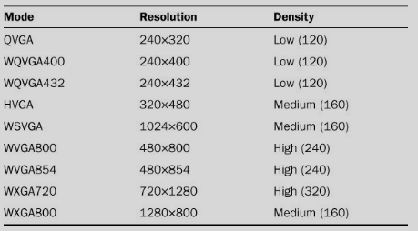
Android Screen Definitions
Notes:
We can detect the screen settings using a class called DisplayMetrics and the drawing Canvas object passed as a parameter to the onDraw() method. We are especially interested in the screen resolution (which comes from Canvas) and the screen density (from DisplayMetrics). Because you will most likely want to test your game on several devices, it is recommended that you create a new AVD for each type of device you want to test and then start up whichever one you want to test. Using the AVD, it takes a lot of patience to put up with its slow speed of operation. If possible, you will want to develop and test your code on a real Android device via USB cable. The two most common modes for Android Tablets (such as the Samsung Galaxy Tab or Toshiba Thrive) are WSVGA and WXGA800.

Slide 79
Packaging the Application

Slide 80
Before you consider your application ready for release
Test your application extensively on an actual devices
Consider adding an End User License Agreement in your application
Consider adding licensing support
Specify an icon and label in the application's manifest
Turn off logging and debugging and clean up data/files
Notes:
1. Test your application extensively on an actual device
It's important to test your application as extensively as possible, in as many areas as possible. To help you do that, Android provides a variety of testing classes and tools. You can use Instrumentation to run JUnit and other test cases, and you can use testing tools such as the UI/Application Exerciser Monkey.
To ensure that your application will run properly for users, you should make every effort to obtain one or more physical mobile device(s) of the type on which you expect the application to run. You should then test your application on the actual device, under realistic network conditions. Testing your application on a physical device is very important, because it enables you to verify that your user interface elements are sized correctly (especially for touch-screen UI) and that your application's performance and battery efficiency are acceptable.
If you can not obtain a mobile device of the type you are targeting for your application, you can use emulator options such as -dpi, -device, -scale, -netspeed, -netdelay, -cpu-delay and others to model the emulator's screen, network performance, and other attributes to match the target device to the greatest extent possible. You can then test your application's UI and performance. However, we strongly recommend that you test your application on an actual target device before publishing it.
2. Consider adding an End User License Agreement in your application
To protect your person, organization, and intellectual property, you may want to provide an End User License Agreement (EULA) with your application.
3. Consider adding support for Android Market Licensing
If you are publishing a paid application through Android Market, consider adding support for Android Market Licensing. Licensing lets you control access to your application based on whether the current user has purchased it. Using Android Market Licensing is optional.
For complete information about Android Market Licensing Service and how to use it in your application, see Licensing Your Applications.
4. Specify an icon and label in the application's manifest
The icon and label that you specify in an application's manifest are important because they are displayed to users as your application's icon and name. They are displayed on the device's Home screen, as well as in Manage Applications, My Downloads, and elsewhere. Additionally, publishing services may display the icon and label to users.
To specify an icon and label, you define the attributes android:icon and android:label in the <application> element of the manifest.
As regards the design of your icon, you should try to make it match as much as possible the style used by the built-in Android applications.
5. Turn off logging and debugging and clean up data/files
For release, you should make sure that debug facilities are turned off and that debug and other unnecessary data/files are removed from your application project.
Remove the android:debuggable="true" attribute from the <application> element of the manifest.
Remove log files, backup files, and other unnecessary files from the application project.
Check for private or proprietary data and remove it as necessary.
Deactivate any calls to Log methods in the source code.

Slide 81
Before you do the final compile of your application:
Version your application
Obtain a suitable cryptographic key
Register for a Maps API Key, if your application is using MapView elements
Notes:
6. Version your application
Before you compile your application, you must make sure that you have defined a version number for your application, specifying an appropriate value for both the android:versionCode and android:versionName attributes of the <manifest> element in the application's manifest file. Carefully consider your version numbering plans in the context of your overall application upgrade strategy.
If you have previously released a version of your application, you must make sure to increment the version number of the current application. You must increment both the android:versionCode and android:versionName attributes of the <manifest> element in the application's manifest file, using appropriate values.
For detailed information about how to define version information for your application, see Versioning Your Applications.
7. Obtain a suitable cryptographic key
If you have read and followed all of the preparation steps up to this point, your application is compiled and ready for signing. Inside the .apk, the application is properly versioned, and you've cleaned out extra files and private data, as described above.
Before you sign your application, you need to make sure that you have a suitable private key. For complete information about how to obtain (or generate) a private key, see Obtaining a Suitable Private Key.
Once you have obtained (or generated) a suitable private key, you will use it to:
Register for a Maps API Key (see below), if your application uses MapView elements.
Sign your application for release, later in the preparation process
8. Register for a Maps API Key, if your application is using MapView elements
For complete information about getting a Maps API Key, see Obtaining a Maps API Key.
If your application uses one or more Mapview elements, you will need to register your application with the Google Maps service and obtain a Maps API Key, before your MapView(s) will be able to retrieve data from Google Maps. To do so, you supply an MD5 fingerprint of your signer certificate to the Maps service.
During development, you can get a temporary Maps API Key by registering the debug key generated by the SDK tools. However, before publishing your application, you must register for a new Maps API Key that is based on your private key.
If your application uses MapView elements, the important points to understand are:
You must obtain the Maps API Key before you compile your application for release, because you must add the Key to a special attribute in each MapView element — android:apiKey — in your application's layout files. If you are instantiating MapView objects directly from code, you must pass the Maps API Key as a parameter in the constructor.
The Maps API Key referenced by your application's MapView elements must be registered (in Google Maps) to the certificate used to sign the application. This is particularly important when publishing your application — your MapView elements must reference a Key that is registered to the release certificate that you will use to sign your application.
If you previously got a temporary Maps API Key by registering the debug certificate generated by the SDK tools, you must remember to obtain a new Maps API Key by registering your release certificate. You must then remember to change the MapView elements to reference the new Key, rather than the Key associated with the debug certificate. If you do not do so, your MapView elements will not have permission to download Maps data.
If you change the private key that you will use to sign your application, you must remember to obtain a new Maps API Key from the Google Maps service. If you do not get a new Maps API Key and apply it to all MapView elements, any MapView elements referencing the old Key will not have permission to download Maps data.

Slide 82
Final Checks
Compile your application
After you compile your application:
  Sign your application
  Test your compiled application
Notes:
Compile your application
When you've prepared your application as described in the previous sections, you can compile your application for release.
After you compile your application
9. Sign your application
Sign your application using your private key and then align it with the zipalign tool. Signing your application correctly is critically important. Please see Signing Your Applications for complete information.
10. Test your compiled and signed application
Before you release your compiled application, you should thoroughly test it on the target mobile device (and target network, if possible). In particular, you should make sure that any MapView elements in your UI are receiving maps data properly. If they are not, go back to Register for a Maps API Key and correct the problem. You should also ensure that the application works correctly with any server-side services and data that you are providing or are relying on and that the application handles any authentication requirements correctly.
After testing, you are now ready to publish your application to mobile device users.

Slide 83
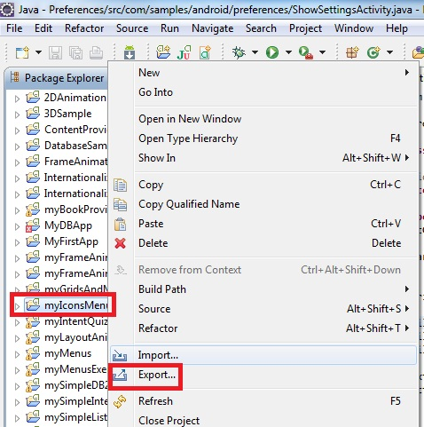
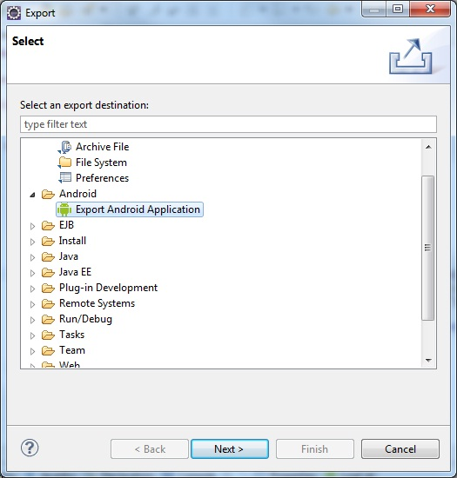
Converting your Android Project into an APK
Notes:
Right click on the project you want to turn into an APK file and select Export.
Select Export Android Application

Slide 84
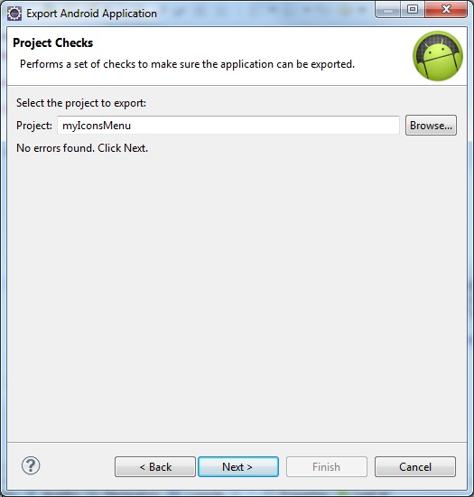
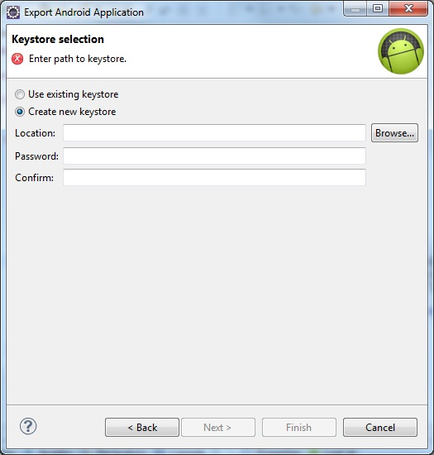
Converting your Android Project into an APK
Notes:
Eclipse will check your App for compliance
Then you will create a keystore for your application.

Slide 85
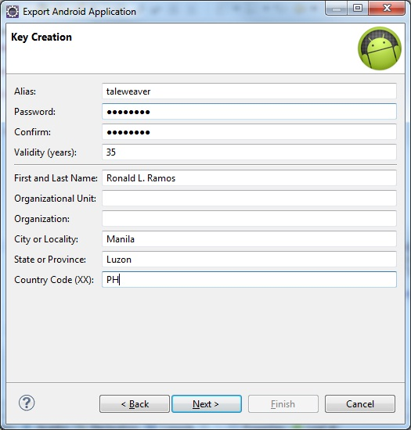
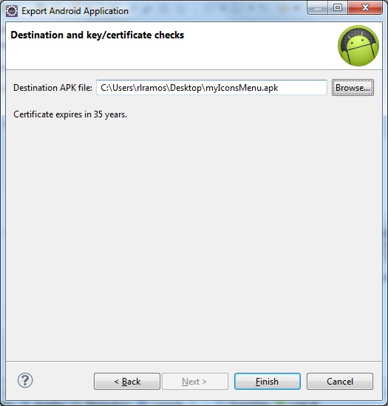
Converting your Android Project into an APK
Notes:
Fill in your keystore info
Select your destination for the APK file. Finish!

Slide 86
Installing the Application

Slide 87
Ways to install
Via the android market if it is published
Via direct install using APK file

Slide 88
Publishing on the Android Market
Notes:
End of seminar

Slide 89
The Android Market
Android Market is a service that makes it easy for users to find and download Android applications to their Android-powered devices, either from the Android Market application on their device or from the Android Market web site (market.android.com).
As a developer, you can use Android Market to distribute your applications to users on all types of Android-powered devices, all around the world.
Notes:
To publish your application on Android Market, you first need to register with the service using a Google account and agree to the terms of service. Once you are registered, you can upload your application to the service whenever you want, update it as many times as you want, and then publish it when you are ready. Once published, users can see your application, download it, and rate it.
To register as an Android Market developer and get started with publishing, visit the Android Market publisher site:
http://market.android.com/publish

Slide 90
Uploading your Apps
To publish your application on Android Market:
  You first need to register with the service using a Google account and agree to the terms of service.
  Once you are registeredyou can upload your application to the service whenever you want, update it as many times as you want
  And then publish it when you are ready.
Once published, users can see your application, download it, and rate it.

Slide 91
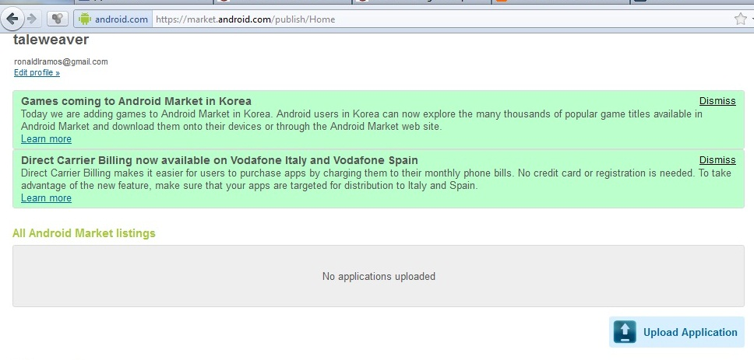
Uploading your App

Slide 92
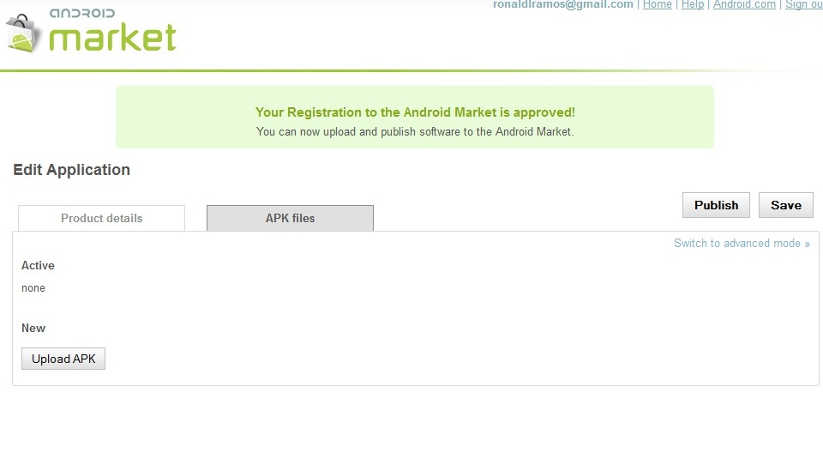
Uploading your App

Slide 93
Requirements enforced by the Android Market server
Your application must be signed with a cryptographic private key whose validity period ends after 22 October 2033.
Your application must define both an android:versionCode and an android:versionName attribute in the <manifest> element of its manifest file.
Your application must define both an android:icon and an android:label attribute in the <application> element of its manifest file.
Notes:
The server uses the android:versionCode as the basis for identifying the application internally and handling updates, and it displays the android:versionName to users as the application's version.

Slide 94
Upload Assets
APK file size: Maximum supported size is 50MB.
Draft application .apk file: When you upload an .apk file, it can be saved as a draft while you edit the other aspects of the list.
Please note that package names for app files are unique and permanent, so please choose wisely. Package names cannot be deleted or re-used in the future.
Screenshots: 2 screenshots are required. The additional 6 are optional.
High-Resolution Application Icon: Required.
Promotional Graphic: Optional.
Feature Graphic: Optional.
Promotional Video: Optional.

Slide 95
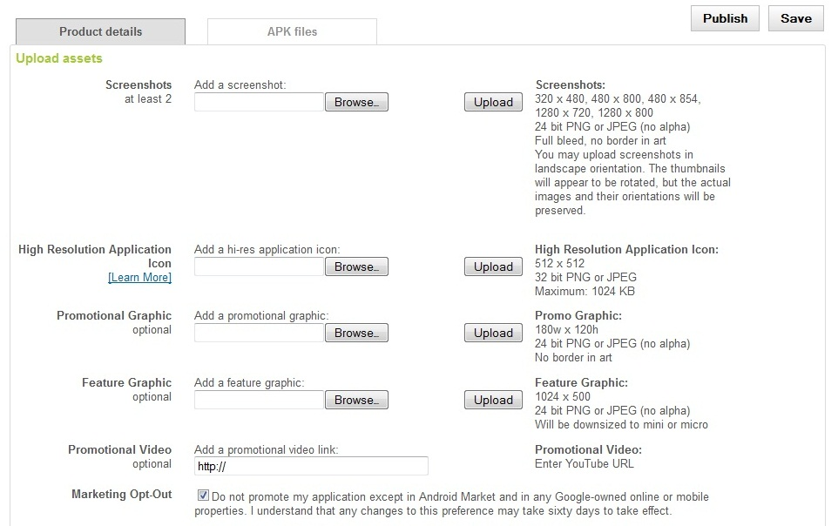
Upload Assets

Slide 96
Final Words
Thank you for attending the first smart android bootcamp!
Hopefully you learned something and will be able to use it in the future

