Slide 1

Android Layouts
Ronald L. Ramos
Android Summer Bootcamp Day 2

Slide 2
Android Project Components

Slide 3
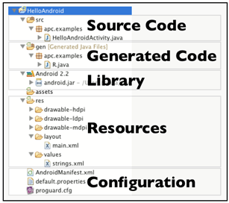

Project Components

Slide 4
R Class
Auto-generated: you shouldn’t edit it
Contains IDs of the project resources
Enforces good software engineering
Use findViewById and Resources object to get access to the resources
  Ex. Button b = (Button)findViewById(R.id.button1)
  Ex. getResources().getString(R.string.hello));

Slide 5
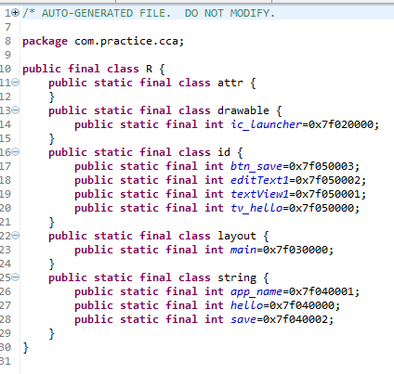
R.Java Class

Slide 6
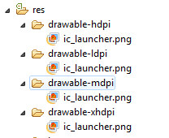
Drawables

Slide 7
Layouts
Eclipse has a visual UI creator
  Generates the XML for you
Composed of View objects
Can be specified for portrait and landscape mode
  Use same file name, so can make completely different UIs for the orientations without modifying any code

Slide 8
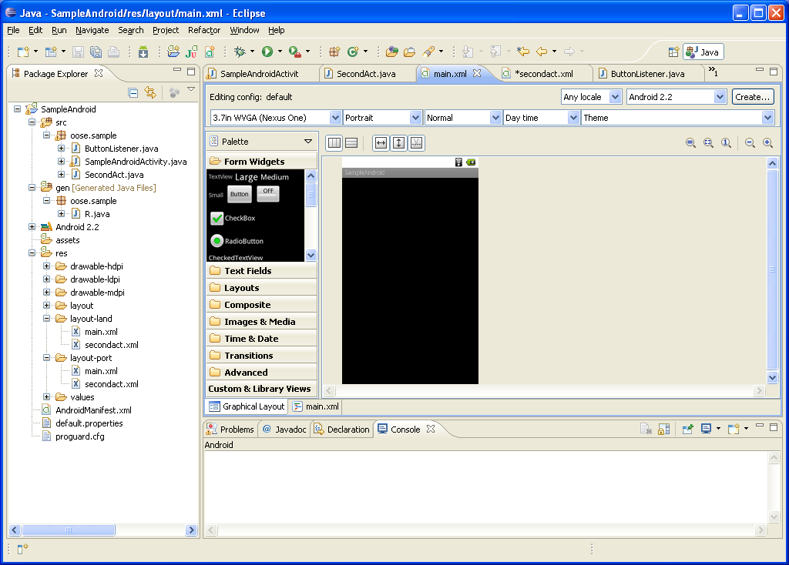
LayoutS
Notes:
Click ‘Create’ to make layout modifications
When in portrait mode can select ‘Portrait’ to make a res sub folder for portrait layouts
Likewise for Landscape layouts while in landscape mode
Will create folders titled ‘layout-port’ and ‘layout-land’
Note: these ‘port’ and ‘land’ folders are examples of ‘alternate layouts’, see here for more info
http://developer.android.com/guide/topics/resources/providing-resources.html
Avoid errors by making sure components have the same id in both orientations, and that you’ve tested each orientation thoroughly

Slide 9
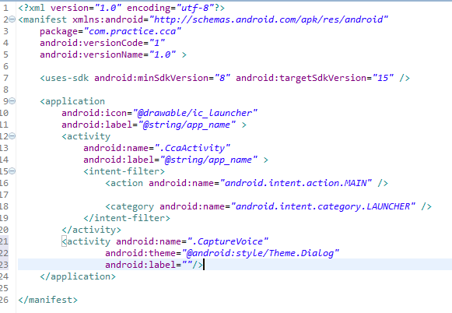
Manifest File

Slide 10
The Application icon
If you intend on your application being available on a large range of devices, you should place your application icon into the four different res/drawable... folders provided . In each of these folders, you should include the correct sized icon:
  drawable-ldpi (120 dpi, Low density screen) - 36px x 36px
  drawable-mdpi (160 dpi, Medium density screen) - 48px x 48px
  drawable-hdpi (240 dpi, High density screen) - 72px x 72px
  drawable-xhdpi (320 dpi, Extra-high density screen) - 96px x 96px
You then define the icon in your AndroidManifest.xml file as such:
  <application android:icon="@drawable/icon_name" android:label="@string/app_name" > .... </application>

Slide 11

Using Layouts
Arranging my UI

Slide 12
Layouts
An Android layout is a class that handles arranging the way its children appear on the screen.
Anything that is a View (or inherits from View) can be a child of a layout.
All of the layouts inherit from ViewGroup (which inherits from View) so you can nest layouts.
You could also create your own custom layout by making a class that inherits from ViewGroup.

Slide 13
Standard Layouts
The standard Layouts are:
  AbsoluteLayout
  FrameLayout
  LinearLayout
  RelativeLayout
  TableLayout

Slide 14
AbsoluteLayout
AbsoluteLayout is based on the simple idea of placing each control at an absolute position.
  You specify the exact x and y coordinates on the screen for each control.
This is not recommended for most UI development (in fact AbsoluteLayout is currently deprecated) since absolutely positioning every element on the screen makes an inflexible UI that is much more difficult to maintain.
Notes:
Consider what happens if a control needs to be added to the UI. You would have to change the position of every single element that is shifted by the new control.

Slide 15
Absolute Layout XML
<AbsoluteLayout xmlns:android="http://schemas.android.com/apk/res/android"
android:layout_width="fill_parent"
android:layout_height="fill_parent">
<Button
android:id="@+id/backbutton"
android:text="Back"
android:layout_x="10px"
android:layout_y="5px"
android:layout_width="wrap_content"
android:layout_height="wrap_content" />
<TextView
android:layout_x="10px"
android:layout_y="110px"
android:text="First Name"
android:layout_width="wrap_content"
android:layout_height="wrap_content" />
<EditText
android:layout_x="150px"
android:layout_y="100px"
android:width="100px"
android:layout_width="wrap_content"
android:layout_height="wrap_content" />
<TextView
android:layout_x="10px"
android:layout_y="160px"
android:text="Last Name"
android:layout_width="wrap_content"
android:layout_height="wrap_content" />
<EditText
android:layout_x="150px"
android:layout_y="150px"
android:width="100px"
android:layout_width="wrap_content"
android:layout_height="wrap_content" />
</AbsoluteLayout
Notes:
Note how each element has android:layout_x and android:layout_y specified.

Slide 16
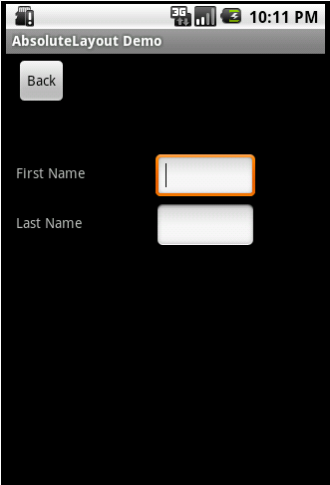
Absolute Layout Screenshoot
Here is a screenshot of the layout produced by the XML.
Notes:
Android defines the top left of the screen as (0,0) so the layout_x value will move the control to the right, and the layout_y value will move the control down.

Slide 17
FrameLayout
FrameLayout is designed to display a single item at a time.
You can have multiple elements within a FrameLayout but each element will be positioned based on the top left of the screen.
Elements that overlap will be displayed overlapping.

Slide 18
Frame Layout XML
<FrameLayout
android:layout_width="fill_parent"
android:layout_height="fill_parent"
xmlns:android="http://schemas.android.com/apk/res/android">
<ImageView
android:src="@drawable/icon"
android:scaleType="fitCenter"
android:layout_height="fill_parent"
android:layout_width="fill_parent"/>
<TextView
android:text="Learn-Android.com"
android:textSize="24sp"
android:textColor="#000000"
android:layout_height="fill_parent"
android:layout_width="fill_parent"
android:gravity="center"/>
</FrameLayout>

Slide 19

Frame Layout Screenshot
You can see both the ImageView and TextView fill the parent in both horizontal and vertical layout.
Gravity specifies where the text appears within its container, so it was set to center.
If gravity was not set the text would have appeared at the top left of the screen.
Notes:
FrameLayout can become more useful when elements are hidden and displayed programmatically. You can use the attribute android:visibility in the XML to hide specific elements. You can call setVisibility from the code to accomplish the same thing. The three available visibility values are visible, invisible (does not display, but still takes up space in the layout), and gone (does not display, and does not take space in the layout).
So you could, for example, have a game in a FrameView where text displayed to the user is visible in the middle of the screen at appropriate times (e.g. “Game Over”).

Slide 20

LinearLayout
LinearLayout organizes elements along a single line.
You specify whether that line is verticle or horizontal using android:orientation.

Slide 21
Linear Layout XML
<LinearLayout xmlns:android="http://schemas.android.com/apk/res/android"
android:orientation="horizontal"
android:layout_width="fill_parent"
android:layout_height="fill_parent">
<Button
android:id="@+id/backbutton"
android:text="Back"
android:layout_width="wrap_content"
android:layout_height="wrap_content" />
<TextView
android:text="First Name"
android:layout_width="wrap_content"
android:layout_height="wrap_content" />
<EditText
android:width="100px"
android:layout_width="wrap_content"
android:layout_height="wrap_content" />
<TextView
android:text="Last Name"
android:layout_width="wrap_content"
android:layout_height="wrap_content" />
<EditText
android:width="100px"
android:layout_width="wrap_content"
android:layout_height="wrap_content" />
</LinearLayout>

Slide 22
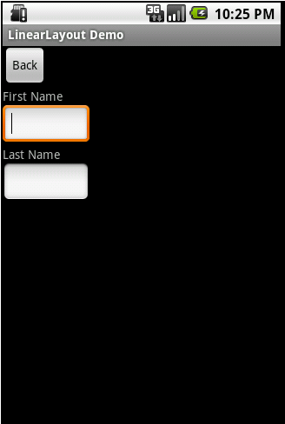
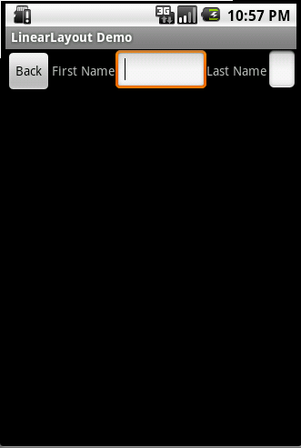
Linear Layout Screenshots
Vertical Align
Horizontal Align

Slide 23
Nested Linear Layouts
<LinearLayout xmlns:android="http://schemas.android.com/apk/res/android"
android:orientation="vertical"
android:layout_width="fill_parent"
android:layout_height="fill_parent">
<Button
android:id="@+id/backbutton"
android:text="Back"
android:layout_width="wrap_content"
android:layout_height="wrap_content" />
<LinearLayout
android:orientation="horizontal"
android:layout_width="fill_parent"
android:layout_height="wrap_content">
<TextView
android:text="First Name"
android:layout_width="wrap_content"
android:layout_height="wrap_content" />
<EditText
android:width="100px"
android:layout_width="wrap_content"
android:layout_height="wrap_content" />
</LinearLayout>
<LinearLayout
android:orientation="horizontal"
android:layout_width="fill_parent"
android:layout_height="wrap_content">
<TextView
android:text="Last Name"
android:layout_width="wrap_content"
android:layout_height="wrap_content" />
<EditText
android:width="100px"
android:layout_width="wrap_content"
android:layout_height="wrap_content" />
</LinearLayout>
</LinearLayout>
Notes:
As you can see we have a Vertical LinearLayout whose children are a button, and two horizontal LinearLayouts.
Each horizontal LinearLayout has two child controls. You should note that in the child LinearLayout elements you use android:layout_height=”wrap_content” instead of fill_parent. If you use fill_parent the first name TextView and EditView would have taken all of the available space on the screen, and the Last Name would not be displayed.

Slide 24
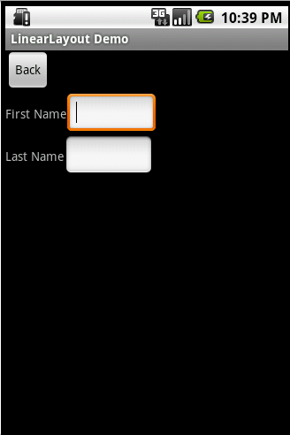
Nested Linear Layouts Screenshots
Nested Layouts do not have to be of one type.
You could, for example, have a LinearLayout as one of the children in a FrameLayout.

Slide 25
RelativeLayout
RelativeLayout lays out elements based on their relationships with one another, and with the parent container.
This is arguably the most complicated layout, and we need several properties to actually get the layout we want

Slide 26
Relative To Container
These properties will layout elements relative to the parent container:
  android:layout_alignParentBottom – Places the bottom of the element on the bottom of the container
  android:layout_alignParentLeft – Places the left of the element on the left side of the container
  android:layout_alignParentRight – Places the right of the element on the right side of the container
  android:layout_alignParentTop – Places the element at the top of the container
  android:layout_centerHorizontal – Centers the element horizontally within its parent container
  android:layout_centerInParent – Centers the element both horizontally and vertically within its container
  android:layout_centerVertical – Centers the element vertically within its parent container

Slide 27
Relative To Other Elements
These properties allow you to layout elements relative to other elements on screen.
The value for each of these elements is the id of the element you are using to layout the new element. Each element that is used in this way must have an ID defined using android:id=”@+id/XXXXX” where XXXXX is replaced with the desired id. You use “@id/XXXXX” to reference an element by its id.
One thing to remember is that referencing an element before it has been declared will produce an error.
  android:layout_above – Places the element above the specified element
  android:layout_below – Places the element below the specified element
  android:layout_toLeftOf – Places the element to the left of the specified element
  android:layout_toRightOf – Places the element to the right of the specified element

Slide 28
Alignment With Other Elements
These properties allow you to specify how elements are aligned in relation to other elements.
  android:layout_alignBaseline – Aligns baseline of the new element with the baseline of the specified element
  android:layout_alignBottom – Aligns the bottom of new element in with the bottom of the specified element
  android:layout_alignLeft – Aligns left edge of the new element with the left edge of the specified element
  android:layout_alignRight – Aligns right edge of the new element with the right edge of the specified element
  android:layout_alignTop – Places top of the new element in alignment with the top of the specified element

Slide 29
Relative Layout XML
<RelativeLayout
android:layout_width="fill_parent"
android:layout_height="fill_parent"
xmlns:android="http://schemas.android.com/apk/res/android">
<Button
android:id="@+id/backbutton"
android:text="Back"
android:layout_width="wrap_content"
android:layout_height="wrap_content" />
<TextView
android:id="@+id/firstName"
android:text="First Name"
android:layout_width="wrap_content"
android:layout_height="wrap_content"
android:layout_below="@id/backbutton" />
<EditText
android:width="100px"
android:layout_width="wrap_content"
android:layout_height="wrap_content"
android:layout_toRightOf="@id/firstName"
android:layout_alignBaseline="@id/firstName" />
<TextView
android:id="@+id/lastName"
android:text="Last Name"
android:layout_width="wrap_content"
android:layout_height="wrap_content"
android:layout_below="@id/firstName" />
<EditText
android:width="100px"
android:layout_width="wrap_content"
android:layout_height="wrap_content"
android:layout_toRightOf="@id/lastName"
android:layout_alignBaseline="@id/lastName" />
</RelativeLayout>

Slide 30
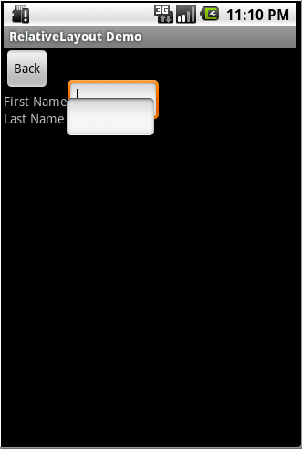
Relative Layout Screenshoot
The problem here is that when Android draws the TextView lastName below the TextView firstName it only sets aside the space it needs for the TextView.
Notes:
Android only reads the Layout XML one time so it doesn’t know that an EditView is the next item and doesn’t plan for it. So when the EditView is drawn to the right of the TextView it only has the height of the TextView to work with so it overlaps the EditView above it. Here is the Layout XML I wrote to create the form the way it should look.

Slide 31
Corrected Relative Layout XML
<RelativeLayout
android:layout_width="fill_parent"
android:layout_height="fill_parent"
xmlns:android="http://schemas.android.com/apk/res/android">
<Button
android:id="@+id/backbutton"
android:text="Back"
android:layout_width="wrap_content"
android:layout_height="wrap_content" />
<TextView
android:id="@+id/firstName"
android:text="First Name"
android:layout_width="wrap_content"
android:layout_height="wrap_content"
android:layout_below="@id/backbutton" />
<EditText
android:id="@+id/editFirstName"
android:width="100px"
android:layout_width="wrap_content"
android:layout_height="wrap_content"
android:layout_toRightOf="@id/firstName"
android:layout_below="@id/backbutton"/>
<EditText
android:id="@+id/editLastName"
android:width="100px"
android:layout_width="wrap_content"
android:layout_height="wrap_content"
android:layout_below="@id/editFirstName"
android:layout_alignLeft="@id/editFirstName"/>
<TextView
android:id="@+id/lastName"
android:text="Last Name"
android:layout_width="wrap_content"
android:layout_height="wrap_content"
android:layout_toLeftOf="@id/editLastName"
android:layout_below="@id/editFirstName" />
</RelativeLayout>
Notes:
Here is the updated RelativeLayout. Elements had to be rearranged in the XML since you cannot reference an element that has not already been laid out.

Slide 32
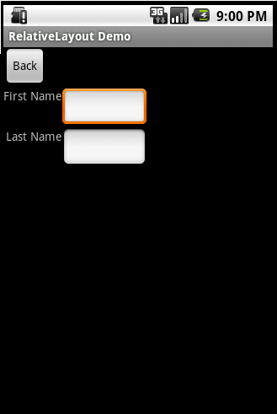
Relative Layout Screenshoot (Corrected)
Looks like a proper form now

Slide 33
TableLayout
TableLayout organizes content into rows and columns.
  The rows are defined in the layout XML, and the columns are determined automatically by Android.
This is done by creating at least one column for each element.
  So, for example, if you had a row with two elements and a row with five elements then you would have a layout with two rows and five columns.
Notes:
You can specify that an element should occupy more than one column using android:layout_span. This can increase the total column count as well, so if we have a row with two elements and each element has android:layout_span=”3″ then you will have at least six columns in your table.
By default, Android places each element in the first unused column in the row. You can, however, specify the column an element should occupy using android:layout_column.

Slide 34
Table Layout XML
<TableLayout
android:layout_width="fill_parent"
android:layout_height="fill_parent"
xmlns:android="http://schemas.android.com/apk/res/android">
<TableRow>
<Button
android:id="@+id/backbutton"
android:text="Back"
android:layout_width="wrap_content"
android:layout_height="wrap_content" />
</TableRow>
<TableRow>
<TextView
android:text="First Name"
android:layout_width="wrap_content"
android:layout_height="wrap_content"
android:layout_column="1" />
<EditText
android:width="100px"
android:layout_width="wrap_content"
android:layout_height="wrap_content" />
</TableRow>
<TableRow>
<TextView
android:text="Last Name"
android:layout_width="wrap_content"
android:layout_height="wrap_content"
android:layout_column="1" />
<EditText
android:width="100px"
android:layout_width="wrap_content"
android:layout_height="wrap_content" />
</TableRow>
</TableLayout>

Slide 35
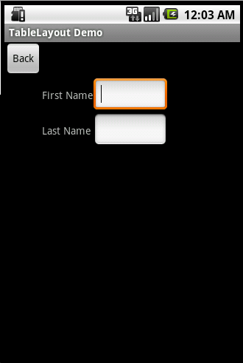
Table Layout Screenshot
This is the result of that XML.

Slide 36
Alternate Layouts
Android will shrink elements when they don’t all fit on the screen. You can reduce the need for this by using alternate layouts for different screen orientations.
  So, for example, you have a LinearLayout that looks pretty good in Landscape but does not have the room it needs in Portrait mode.
  Before looking in the res/layout folder for your layout XML Android will check for one of these alternate layouts.
res/layout-land – The alternate layout for a landscape UI
res/layout-port – The alternate layout for a portrait UI
res/layout-square – The alternate layout for a square UI
Notes:
There are many Alternate Resource types you can use in addition to screen orientation. A more complete list can be found on developer.android.com.

Slide 37
Sample XML
<LinearLayout xmlns:android="http://schemas.android.com/apk/res/android"
android:orientation="horizontal"
android:layout_width="fill_parent"
android:layout_height="fill_parent">
<Button
android:id="@+id/backbutton"
android:text="Back"
android:layout_width="wrap_content"
android:layout_height="wrap_content" />
<TextView
android:text="First Name"
android:layout_width="wrap_content"
android:layout_height="wrap_content" />
<EditText
android:width="100px"
android:layout_width="wrap_content"
android:layout_height="wrap_content" />
<TextView
android:text="Last Name"
android:layout_width="wrap_content"
android:layout_height="wrap_content" />
<EditText
android:width="100px"
android:layout_width="wrap_content"
android:layout_height="wrap_content" />
</LinearLayout>
Notes:
Create a folder named layout-land under the res folder and place this XML under the new folder. The XML file should have the same name it has in the layout folder.

Slide 38
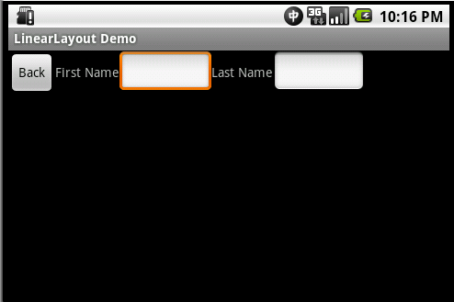
Alternate Layout screenshot
In the Emulator you can press 7 on your numberpad to change between Landscape and Portrait orientations.
When you switch to landscape I see the Layout from the layout-land folder.

Slide 39
Activities and Intents

Slide 40
Activities
How Android interacts with the outside world

Slide 41
Activities
Uses a series of functions to interact with the user or the phone
At its base you must override the function:
  onCreate()
Other methods you can override:
  onStop()
  onPause()
  onResume()
  onKeyDown()
Notes:
By default, new Android applications created within Eclipse implement “Hello World” whenever you create a project.

Slide 42
Getting familiar with Activities
Get your hands dirty…

Slide 43
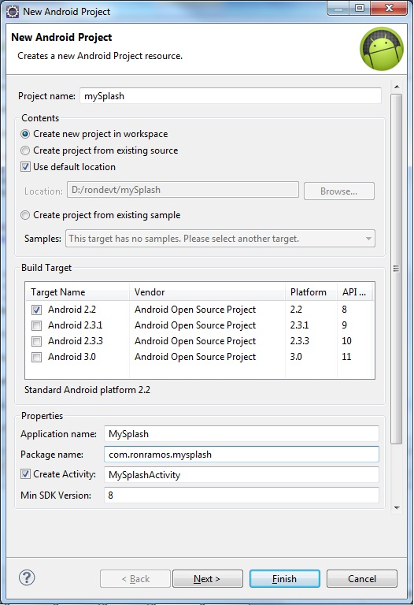
Start a new project
Create a new android project with the specified items shown in the picture
Don’t forget to replace “com.ronramos.splashy” with “com.<yourname>.splashy”

Slide 44
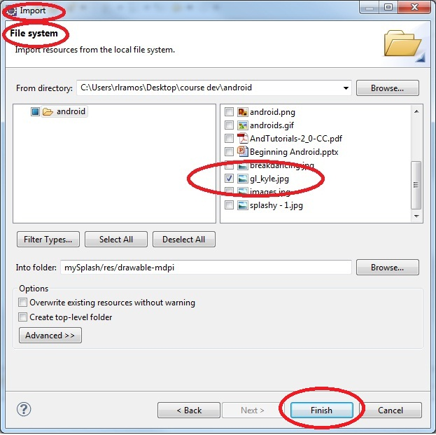
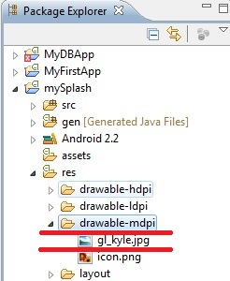
Add a graphic resource
Notes:
Make sure you right click on the \res\drawable-mdpi and select import

Slide 45
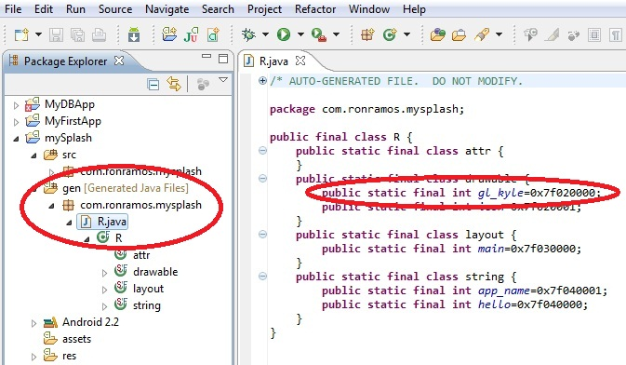
Check if R.java was updated
Remember that R.java is autogenerated by Eclipse
DO NOT MODIFY R.JAVA BY YOURSELF

Slide 46
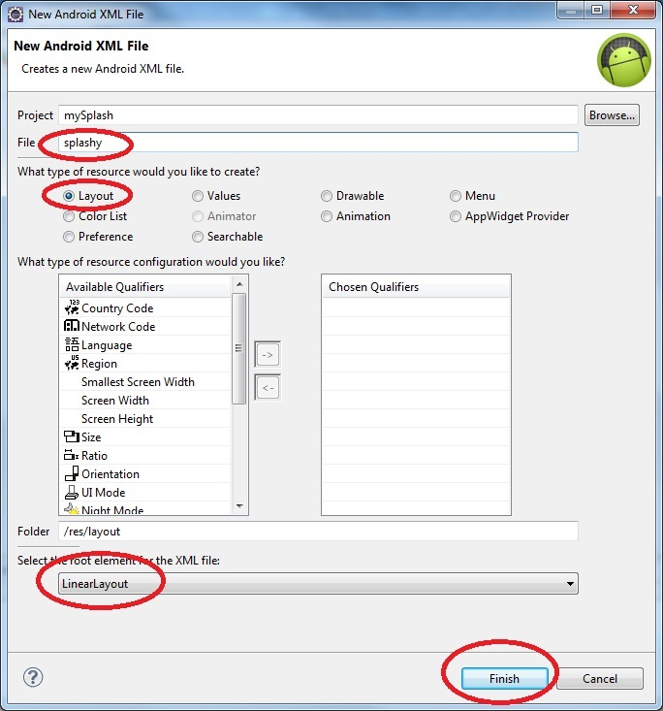
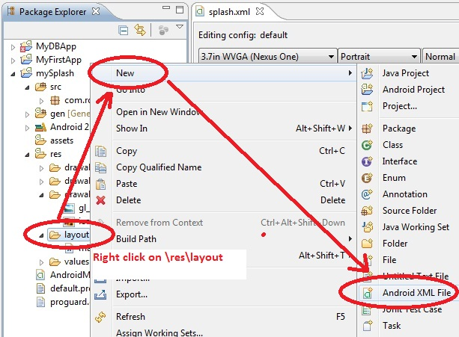
Create a new layout

Slide 47
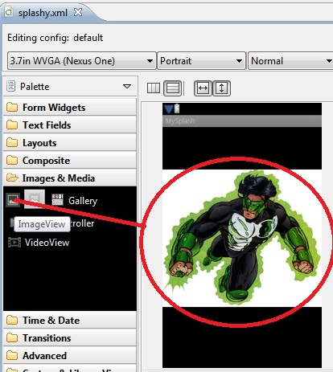
Xml for splashy.xml layout
<?xml version="1.0" encoding="utf-8"?>
<LinearLayout
xmlns:android="http://schemas.android.com/apk/res/android"
android:orientation="vertical"
android:layout_width="match_parent"
android:layout_height="match_parent">
<ImageView
android:src="@drawable/gl_kyle"
android:layout_width="fill_parent"
android:layout_height="fill_parent">
</ImageView>
</LinearLayout>

Slide 48
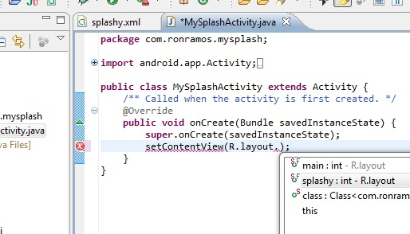
Change MySplashActivity’s onCreate function
import android.app.Activity;
import android.os.Bundle;
public class MySplashActivity extends Activity {
/** Called when the activity is first created. */
@Override
public void onCreate(Bundle savedInstanceState) {
super.onCreate(savedInstanceState);
setContentView(R.layout.splashy);
}
}

Slide 49
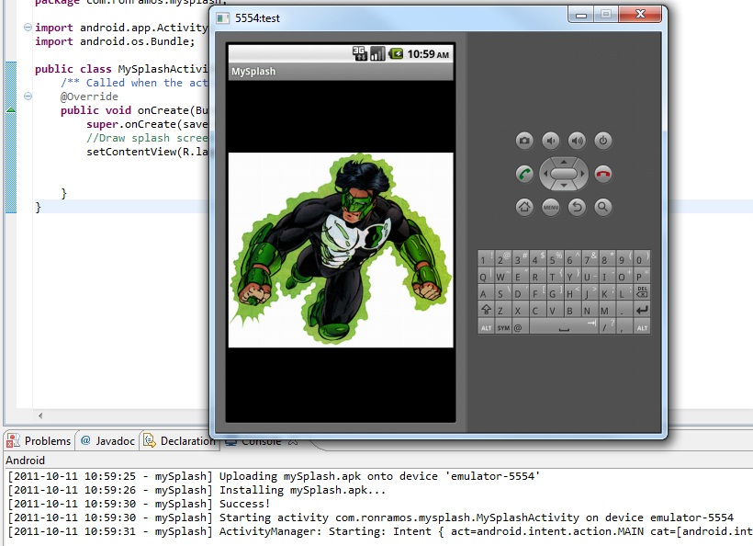
Running the app

Slide 50
Intents
INTENTS – Android’s glue

Slide 51
Intents
An intent is an abstract description of an operation to be performed.
  It can be used with startActivity to launch an Activity,
  broadcastIntent to send it to any interested BroadcastReceiver components,
  and startService(Intent) or bindService(Intent, ServiceConnection, int) to communicate with a background Service.
An Intent provides a facility for performing late runtime binding between the code in different applications.
Its most significant use is in the launching of activities, where it can be thought of as the glue between activities.
It is basically a passive data structure holding an abstract description of an action to be performed.
Notes:
The primary pieces of information in an intent are:
action -- The general action to be performed, such as ACTION_VIEW, ACTION_EDIT, ACTION_MAIN, etc.
data -- The data to operate on, such as a person record in the contacts database, expressed as a Uri.

Slide 52
Overview
Objects of type "android.content.Intent" are used to send asynchronous messages within your application or between applications.
  Intents allow to send or receive data from and to other activities or services. They also allow to broadcast that a certain event has occurred.
Intents are a powerful concept as they allow the creation of loosely coupled applications.
  Intents can be used to communicate between any installed application component on the device.
Notes:
An Intent object can contain information for the receiving component. For example if your application calls via an Intent a browser it may send the URL to the browser component. An Intent also contain information for the Android system so that the Android system can determine which component should handle the request.

Slide 53
Explicit vs. Implicit Intents
Android supports explicit intents and implicit intents.
Explicit intents name the component, e.g. the Java class which should be called.
Implicit intents ask the system to perform a service without telling the system which Java class should do this service.
Notes:
In constructing an implicit Intent you specify the action which should be performed and optionally an URI which should be used for this action. For example you could tell the system that you want to view (action) a webpage (URI). By starting an intent for this data the system would try to find an application which is registered for this event, e.g. a browser. You can add more data to the Intent by adding "extras" to the Intent. These are key/value pairs.

Slide 54
Explicit Intents

Slide 55
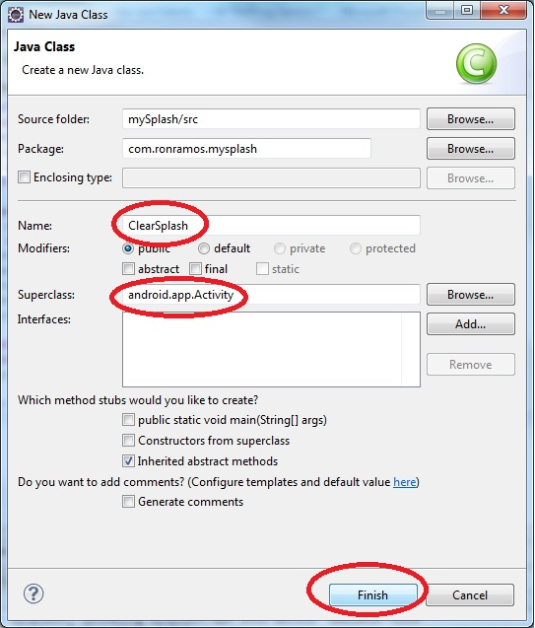
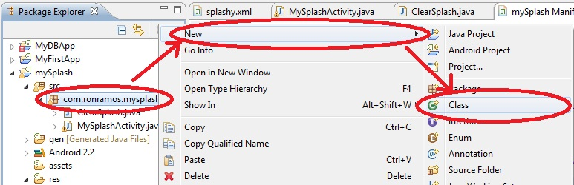
Add a new class of type Activity

Slide 56
ClearSplash.java code
import android.app.Activity;
import android.os.Bundle;
public class ClearSplash extends Activity {
public void onCreate(Bundle savedInstanceState) {
super.onCreate(savedInstanceState);
//Draw splash screen
setContentView(R.layout.main);
}
}

Slide 57
Modify MySplashActivity.java
//Simple timer thread
Thread splashTimer = new Thread(){
public void run(){
try{
//Wait loop
long ms = 0;
while(splashActive && ms < splashTime){
sleep(100);
if(!paused){
ms += 100;
}
}
Intent intent = new Intent(MySplashActivity.this, ClearSplash.class);
startActivity(intent);
}
catch(Exception e){
Log.e("Splash", e.toString());
}
finally{
finish();
}
}
};
splashTimer.start();
Notes:
The code above is inserted after setContentView() inside the onCreate() function.
Also add the following code before the onCreate() function:
long splashTime = 3000;
boolean paused = false;
boolean splashActive = true;

Slide 58
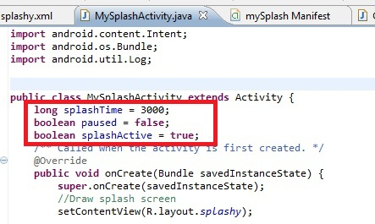
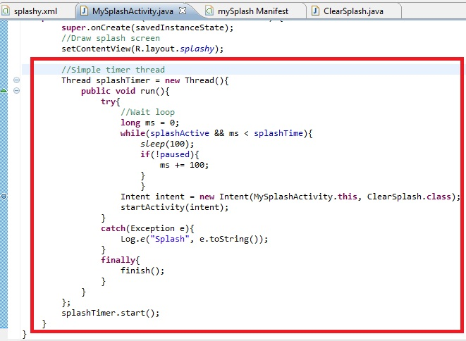
Modify MySplashActivity.java

Slide 59
Some explanations
Code | Explanation
Thread splashTimer = new Thread(){ | Creates a new thread; most new threads occur in their own thread
sleep(100); | Pauses the activity for 100 milliseconds
Intent intent = new Intent(MySplashActivity.this, ClearSplash.class); | Set-ups activity to call
startActivity(intent) | Starts the second activity

Slide 60
Modify AndroidManifest.xml
<?xml version="1.0" encoding="utf-8"?>
<manifest xmlns:android="http://schemas.android.com/apk/res/android"
package="com.ronramos.mysplash"
android:versionCode="1"
android:versionName="1.0">
<uses-sdk android:minSdkVersion="8" />
<application android:icon="@drawable/icon" android:label="@string/app_name">
<activity android:name=".MySplashActivity"
android:label="@string/app_name">
<intent-filter>
<action android:name="android.intent.action.MAIN" />
<category android:name="android.intent.category.LAUNCHER" />
</intent-filter>
</activity>
<activity
android:name=".ClearSplash"
android:label="Second Screen">
</activity>
</application>
</manifest>
Notes:
<?xml version="1.0" encoding="utf-8"?>
<manifest xmlns:android="http://schemas.android.com/apk/res/android"
package="com.ronramos.mysplash"
android:versionCode="1"
android:versionName="1.0">
<uses-sdk android:minSdkVersion="8" />
<application android:icon="@drawable/icon" android:label="@string/app_name">
<activity android:name=".MySplashActivity"
android:label="@string/app_name">
<intent-filter>
<action android:name="android.intent.action.MAIN" />
<category android:name="android.intent.category.LAUNCHER" />
</intent-filter>
</activity>
<activity
android:name=".ClearSplash"
android:label="Second Screen">
</activity>
</application>
</manifest>

Slide 61
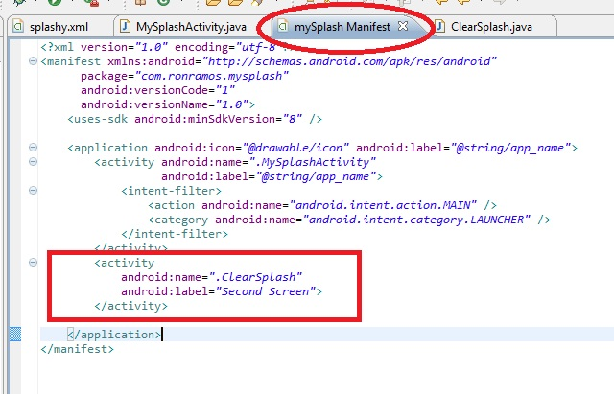
Modify AndroidManifest.xml

Slide 62
Some explanations
Code | Explanation
<activity android:name=".ClearSplash" android:label="Second Screen"> </activity> | Allows other activities to call ClearSplash
android:name=".ClearSplash" | .ClearSplash is a shortcut for com.ronramos.ClearSplash

Slide 63
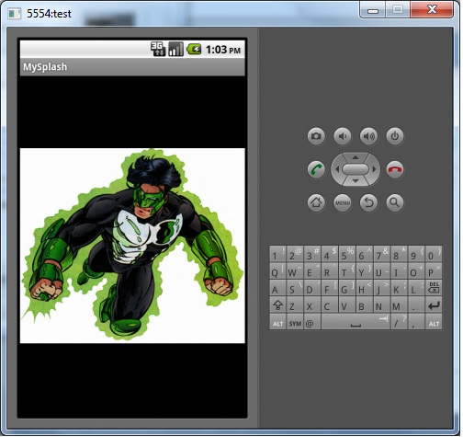
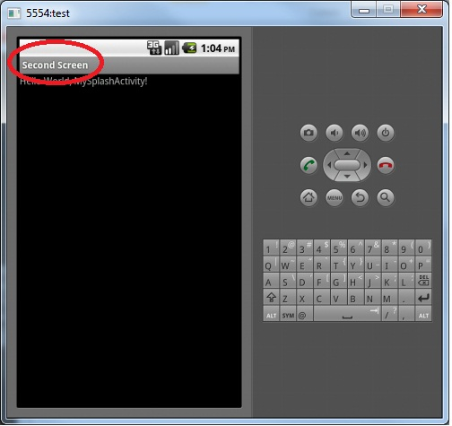
Running the modified app
Notes:
Splash screen appears. Note the label on top says MySplash
After a few seconds second window appears. Note the label says Second Screen

Slide 64
Seatwork
Simple Intents

Slide 65
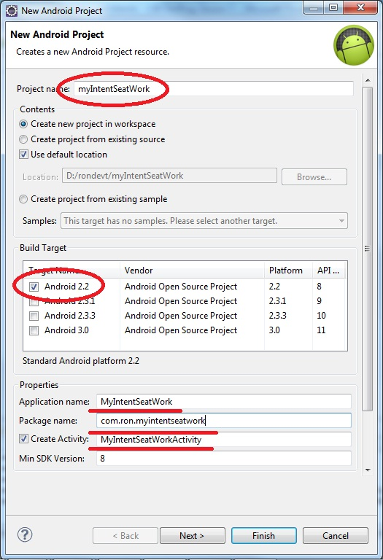
Create a new android project
Make sure you follow the specified values
  Project name:
    MyIntentSeatWork
  Application Name:
    My Intent Seatwork
  Package name:
    com.FirstnameLastName.myintentseatwork
  Activity Name:
    MyIntentSeatWork
  Android 2.2

Slide 66
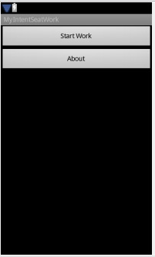
Add main.xml
Contains two buttons
Start work will display the work window
About will display the about page

Slide 67
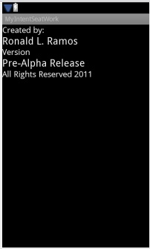
Add about.xml
About screen for application
Called from clicking about button

Slide 68
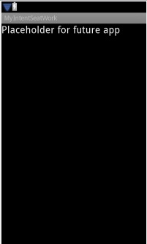
Add work.xml
Placeholder window for future development
Eventually this will reflect application logic

Slide 69
Add 2 Java classes for the 2 activities (Work and About)
Work.java
About.java
import android.app.Activity;
import android.os.Bundle;
public class Work extends Activity {
/** Called when the activity is first created. */
@Override
public void onCreate(Bundle savedInstanceState) {
super.onCreate(savedInstanceState);
setContentView(R.layout.work);
}
}
import android.app.Activity;
import android.os.Bundle;
public class About extends Activity {
/** Called when the activity is first created. */
@Override
public void onCreate(Bundle savedInstanceState) {
super.onCreate(savedInstanceState);
setContentView(R.layout.about);
}
}

Slide 70
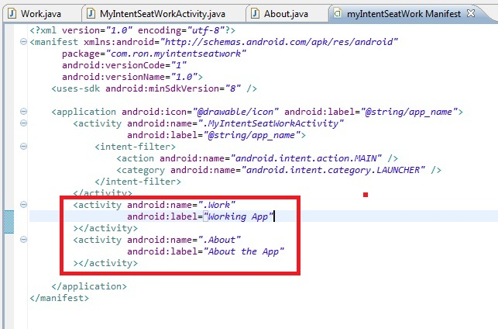
Modify AndroidManifest.xml

Slide 71
Modify MyIntentSeatWorkActivity.java
Notes:
Clicking on the buttons will take them to the corresponding screens.

Slide 72
Implicit Intent

Slide 73
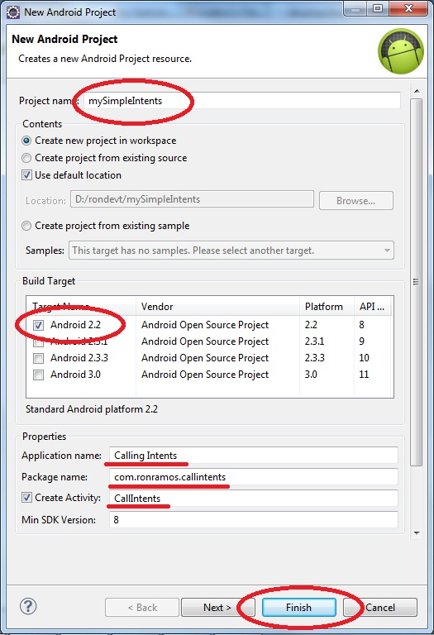
Intents project (Implicit intents)
Notes:
The following creates an example project for calling several implicit intent. The Android system is asked to display a URI and chooses the corresponding application for the right URI. Create a new Android application

Slide 74
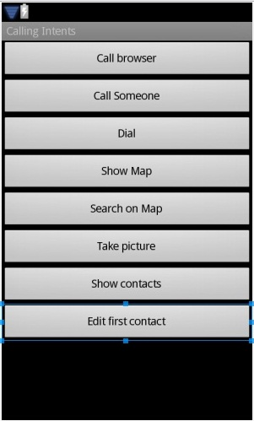
Main.xml
<?xml version="1.0" encoding="utf-8"?>
<LinearLayout xmlns:android="http://schemas.android.com/apk/res/android"
android:orientation="vertical" android:layout_width="fill_parent"
android:layout_height="fill_parent">
<Button android:id="@+id/Button01" android:layout_width="fill_parent"
android:layout_height="wrap_content" android:text="Call browser"
android:onClick="callIntent"></Button>
<Button android:id="@+id/Button02" android:layout_width="fill_parent"
android:layout_height="wrap_content" android:text="Call Someone"
android:width="100px" android:onClick="callIntent"></Button>
<Button android:id="@+id/Button03" android:layout_width="fill_parent"
android:layout_height="wrap_content" android:text="Dial"
android:width="100px" android:onClick="callIntent"></Button>
<Button android:id="@+id/Button04" android:layout_width="fill_parent"
android:layout_height="wrap_content" android:text="Show Map"
android:width="100px" android:onClick="callIntent"></Button>
<Button android:id="@+id/Button05" android:layout_width="fill_parent"
android:layout_height="wrap_content" android:text="Search on Map"
android:width="100px" android:onClick="callIntent"></Button>
<Button android:id="@+id/Button06" android:layout_width="fill_parent"
android:layout_height="wrap_content" android:text="Take picture"
android:width="100px" android:onClick="callIntent"></Button>
<Button android:id="@+id/Button07" android:layout_width="fill_parent"
android:layout_height="wrap_content" android:text="Show contacts"
android:width="100px" android:onClick="callIntent"></Button>
<Button android:id="@+id/Button08" android:layout_width="fill_parent"
android:layout_height="wrap_content" android:text="Edit first contact"
android:width="100px" android:onClick="callIntent"></Button>
</LinearLayout>
Notes:
Create the following view layout:
<?xml version="1.0" encoding="utf-8"?>
<LinearLayout xmlns:android="http://schemas.android.com/apk/res/android"
android:orientation="vertical" android:layout_width="fill_parent"
android:layout_height="fill_parent">
<Button android:id="@+id/Button01" android:layout_width="fill_parent"
android:layout_height="wrap_content" android:text="Call browser"
android:onClick="callIntent"></Button>
<Button android:id="@+id/Button02" android:layout_width="fill_parent"
android:layout_height="wrap_content" android:text="Call Someone"
android:width="100px" android:onClick="callIntent"></Button>
<Button android:id="@+id/Button03" android:layout_width="fill_parent"
android:layout_height="wrap_content" android:text="Dial"
android:width="100px" android:onClick="callIntent"></Button>
<Button android:id="@+id/Button04" android:layout_width="fill_parent"
android:layout_height="wrap_content" android:text="Show Map"
android:width="100px" android:onClick="callIntent"></Button>
<Button android:id="@+id/Button05" android:layout_width="fill_parent"
android:layout_height="wrap_content" android:text="Search on Map"
android:width="100px" android:onClick="callIntent"></Button>
<Button android:id="@+id/Button06" android:layout_width="fill_parent"
android:layout_height="wrap_content" android:text="Take picture"
android:width="100px" android:onClick="callIntent"></Button>
<Button android:id="@+id/Button07" android:layout_width="fill_parent"
android:layout_height="wrap_content" android:text="Show contacts"
android:width="100px" android:onClick="callIntent"></Button>
<Button android:id="@+id/Button08" android:layout_width="fill_parent"
android:layout_height="wrap_content" android:text="Edit first contact"
android:width="100px" android:onClick="callIntent"></Button>
</LinearLayout>

Slide 75
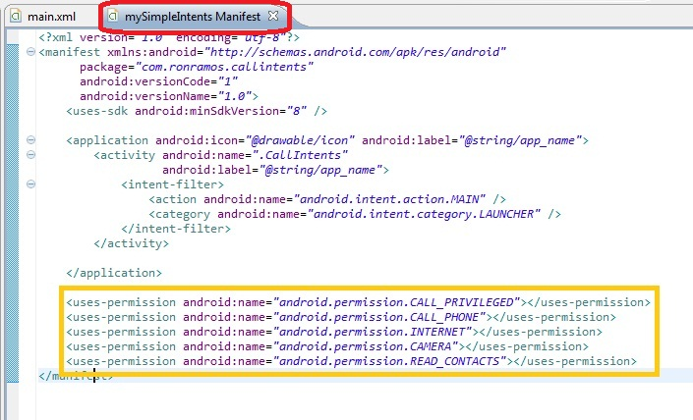
AndroidManifest.xml
<uses-permission android:name="android.permission.CALL_PRIVILEGED"></uses-permission>
<uses-permission android:name="android.permission.CALL_PHONE"></uses-permission>
<uses-permission android:name="android.permission.INTERNET"></uses-permission>
<uses-permission android:name="android.permission.CAMERA"></uses-permission>
<uses-permission android:name="android.permission.READ_CONTACTS"></uses-permission>
Notes:
To be able to use certain intents you need to register then for your application. Maintain the following "AndroidManifest.xml".

Slide 76
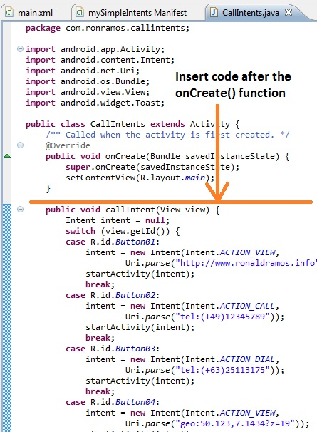
Activity logic
*see complete code
In the notes section
Notes:
Change your activity to the following. We will start the new intent with the method startActivityForResult() which allow us to specify a desired result code. Once the intent is finished the method onActivityResult() is called and you can perform actions based on the result of the activity.
If you start your application you should see an list of buttons and if you press the button, different activities should be performed. Note that you do not specify any specific application.
Code:
import android.app.Activity;
import android.content.Intent;
import android.net.Uri;
import android.os.Bundle;
import android.view.View;
import android.widget.Toast;
public class CallIntents extends Activity {
/** Called when the activity is first created. */
@Override
public void onCreate(Bundle savedInstanceState) {
super.onCreate(savedInstanceState);
setContentView(R.layout.main);
}
public void callIntent(View view) {
Intent intent = null;
switch (view.getId()) {
case R.id.Button01:
intent = new Intent(Intent.ACTION_VIEW,
Uri.parse("http://www.ronaldramos.info"));
startActivity(intent);
break;
case R.id.Button02:
intent = new Intent(Intent.ACTION_CALL,
Uri.parse("tel:(+49)12345789"));
startActivity(intent);
break;
case R.id.Button03:
intent = new Intent(Intent.ACTION_DIAL,
Uri.parse("tel:(+63)25113175"));
startActivity(intent);
break;
case R.id.Button04:
intent = new Intent(Intent.ACTION_VIEW,
Uri.parse("geo:50.123,7.1434?z=19"));
startActivity(intent);
break;
case R.id.Button05:
intent = new Intent(Intent.ACTION_VIEW,
Uri.parse("geo:0,0?q=query"));
startActivity(intent);
break;
case R.id.Button06:
intent = new Intent("android.media.action.IMAGE_CAPTURE");
startActivityForResult(intent, 0);
break;
case R.id.Button07:
intent = new Intent(Intent.ACTION_VIEW, Uri.parse("content://contacts/people/"));
startActivity(intent);
break;
case R.id.Button08:
intent = new Intent(Intent.ACTION_EDIT, Uri.parse("content://contacts/people/1"));
startActivity(intent);
break;
default:
break;
}
}
@Override
public void onActivityResult(int requestCode, int resultCode, Intent data) {
if (resultCode == Activity.RESULT_OK && requestCode == 0) {
String result = data.toURI();
Toast.makeText(this, result, Toast.LENGTH_LONG);
}
}
}

Slide 77
Listviews

Slide 78
What is a ListView?
Android provides the view "ListView" which is capable of displaying a scrollable list of items.
  "ListView" gets the data to display via an adapter.
  An adapter which must extend "BaseAdapter" and is responsible for providing the data model for the list and for converting the data into the fields of the list.
Android has two standard adapters, ArrayAdapter and CursorAdapter .
  "ArrayAdapter" can handle data based on Arrays or Lists
  "SimpleCursorAdapter" handle database related data.
You can develop your own Adapter by extending these classes or the BaseAdapter class.

Slide 79
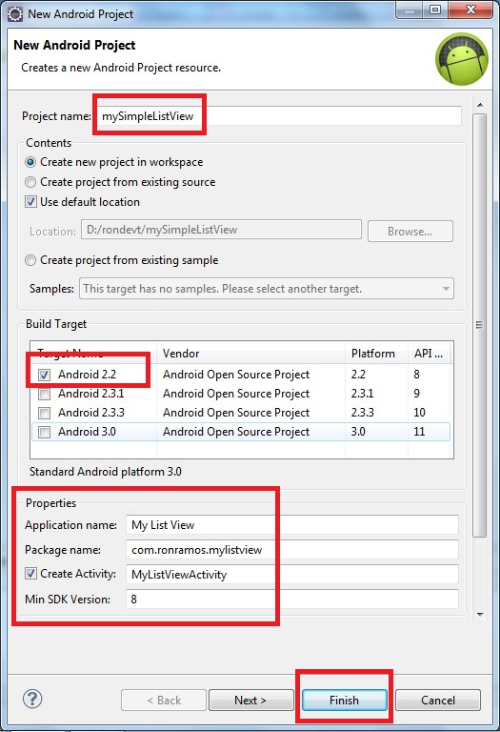
Create a new project

Slide 80
Main.xml
<?xml version="1.0" encoding="utf-8"?>
<LinearLayout android:id="@+id/LinearLayout01"
android:layout_width="fill_parent" android:layout_height="fill_parent"
xmlns:android="http://schemas.android.com/apk/res/android">
<ListView android:id="@+id/ListView01" android:layout_width="wrap_content"
android:layout_height="wrap_content" />
</LinearLayout>

Slide 81
Activity code
public class MyListViewActivity extends Activity {
/** Called when the activity is first created. */
private ListView lv1;
private String lv_arr[]={"Android","iPhone","BlackBerry","AndroidPeople"};
@Override
public void onCreate(Bundle savedInstanceState) {
super.onCreate(savedInstanceState);
setContentView(R.layout.main);
lv1=(ListView)findViewById(R.id.ListView01);
// By using setAdapter method in listview we an add string array in list.
lv1.setAdapter(new ArrayAdapter<String>(this,android.R.layout.simple_list_item_1 , lv_arr));
}

Slide 82
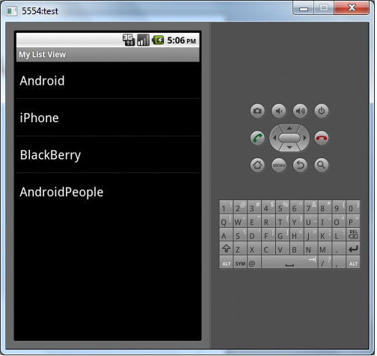
Run the App

Slide 83
Modify the Activity Code
private ListView lv1;
private String lv_arr[]={"Android","iPhone","BlackBerry","AndroidPeople"};
@Override
public void onCreate(Bundle savedInstanceState) {
super.onCreate(savedInstanceState);
setContentView(R.layout.main);
lv1=(ListView)findViewById(R.id.ListView01);
lv1.setOnItemClickListener(this);
// By using setAdpater method in listview we an add string array in list.
lv1.setAdapter(new ArrayAdapter<String>(this,android.R.layout.simple_list_item_1 , lv_arr));
}
public void onItemClick(AdapterView arg0, View v, int position, long arg3) {
// TODO Auto-generated method stub
Toast.makeText(this, "u clicked " + lv_arr[position] ,Toast.LENGTH_LONG).show();
}

Slide 84

End of Presentation

